Slide 1
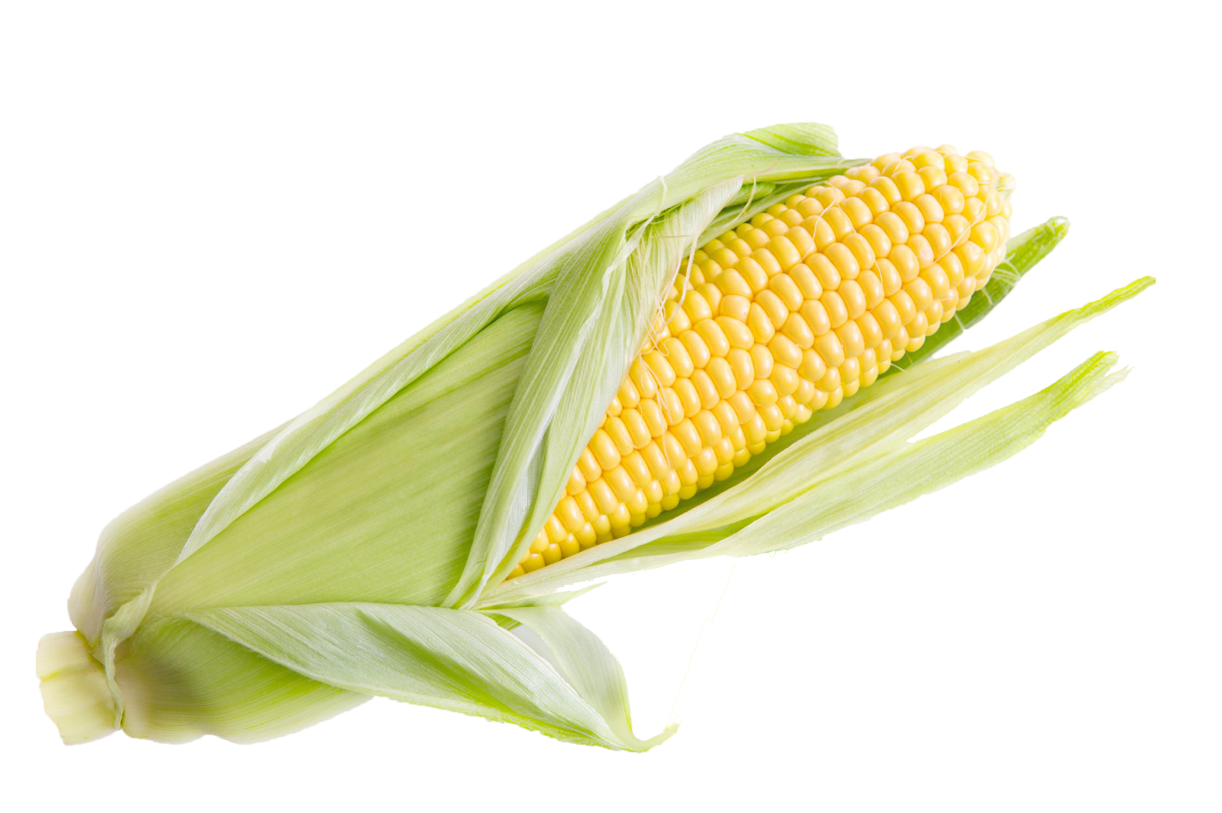
DDG Nutrient Testing
Notes:
This lab can be done either as a sequential piece of the distillation lab (recommended) or as a stand alone version. The first _12_ slides are designed to give a background presentation to the students if this is being used as a stand-alone lab. If you are using this as a sequence you can skip to slide # _13___ to begin the lab.

Slide 2
Why Ethanol?
The increasing demand of fuel for transportation, increased world-demand for oil (gasoline) and the negative consequences of global warming due to gasoline production have all contributed to the increased use of corn-based sugar to produce ethanol which you have just completed in a previous lab.

Slide 3
What is Ethanol?
Talk to your table partners and discuss your thoughts on Ethanol.
What is it?
What is it used for?
How is it produced?
(Which character are you?)
Notes:
I would give the students a few minutes to write down their thoughts and then have each table share one of the things they came up with.

Slide 4
What is Ethanol?
Ethanol is an alcohol fuel that's distilled from plant materials, such as corn and sugar. It is blended with gasoline creating a mix that releases fewer emissions into the environment and is considered cleaner in nature.
Unlike gasoline, pure ethanol is nontoxic and biodegradable, and it quickly breaks down into harmless substances if spilled.

Slide 5
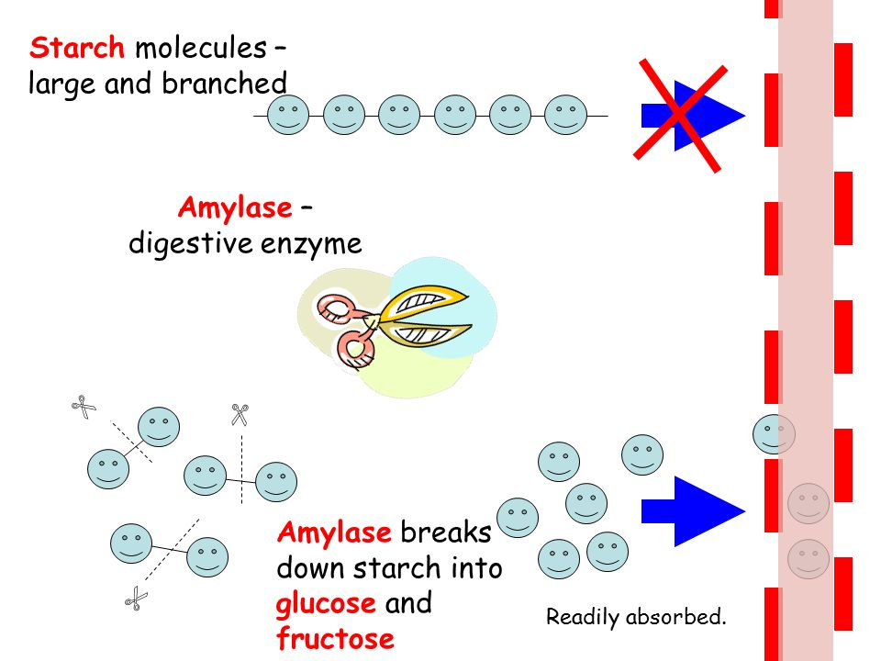
How do we get Ethanol?
In the United States, commercial production of fuel ethanol involves breaking down the starch present in corn into simple sugars, also called “glucose”. These sugars are then fed to yeast, which begins the process of fermentation.

Slide 6
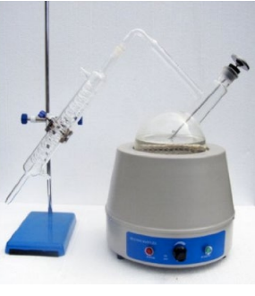
How do we get Ethanol?
Following fermentation, the liquid (ethanol) is strained from the feed material. The liquid is then distilled into a purer form of ethanol.
For each pound of simple sugars, yeast can produce approximately 0.5 pounds (0.15 gallons) of ethanol.

Slide 7
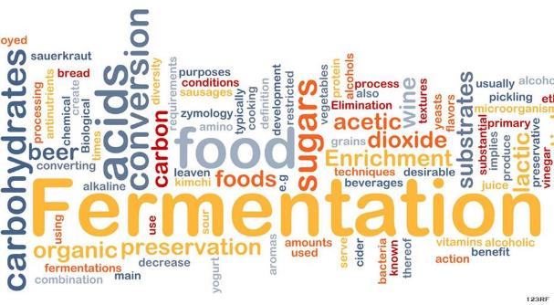
What is Fermentation?
Fermentation is a metabolic process that consumes sugar in the absence of oxygen. (anaerobic)
Yeast performs fermentation to obtain energy by converting sugar into alcohol.

Slide 8
Why is fermentation Important?
The yeast breaks the sugars down into Ethanol and carbon dioxide (CO₂).
Some of the other products are animal feed and corn oil.
The remaining nutrients are proteins, fats, minerals, and vitamins that are essential in use in feed for livestock

Slide 9
Fermentation Co-Products: Nothing wasted

Slide 10
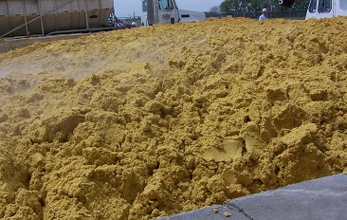
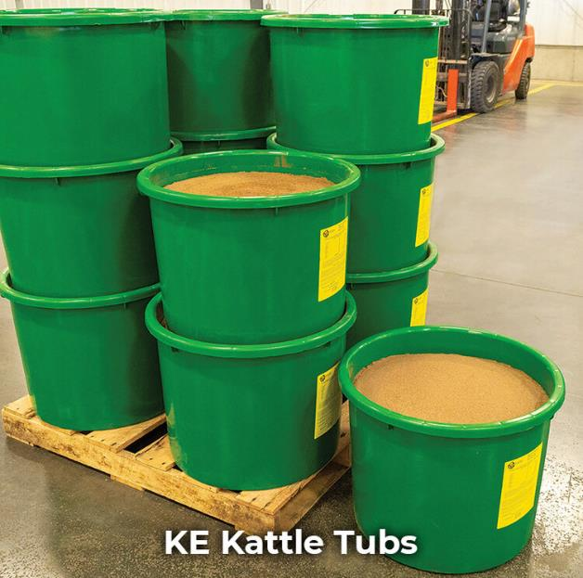
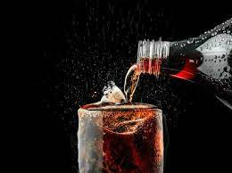
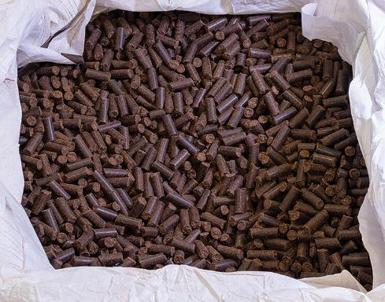
Fermentation Co-Products: Nothing wasted

Slide 11
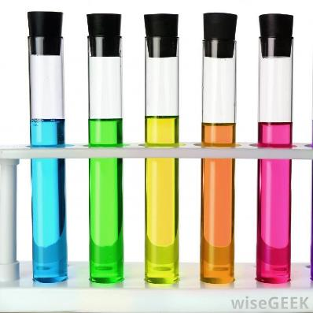
Why is nutrient testing important?
The availability of nutrients is important to maintaining the diets of livestock to keep them healthy.
Having the correct ratio of nutrients is important to ensure that feed nutrients are not wasted, not overfed, and that feed efficiency is optimized on the farm.
Scientists use specialized testing protocols to determine the major components required for healthy growth and the development of livestock.
Our job is to try and figure out what product will provide us with the highest nutrient availability. We will be comparing a corn slurry and a corn mash after fermentation.

Slide 12
Materials Needed: For Stand Alone Lab
For preparation of corn mash: Note: For stand-alone lab only)
600 ml beaker
Distilled water
Corn meal/crushed corn
Hot plate
Amylase solution (Mix ¼ tsp of amylase with 1 L of distilled water. Stir thoroughly.)
Buffer Solution
Glucoamylase solution (Mix ¼ tsp of glucoamylase with 1 L of distilled water. Stir thoroughly.)
Yeast
Parafilm or saran wrap
Graduated Cylinders (10 ml)
Cheesecloth for filtering
For Workstations:
5 pipettes per station
6 test tubes per station
Test tube rack
Parafilm
Benedicts Solution
Lugol’s Solution (Iodine)
Biuret Solution
Hot Plate or water bath
600 ml beaker (for water bath)
Water (for water bath)
Materials for Corn Slurry: (Note: For stand-alone lab only)
Mortar and pestle
Corn
Distilled water
Filter paper
Beaker (25-50 ml)
Notes:
These are all the material that are needed for the stand alone lab.

Slide 13
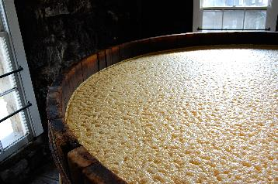
Corn Mash Preparation Instructions For Stand Alone Lab
Ethanol preparation Instructions (Corn Mash)
Add 100 g of corn meal to a 600 ml beaker.
Add 300 ml of warm distilled water and stir.
Place the beaker on a hotplate, bring to a gentle boil for 15 minutes, add water as needed.
Allow beaker to cool. While the beaker is cooling, in a 250 ml beaker add 100 ml distilled water and 10 ml of the amylase solution (be sure to shake the solution well). Add to the cooled solution and stir for 10 min.
Add 35 ml of the buffer solution, 10 ml of the glucoamylase solution, and 10 ml of the yeast solution into the corn mash. Stir the entire solution well.
Cover the beaker with plastic wrap and a rubber band or use Parafilm to cover the beaker.
Allow to ferment for 1-2 days.
Use a cheesecloth to filter out the liquid from the DDG*
Click the picture for video of mash production
Notes:
This is how you will need to produce the corn mash to recover the solution that is needed for testing.
* If you do not get enough liquid, you can mix distilled water with the DDG material and strain the liquid out again.

Slide 14
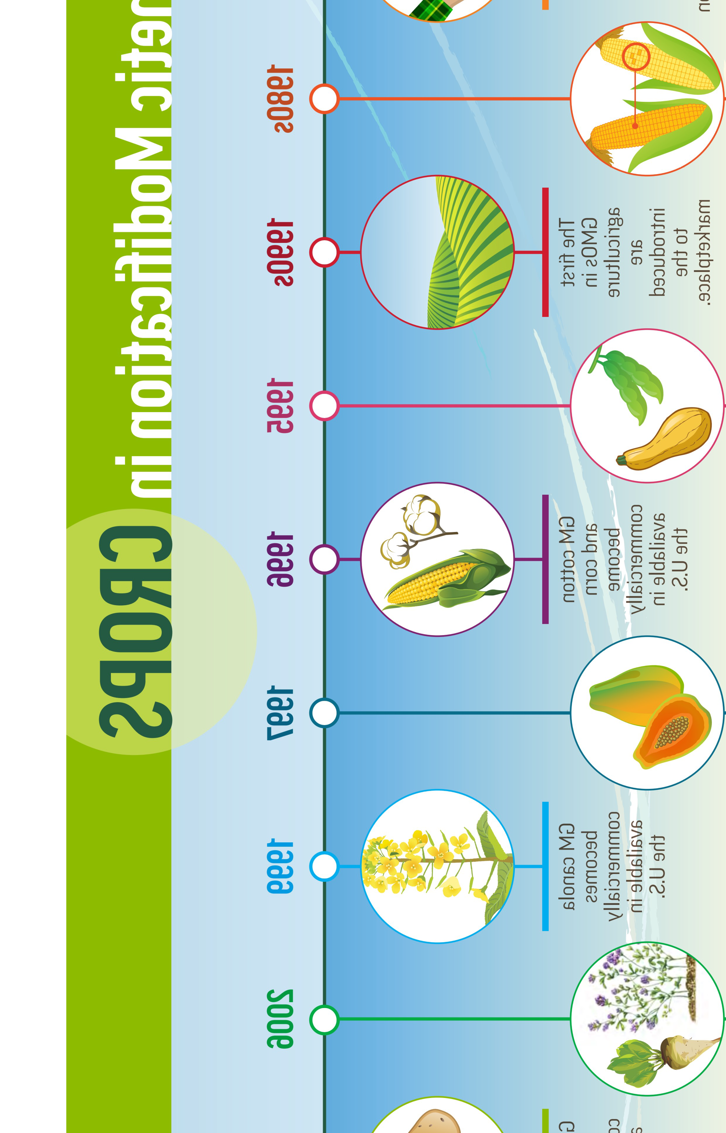
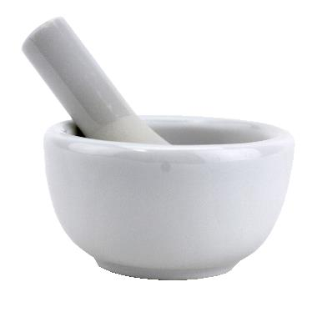
Corn Slurry Preparation Instructions For stand alone lab
Corn slurry Preparation and workstation set up.
The corn slurry can be made for each group. For one group grind 5 g of corn and mix with 20 ml of distilled water.
Filter the slurry keeping the liquid food sample

Slide 15
Pre-Lab Review Questions!
DDG Nutrient Testing---Use S1 worksheet
What is fermentation?
What role does the yeast play in the fermentation process?
Answer these questions with your lab group.
Notes:
You will pass out the DDG Nutrient Testing student sheet at this time. The students will answer these questions on their student sheet as a check to the background information obtained by their teacher. I would give them a few minute for their discussion and then have them share what the feel.

Slide 16
Investigation Question: What is your hypothesis
DDG Nutrient Testing—Use S1 worksheet
Which of these, corn slurry (before fermentation) or corn mash (after fermentation), will provide the highest nutritional value to livestock after fermentation has occurred? Why do you think so?
Notes:
I have the student brainstorm for and answer within their groups. They will then use this answer as part of their hypothesis for the lab.

Slide 17
Carbohydrate Indicator Test (Glucose)
DDG Nutrient Testing—Use S2 worksheet
Label a test tube for corn slurry glucose test, and another test tube for corn mash glucose test.
Add 2 ml of corn slurry to a test tube, then add 2 ml of Benedict’s Solution.
Cover with Parafilm and or stopper and mix if using short test tubes.
Place test tube in a boiling water bath for 2 minutes. (Caution: Use a test tube holder as the test tube will be hot to touch).
Record color change in the table.
Repeat steps 2 - 5 in a new test tube with the fermented corn mash.
Notes:
You can either go through these as a class or just use this as a reference. I have the students read their own packet but some of the IEP students may benefit from step be step here.

Slide 18
Complex Carbohydrate Indicator Test (Starch)
DDG Nutrient Testing—Use S2 worksheet
Label a test tube for corn slurry starch test, and another test tube for corn mash starch test.
Add 1 ml of corn slurry in a test tube and add 1 drop of the Lugol’s solution.
Cover with Parafilm or stopper and mix.(optional)
Do not heat solution.
Record color change in the table.
Repeat steps 2 - 5 in a new test tube with the fermented corn mash.
Notes:
You can either go through these as a class or just use this as a reference. I have the students read their own packet but some of the IEP students may benefit from step be step here.

Slide 19
Protein Indicator Test
DDG Nutrient Testing—Use S2 worksheet
Label a test tube for corn slurry protein test, and another test tube for corn mash protein test.
Add 1 ml of corn slurry and add 2 ml of Biuret Reagent to a test tube.
Cover with Parafilm or stopper and gently mix.(optional)
Wait 30 seconds for a color change.
Record color change in the table.
Repeat steps 2 - 5 in a new test tube with the fermented corn mash.
DO NOT HEAT!
Heating will cause protein breakdown
and give a negative test.
Notes:
You can either go through these as a class or just use this as a reference. I have the students read their own packet but some of the IEP students may benefit from step be step here.

Slide 20
DDG Nutrient Testing
Student Data Table
Sample | Carbohydrate Indicator Test (Glucose) | Complex Carbohydrate Indicator Test (Starch) | Protein Indicator Test
Corn Slurry
Fermented Corn Mash
Notes:
Students will fill in their data on their student sheets. I would then ask for some results and collect from the entire class to compare.

Slide 21
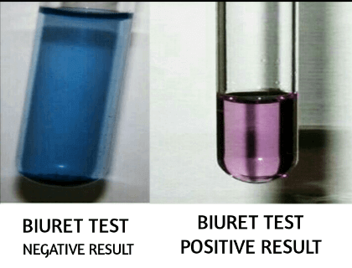
Results expected:
DDG Nutrient Testing—Use S2 worksheet
Lugol’s Starch Test
Benedict’s Glucose Test
Biuret Protein Test
Notes:
You can either go through these as a class or just use this as a reference. I have the students read their own packet but some of the IEP students may benefit from step be step here.

Slide 22
DDG Nutrient Testing
Lab Analysis
Were your predictions correct?
What do the results tell you about what happened during the fermentation process?

Slide 23
DDG Nutrient Testing
Reflection and Conclusion:
Our livestock are in need of protein. Based on our observations, which solution would best be used for our livestock? Why?
Based on our test results, which types of macromolecules are primarily seen after the fermentation process?

Slide 24
DDG Nutrient Testing
Take it further!
Protein is vital for the health and upkeep of livestock. Do some research to compare the different benefits between using distillers grains (WDG) (DDG) and other corn based feeds in the daily diet of livestock. Look for the topics below during your research. Write a two-paragraph summary or your findings.
Cost of feed
Availability of feed
Nutrient supply

Slide 25
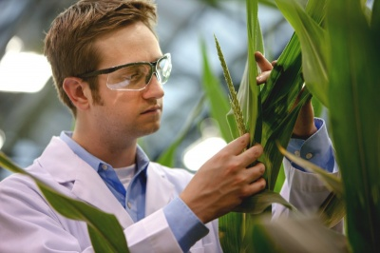
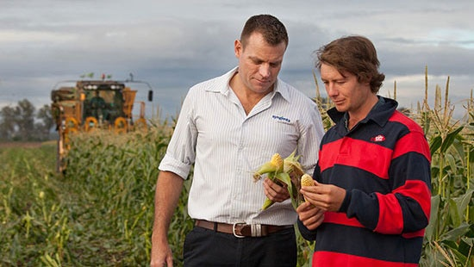
DDG Nutrient Testing
Take it EVEN FARTHER
Science and Agriculture careers:
These are a few of the careers that would apply to this type of laboratory specialty. Do a little research and write a short summary on one that would interest you. You may even find one not on the list.
Agricultural Inspector
Agricultural Specialist
Chemist
Food Specialist
Soil and Plant Scientist

Slide 26
All of these lessons, including the PowerPoint presentations can be found at in the lesson library
www.kscorn.com

