Slide 1
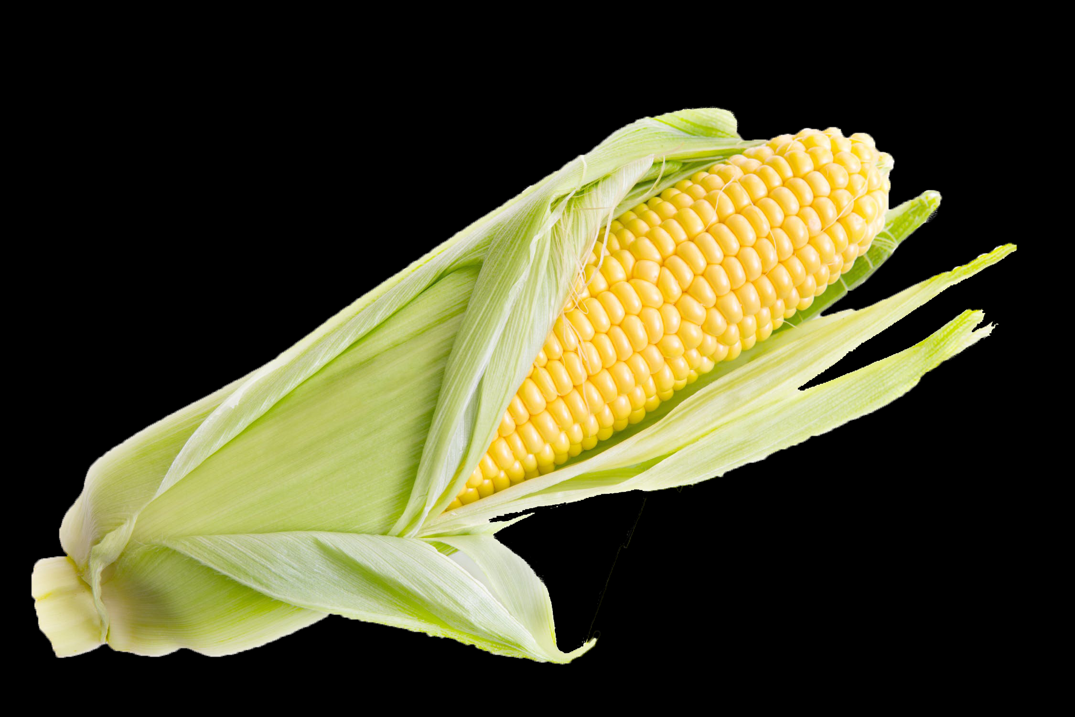
Fermentation in a Bag
Presentation for Middle School Teacher Workshop

Slide 2
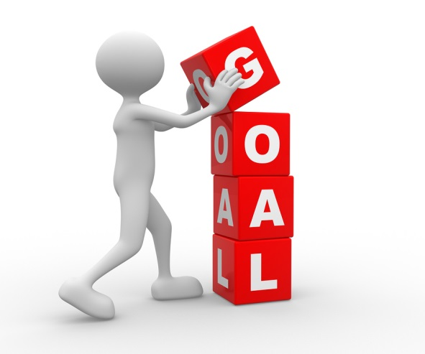
Goals for today
Budget
Complete Fermentation in a Bag lab
Actually do the lab and get comfortable with the procedure and materials.
Learn the different ways this lab can be differentiated
Be willing to ask questions
Share your knowledge with others and support each other
Learn how this lab can fit into a larger unit of Biofuel
Discover how this lab can fit into your existing classroom curriculum.
2019 Expenses $778,404
2020 Proposed $753,497

Slide 3
Why I Love this Lab!
Budget
Very inexpensive
This lab can be done with no “science equipment”
Nothing to order
Everything can be found at your local grocery store
Easy setup
Easy cleanup
Can be done in one lab period
Can easily be differentiated up or down depending on your students
2019 Expenses $778,404
2020 Proposed $753,497

Slide 4
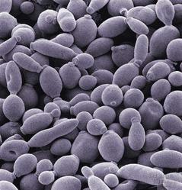
Yeast and Ethanol
Budget
When yeast have optimal conditions they grow and reproduce
When yeast metabolize they produce both carbon dioxide and ethanol.
The better the conditions, the more they metabolize, and more CO₂ and ethanol are produced.
Today we are going to feed the yeast different types of food and enzymes while measuring their CO₂ output.
2019 Expenses $778,404
2020 Proposed $753,497

Slide 5
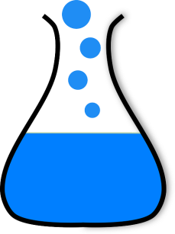
Background Information
Budget
Fermentation or anaerobic respiration is the process yeast use to convert glucose to energy. The first step in anaerobic respiration is to break down the glucose molecule. This creates two ATP molecules the yeast can use as fuel. This process also produces ethanol and carbon dioxide molecules as waste products.
The rate and of fermentation can be determined by measuring the amount of carbon dioxide produced. The more carbon dioxide, the more ethanol.
2019 Expenses $778,404
2020 Proposed $753,497

Slide 6
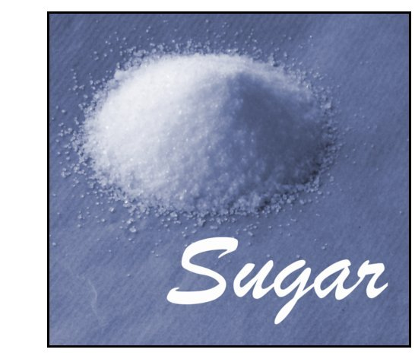
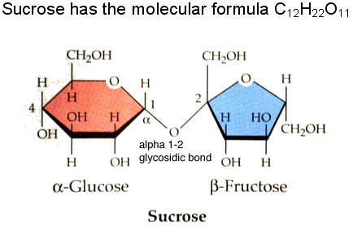
Background
Budget
Glucose is a simple sugar the yeast use for energy, but the ethanol industry feeds yeast corn. In corn, most of the sugars molecules are contained in long chains, called “starch”.
Enzymes help break starch up into smaller pieces which are more useful for the yeast. Amylase is an enzyme that breaks starch into smaller pieces, while glucoamylase is more specialized in removing individual glucose molecules from the ends of the starch.
2019 Expenses $778,404
2020 Proposed $753,497

Slide 7
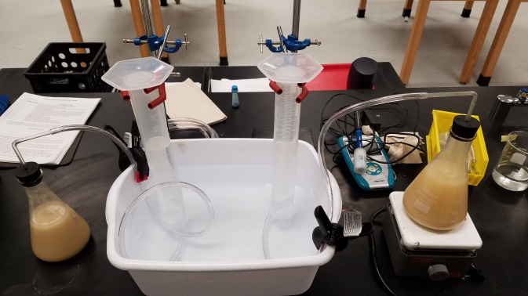
Student Designed Experiments
What are some variables that students could change to create and design their own experiments?
This is one of the many ways the experiment can be adjusted to meet the needs of a variety of students
This can be done as a standalone lesson
This can be part of a larger unit where students learn how to distill the ethanol out of the mixture and use that ethanol as a biofuel.

Slide 8
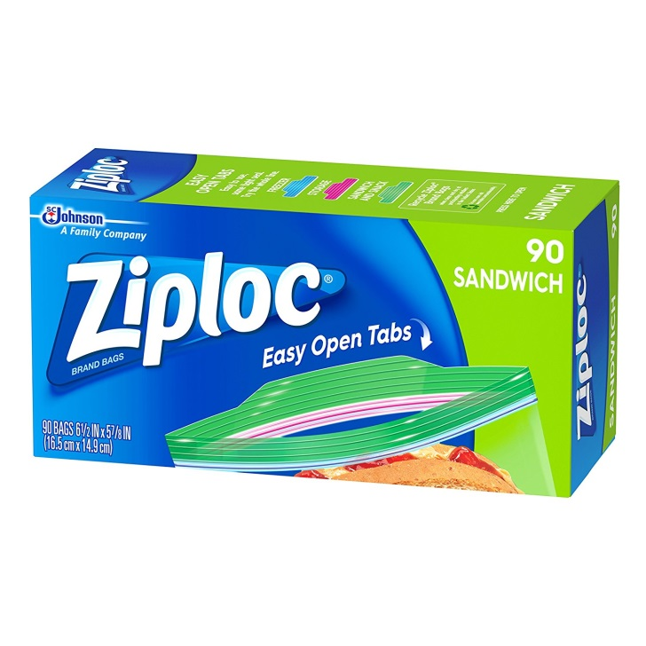
Materials
Budget
Student Data Sheet A or B
Feed stock: cracked corn, corn syrup, corn starch, corn meal, dextrose or glucose, sucrose (table sugar), sweet corn
Active dry yeast ( 1 tsp per bag)
Amylase solution (1 tsp/500 ml water or 1g/125 ml)
Glucoamylase solution (1 tsp/500 ml water or 1g/125 ml)
Measuring spoons
Graduated cylinders (100 ml)
Resealable bags
Index cards
Rulers
Yeast
Paper towels
Breathalyzer (optional)
100 ml syringe (optional)
2019 Expenses $778,404
2020 Proposed $753,497

Slide 9
Procedure
Budget
As a group, decide what you want to feed your yeast. and what enzyme or enzymes to use
Decide if food or enzymes will be your variable.
Groups will need 4 labeled, resealable bags
Label what food and enzymes type is in each bag.
In a snack-sized resealable bag, combine 1 tsp of food and one tsp of yeast.
Add 1 ml of enzymes into the labeled resealable bags that are.
Add 50 ml (1/4 cup) of warm water and zip the bag closed, removing as much air as possible.
2019 Expenses $778,404
2020 Proposed $753,497

Slide 10
Procedure
Budget
Mix gently.
Lay the fermenting bag flat on a horizontal surface.
Place an index card on top of the bag, parallel to the table.
Hold the ruler perpendicular to the table and record where the paper intersects the ruler.
Record this measurement in 5-minute intervals in the data section.
2019 Expenses $778,404
2020 Proposed $753,497

Slide 11
Using Breathalyzers
Budget
Students can use an ethanol probe or breathalyzer to compare relative differences in ethanol concentrations.
Breathalyzers are designed for measuring blood alcohol content in humans; therefore, the readings will not tell you directly how much ethanol is in each sample. Still, the readings can be used to determine if ethanol was produced and to make comparisons in ethanol production between the bags.
2019 Expenses $778,404
2020 Proposed $753,497

Slide 12
Breathalyzer Procedure
Budget
Open a small part of the bag and insert the syringe, being careful not to release too much air.
Extract 100 ml of air from the space above the fermenting mixture, without sucking in any of the liquid.
Turn on the breathalyzer. Slowly expel the air over a 5-second period.
Record the readings on the breathalyzer. The higher the number on the display, the higher the ethanol concentration in the sample. Use these values to compare the ethanol concentrations from each sample.
2019 Expenses $778,404
2020 Proposed $753,497

Slide 13
Data
Budget
Share out your data!
Students should share out what combinations of food and enzymes produced the most carbon dioxide and which did not.
Have students share out why they think some performed better that others.
2019 Expenses $778,404
2020 Proposed $753,497

Slide 14
Budget
This lab is made possible with the support and content contributions of the Kansas Corn Commission.

