Slide 1
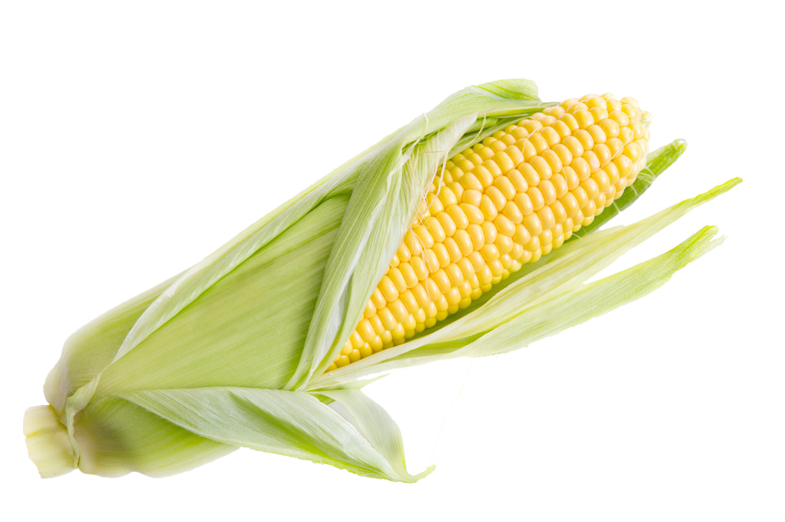
Corn Mash and Distillation
Producing Fuel

Slide 2
Ethanol
Ethanol is a renewable source of fuel for vehicles that is widely produced from corn. Ethanol production is reliant on the anaerobic fermentation of corn sugars by yeast.
Glucose
Ethanol
Carbon dioxide
C₆H₁₂O₆ → 2 C₂H₅OH + 2 CO₂ + Energy
2 ATP

Slide 3
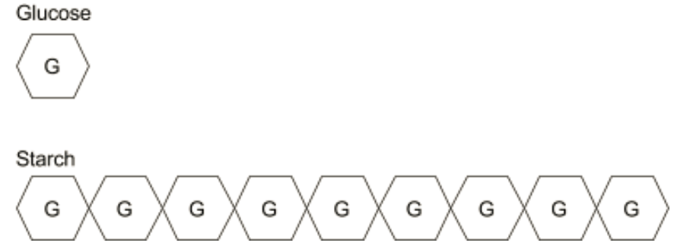
Ethanol
Scientists and industry professionals are constantly working to make the fermentation procedure more efficient. Different enzymes are added to the corn in order to break the starch into simple sugars that the yeast can process into ethanol.

Slide 4
Ethanol
This lab is designed to allow students to test their procedures they developed in fermenting fuel to produce and distill ethanol.

Slide 5
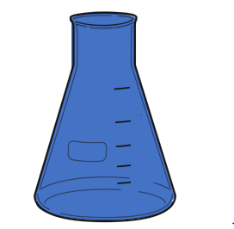
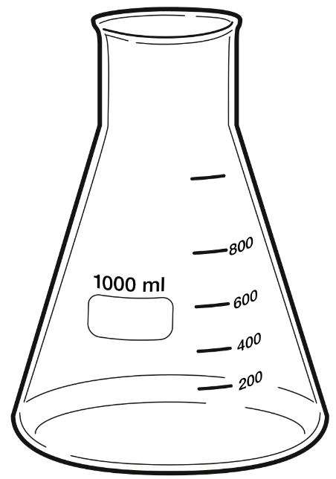
Preparing samples
Materials needed:
500 ml Filtration or Erlenmeyer Flask
50.0 g ground corn
distilled water
amylase solution
stirring rod

Slide 6
Preparing samples
Add 50 g ground corn
Add distilled water
Measure and add amylase solution
Stir

Slide 7
Boiling Samples
Boiling breaks down the cellulose in the corn
Materials Needed Hot Plate
1000 ml Beaker (or larger)
Water
Bring 400-500 ml of water to boiling on a hot plate

Slide 8
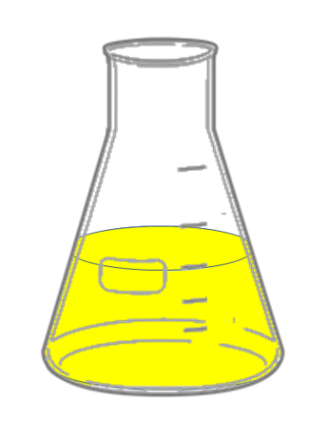
Boiling Samples
Add sample to the boiling water and allow to boil for 10 minutes
(Heating time could be a variable for students to test)

Slide 9
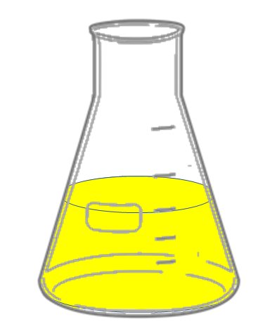
Allow sample to cool before adding enzymes.
After cooling, students should add the enzymes, buffer solution and yeast they have written in their procedures.
Distilled Water may be added to thin the mixture.
Stir again

Slide 10
Close flask with stopper

Slide 11
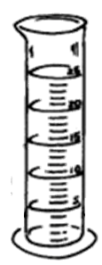
Gas Collection
Fill Pan half full of water
Completely Fill 1000 ml Graduated cylinder
Cover with glass square
Invert into pan

Slide 12
Gas Collection
Position tubing inside the inverted graduated cylinder to capture any carbon dioxide released.
Let the mash ferment overnight.

Slide 13
Day 2
Record the amount of CO₂ collected.
The amount of gas will be used to estimate the amount of ethanol produced.

Slide 14
Distillation
Separation of components of a mixture using their different boiling points.
Fermentation produces a mixture of ethanol and water, usually no more than 20% ethanol.
We need to purify the ethanol which boils at 78.4 ^{ο}C.
Heating the mixture to this temperature will cause the ethanol to boil while the water is not.
Condensing the vapor produced will result in a sample that is much higher concentration of ethanol.

Slide 15
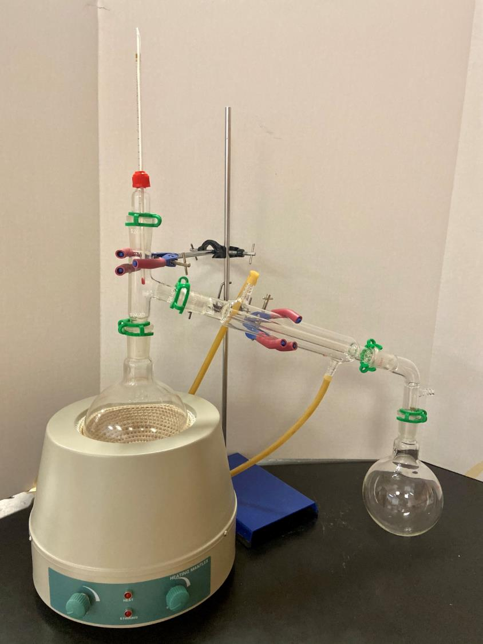
Distillation Set Up
Condenser
Distillation Flask
Heating Mantle
Receiving Flask
(Distillate)

Slide 16
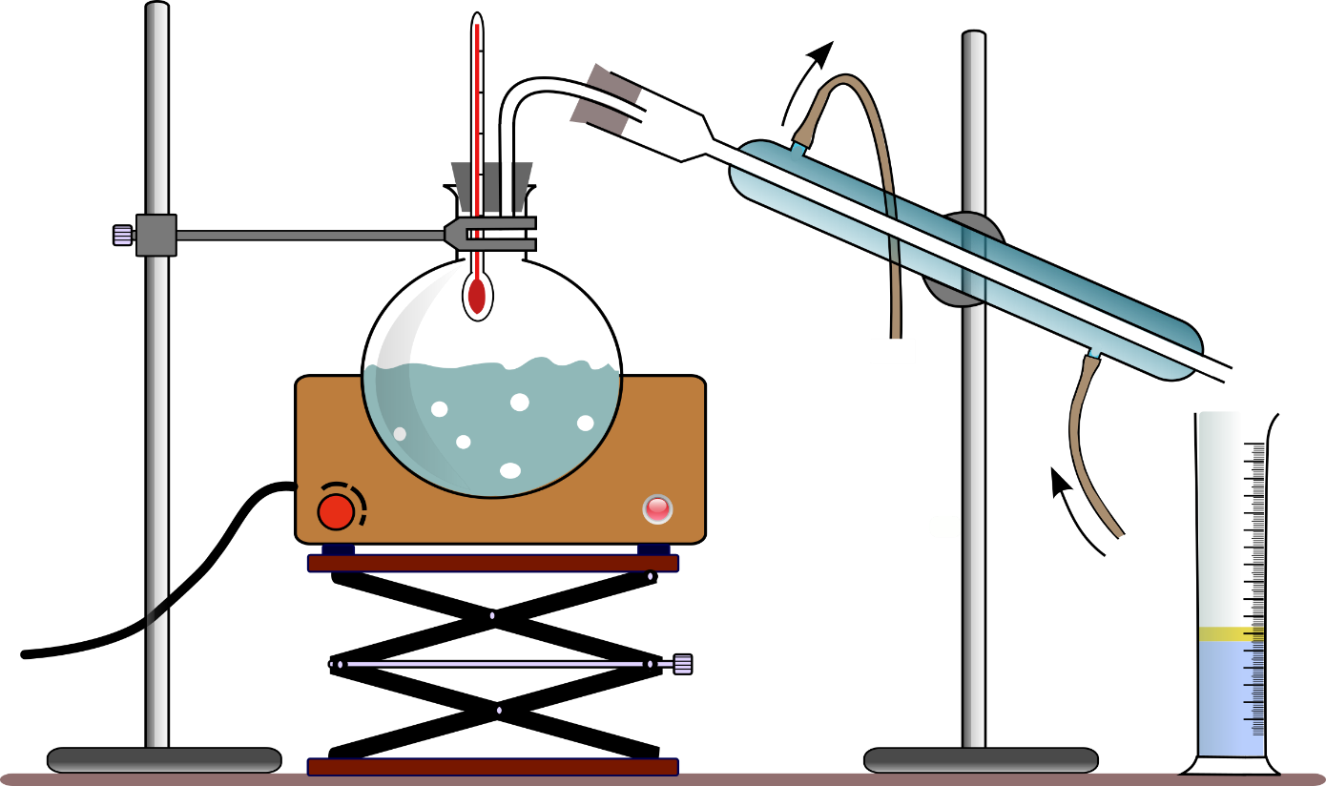

Slide 18
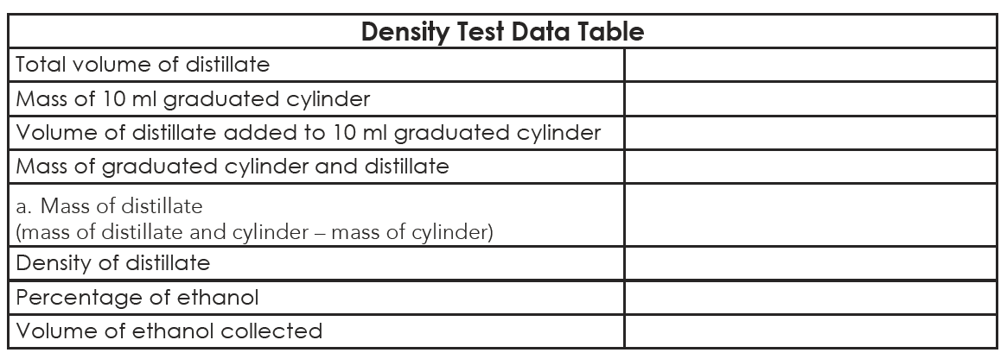
Using Density to Determine Ethanol Percentage
15.45 ml
35.20 g
8.95 ml
43.40g
8.20g
0.916 g/ml
8.20g
= 0.916 g/ml
8.95 ml

Slide 19
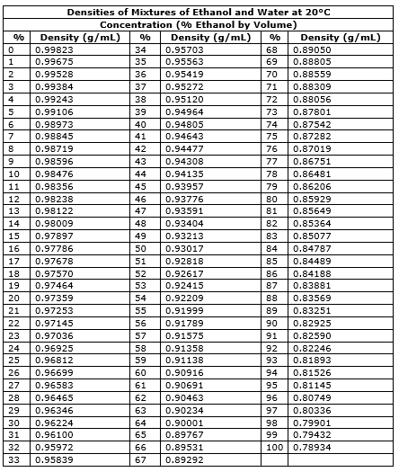
57 %

Slide 20
Using Density to determine Ethanol Percentage
15.45 ml
15.45 ml
35.20 g
8.95 ml
x 0.57
43.40 g
8.81 ml
8.20 g
0.916 g/ml
57 %
8.81 ml

Slide 21
Flame Test
If the percentage is above 30% it should sustain a flame
Add 2-3 ml of distillate to a watch glass
Remove distillate and any other flammable materials from area
Use a lighter to light the distillate

Slide 22
Budget
This lab is made possible with the support and content contributions of the Kansas Corn Commission.

