Slide 1
Kansas Corn:
Explore Corn

Slide 2
Explore Corn - Goals
Introduce students to corn - its history, characteristics, uses and how/when it is planted
Discuss the growth stages of corn - emergence, vegetative and reproductive
Explore the characteristics of an ear of corn and its kernels
Identify each growth stage using the leaf collar method by dissection of a corn plant

Slide 3
Let’s Play A Game!
Introduce yourselves to your team…
Then, 5 questions
This can also be played as a Kahoot!
https://tinyurl.com/ExploreCornKahoot

Slide 4
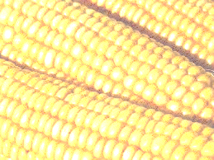
Question 1
Name 2 of the 4 basic types of corn…

Slide 5
Answer 1

Slide 6
Question 2
How long has corn been around?

Slide 7
Answer 2
Answer: 7,000 - 9,000 years ago from Central Mexico… or sweet corn developed in 1700s

Slide 8
Question 3
How many kernels are on an average ear of corn?

Slide 9
Answer 3
Answer: 600 to 800 kernels

Slide 10
Question 4
About how many corn plants can grow on an acre of land?

Slide 11
Answer 4
Answer: 22,000 to 35,000 plants

Slide 12
Question 5
The majority of grown corn is used for what purpose?

Slide 13
Answer 5
Livestock feed

Slide 14
Question 6
How much does a pirate pay for an ear of corn?

Slide 15
Answer 6
A buccaneer

Slide 16
Introduction to Corn - Article with Kahoot!
A. Start a class discussion:
Where is corn grown? Why is it grown there?
How is corn grown?
Are there specific stages that corn goes through when it grows?
When can you harvest corn?
How many ears of corn are there on one stalk?
How many kernels of corn are found on each ear?
How many corn plants can be grown on an acre of land?
What types of corn are there?
What products are made from corn?
B. Have students read Introduction to Corn article:
Encourage students to highlight, in a specific color, important concepts they would like to further explore. Also, have students highlight, in a different color, important facts or take-a-ways from the world of corn.
Then have students get together in groups. Hand each group a big sheet of butcher paper and a box of colored markers or pencils.
Ask each student within the group to draw a picture that represents a piece of information they took away from the article – no words!
After given enough time to complete this activity (~15 minutes), ask each group to present their drawings to the class and talk about one of the pictures and the information it represents. Once a piece of information has been used, groups afterwards cannot repeat that information.

Slide 17
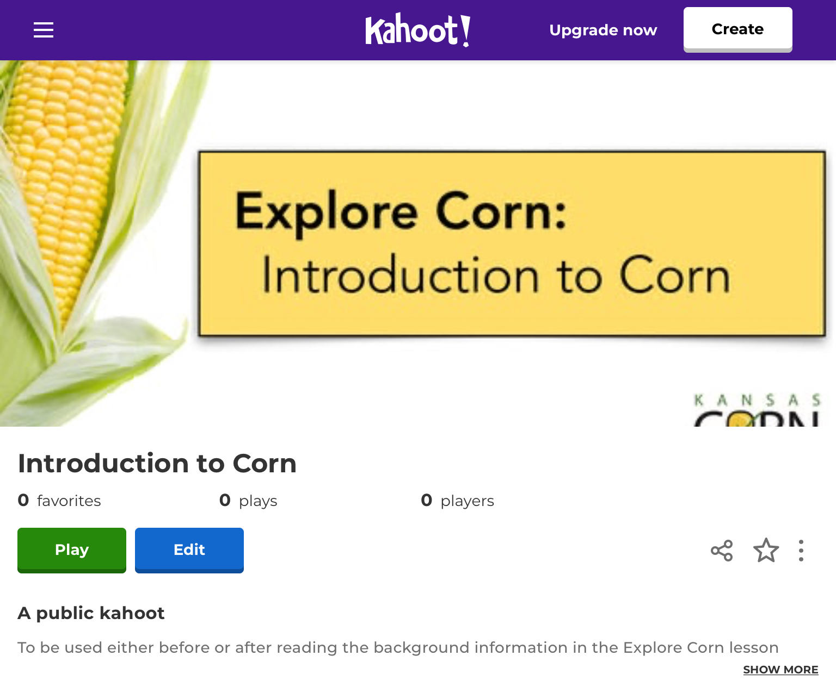
Introduction to Corn - Article with Kahoot!
C. Kahoot!: Introduction to Corn
https://tinyurl.com/CornIntroKahoot
D. Reflection Questions
What are three uses for corn?
Human consumption, livestock feed, ethanol, nylon fibers, plastics, etc.
How long has corn been around? Where did it originate?
9,000 years from Central Mexico or sweet corn developed in 1700s.
How many kernels are on an ear of corn? How many plants can grow on one acre?
600-800 kernels on one ear and 22,000 to 35,000 plants per acre.
What percentage of corn is used for human consumption?
9%
What should the ground temperature reach before planting corn?
After consecutive or future days of 50 °F

Slide 18
Lesson 1 - Corn Staging
A. Corn Staging Student Worksheet:
Pass out a copy of the Corn Staging Student Worksheet.
Students will need internet access to visit the DuPont Pioneer websites. The websites will be used as a resource to complete the Corn Staging Student Worksheet.
Students will read about and explore the different stages of corn growth while completing the worksheet.
Think of this as a pre-lab so students understand different stages of life of corn.
B. Corn Staging Resources:
Dupont Pioneer Overview of Stages of Corn Growth
Tinyurl.com/cornstages
Dupont Pioneer Vegetative Stages of Corn Growth
https://tinyurl.com/PioneerCornVegetativeStages
Dupont Pioneer Reproductive Stages of Corn Growth
https://tinyurl.com/PioneerCornReproductiveStages

Slide 19
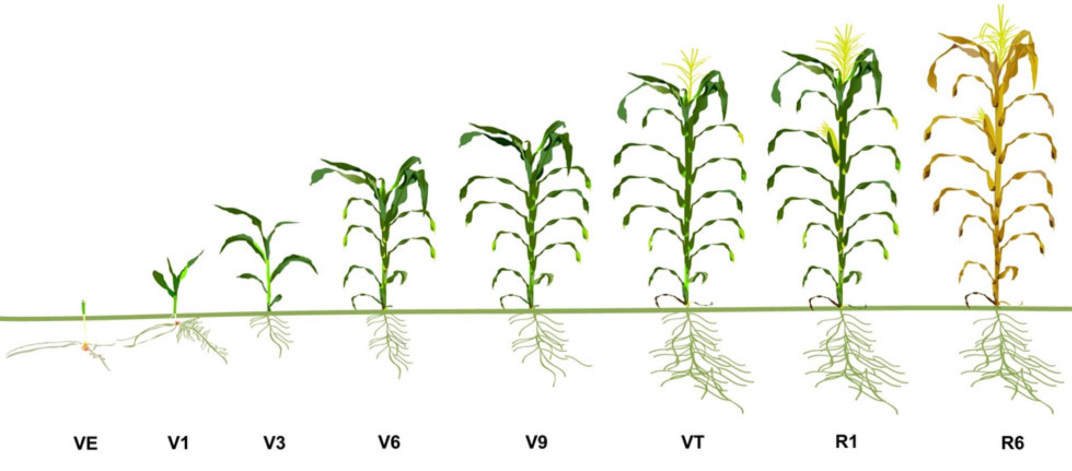
Lesson 1 - Stages of Corn

Slide 20
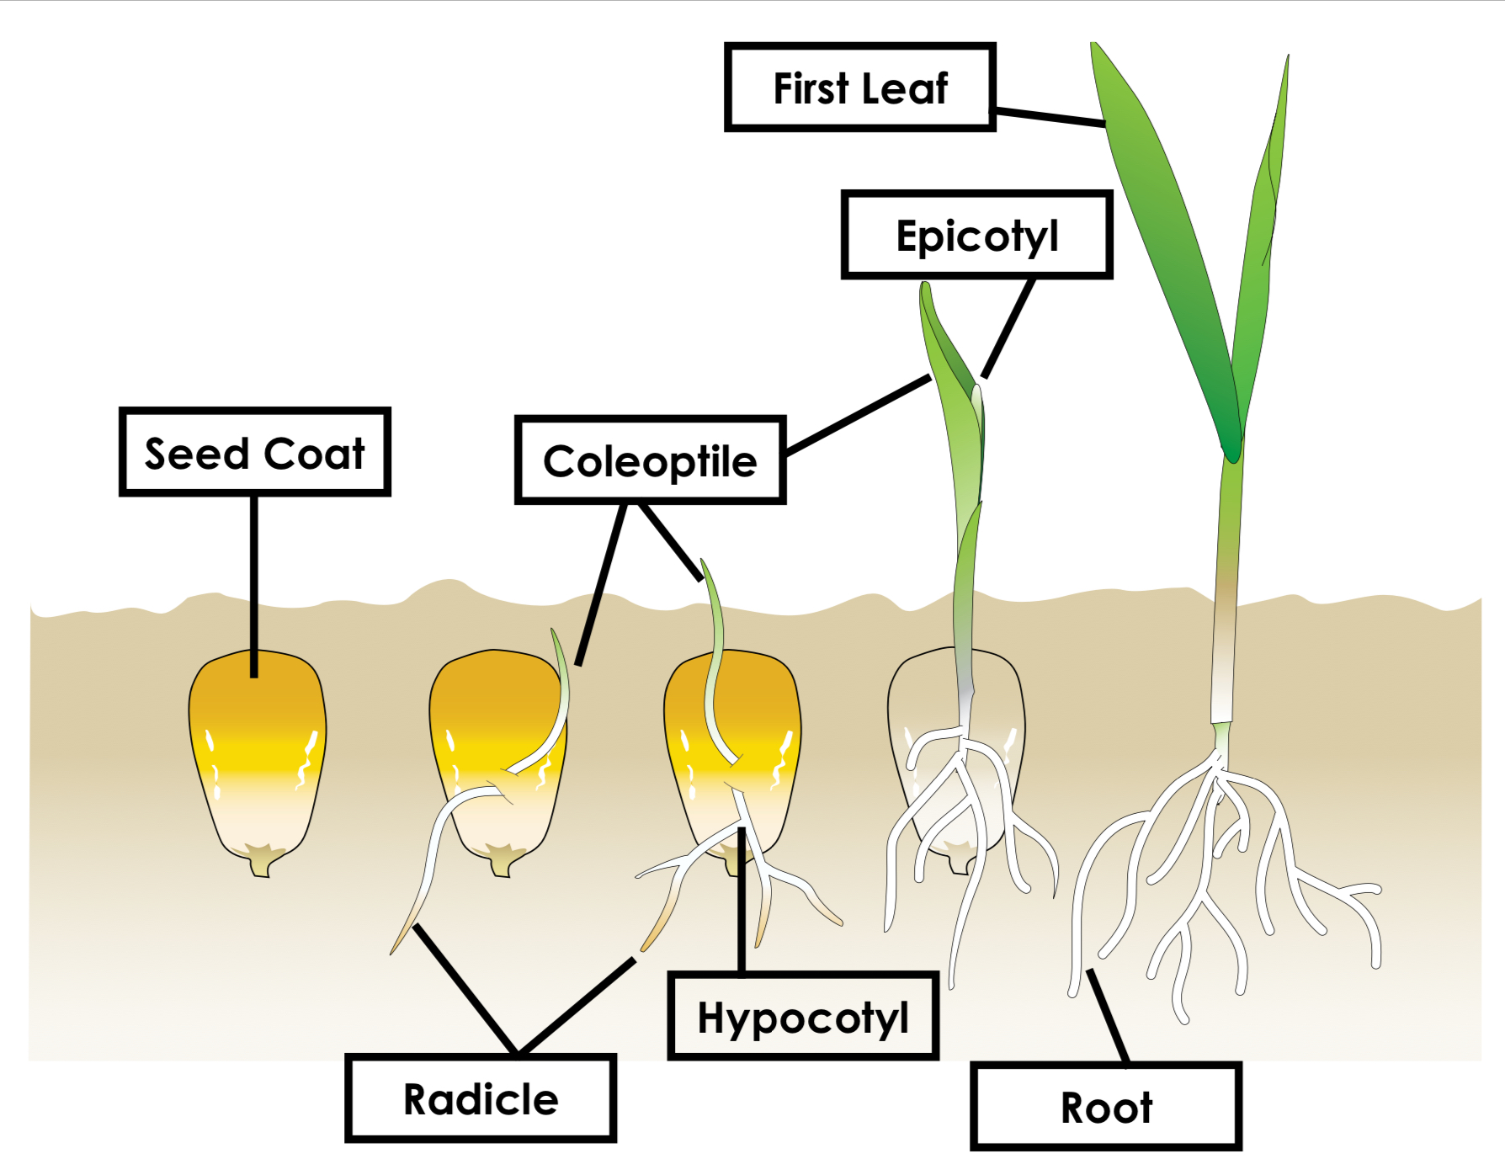
Lesson 1 - Stages of Emerging Corn Plant VE - V1

Slide 21
Lesson 1 - Stages of Emerging Corn Plant VE - V1
Protective outer covering of seed (Pericarp)

Slide 22
Lesson 1 - Stages of Emerging Corn Plant VE - V1
Protective outer covering of seed (Pericarp)
Moves downward
Uptakes water and nutrients

Slide 23
Lesson 1 - Stages of Emerging Corn Plant VE - V1
Pointed protective sheath that covers the emerging shoot
Protective outer covering of seed (Pericarp)
Moves downward
Uptakes water and nutrients

Slide 24
Lesson 1 - Stages of Emerging Corn Plant VE - V1
Pointed protective sheath that covers the emerging shoot
Protective outer covering of seed (Pericarp)
Moves downward
Uptakes water and nutrients
Region between coleoptile and radicle that forms more roots

Slide 25
Lesson 1 - Stages of Emerging Corn Plant VE - V1
Pointed protective sheath that covers the emerging shoot
Protective outer covering of seed (Pericarp)
Uptakes water and nutrients from soil
Moves downward
Uptakes water and nutrients
Region between coleoptile and radicle that forms more roots

Slide 26
Lesson 1 - Stages of Emerging Corn Plant VE - V1
Region inside coleoptile that forms leaves and stems
Pointed protective sheath that covers the emerging shoot
Protective outer covering of seed (Pericarp)
Uptakes water and nutrients from soil
Moves downward
Uptakes water and nutrients
Region between coleoptile and radicle that forms more roots

Slide 27
Lesson 1 - Stages of Emerging Corn Plant VE - V1
First true leaf to appear
Has a rounded tip and all others will be pointed
Region inside coleoptile that forms leaves and stems
Pointed protective sheath that covers the emerging shoot
Protective outer covering of seed (Pericarp)
Uptakes water and nutrients from soil
Moves downward
Uptakes water and nutrients
Region between coleoptile and radicle that forms more roots

Slide 28
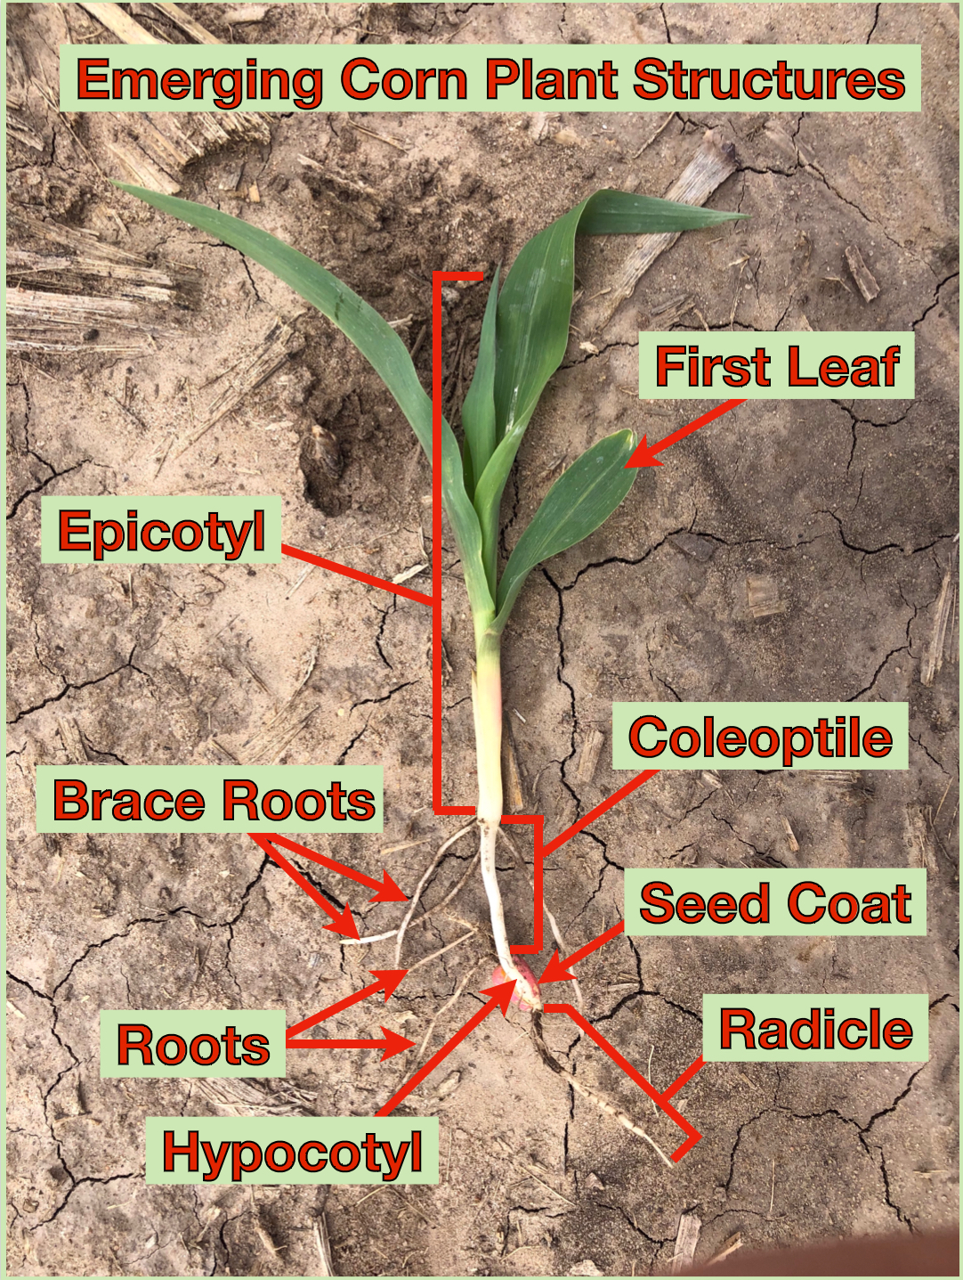
Watch this Kansas Corn STEM Time Lapse Video of Seed Germination:
https://tinyurl.com/KSCornSeedGerminationTimeLapse

Slide 29
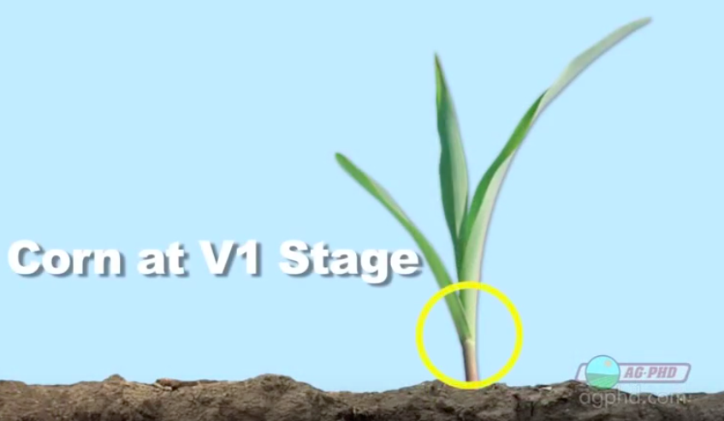
Lesson 1 - Determining Corn Stage - Leaf Collar Method
Click for Video on Corn Stage Growth

Slide 30
Lesson 1 - Stages of Corn

Slide 31
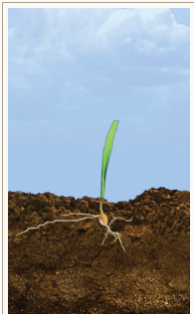
VE - Vegetative Emergence
Coleoptile breaks through the surface
Can take up to 2 weeks. (5 days under ideal conditions)

Slide 32
V1 - 1st Collar Showing
Difficult to distinguish from VE
collar around first leaf distinguishes this stage

Slide 33
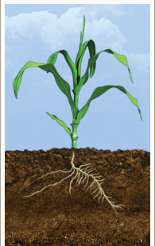
V3 - 3rd Collar Showing
Much of the growth is still below the surface
3 collars present
All of the leaves and ear shoots (potential ears) this plant will ever produce form inside stalk from V3 to V5!

Slide 34
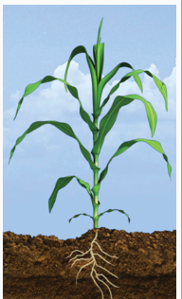
V4 - V9: 4 - 9 Collars Showing
V7-V8: Number of kernel rows is being determined by plant
V9: Tassel begins to develop

Slide 35
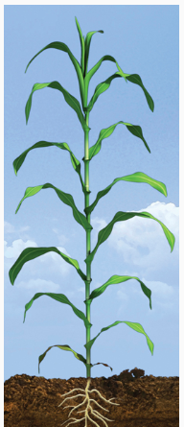
V10 - V15: 10 - 15 Collars Showing
V10: New leaves produced about every 2-3 days
V15: New leaves produces about every 1-2 days
tip of tassel might be visible

Slide 36
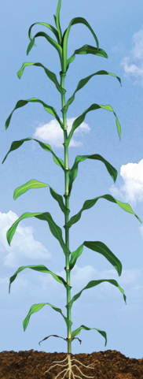
V16 - V18: 16 - 18 Collars Showing
V18: Silks from ear begin elongating
Silking is about 1 week away
Then corn cob making begins!

Slide 37
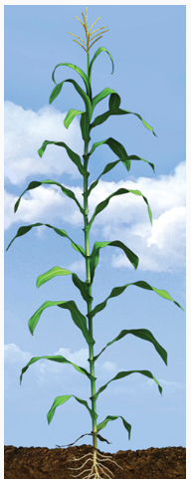
VT: Tasseling
VT: Tassel fully visible… time for reproduction!
Plant is now very vulnerable to hail damage!
We need fertilization with tassel and silks to happen…

Slide 38
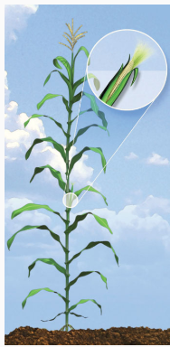
R1 - Silking
Silk fully visible outside of husk
Silks catch falling pollen…transfer pollen down ovule for fertilization.
All silks usually fertilized in about 2-3 days

Slide 39
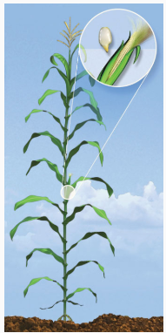
R2 - Blistering (10 to 14 days after silking
Silk fully visible outside of husk
Silks catch falling pollen…transfer pollen down ovule for fertilization.
All silks usually fertilized in about 2-3 days
Kernels are white on outside and resemble a… blister!
Cob is close to full size
Kernels begin to accumulate matter
kernels about 85% moisture

Slide 40
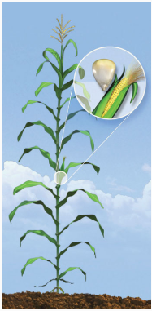
R3 - Milk (18 to 22 days after silking)
Silk fully visible outside of husk
Silks catch falling pollen…transfer pollen down ovule for fertilization.
All silks usually fertilized in about 2-3 days
Kernels are turning yellow
Inner fluid now milky white
Silks becoming dry
Sweet corn picked in this stage

Slide 41
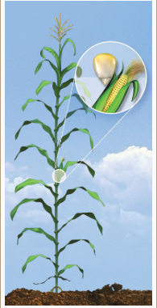
R4 - Dough (24 to 28 days after silking)
Inner milky white fluid is now a “doughy” consistency
Kernels at the edge of cob begin to “dent” toward end of this stage

Slide 42
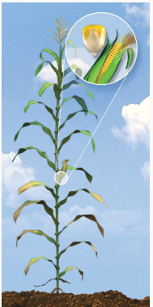
R5 - Dent (35 to 42 days after silking)
Kernels are dented.
Drying occurs from the top of cob to the bottom.

Slide 43
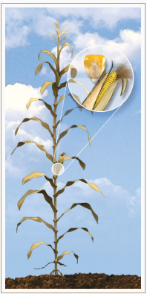
R6- Physiological Maturity (55 to 65 days after silking)
Maximum dry weight

Slide 44
Lesson 2 - Explore an Ear of Corn
A. Explore an Ear of Corn Student Worksheet:
Students will break into groups of 3-5 and should closely follow the instructions in the Explore an Ear of Corn Student Worksheet.
Hand out an ear of corn and corn plant.
Identify the following terms on the blank corn diagram at the bottom of the worksheet: roots, stalk, ear, kernel, silks, tassels, husk, and shank.
Explore the internet to help match the terms to their structures or
Watch this video over parts of the corn plant:
https://tinyurl.com/KSCornPartsOfACornPlant
B. Worksheet Questions:
What growth stage is it in? V (vegetative), VT (tasseling), or R (reproductive)?
If there are kernels on the cob, what reproductive stage is it in?
Lift the bushel, how much does it weigh?
Pop off kernels. How much does a kernel weigh?
How many kernels are there in a bushel?
Questions?
What are some things that may have altered these ears (pests, drought, water)?
What stage are they in (vegetative or reproductive)? Can you go into more detail about the stage?
Explore your ear – how many rows, how many kernels per row, how many kernels per ear?
At the end of this activity, regrouping the class to review can be helpful.

Slide 45
Lesson 3 - Leaf Collar Method
A. Explore an Ear of Corn Student Worksheet:
Students will break back out into groups of 3-5 for the Leaf Collar Method activity.
Students will be working with cutting utensils for this portion. Have students closely follow the instructions on their Leaf Collar Method Student Worksheet.
Use a knife and cutting board to carefully split the stalk of a corn plant in half, vertically, down to the roots.
The first four nodes are often indistinguishable within the crown, count the number of nodes to determine the vegetative stage that the corn plant is in.
Compare the nodes counted within the stalk to the number of leaf collars found on the outside of the plant.
B. Reflection Questions:
Why is it necessary to split the stalk to accurately determine what vegetative stage the corn plant is in?
How do the internal nodes compare to the external leaf collars found in/on the plant?
How can determining the vegetative stage of the corn plant help the farmer determine when to input fertilizers and predict the ear length?
Regroup the class at the end of this activity to talk through answers to questions.

Slide 46
Assessment - Exit Ticket
Before leaving class, one way to evaluate content knowledge is to create an “Exit Ticket”. Students respond to these questions before leaving class (answers are listed in bullet points):
What are four major stages of growth for a corn plant?
VE, VT, R1, R3, R6
What are the top two uses for corn?
Livestock feed and Ethanol
How long is it thought corn has been around?
7,000 - 9,000 years
How many kernels are on a corn ear? How many plants can grow on one acre?
600 - 800 kernels per ear, 22,000 to 35,000 plants per acre
What can the Leaf Collar Method tell us about a corn plant? What stage of life it is currently in?
answers vary depending on stage of corn plant
What are some things that can impact corn growth?
Pests, drought, water

