Slide 1
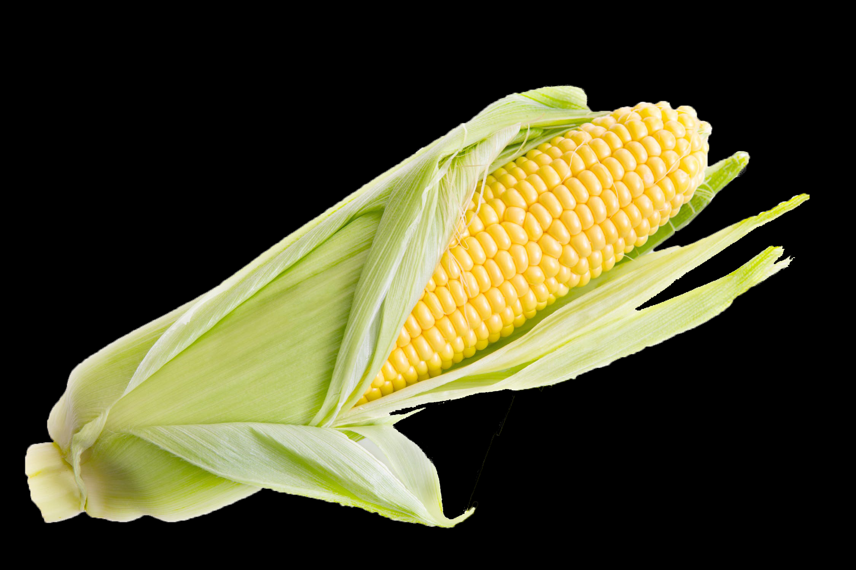
Fermenting Fuel
Designing a Procedure for Fast Fermentation

Slide 2
Ethanol
Ethanol is a renewable source of fuel for vehicles that is widely produced from corn. Ethanol production is reliant on the anaerobic fermentation of corn sugars by yeast.
Glucose
Ethanol
Carbon dioxide
C₆H₁₂O₆ → 2 C₂H₅OH + 2 CO₂ + Energy
2 ATP

Slide 3
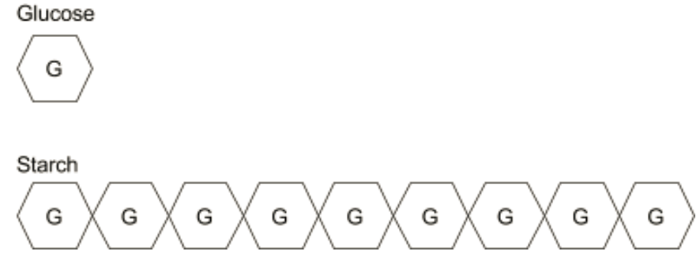
Enzymes
Scientists and industry professionals are constantly working to make the fermentation procedure more efficient. Different enzymes are added to the corn in order to break the starch into simple sugars that the yeast can process into ethanol.

Slide 4
Enzymes
Amylase
Glucoamylase

Slide 5
Ethanol
This lab is designed to allow students to experiment with different variables in the fermentation process to determine their effect. These findings are then used to develop a fermentation procedure that they may use on a larger sample for the distillation lab.

Slide 6
Preparing samples
Materials needed:
1 test tube
1.0 g ground corn
5 ml of distilled water
Stirring rod
Test tube cholder

Slide 7
Preparing samples
Add 1.0 g of corn to each test tube
Add approximately 5 ml of water
Use stirring rod to mix well

Slide 8
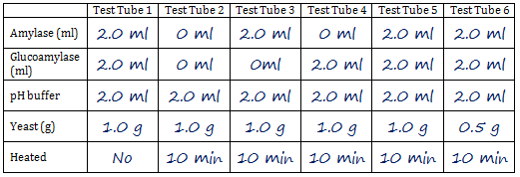
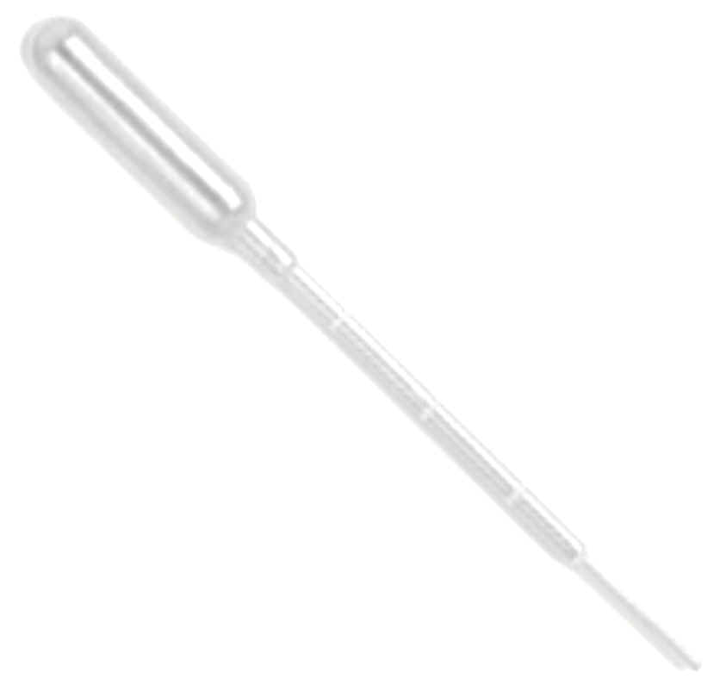
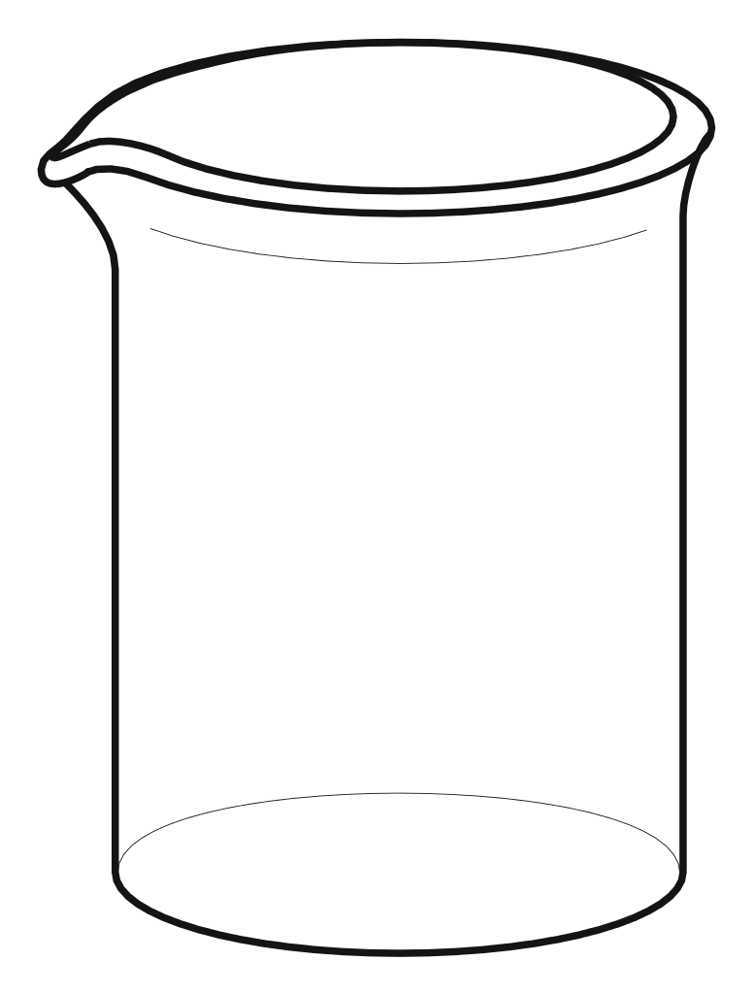
1
2
3
4
5
Amylase

Slide 9
Boiling Samples
Boiling breaks down the cellulose in the corn
Materials Needed Hot Plate
500 ml Beaker (or larger)
Water
Bring 250-300 ml of water to boiling on a hot plate

Slide 10
Boiling Samples
Add samples to the boiling water
Let them boil for 10 minutes

Slide 11
Samples may be placed in racks or a cool water bath.
If being kept overnight, insert a stopper.

Slide 12
1
2
3
4
5
Gluco
amylase

Slide 13
1
2
3
4
5
pH Buffer

Slide 14
1
2
3
4
5
Yeast

Slide 15
Add distilled water to equalize volume
1
2
3
4
5
Distilled Water

Slide 16
Stir with Stirring Rod
1
2
3
4
5
Distilled Water

Slide 18
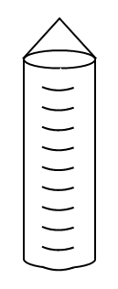

Slide 20
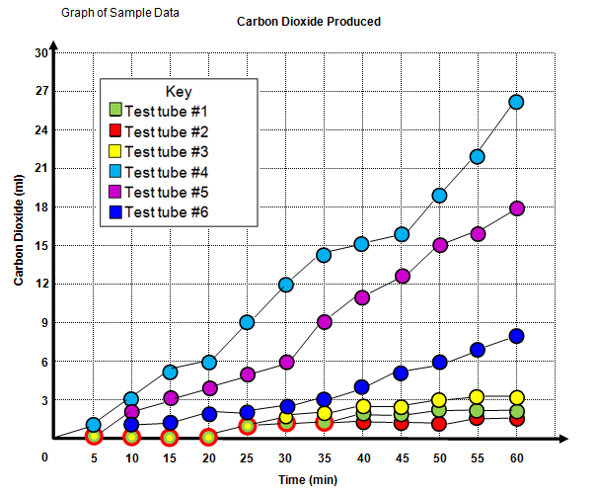
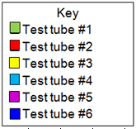
Data Collection: CO₂ produced (ml)
Time (min) | Test Tube 1 | Test Tube 2 | Test Tube 3 | Test Tube 4 | Test Tube 5 | Test Tube 6
5 | 0 | 0 | 0 | 1 | 1 | 0
10 | 0 | 0 | 0 | 3 | 2 | 1
15 | 0 | 0 | 0 | 5 | 3 | 1
20 | 0 | 0 | 0 | 6 | 4 | 2
25 | 1 | 1 | 1 | 9 | 5 | 2
30 | 1 | 1 | 1.5 | 12 | 6 | 2.5
35 | 1 | 1 | 2 | 14 | 9 | 3
40 | 1.5 | 1 | 2.5 | 15 | 11 | 4
45 | 1.5 | 1 | 2.5 | 16 | 12.5 | 5
50 | 2 | 1 | 3 | 19 | 15 | 6
55 | 2 | 1.5 | 3.5 | 22 | 16 | 7
60 | 2 | 1.5 | 3.5 | 26 | 18 | 8
0 | 0 | 0 | 1 | 1 | 0
0 | 0 | 0 | 3 | 2 | 1
0 | 0 | 0 | 5 | 3 | 1
0 | 0 | 0 | 6 | 4 | 2
1 | 1 | 1 | 9 | 5 | 2
1 | 1 | 1.5 | 12 | 6 | 2.5
1 | 1 | 2 | 14 | 9 | 3
1.5 | 1 | 2.5 | 15 | 11 | 4
1.5 | 1 | 2.5 | 16 | 12.5 | 5
2 | 1 | 3 | 19 | 15 | 6
2 | 1.5 | 3.5 | 22 | 16 | 7
2 | 1.5 | 3.5 | 26 | 18 | 8

Slide 22
Engineering a Better Procedure
Students will now use their results to develop another experiment or a procedure for a larger scale fermentation.

Slide 23
