Slide 1
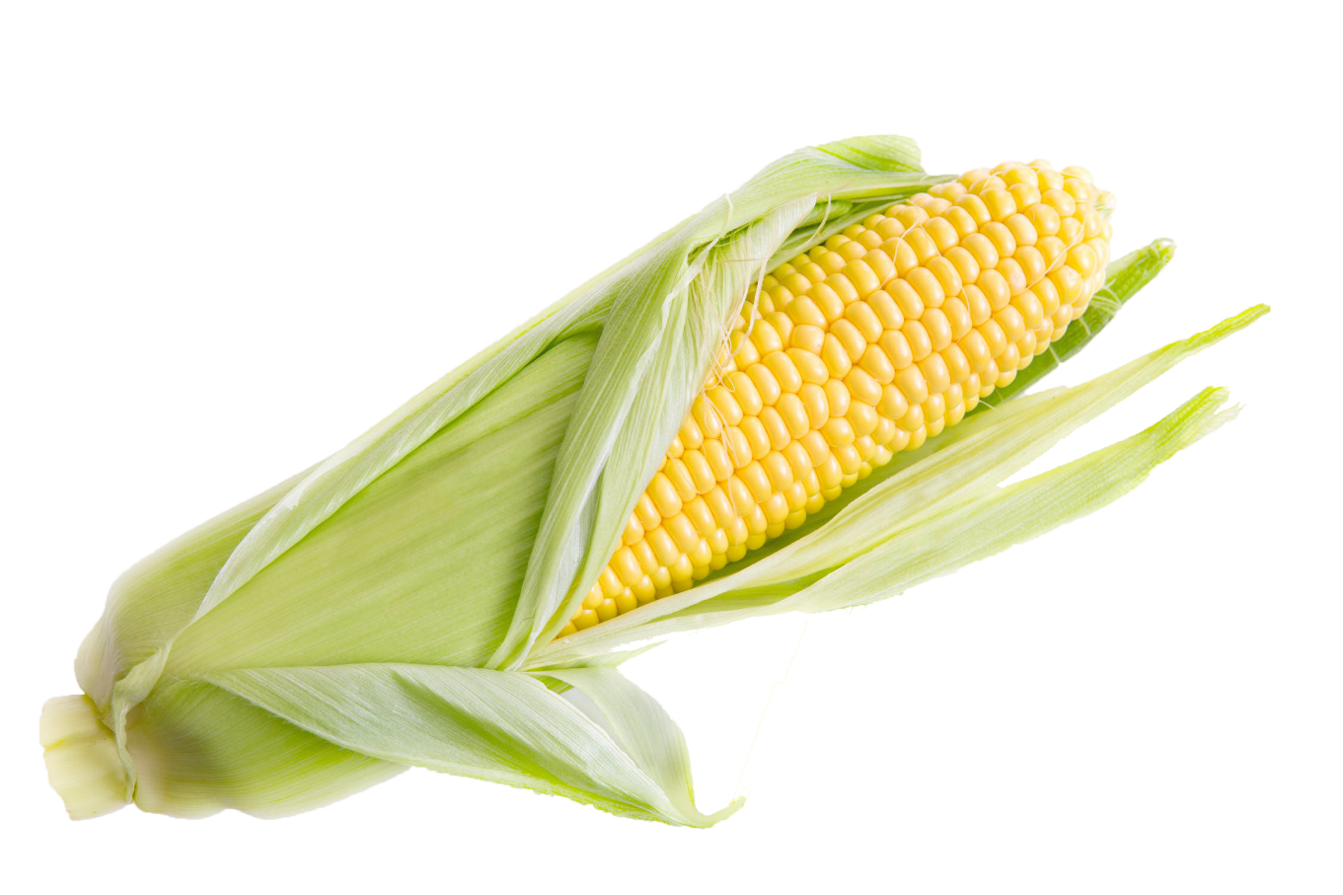
Pipette Technique

Slide 2
What is it?
What is the purpose of this equipment?
Where might we find this equipment?
What are some of the major features we can use as clues?
How would you operate this equipment?

Slide 3
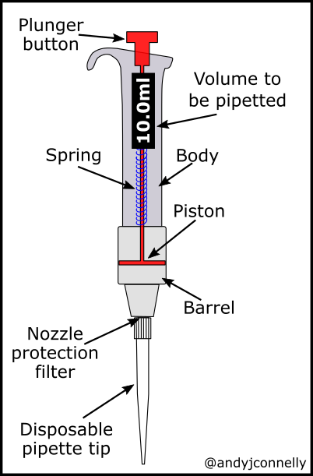
Actually it’s a pipette!
It’s a tool used in labs around the world
It measures very small amounts of liquid samples.
The numbers on the dial tell you how many microliters you are measuring.
Micropipettes come in many volume ranges and some are fixed volumes.

Slide 4
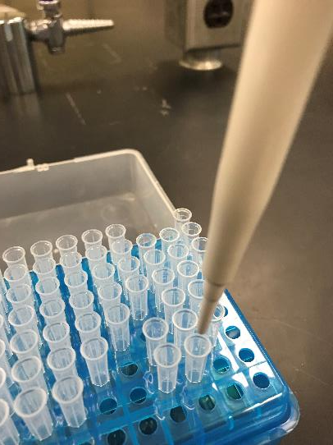
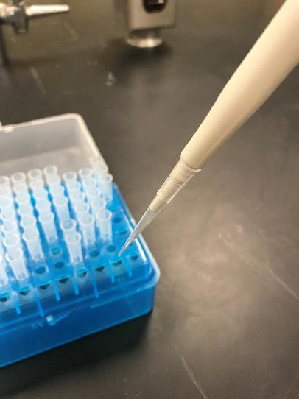
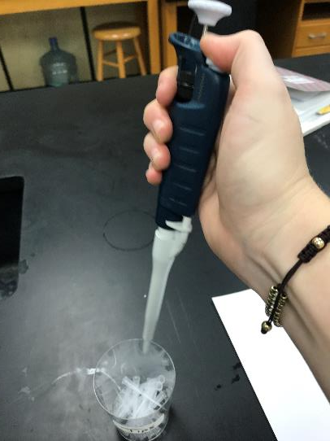
Operation: Step 1 Load a tip
Line up your pipette
Push down on the pipette firmly
Pick up the pipette,
Tip will be attached!
Get a new tip for every
sample! Push the eject
button to remove the
used tip

Slide 5
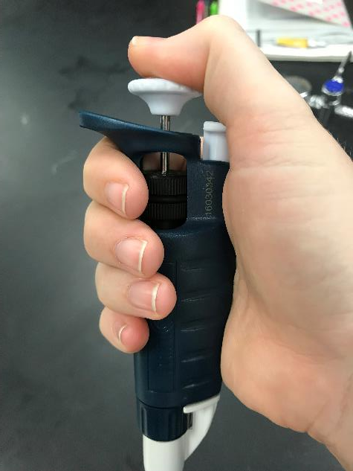
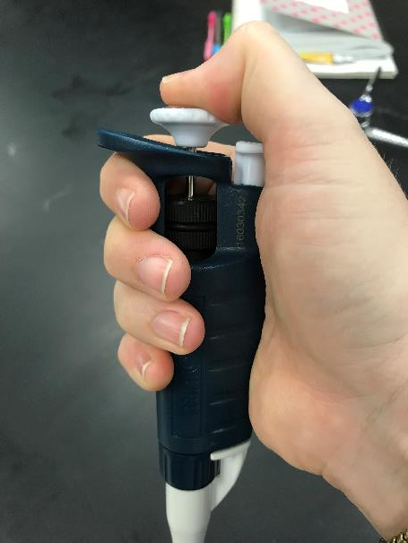
Operation: Step 2 Soft vs Hard Stop
If you continue to push down
Until you can push down no more,
You are at the HARD STOP.
Push down on the plunger
The first point of resistance is
The SOFT STOP

Slide 6
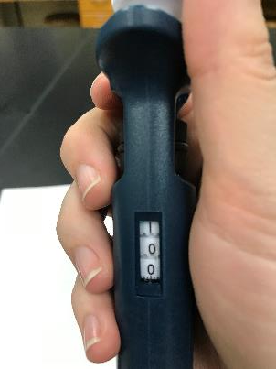
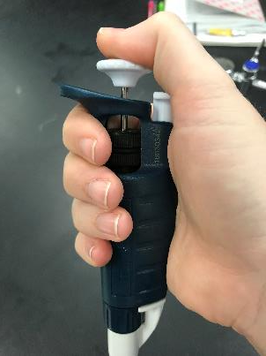
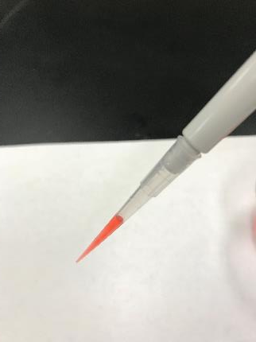
Operation: Step 3 Drawing up a sample
Check your volume
Push plunger to
soft stop
Dip tip into sample,
Do NOT touch the sides
of the container
Release plunger,
The Sample will be drawn
Into the tip,
raise the pipette and tip

Slide 7
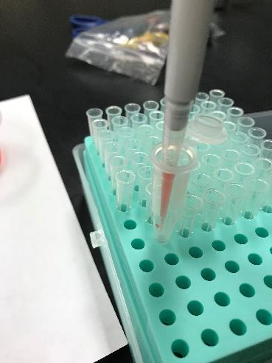
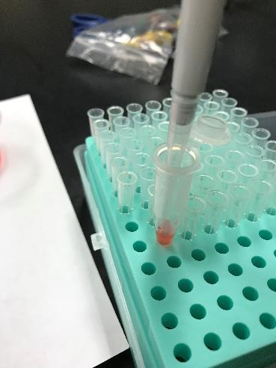
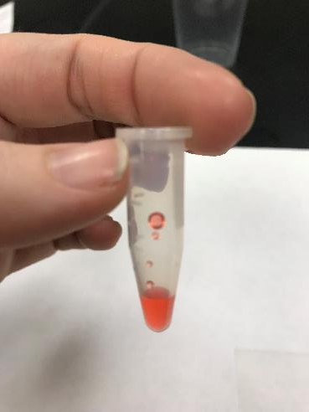
Operation: Step 4 Expelling Sample
Put tip into the
intended container
Make sure you aren’t
Touching the bottom or
the sides of the container
If you touch the sides
You end up with sample
On the sides, instead of all
At the bottom!
Push the plunger
Down to the Hard Stop

Slide 8
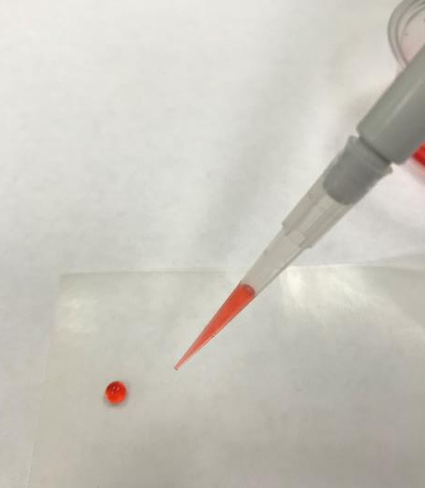
Activity Part 1
Practice Drawing up samples
Practice Expelling Samples
Check your accuracy by combining different volume samples, touch the tip of the pipette into the sample and drag it up to another sample close to it. Adjust your pipette to the volume of these two samples together.
Try and draw up the new joined sample without leaving any behind, or creating air bubbles!

Slide 9
Calculating % Error
GOAL: Measure out 2ml of sample with a 20-200ul
Decide how you want to get to the total
10 samples of 200ul
20 samples of 100ul
16 samples of 125ul
40 samples of 50 ul
80 samples of 25 ul
Measure out all your samples, don’t let them touch!
Then weigh your total sample.
Use the equation for % error and figure yours!

Slide 10
Check your Precision… Are you repeatable?
Repeat the process 10 more times, recording your final weight after each trial.
Then analyze the data points by using the coefficient of variation equation below
OPTIONALLY: USE Excel to do the work for you!
Input all the weights into a spread sheet
Then using the Excel short cut for determining standard deviation
=STDEV(A2:A13)/AVERAGE(A2:A13)*100
Making sure your cell tags match where you have placed your data.

Slide 11
Analysis and Discussion Questions
Using your mathematical models determine what is the optional volume setting for this particular task.
Why would having a variable pipette be a good thing? How does it affect your overall %Error if you are completing less samples for one total volume.
What are some things that could affect your overall accuracy in this lab? What about precision?
How can you control those variables?
In major seed development labs, where precision and accuracy can be vitally important, most pipetting is automated and controlled via computer. How would this increase the accuracy and prevision of professional labs? How would that impact the overall quality of their product?

