Slide 1
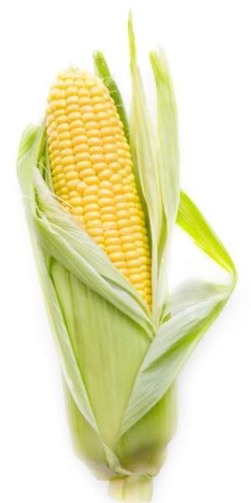
Decoding DNA
Modeling Protein Synthesis

Slide 2
All handouts for the lab can be found in your notebook- -Blue Tabs pages S10-S12 -online at www.kscorn.com

Slide 3
Purpose of this lab:
The purpose of this lab it to model the intricate process of protein synthesis that is detailed in the DNA by analyzing the genetic code and converting that into a protein through the processes of transcription and translation.

Slide 4
Desired learning outcomes:
Students will model that DNA is the storage molecule for genetic information in the cell
Students will perform transcription of DNA molecules into mRNA
Students will translate the mRNA molecules into sentences that represent proteins
Students will reverse the process to code a DNA molecule that will produce a given sentence

Slide 5
How to incorporate into your curriculum:
Genetics unit
GMO’s

Slide 6
Materials Needed:
DNA Sentence Strips – High School (pg. S1-2)
DNA Sentence Strips – Middle School (pg. S3-4)
tRNA cards; 1 set for each group (pg. S6-9)
Blank strips to transcribe mRNA; 1 for each sentence to be transcribed (pg. S5)
Decoding DNA Student Handout (pg. S10-12)
Decoding DNA PowerPoint
3D printed ribosome model (stl file is available online)
(all of these are available online at kscorn.com)
Model of DNA
A hula hoop to represent the nucleus of the cell

Slide 7
Set up:
Make sure each group receives
a complete set of tRNA cards
a blank strip (mRNA) for each sentence they will transcribe
a student recording sheet
a blank strip to record their engineered DNA to return to the nucleus

Slide 8
Set up:
Arrange the room into groups.
Print and cut the DNA sentence strips for the grade level you are working with (middle school or high school)
Designate a table in a central location the nucleus (hula hoop) that will be the location of the DNA strips.
DNA strips must not leave the nucleus.
One student from each group will go the nucleus and transcribe a sentence that their group has not yet decoded.

Slide 9
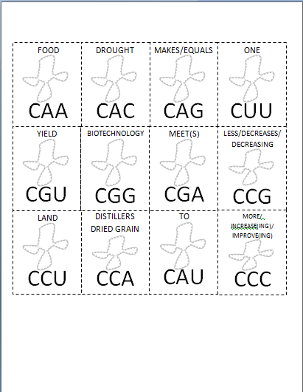
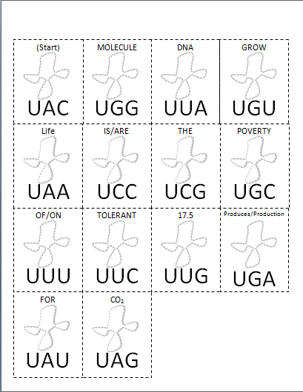
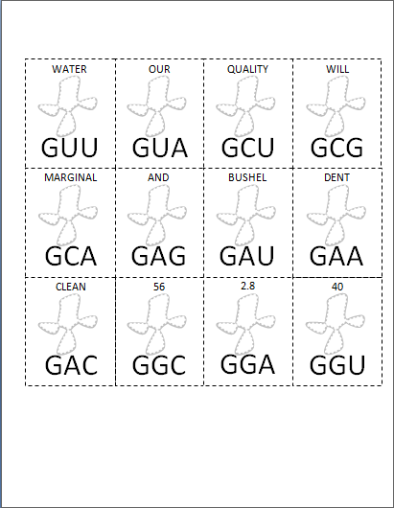
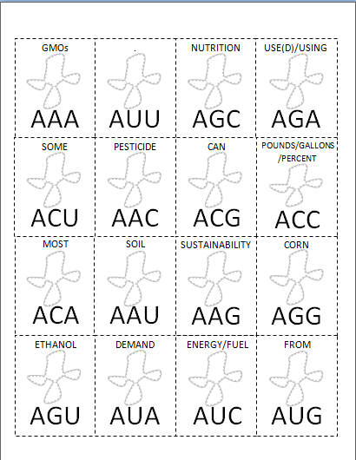
Set up:
Print tRNA cards, each group will need a complete set, cut these out before hand.
It is helpful if each page of cards are printed on a different color

Slide 10
Classroom Set up:
Group 1
Group 2
Nucleus
Group 3
Group 4
Nucleus
Group 5
Group 6

Slide 11
Decoding DNA
Modeling Protein Synthesis

Slide 12
Introduction
I often start by showing a short video clip to get their attention:
Overview of transcription and translation
https://youtu.be/h3b9ArupXZg
HHMI DNA transcription https://www.youtube.com/watch?v=8M198uHJd_8
HHMI DNA Translation https://www.youtube.com/watch?v=ZNl1z6Lev1E

Slide 13
A T A C G T A C G A T C G A T C G A
T A T G C A T G C T A G C T A G C T
DNA carries the genetic instructions for an organism.
It is a polymer of four different nucleotides: A, T, C and G.
It is arranged in long chains that form a double helix.
On each side of the helix is a complementary nucleotide.
A pairs with T C pairs with G
End of Slide

Slide 14
Transcription: DNA to mRNA
RNA polymerase
mRNA
DNA cannot leave the cell’s nucleus
RNA polymerase copies DNA to make mRNA
Notice that in RNA, A codes for U instead of T.
mRNA is a working copy of the DNA that carries DNA’s message.
End of Slide

Slide 15
Translation: mRNA to Protein
Start
Codon
mRNA
mRNA is “read” in 3 base (letter) sequences called codons.
AUG is the “Start Codon”.
After the start codon; each 3 letter sequence is another codon.
Each codon codes for one amino acid in the protein.
End of Slide

Slide 16
Translation: mRNA to Protein
MET
Amino Acid
MET
tRNA is a molecule that translates mRNA into amino acids.
On one end of tRNA there is a 3 letter sequence called an anticodon.
On the other end tRNA carries an amino acid.
tRNA
U A C
Anticodon
U A C
End of Slide

Slide 17
Translation: mRNA to Protein
HIS
MET
The process of translation is carried out by a ribosome.
The ribosome can hold two pieces of tRNA at a time.
When two tRNA molecules are held in a ribosome, their amino acids bond together, forming a protein.
U A C
GU A
Ribosome
End of Slide

Slide 18
Translation: Initiation
MET
U A C
A matching tRNA attaches to the AUG start codon.
The ribosome attaches to the mRNA where it finds this tRNA attached.
End of Slide

Slide 19
Translation: Elongation
HIS
GU A
MET
A matching tRNA attaches to the next codon.
A bond forms between the amino acids
U A C
End of Slide

Slide 20
Translation: Elongation
ALA
CGA
HIS
MET
U A C
GU A
End of Slide

Slide 21
Translation: Elongation
SER
UCG
HIS
ALA
MET
GU A
CGA
End of Slide

Slide 22
Translation: Termination
STOP
AUC
HIS
ALA
MET
SER
A stop codon, UAG codes for a tRNA that releases the protein.
CGA
UCG
End of Slide

Slide 23
Translation: Termination
HIS
ALA
STOP
SER
MET
Protein
UCG
AUC
End of Slide

Slide 24
Student Handout

Slide 25
DNA Strips

Slide 26
Lab Procedure: Transcription
Each group will send one member to the nucleus to pick a DNA strand to transcribe in mRNA. Record the number of the DNA strand as well. Remember DNA has to stay in the nucleus.
Gene #1 TAC AGT CCG TAG TGA ATT
mRNA # __
1 A U G UCA GGC AUC ACU UAA
End of Slide

Slide 27
Lab Procedure: Translation
Leaving the DNA in the nucleus, return to group with mRNA.
Working as a group scan mRNA for first AUG (Start Codon) and highlight.
Make a mark every three letters after to divide remaining codons.
mRNA # __
1 A U G UCA GGC AUC ACU UAA
End of Slide

Slide 28
Lab Procedure: Translation
Find the tRNA card with the UAC anticodon and match it with the start codon.
(Start)
UAC
mRNA # __
1 A U G UCA GGC AUC ACU UAA
End of Slide

Slide 29
Lab Procedure: Translation
Record the number of the mRNA strand in blank after the sentence #.
(Start)
UAC
mRNA # __
1 A U G UCA GGC AUC ACU UAA
Sentence # 1
End of Slide

Slide 30
Lab Procedure: Translation
Find the tRNA card with the anticodon that matches the next codon.
(Start)
UAC
Ethanol
AGU
mRNA # __
1 A U G UCA GGC AUC ACU UAA
Sentence # 1
End of Slide

Slide 31
Lab Procedure: Translation
Write the words that are on the cards to complete a sentence.
(Start)
UAC
ethanol
AGU
mRNA # __
1 A U G UCA GGC AUC ACU UAA
Sentence # 1 Ethanol .
End of Slide

Slide 32
Lab Procedure: Translation
Write the words that are on the cards to complete a sentence.
(Start)
UAC
ETHANOL
AGU
LESS/DECREASES/DECREASING
CCG
CO₂
UAG
Produces/Production
UGA
.
AUU
mRNA # __
1 A U G UCA GGC AUC ACU UAA
Sentence # 1 Ethanol decreases CO₂ production . .
End of Slide

Slide 33
Translation
Continue matching anticodons with codons until the sentence is complete.
Each sentence should end with a period which represents the stop codon.
Another group member will go to the nucleus and transcribe a different DNA strand to be translated by the group.
Continue until your group has completed 4 sentences.
Have your teacher check your sentences, and correct any mistakes.
End of Slide

Slide 34
Online Interactive for Practice

Slide 35
Genetic Engineering
Ask your teacher for a sentence (protein) that would benefit the organism.
Sentence The sequence of DNA is important.
End of Slide

Slide 36
Genetic Engineering
In your group find the cards (tRNA) that would produce the sentence. Don’t forget the start or punctuation cards.
Sentence The sequence of DNA is important.
(Start)
UAC
the
GUA
sequence
CUA
of
UGA
DNA
UUA
is
AAA
important
AAU
.
UUU
End of Slide

Slide 37
Genetic Engineering
Write the mRNA strand that would code for this sequence of tRNA.
(Start)
UAC
the
GUA
sequence
CUA
of
UGA
DNA
UUA
is
AAA
important
AAU
.
UUU
mRNA
AUGCAUGAUACUAAUUUUUUAAAA
End of Slide

Slide 38
Reverse Transcription
Write the DNA strand that would code for the mRNA.
Remember this is DNA so A codes for T.
mRNA
AUGCAUGAUACUAAUUUUUUAAAA
DNA
TACGTACTATGATTAAAAAATTTT
End of Slide

Slide 39
Genetic Engineering
Have your teacher check your DNA strand.
If it is correct, place your DNA strand in the nucleus.
Don’t forget Start and stop codons.
End of Slide

Slide 40
Genetically engineer the sentence:
Biotechnology can increase our quality of life.

Slide 41
Reflection and Conclusion:
How are chromosomes, DNA, genes, and proteins related?
What area of the cell does the table/hula hoop holding DNA represent in this modeling activity?
Why can the DNA strand not be brought back to your group?
What area of the cell does your table represent?
What do the words represent? The completed sentences?
What do you think the consequences might be if an error occurred in the cell as it goes through the process of protein synthesis?

Slide 42
Budget
This lab is made possible with the support and content contributions of the Kansas Corn Commission.

