Slide 1
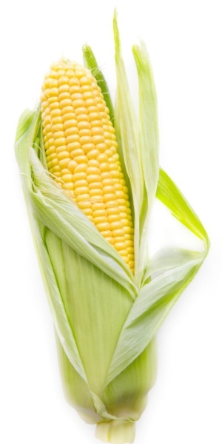
Feeding the World!
Bacterial Transformation

Slide 2
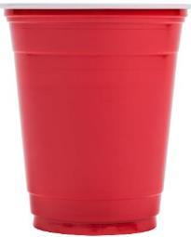
Sterile Technique :: Keep it clean
Disposable items
One time use: Use it. Trash it.
Dispose in the red solo cup (10% bleach solution)
Puppy pad catches all the spills
Only open when you need them & NOT before!
Non-pathogenic E. Coli strain: Lab created! We are SAFE!!
2019 Expenses $778,404
2020 Proposed $753,497

Slide 3
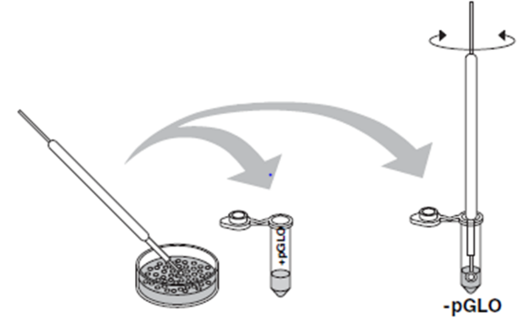
Let’s dive in :: Selecting a colony
Using a sterile yellow loop, take the circle end and scoop up one colony (one circle of bacteria).
Try to just scrape the white colony off the top of the clear agar. If you’re digging into the agar, too aggressive!
Insert the loop into the + pGLO tube and spin it around vigorously! You are suspending the bacteria in the solution.
Repeat this process with the – pGLO tube, using a new loop and a new colony from the starter plate!

Slide 4
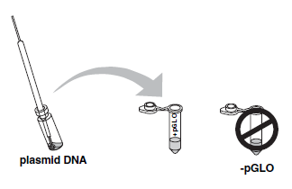
Examine and add the plasmid
Look at the plasmid in your tube & note anything special about it
Dip a sterile loop into the plasmid tube
Withdraw the loop, there should be a thin film on the loop itself (just like blowing bubbles)
Put the loop with the plasmid into the + pGLO tube and twirl the loop.
DO NOT do this with the – pGLO tube!

Slide 5
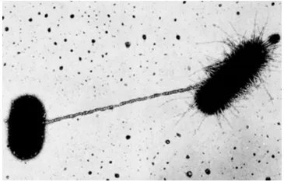
Incubate on ice :: TEN minutes
Facts about plasmids
Naturally occurring pieces of DNA that can be transferred back and forth between bacteria species
Helps protect bacteria from evolving threats
Can transmit new traits into a species (like antibiotic resistance)

Slide 7
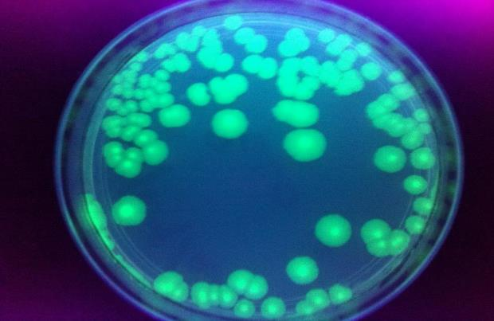
Transformation by design :: Glow, Baby, Glow!
Engineering the specific genes that are on the plasmids allows us to control the process
Exploiting this naturally occurring phenomenon has allowed us to create species that can produce human insulin from bacteria

Slide 8
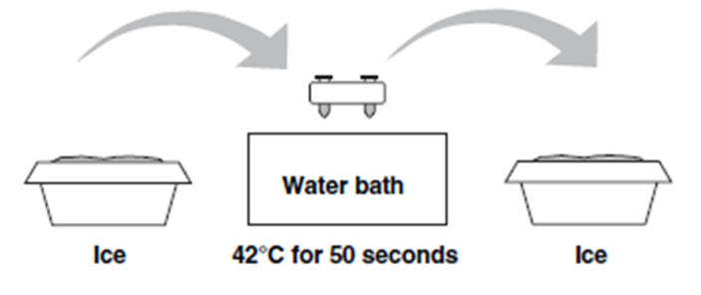
Slight bacterial encouragement :: Heat shock
Exposing bacteria to extreme temperature changes : Cold-HOT-Cold
Encourages bacteria to open the pores in the cell walls, which allows the plasmid in
Time sensitive process

Slide 9
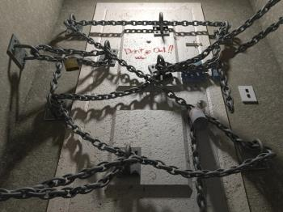
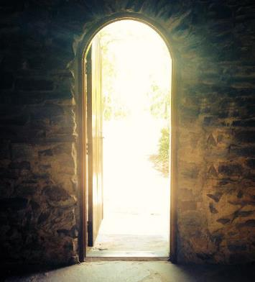
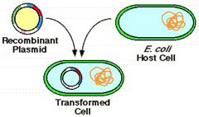
Process :: Plasmid lock down
Two minutes in the cold
Ensures the plasmid stays in the bacteria
The pores shut tight
Trapping the plasmid

Slide 10
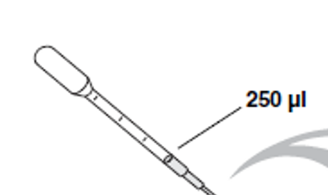
Pipettes are graduated

Slide 11
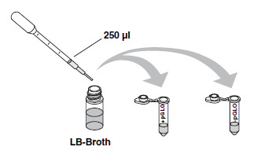
Let’s make them happy!
We are feeding the bacteria
Pipette 250ul of LB Broth from the yellow tube into + pGLO and the – pGLO tubes
Allows the bacteria to recover quicker from the heat shock process
Makes them want to replicate quickly
NAP time :: Rest the tubes at room temperature for ten minutes

Slide 12
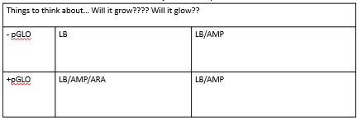
Predictions…
If the bacteria took in the plasmid, Then….
**This bacteria does not normally have a gene for ampicillin resistance, nor will it glow in the presence of arabinose

Slide 13
How to streak a plate : Streak. Turn. Streak.

Slide 14
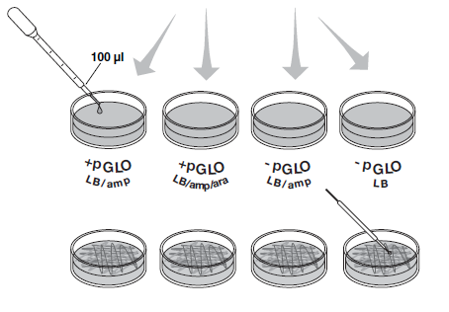
Streak those plates!
Using a fresh sterile pipette, add 100 ul of the + pGLO to each of the + pGLO plates (2 total)
Using a fresh sterile pipette, add 100 ul of the – pGLO to each of the – pGLO plates (2 total)
For each plate, streak the samples across the plates using the quarter turn technique
DON’T CROSS CONTAMINATE: Use a new sterile loop for each one

Slide 15
RESULTS

Slide 16
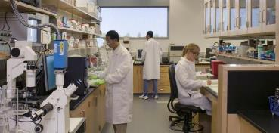
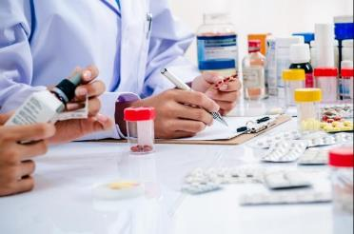
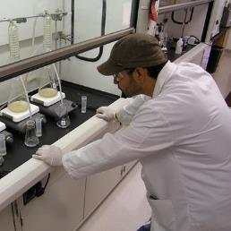
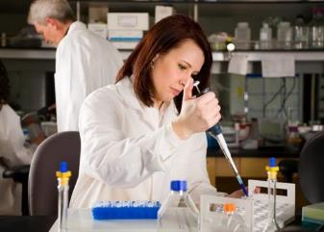
Applications to your content
SKILLS:
Hands-on lab experience
Sterile technique
Pipetting skills
Streaking skills
Predictions & observations
RELATED CAREERS:
Research & Development
Quality Control
Lab Technicians & Managers

Slide 17
Budget
This lab is made possible with the support and content contributions of the Kansas Corn Commission.

