Slide 1
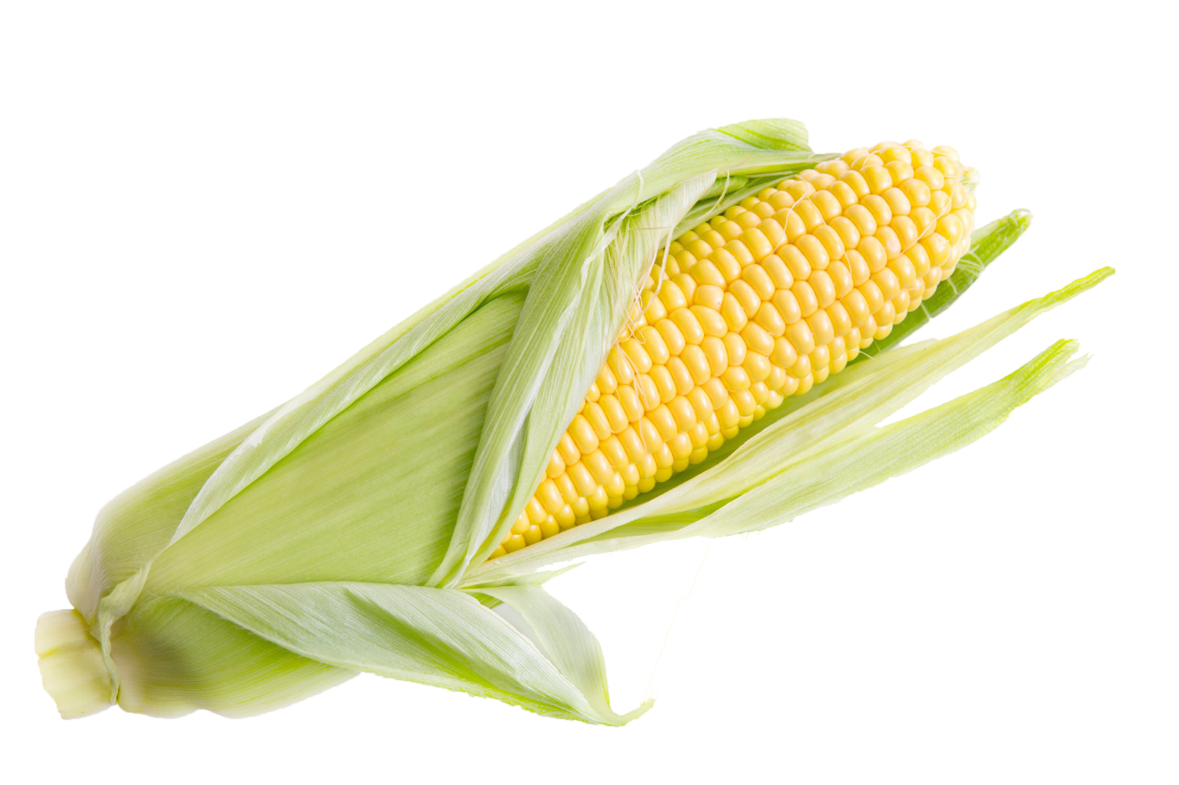
Genetically Modified?
What do you know about GMO’s?

Slide 2
What is a GMO?
Notes:
Most people don’t really even know what GMO stands for yet, they have very strongly help opinions.
Why is that? They have been shaped by the ideas and images they have seen in the media overall.

Slide 3
Do you know GMO?
On your student sheet page 1 write your own definition for what GMO means.
Find a partner or group! Compare your definitions.
Underline anything you have in common.
What’s left? Can you eliminate anything or does it have to stay??
Put a single line through anything that can go
Create a team definition.
Must include all the important underlined elements from before.
You must all agree on your definition.
Notes:
Goes with GMO Discussion Student Sheet questions.
Walk students through the questions one at a time. Make sure each step is complete before you move on to the next.

Slide 4
Our Definition of GMO:
Look at the meaning of each word independently…
Genetic: referring to genes or DNA
Modification: changing from an original
Organism: any living thing including animals, plants, bacteria, fungi….
Now add all of these definitions together:
Intentionally changing a living thing’s original genes or DNA.
Notes:
One approach might be to look at each word in this important phrase.
This will be our operational definition.

Slide 5
Why an Operational Definition?
Notes:
Operational Definitions help us be able to compare apples to apples not apples to oranges. Just as different people gather different information, like these blind men and the elephant, each is making different assumptions based on their limited amount of information. In order to really know what you are dealing with, you have to look at the full picture.
Making sure that everyone has a clear picture of the topic is vitally important to having constructive conversations.
Because GMO is such a polarizing term most scientists don’t even use the phrase since the vast amount of the public already has preconceived, and often incorrect definitions of the term.

Slide 6
Why do we even need GMO’s?
Growing population = more food needed
Soil degradation due to the loss of biodiversity means our crops contain fewer nutrients
Climate change

Slide 7
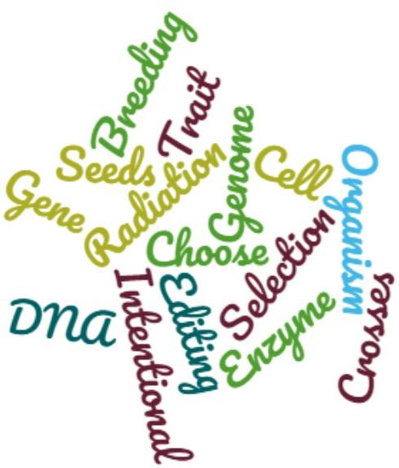
Lets use our definitions to classify whether these would create a GMO based on our operational definition.
Intentionally changing a living thing’s original genes or DNA.
Notes:
Sometimes its hard to make sense of different methods of breeding because their definitions seem so similar. When you start to see the same words over and over again, it helps to try and organize them based on some simple differences. Let’s begin.

Slide 8
Look at your cards and sort into two groups!
Non-GMO
GMO
1.
2.
3.
4.
1.
2.
3.
4.
Notes:
Have students use the information they have gathered to sort the six techniques into the category of GMO or Non-GMO….
There is really no right or wrong answer at this point, students should use the criteria in the definition to help group them.
Use leading questions such as “So how is DNA changed?” or “Does it matter what changes the DNA?” to help guide students.

Slide 9
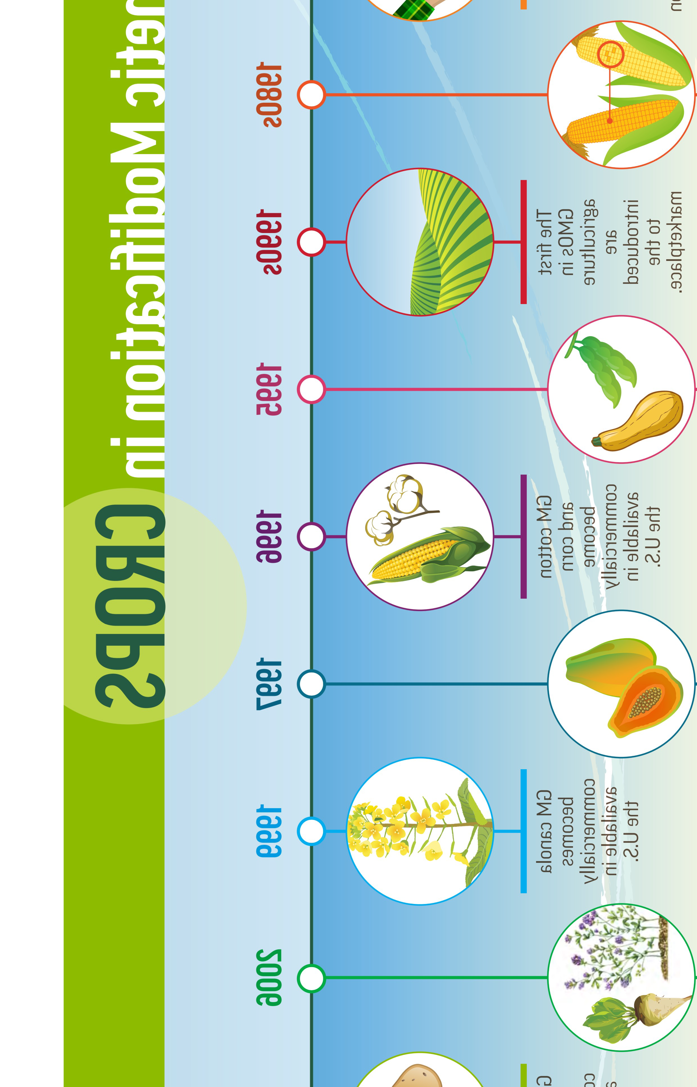
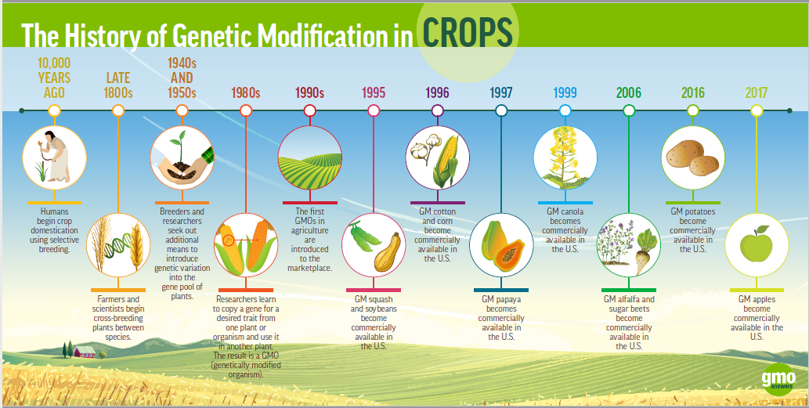
History of GMO….
Insect resistance
disease resistance
Mosaic virus resistance
Ring spot Virus
Notes:
Pay close attention to the timeline… Where would you put each of these methods?
When did we start the domestication of crops?
When did we start choosing the genes in our crops?

Slide 10
Technically….
Since we have been choosing plants to domesticate, we have been creating GMOs for about 10,000 years
We choose the plants with desirable traits, (good DNA/Genes)
Produces lots of fruit, survives drought, doesn’t get eaten by bugs…
We plant those seed with those traits (others we don’t)
Making breeds of plants!
So any plant we choose to domesticate or grow for our own good, is having their genes changed by us, it’s a GMO!

Slide 11
Before Domestication
So many of our most common foodstuffs look nothing like their ancestors.
Since humans have started domesticating plants for widespread production, we have chosen the traits we want to see in plants.

Slide 12
So….. Does that change your sorting?
Non-GMO
GMO
Simple selection
Selective breeding
Interspecies crosses
Mutagenesis
Genome editing
Transgenesis
Notes:
Let your students move around any of the card they feel should be moved into a new group.
Ask them some more leading questions : “When we select plants to grow as crops how do we choose? What controls those traits?”

Slide 13
Are they really all the same???
These six represent both “Traditional Breeding Techniques” and “Genetic Engineering Techniques”
Sort into the two groups!
Traditional
Genetic Engineering
Notes:
Clearly some of these techniques have been used long before we knew anything about DNA specifically.
We didn’t find out about DNA structure until 1952 and it still took several years before we fully understood the importance of DNA to heredity.
Not all of these techniques require the same level of technology to achieve.

Slide 14
What’s the difference…???

Slide 15
Take another shot at grouping
Traditional:
Genetic Engineering:
Notes:
The key is specifically the number of genes that are changed at once.
Traditional techniques have the potential to change thousands or hundreds of thousands of genes at once. With this type of breading you cannot choose to target one specific gene without possibly effecting many others. This of it as one good but thousands of possible bads too…. This process can take a long time, with many many crosses before the desirable combination of traits occurs, if ever at all!
Genetic Engineering uses technology to specifically isolate one gene or one small set of genes to confer the a single desirable trait. Since only one gene is altered or inserted you don’t have to worry about any additional changes to the rest of the genome.

Slide 16
One Gene Vs Many Genes
Traditional: Many Genes Changed
Genetic Engineering: One Gene Changed
Transgenesis
Genome Editing
Simple Selection
Selective Breeding
Interspecies Crosses
Mutagenesis
Takes many “generations” to make noticeable changes
Many people confuse the words, Genetically Engineered and GMO!
Notes:
The key is specifically the number of genes that are changed at once.
Traditional techniques have the potential to change thousands or hundreds of thousands of genes at once. With this type of breading you cannot choose to target one specific gene without possibly effecting many others. This of it as one good but thousands of possible bads too…. This process can take a long time, with many many crosses before the desirable combination of traits occurs, if ever at all!
Genetic Engineering uses technology to specifically isolate one gene or one small set of genes to confer the a single desirable trait. Since only one gene is altered or inserted you don’t have to worry about any additional changes to the rest of the genome.

Slide 17
So where would we draw the line here?
Source: GMOanswers.com
Notes:
Remember the One Vs Many rule of thumb.

Slide 18
Only Transgenesis
Adding a specific, well-characterized gene to a new organisms to transfer a specific trait!
One or a few traits!
Lots of methods to get the new trait into the cell!
Gene Gun Particle Accelerator
DNA microinjection
Retrovirus Insertion
Restriction Enzyme Insertion
Stem Cell Transgenesis
CRISPER

Slide 19
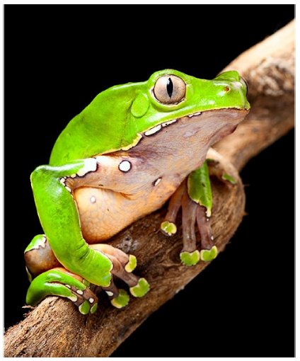
Transgenic Speed Dating!!!
Part of the struggle is finding your match!
What gene do I need to add into this crop? Where do I get it from?
Lets Play!
Each player has a card (Recipient or Donor)
Read your card, find your purpose, what do you do?
Find your gene mate!
Hint, there might be more than one!!!
Notes:
Hand out a card to each individual. Make sure that you have provided pairs to all the cards.
Arrange students in your preferred mode, just make sure it involved movement!
Option 1: Could be donor sitting and recipients standings and recipients move from table to table, rotating every 30-60 seconds.
Option 2:Could do an inside outside circle donors in one circle, recipients in the other, rotating every 30-60 seconds. ….
Option 3: Could do a “stand up, pair up”….. Have students mill around the room until their find their match

Slide 20
Match Reflections….
What organisms are involved?
Who is the donor, what are they giving?
Who is the recipient?
Are these the same type of organism?
What problem is this addressing?
Aka Pest resistance, medical treatments….
How can this help the world? / Making things easier or better?
Notes:
Have students fill out their reflections on a large piece of sticky paper or a white board.
Set up all the reflections for the students to see the pairs OR have students share out their reflections for the entire group.
Once all groups have shared or you have gone through a gallery walk, ask students if you have all the data yet?
The biggest question out there today is “ARE GMO’s SAFE?”

Slide 21
Food Labeling
Starting January 2022, you will start to see new GMO labeling for products that are bioengineered or contain bioengineered ingredients. The National Bioengineered Food Disclosure Standard establishes the rules for disclosing which foods in the U.S. that have been or may have been bioengineered (BE) and enforced by USDA. To learn more about the labeling visit https://gmoanswers.com/USDA-Bioengineered-BE-GMO-labels

Slide 22
Time to reflect!
Who is involved?
List Donor
List Recipient
Problem being solved?
Describe
Ex: pest resistance, medicinal…
How can this help the world?
What impact does this have on our existence?
How different are they?
Notes:
Here is an example of how you might decide to make your poster to share with the class!

Slide 23
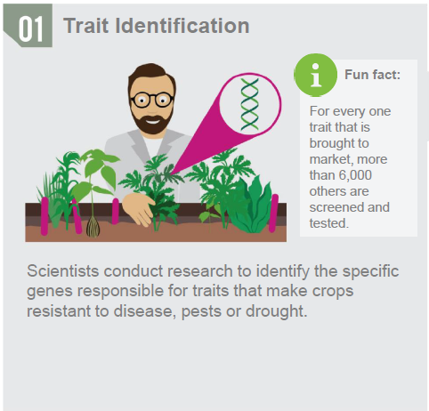
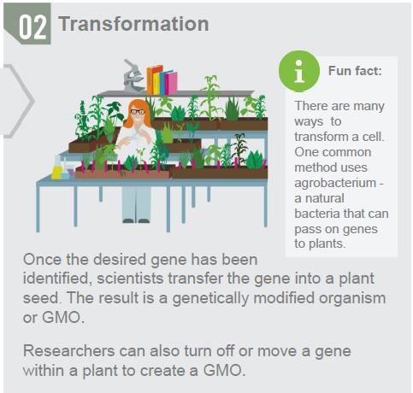
What happens next? Here’s a look a the cycle!
Notes:
Scientists are not going through the world and randomly creating transgenic organisms with whatever they can find. The process is long, takes millions of dollars, and can be decades of work by countless individuals completing rigorous testing at every possible turn.

Slide 24
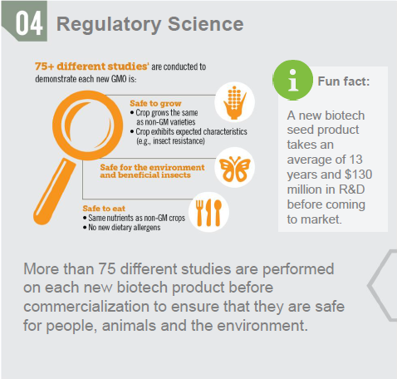

Slide 25
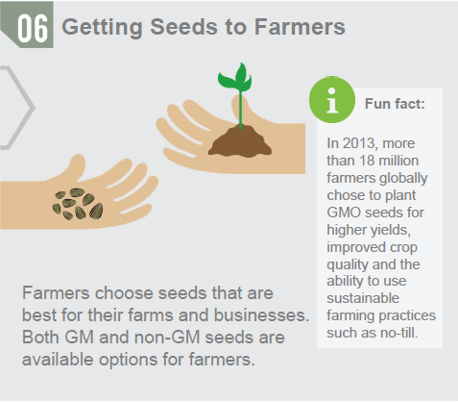

Slide 26
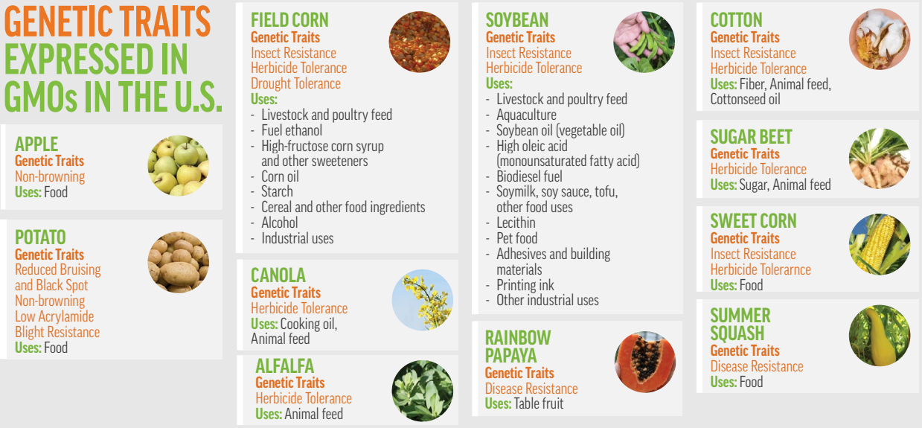
Notes:
This represents all of the transgenic crops that are present in the US!
Is this smaller than you expected? Do you see some missing?
All of the medical uses have been omitted because they are screened under a much more rigorous standards by the FDA!
All of the fiber transgenics are also excluded, like spider web goats milk, are used in industry and not food or crop production.

Slide 27
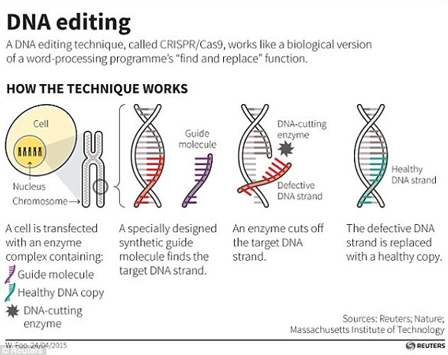
Genetic Engineering in the future?
Altering the DNA within an organism by changing the organisms original genome.
Deleting genes that are harmful
Duplicating genes that induce certain protein productions, additional starch production in corn
Editing genes to change specific sequences and change proteins
So… GMO or Not?

Slide 28
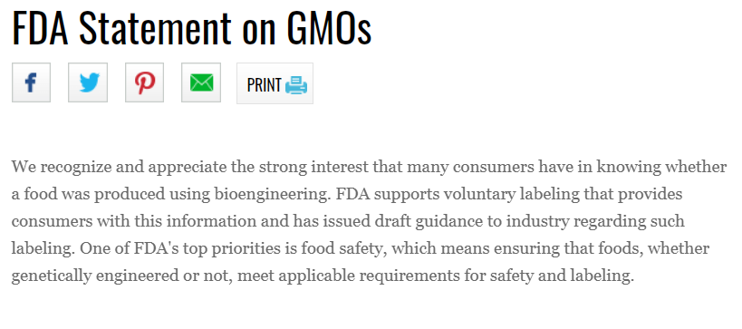
GMO Labeling

Slide 29
GMOanswers.com
Yourgenome.org
New Regulations of food labeling as of January 1, 2022

Slide 30
Bill Nye—8 minutes
South Park---7 seconds
Why are GMO’s Bad—11:25 minutes
The Science of GMO’s by Neil deGrasse Tyson--- 20 minutes

Slide 31
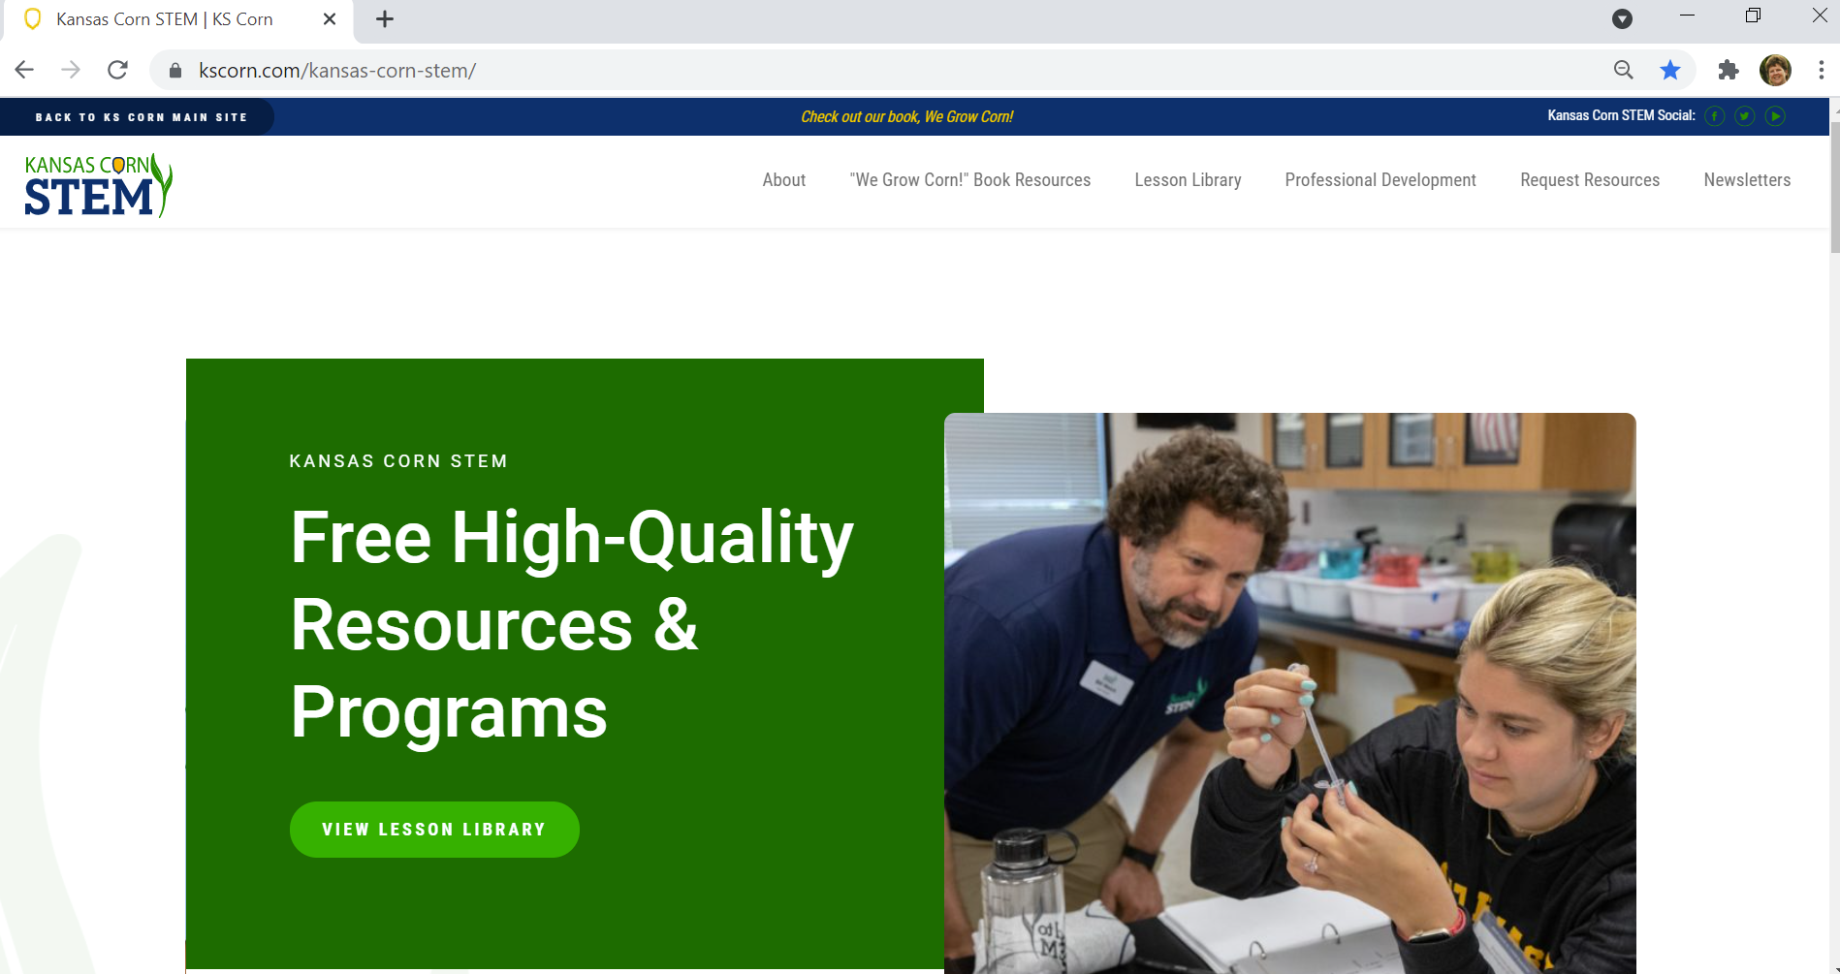
All of these lessons, including the PowerPoint presentations can be found at in the lesson library
www.kscorn.com

Slide 32
kscorn.com

