Slide 1
DNA, How it’s Packaged

Slide 2
How to Construct the DNA Model

Slide 3
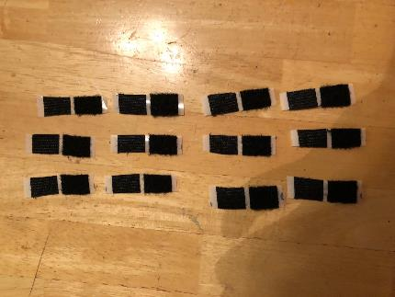
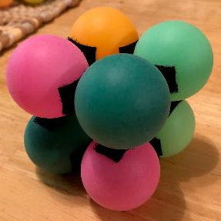
Materials needed to construct the DNA Model
12 – 0.5 inch paired pieces of velcro per NUCLEOSOME
8 Ping Pong balls per Nucleosome
1 Completed Nucleosome
Made up of 8 Histone Proteins
Using a SHARPIE you can write HISTONE PROTEIN on each Ping Pong Ball

Slide 4
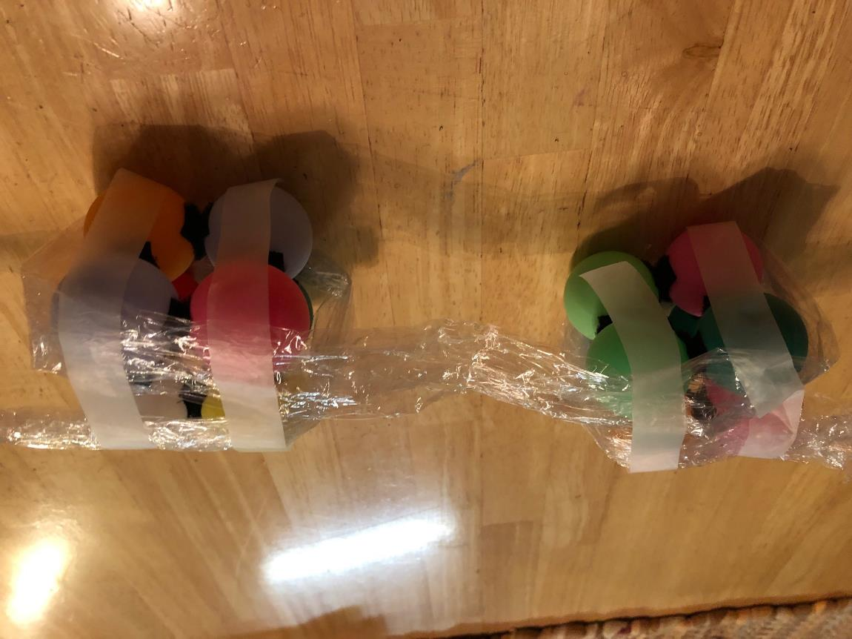
Clear Tape to connect the wrapped DNA to the Nucleosome
Nucleosome
Saran Wrap will Represent DNA
The Saran wrap will be wrapped around the nucleosome

Slide 5
Uncoiled DNA wrapped around Nucleosomes

Slide 6
Condensed DNA to form a Chromosome

Slide 7
Total Materials List for DNA Model Lab
Velcro - $10
Tape - $3.50
Ping Pong Balls [Brewski Brothers ($6.45/144 balls)]
Saran Wrap - $3.50
55 gal Clear Trash Bags [HDX Xtra Large Bags -LOWES ($9.95 /50 bags)]
Sharpie - $1.00

Slide 8
Extracting DNA from Corn T9-T10

Slide 9
Salting out Proteins Demonstration
Whole Milk
Salt + Water – Salt solution
Add 50 ml of Salt Solution to 50 ml of Whole Milk
Stir mixture for one minute and let sit for 5 minutes
Record Observation

Slide 10
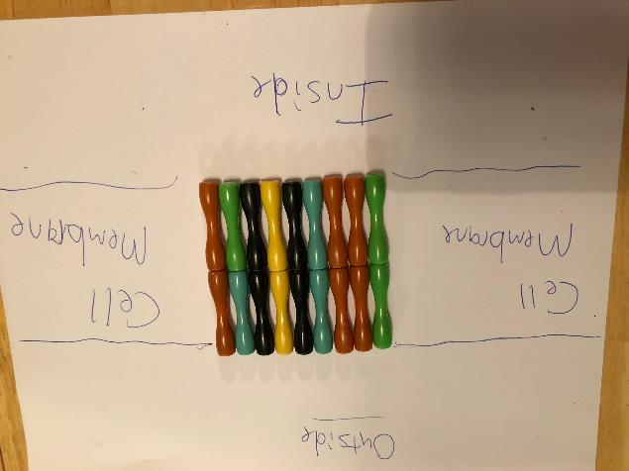
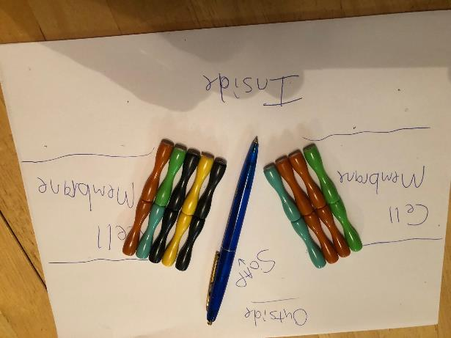
Separating Lipids/Fats using Detergents (Soap)
Melted butter add 3-4 drops of liquid soap (colored) and observe what happens around the soap droplets.

Slide 11
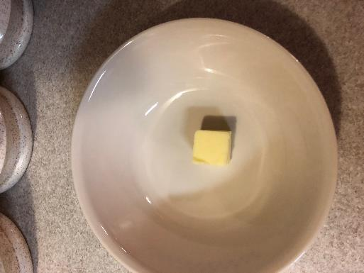

Slide 12
Separation Techniques
Bi-lipid Membranes – how to open the cell membrane and the nuclear membrane in order to get to the DNA [SOAP]
Histone Proteins – how to separate the histone proteins from the DNA that is wrapped around them [SALT]
Negative DNA from Solution – COLD alcohol to precipitate out DNA

Slide 13
Gather JUST 10 embryos from 10 kernels of canned, germinating, and dry corn. Attempt DNA extraction from just those 10 embryo tissues to determine efficiency of protocols.

