Slide 1
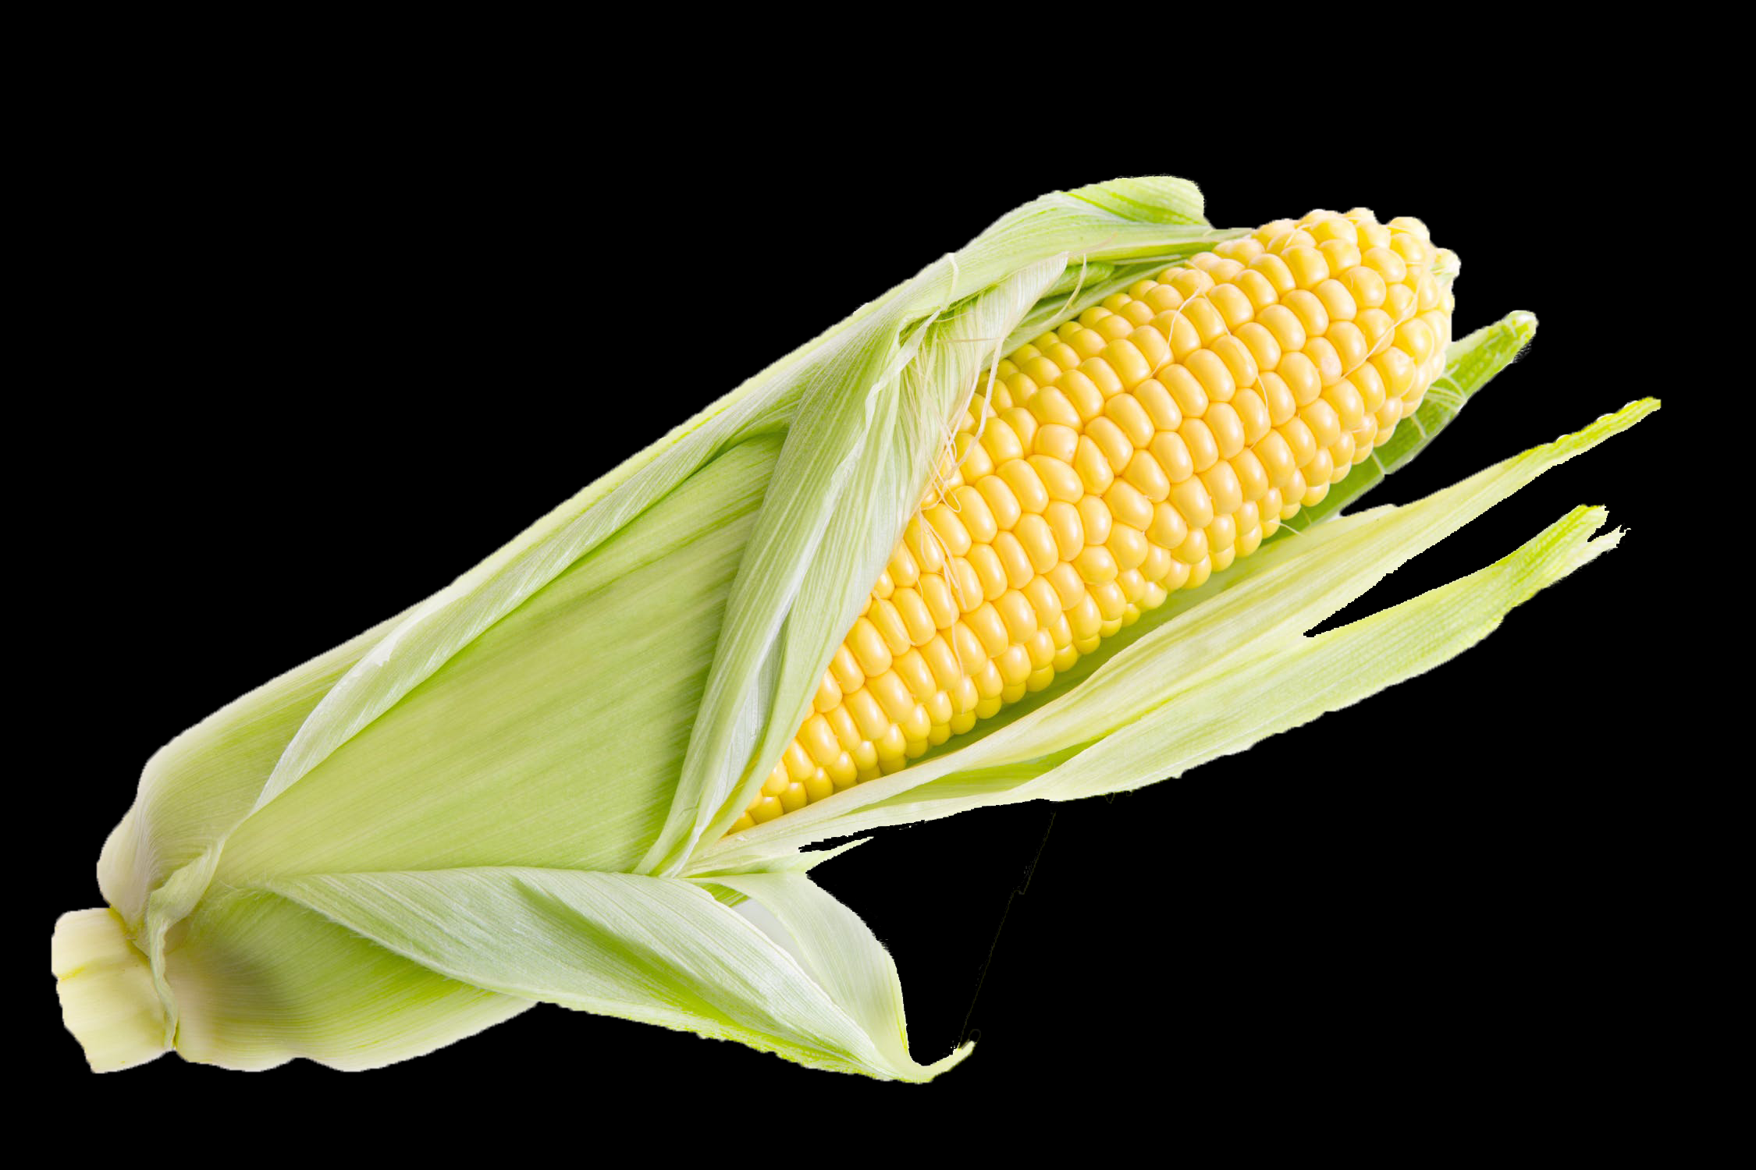
DNA, What’s it Look Like
Bill Welch

Slide 2
Overview
It is important for students to understand what DNA is and how all cells utilize it. One major difference in this DNA lab is that we attempt to extract DNA from corn while we build a physical and mental model of the structure of DNA. After extracting DNA and building a model, the students then attempt to utilize their newly acquired knowledge of the structure of DNA to optimize the extraction of DNA from corn.
This lab has three parts: 1) DNA extraction from canned corn, 2) DNA modeling activity to be done while waiting for part 1 results, and 3) student experimenting with DNA extraction procedure to obtain more DNA.

Slide 4
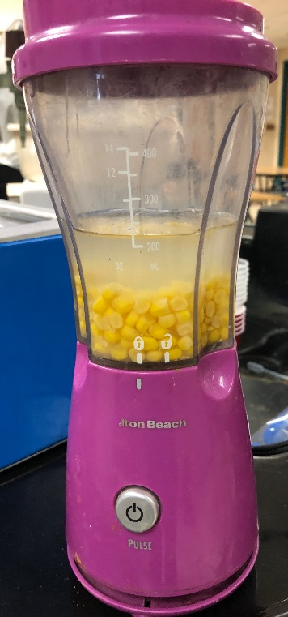

Slide 5
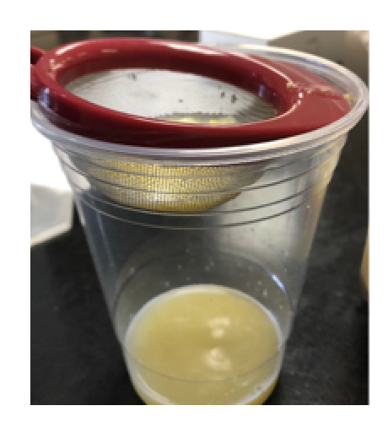

Slide 6
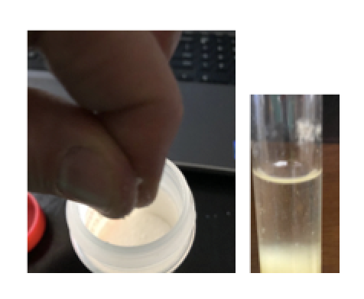

Slide 7
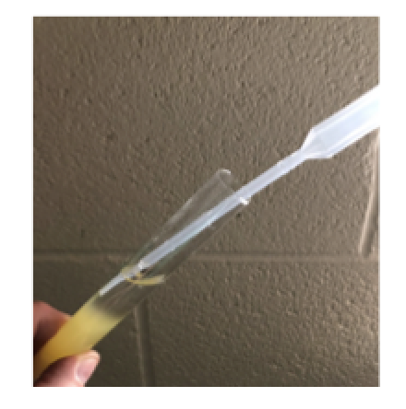

Slide 8
PART 2. Modeling DNA Structure
Follow instructions in handouts provided.

Slide 9
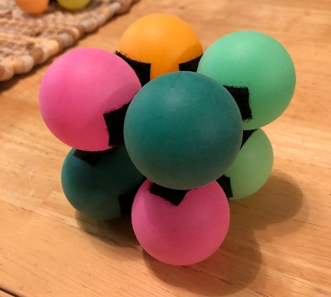
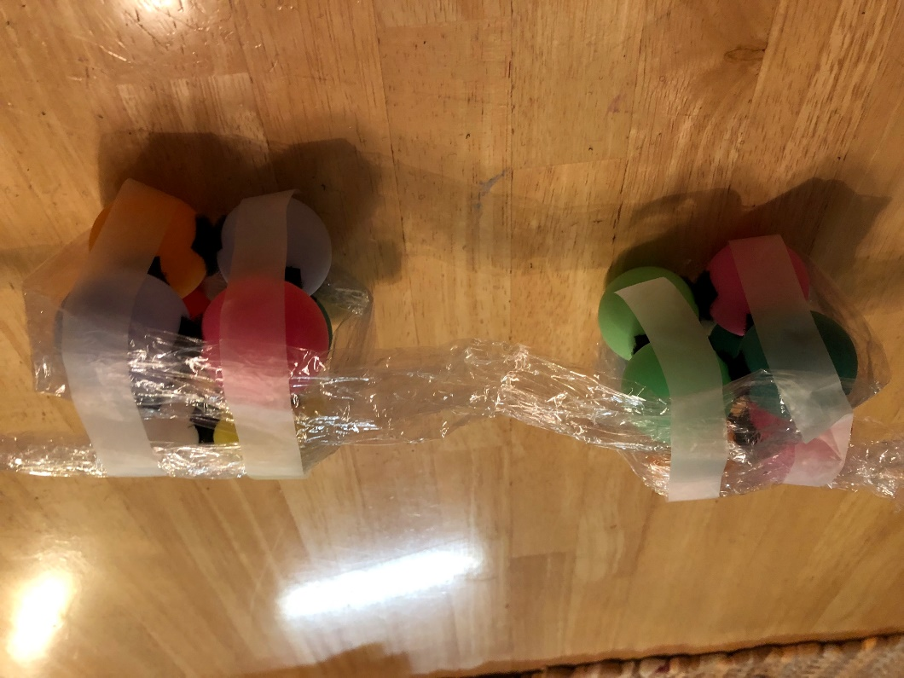

Slide 10
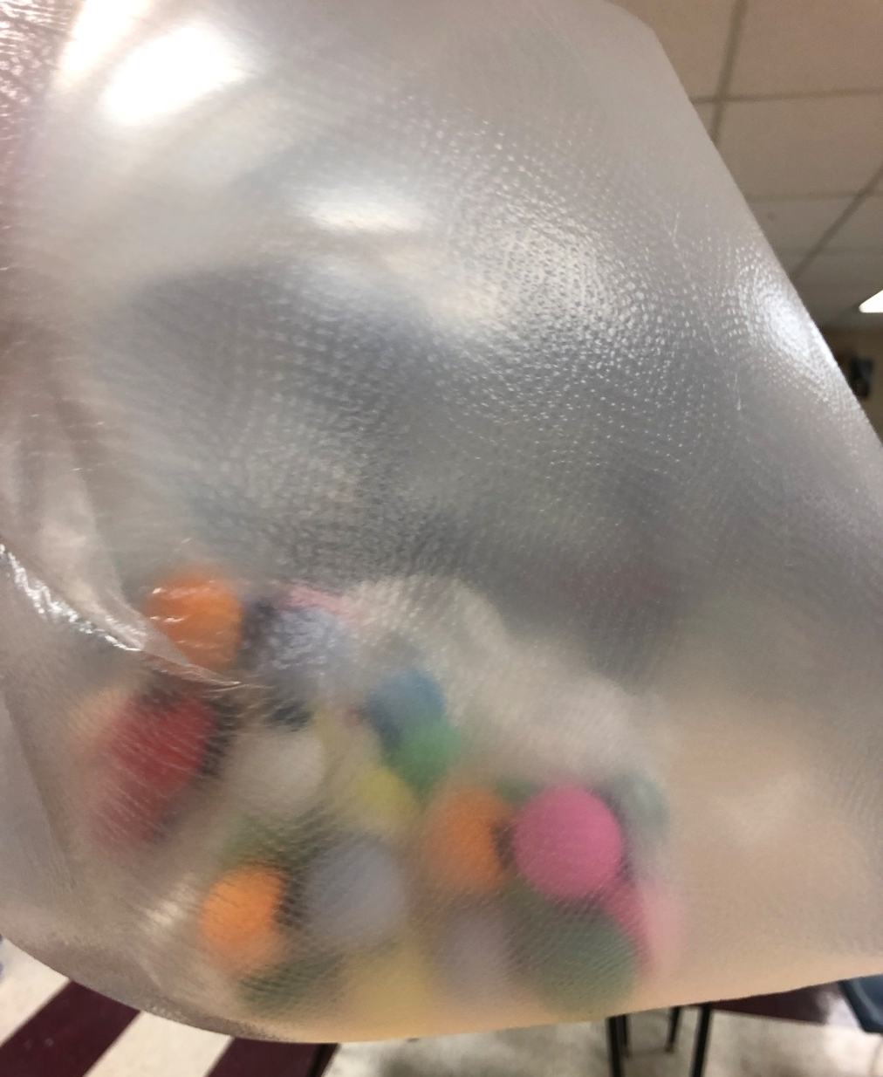

Slide 11
PART 3. How to get MORE DNA from CORN
Project goal: Your group’s goal is to obtain the greatest quantity of DNA from 3 tbsp. of the canned corn provided. You can only alter the materials we provided. Once you have changed your procedure, you will need to describe exactly why you made the changes that you did.

Slide 12
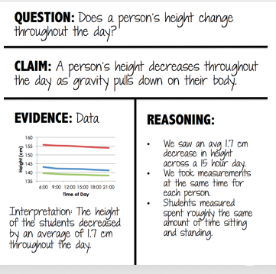
White boarding Activity for Student Groups
Attempting to get the greatest quantity of DNA from 3 tbsp of Canned Corn.

Slide 13
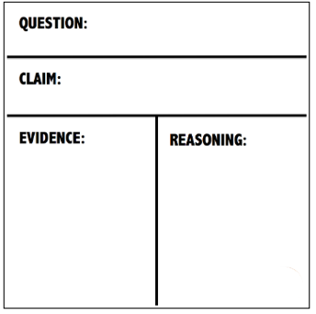
Claim Evidence Reason

Slide 14
The Question for all groups to work through is… How can you get the DNA out of the Cell Nucleus and then the Cell?

Slide 15
Questions: ????
Suggestions?

