Slide 1
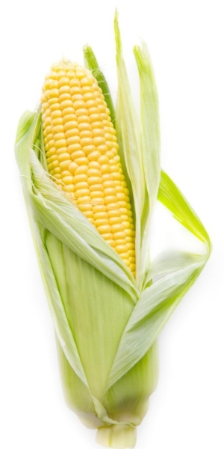
Hybrids
DNA Analysis of Traits!

Slide 2
Who is this man?
Take a good long look!
You will have to identify this man again!
What features would you write down to help you identify him later on?

Slide 3
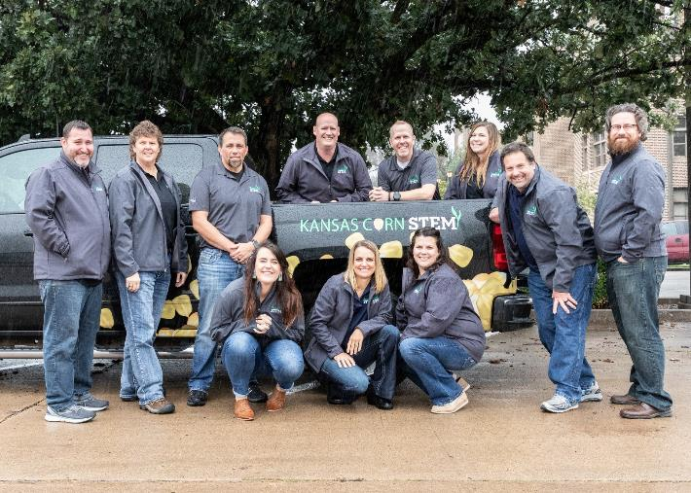
Which one was he?

Slide 4
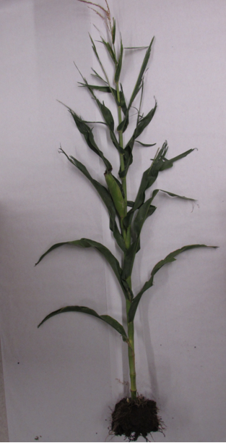
Check out this plant….
Don’t forget to write down its major features!

Slide 5
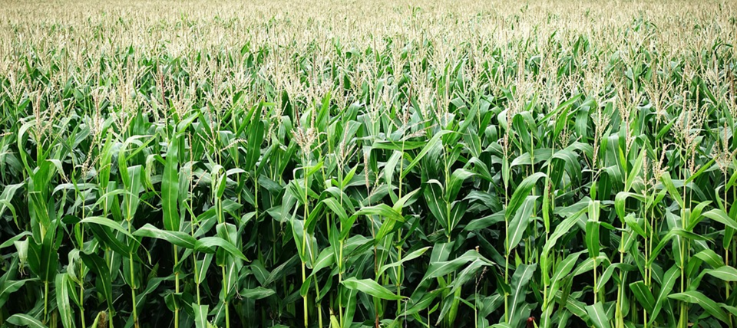
Which plant was it?

Slide 6
Macro Differences Vs Micro Differences
Macro- large features we can use to help us distinguish between individuals or items.
Micro- What are some examples???

Slide 7
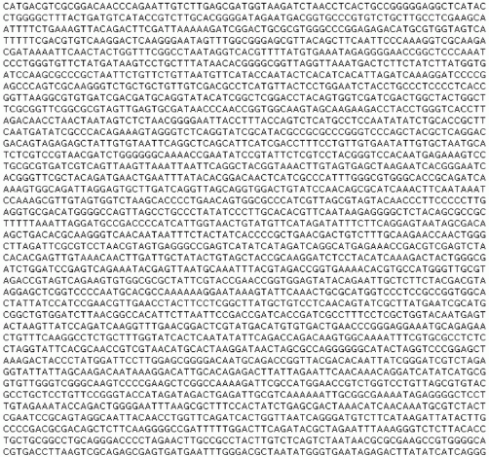
Comparing DNA!
Number off! 1-4
Each group member gets a different sequence of DNA!
How many differences are there in your sequences?
How can we compare?
Letter by Letter?

Slide 8
Oh tell me there’s another way!!!
Analyze your DNA…
Go through and look for each of these sequences.
If you find the sequence, mark it with the appropriate color, then cut right after the mark!
Repeat for all four sequences!

Slide 9
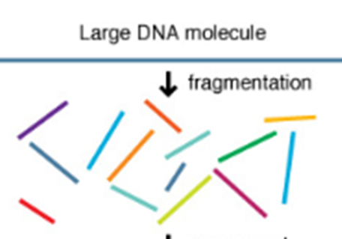
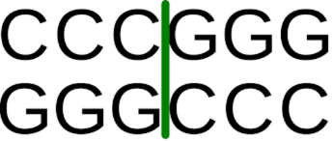
Restriction Enzymes!
They do the heavy lifting..
They are programmed to cut at specific sequences.
Anytime they see that sequence they cut!
they will cut that piece of DNA into two pieces
If the DNA is the same then the 2 resulting fragments will be the exact same sizes from both DNA samples!

Slide 10
Compare!
How many fragments do you have?
How long are your fragments?
Did all the Restriction Enzymes work?
Which ones worked? Which did not?
Branch out and find someone a similar DNA sequence!

Slide 11
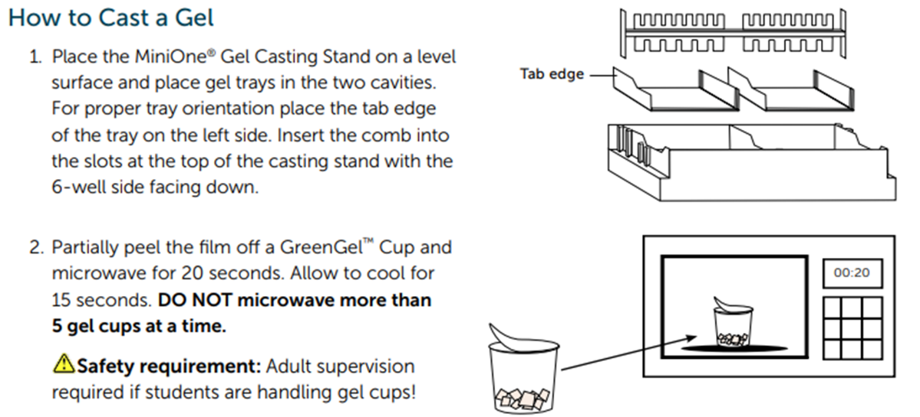

Slide 12
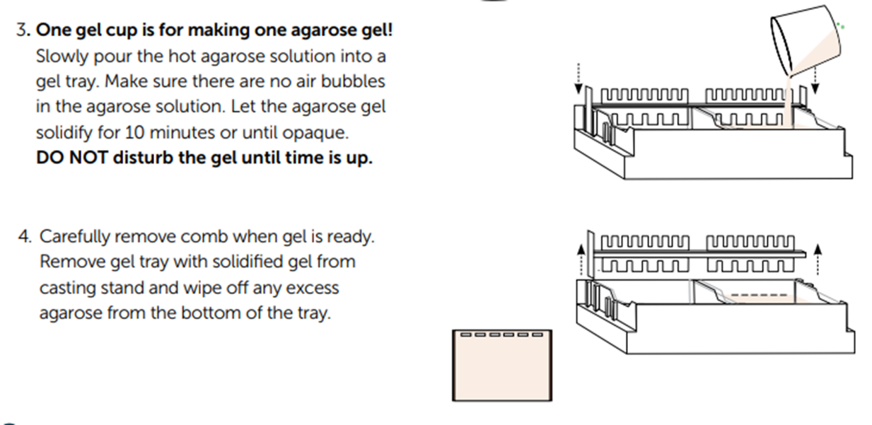

Slide 13
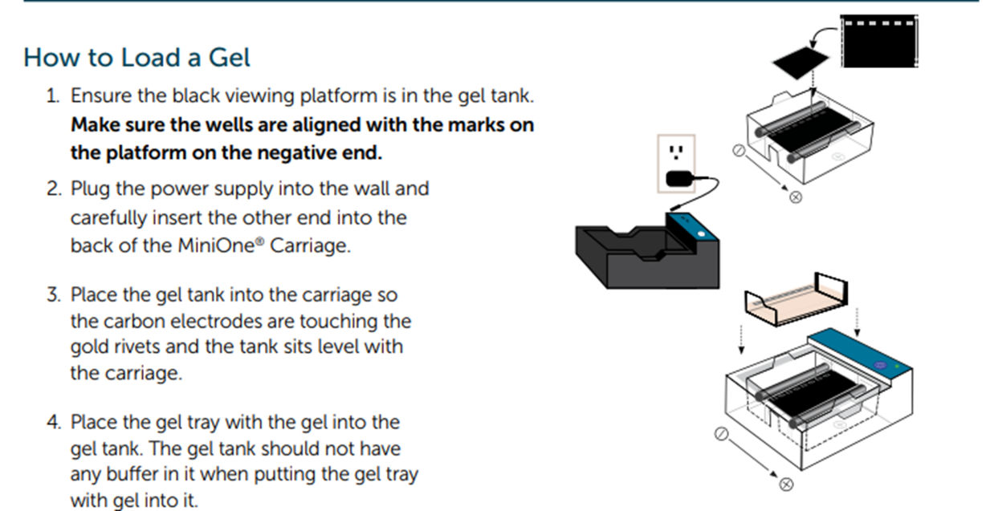

Slide 14
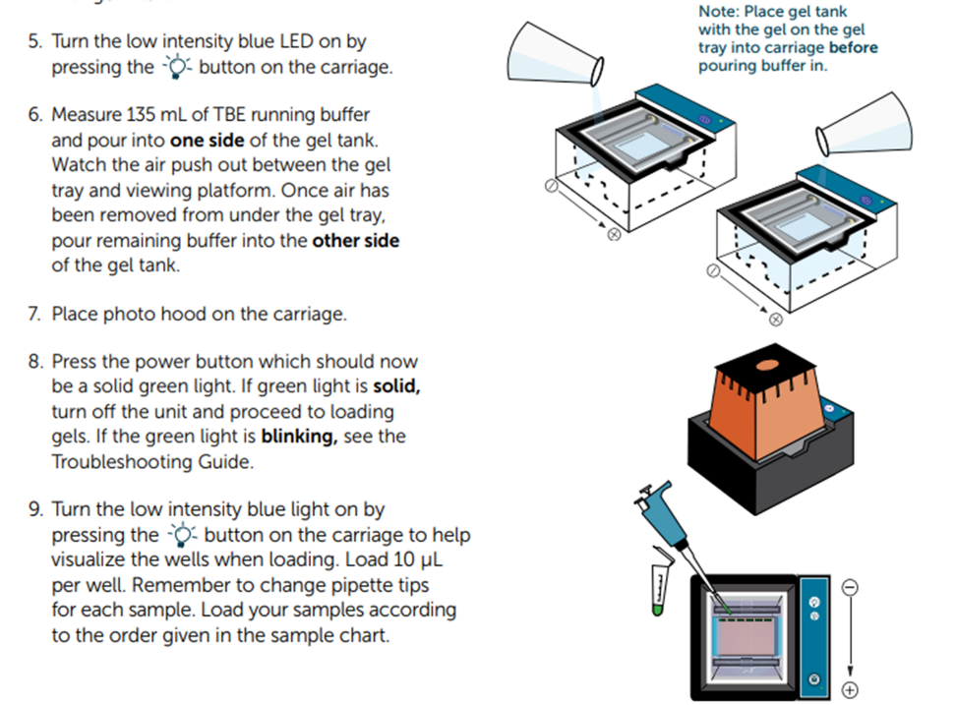

Slide 15
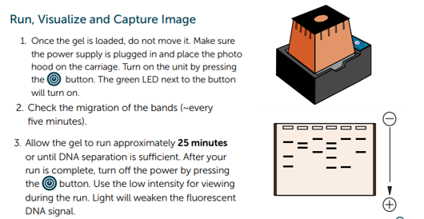

Slide 16
And they are off! Let’s model what is happening!
In your group…
Race down your lane…
Head for the finish line but you can’t separate!

Slide 17
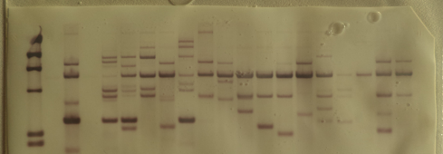
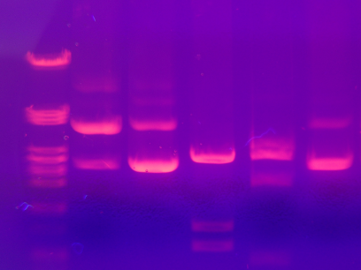
What is happening???
DNA has a Negative charge
Opposites Attract! When a charge is applied it will move towards the positive electrode.
Bigger fragments move slower through the gel
Their bands are closer to the wells
Smaller fragments move fast through the gel
Their bands are farther from the wells.

Slide 18
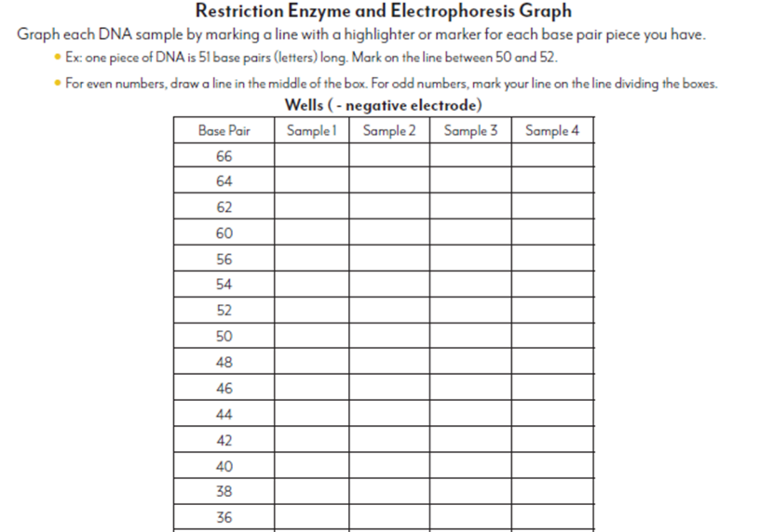
Finish up your Modeling Activity!

Slide 19
Viewing the final results!

Slide 20
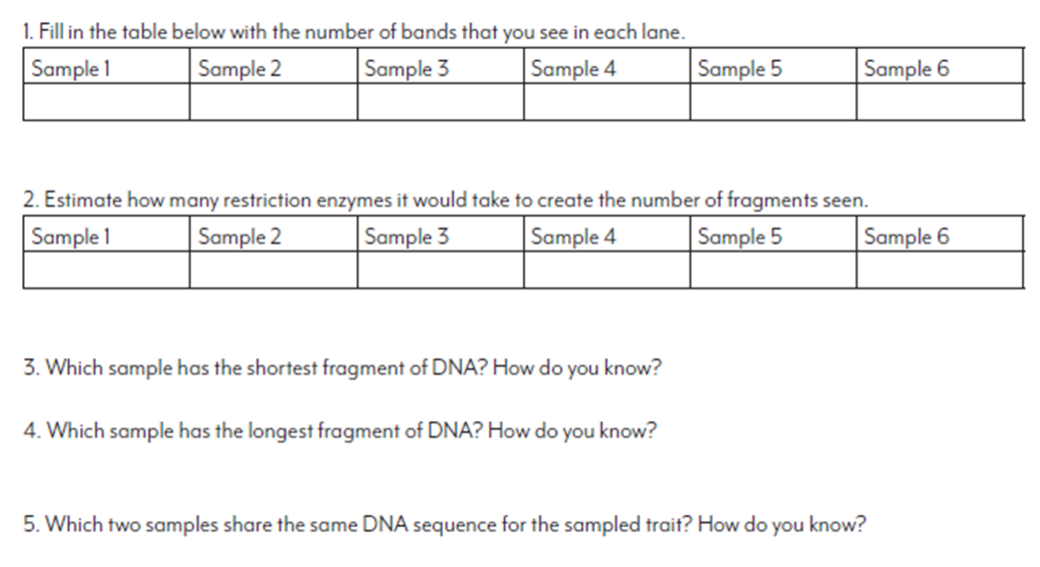
So which plants have the same trait?

Slide 21
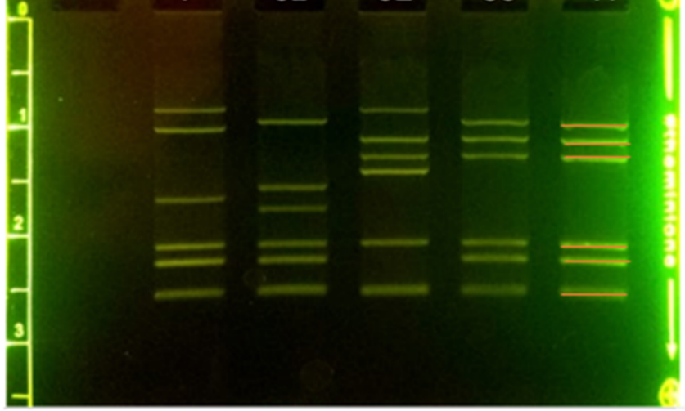

Slide 22
Budget
This lab is made possible with the support and content contributions of the Kansas Corn Commission.

