Slide 1
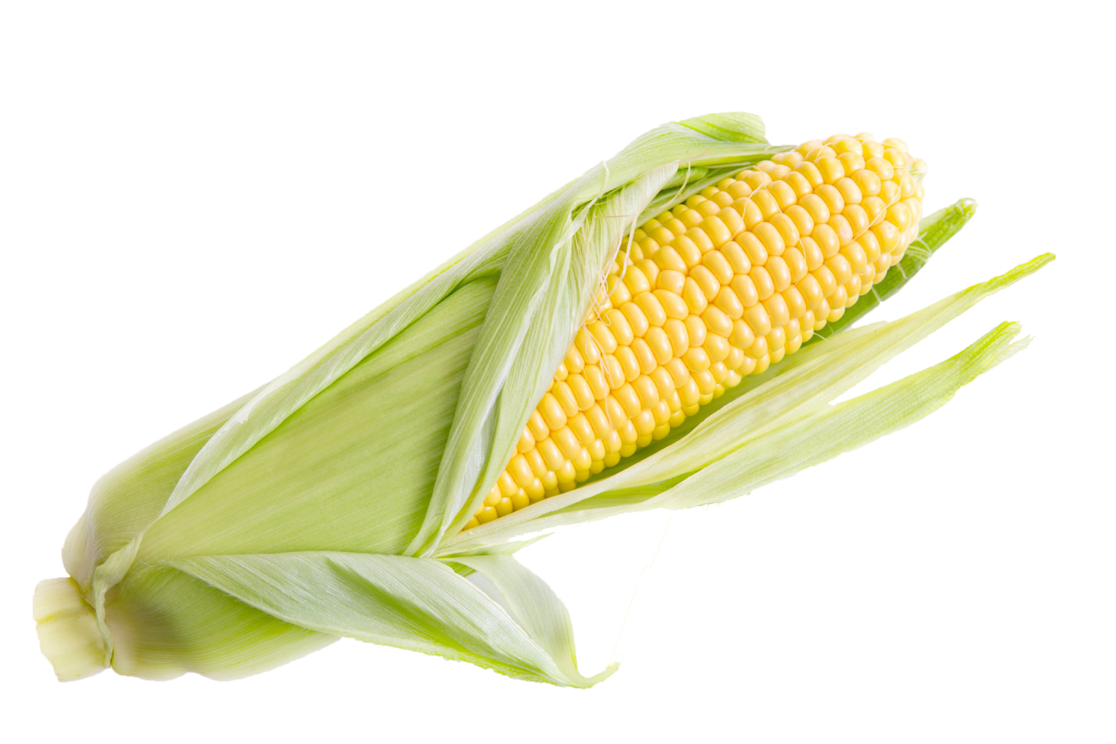
Kansas Corn:
Soil Sleuths
Kansas Corn - Seed to STEM - kscorn.com
Twitter: #kansascornSTEM
@kansascornSTEM

Slide 2
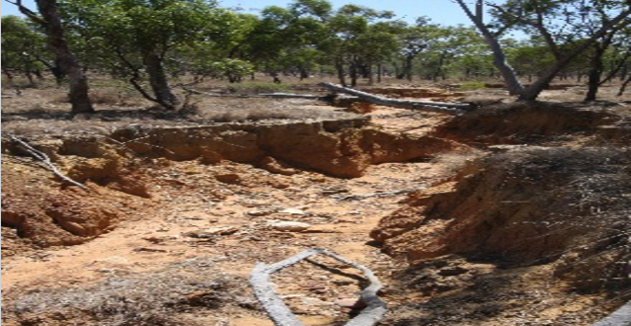
Phenomena

Slide 3
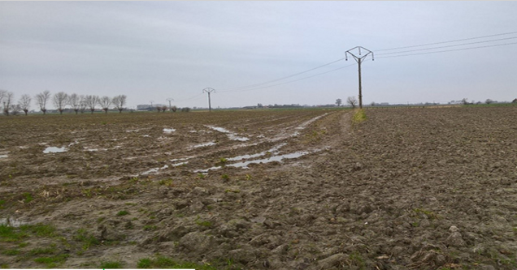
Phenomena

Slide 4
Thoughts on Soil
What is soil?
How is soil different from dirt?
How is soil formed?
What role does soil play in plant production?
Depletion of nutrients from soil.
What can be found in soil?
Notes:
Soil is minerals, air, water, living matter and decaying matter
Difference from dirt: disassociated from ecosystem. Dirt is dead and lacks the nutrients for plant growth. Example: dirt under fingernails
How is soil made: weathering of parent material-aka-rocks
What is found in soil: minerals, water, air, organic material living and non living

Slide 5
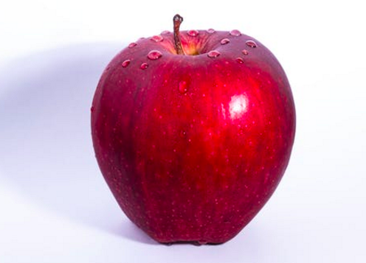
Earth As an Apple
S1 in book
Video Link:
https://vimeo.com/128288736

Slide 6
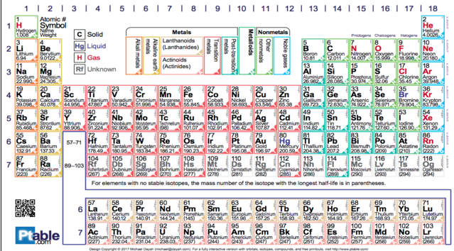
Essential Nutrients and Elements
Notes:
Humans:
Carbon
Oxygen
Hydrogen
Nitrogen
Calcium, phosphorus,etc.
Plants:
Nitrogen
Phosphorus
Potassium
Hydrogen
Carbon
Oxygen

Slide 7
Representative Sample When collecting
Representative sample
Non Representative sample

Slide 8
Dry Soil Mystery
Congratulations on your new position as an agronomist for the Kansas Corn Commission! All the hard work and study that you have been putting in has finally paid off and we know that you will do wonderful. Unfortunately, some of the soil sample bins were knocked off the counter and have been mixed up. We really need to get started planting as soon as possible but MUST make sure we are using the best soil for the corn. Use your investigation skills to help identify which of the three soils should be used. To help, fell free to record your observations on the Dry Soil Mystery recording sheet.
S6 in Soil Sleuths Lab

Slide 9
Dry Soil Investigation
S3-S5 in Soil Sleuths Lab

Slide 10
Soil and Air Space Investigation
S7 in Soil Sleuths Lab

Slide 11
Soil and Water Investigation
S8-S9 in Soil Sleuths Lab

Slide 12
Mudwatts
Seed to Stem 1.0 “Starts with Soil”
“Soil Sleuths” is the updated version
Mudwatts are one part of this

Slide 13
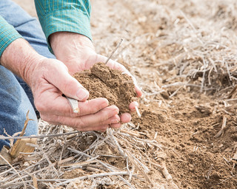
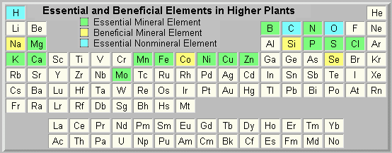
What can be found in soil?
Interactive plant essential elements website

Slide 14
What else is in soil that the average person does not think about?
Microbes

Slide 15
What are Microbes?
Microbes, short for microorganisms, are tiny organisms that are too small to be seen with the naked eye.
Can be a virus, bacteria or fungus.
Often are given a “bad rap” as they cause disease and illness.
Are ESSENTIAL for nutrient recycling

Slide 16
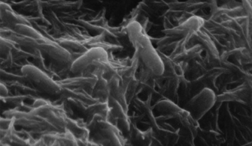
Meet Shewanella oneidensis….aka Shewie
Environmentally friendly bacteria that can consume toxins such as radioactive waste and petroleum spills.
Live everywhere on earth such as mountain top soil or ocean sediment
Metabolizes metals and release electrons through appendages known as “nanowires”
Nanowires allow one Shewie to connect to thousands of others creating a network which transfers electrons.
Being researched by NASA to aid
in future space travel.

Slide 17
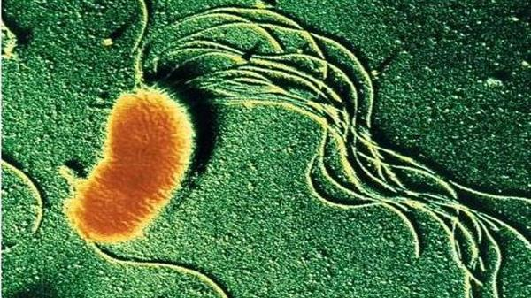
Meet Geobatcher Sulfurreducens…..aka Geo
Environmentally friendly bacteria
Craves anaerobic environments deep in the soil or ocean sediment
Metabolizes iron, sugars and other nutrients and release electrons through appendages known as “nanowires”

Slide 18
How does a micro fuel cell (MudWatt) cell work?
Using worksheet S10 students can read about and summarize how a micro fuel cell works.
Read page 2 of the booklet accompanying the Mudwatt
Watch this video.
Using the procedures on S10, develop your hypothesis and test the impact of soil type on power production.

Slide 19
Setting up your MudWatt
Read page 8-11 of the booklet accompanying the Mudwatt
Watch this video.

Slide 20
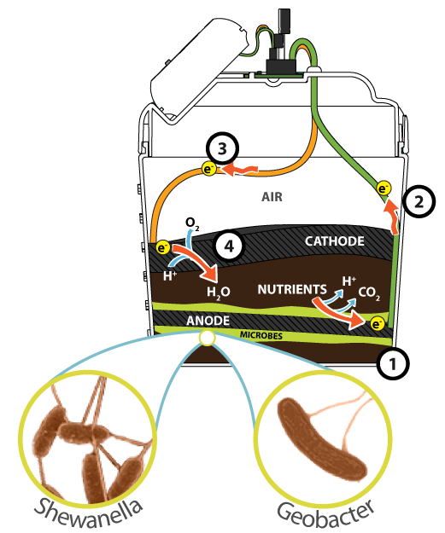
Electron Flow Through the MudWatt
Bacteria consume the nutrients in mud/soil and expel electrons that come in contact with the anode (-) layer.
The electrons make their way up the anode wire to the Hacker board to give power to the LED or clock.
Electrons then travel back to the mud/soil through the cathode (+) wire.
Electrons some in contact with oxygen and protons in the soil forming water.
Repeat trillions of times per second.

Slide 21
Monitoring your MudWatt
Give the MudWatt 3-5 days for the microbes to get the process of electron production established and produce enough power to illuminate your LED bulb.
Using S11 students can record their observations
Using the MudWatt Explorer App students can measure the power output of their individual MudWatts.

Slide 22
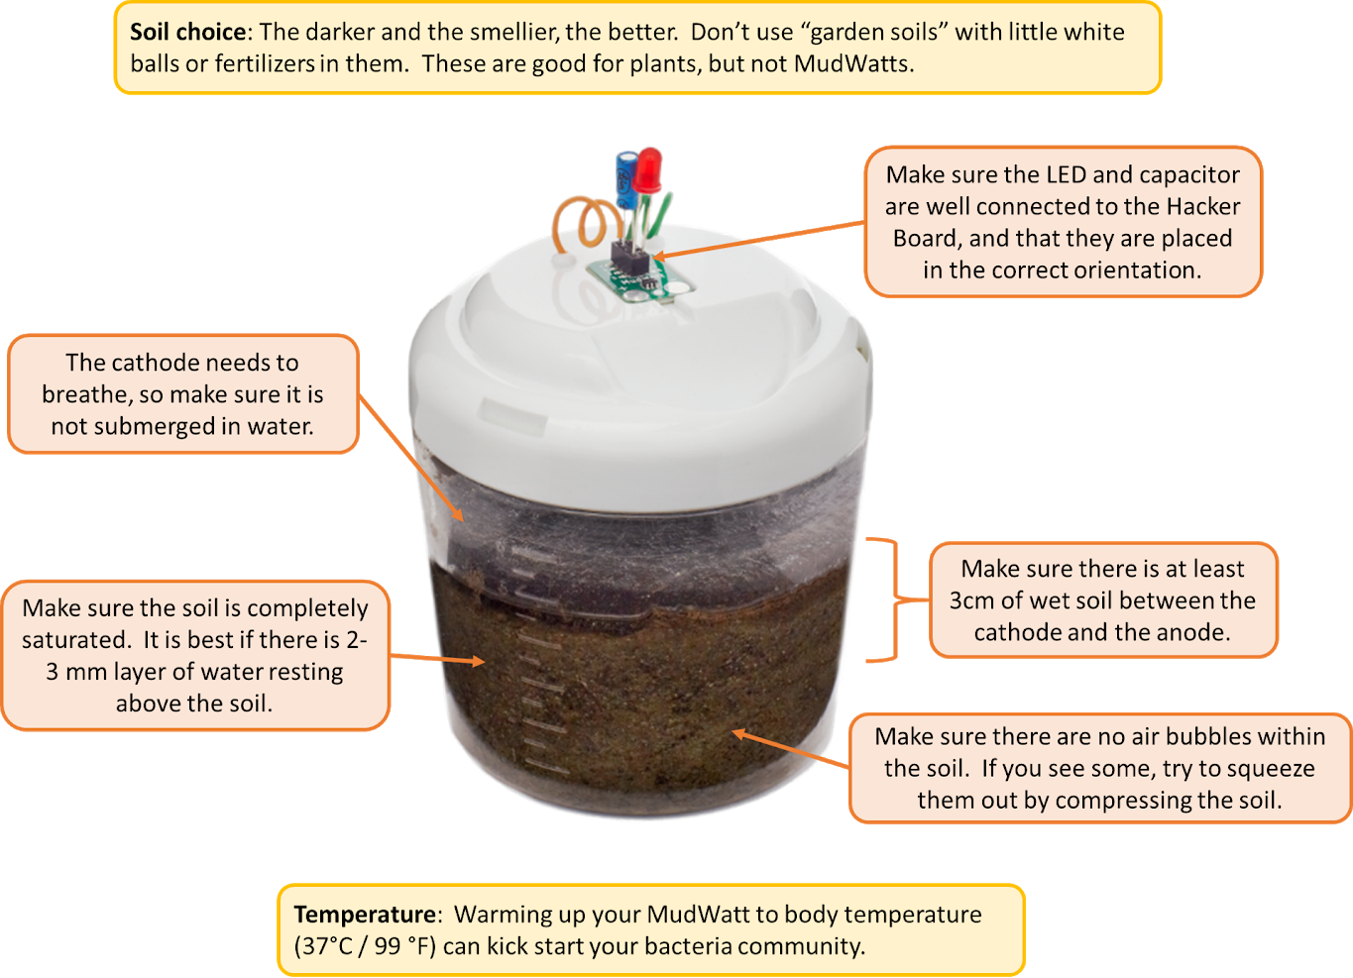
Trouble Shooting

Slide 23
Beyond the soil and microbes
Flow of electricity
Voltage
Current
Capacitors
Power

Slide 24
Brought to You By:

