Slide 1
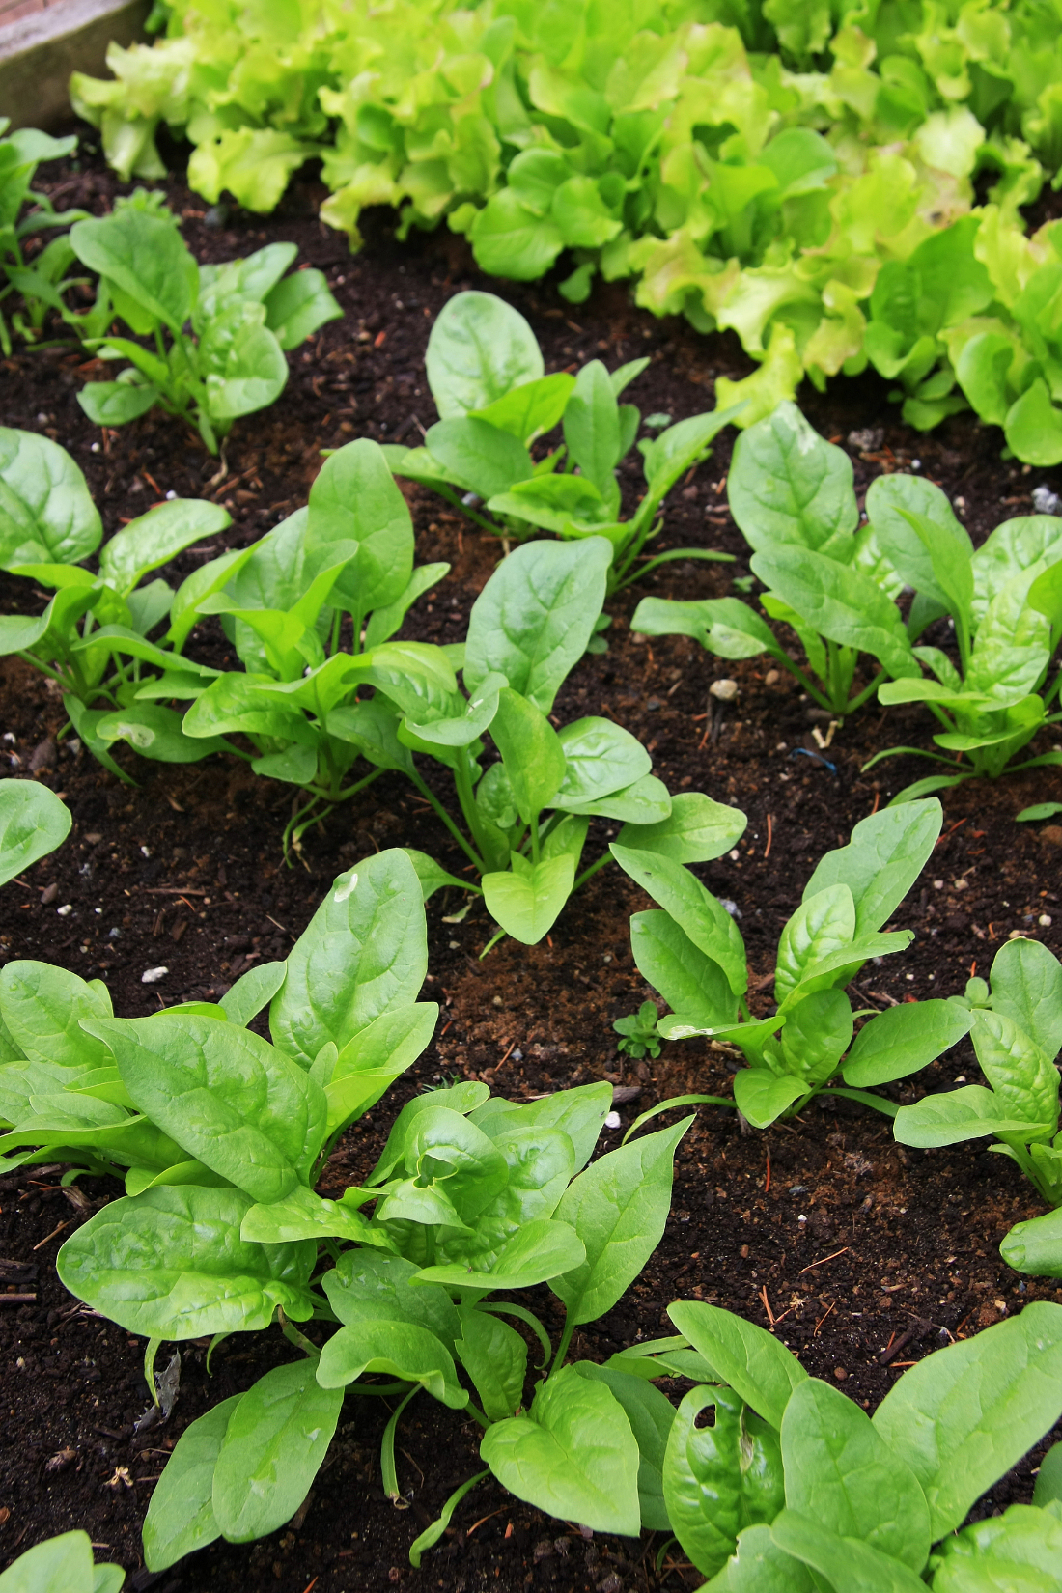
Soil Microbes

Slide 2
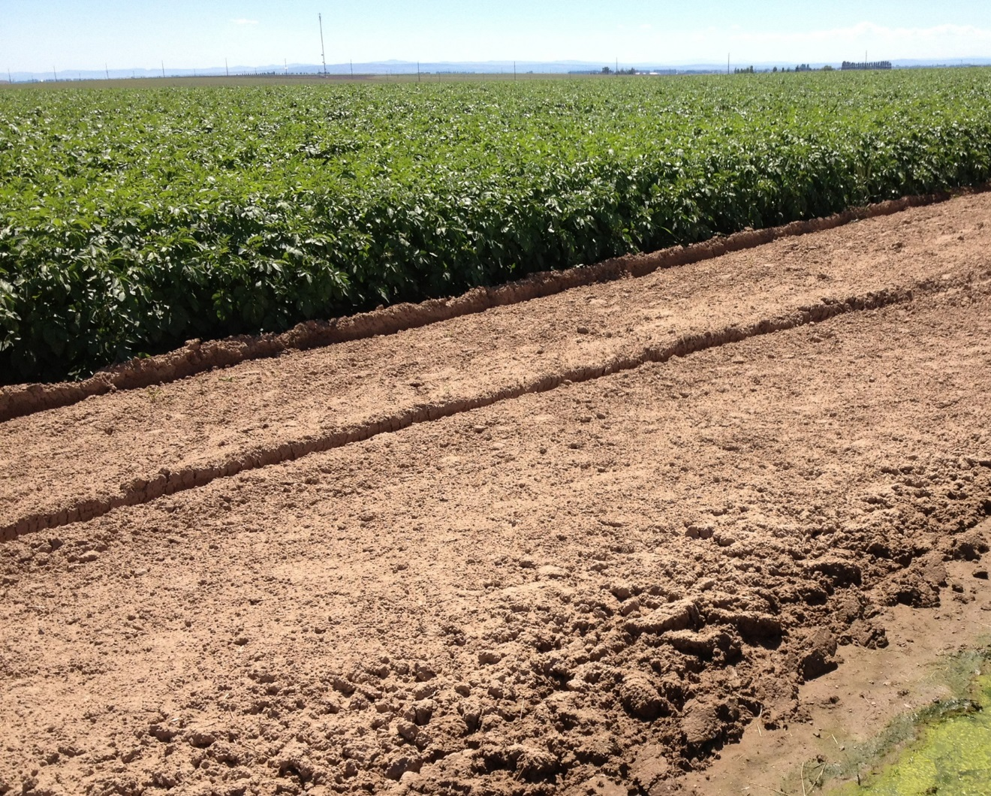
What is Soil?
Soil is the outer layer of the Earth. It is made of natural components - minerals, organic matter, liquids, gases and organisms. Soil is a medium for plant growth, stores and purifies water, influences the Earth’s atmosphere and is a habitat for organisms.

Slide 3
What can you see?
Use hand lenses to help you identify different features in your soil sample.

Slide 4
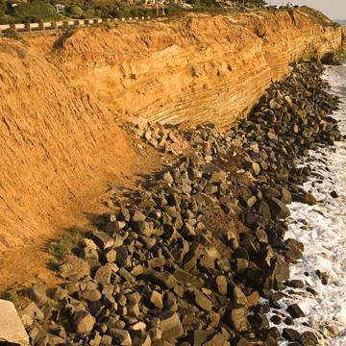
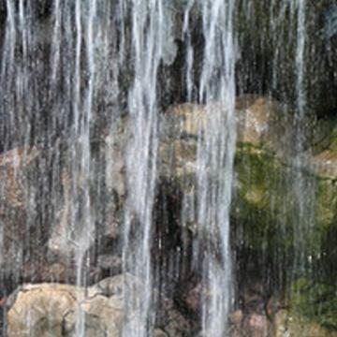
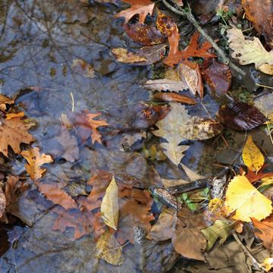
Soil is created by the processes of:
Erosion
Weathering
Decomposition
Notes:
The characteristics of a soil are influenced by five major factors during its formation. The famous mnemonic for the soil forming factors is ClORPT.
Climate – The amount of precipitation and temperature affects the rate of weathering and physical, chemical and biological processes.
Organisms – Living organisms break down organic matter, become organic matter when they die, and create pore spaces in soils.
Relief – The topography, or slope, of the land determines the type and depth of the soils.
Parent Material – Soils inherit qualities from the materials from which they are made. Materials can be deposited by wind and glacial activity, volcanic debris, and bedrock.
Time – Soil is continuously changing so the length of time that the soil has been affected by the above factors influences the soil composition.

Slide 5
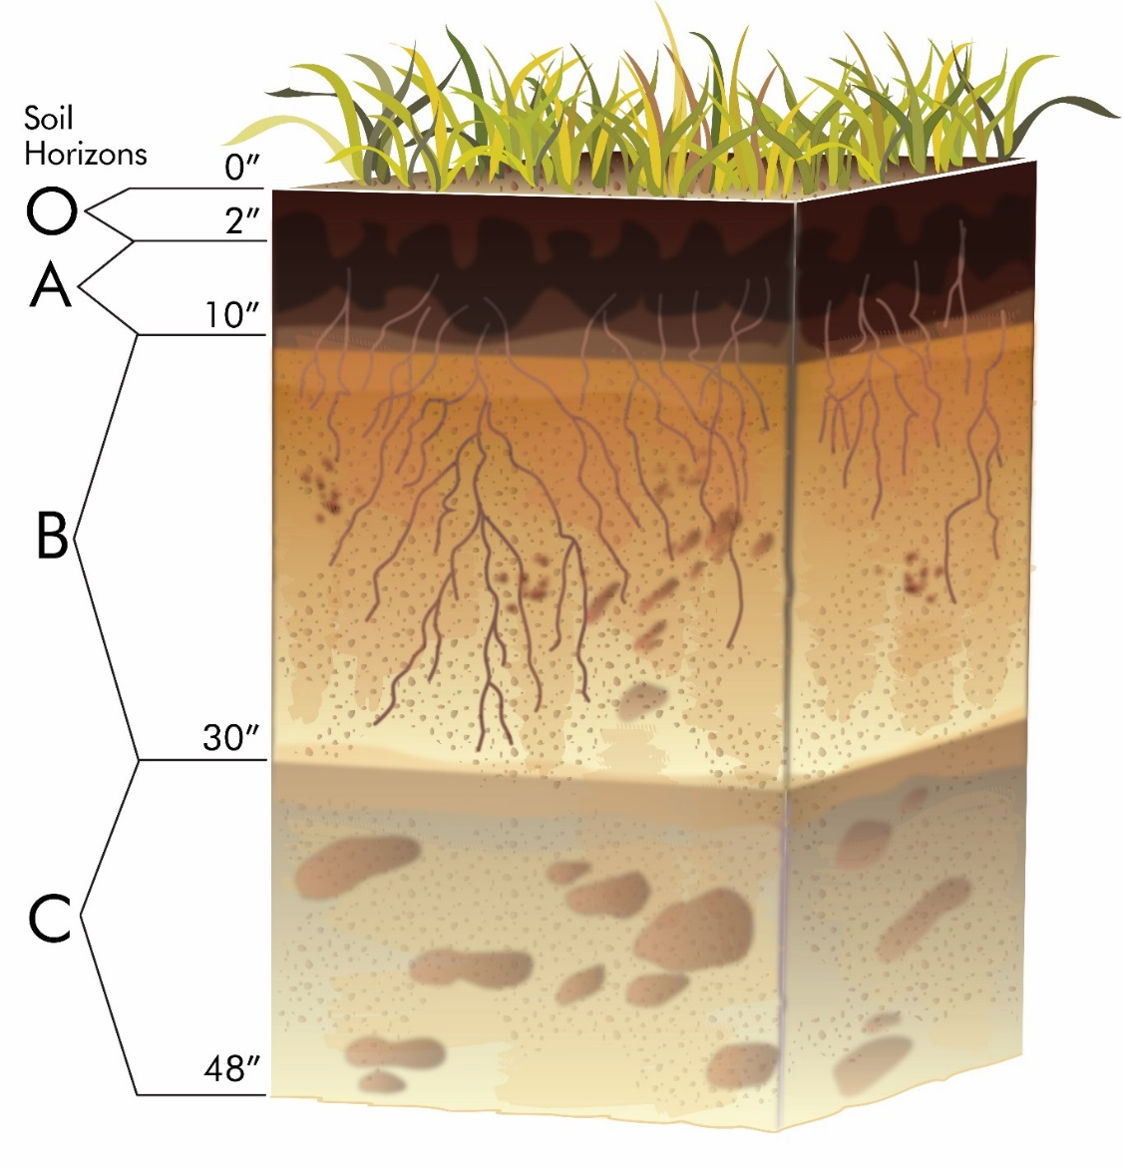
Soil Horizons
A cross section of soil will show soil horizons. The characteristics of each soil horizon determine what happens in that layer and how it can be used.
Notes:
Soil horizons are defined by physical features – some of which are easily seen like color, texture, structure, and thickness – and others that are less easily seen like mineral and chemical content. Soil separates into layers due to the influence of air, water, solar radiation and plant material at the surface of the soil where it is exposed to the air. Since weathering of the soil occurs at the surface the upper layers differ the most from the parent material. Deeper layers are most like the parent material.

Slide 6
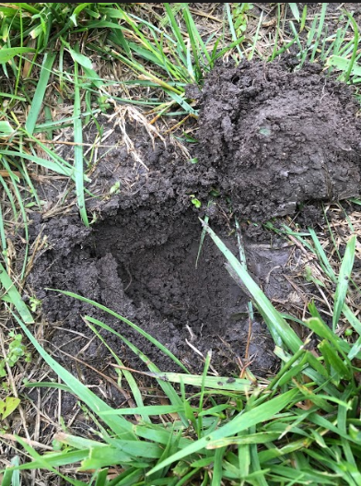
What horizon?
Just below the surface, top 2-4 inches of soil?
Why sample here and not further down?

Slide 7
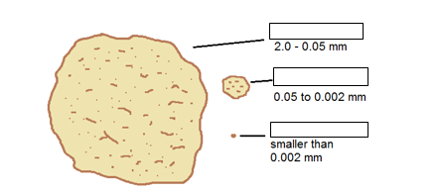
Particle Size
Sand
Silt
Clay

Slide 8
Soil Texture
Soil texture is determined by the size and proportion of the particles that make up the soil.
SIZE & SURFACE AREA OF SOIL PARTICLES
PARTICLE TYPE | DIAMETER | NUMBER of PARTICLES/g | SURFACE AREA sq cm/g
Very coarse sand | 1-2 | 90 | 11
Course sand | 0.5-1.0 | 720 | 23
Medium sand | 0.25-0.50 | 5,700 | 45
Fine sand | 0.10-0.25 | 46,000 | 91
Very fine sand | 0.05-0.10 | 722,000 | 227
Silt | 0.0002-0.05 | 5,780,000 | 454
Clay | <0.002 | 90,300,000,000 | 8,000,000
Source: Foth, H.D. and L. M. Turk, Fundamentals of soil science. Wiley, New York (1972).

Slide 9
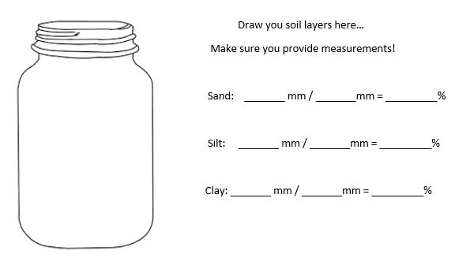
What type of soil do we have?

Slide 10
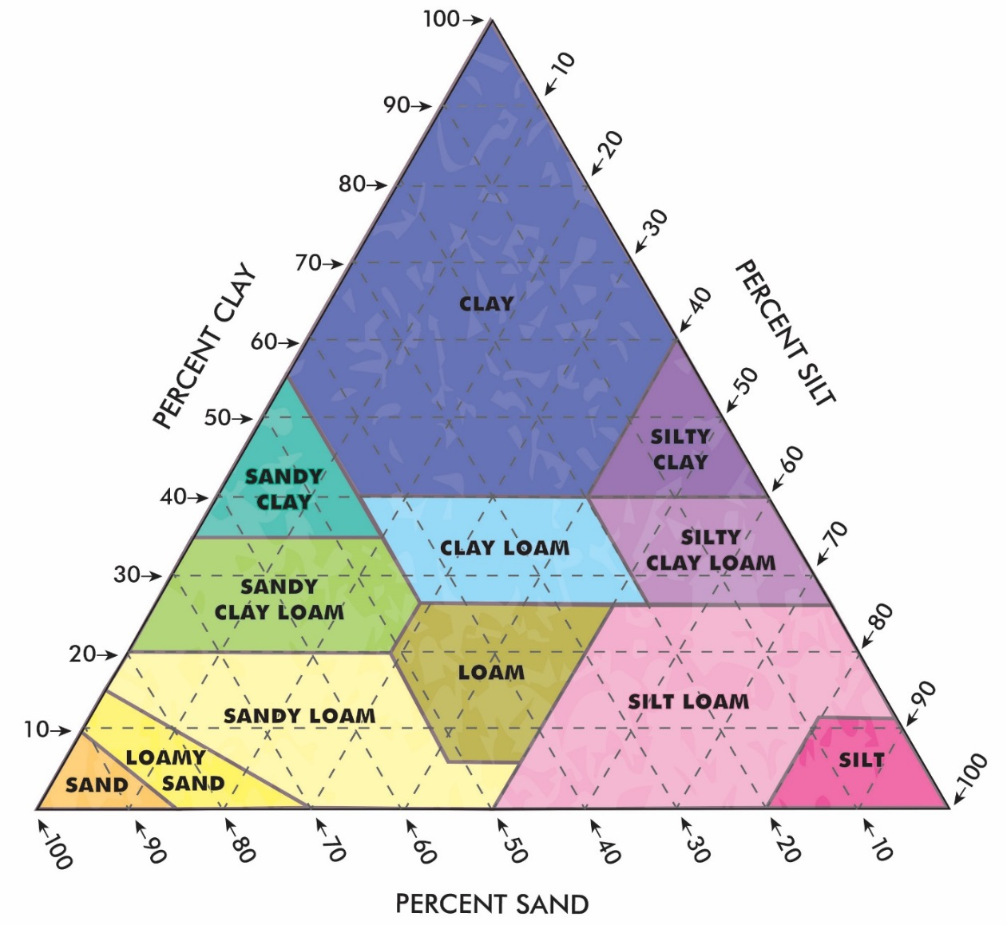
Soil Texture Triangle
Every soil can be classified by using the Soil Texture Triangle.
Follow the directions of the arrows.
Using your percentages, find where your soil sample would land!
These were all taken in a 2 mile radius… should there be similarities? Should there not be?
Notes:
Sandy soil is described as soil material that contains 85% or more sand where the percentage of silt plus 1.5 times the percentage of clay does not exceed 15%. Silt soil is described as soil material that contains 80% or more silt and less than 12% clay. Clay soil is described as soil material that contains 40% or more clay, less than 45% sand and less than 40% silt. Loam soil is the most favorable texture for growing plants. It is 20% clay, 40% silt and 40% sand.

Slide 11
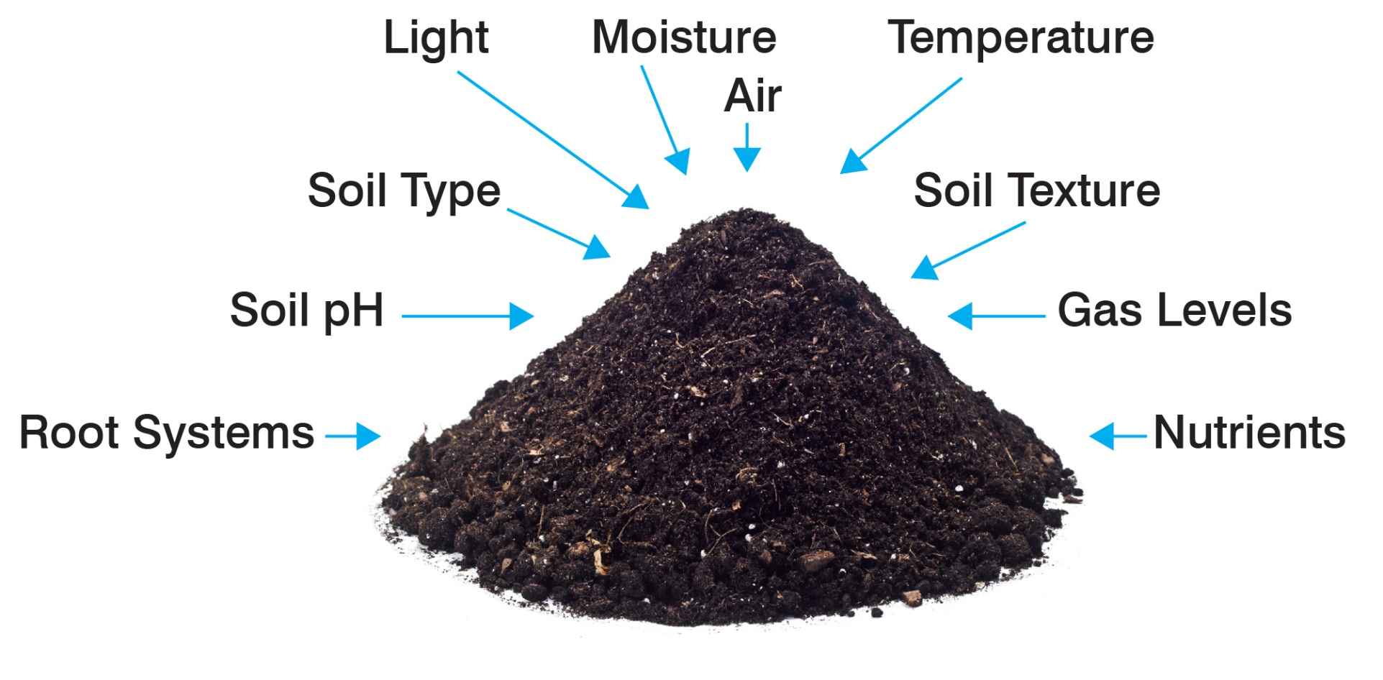
In the soil ecosystem animals, plants and microbes interact with nonliving components.
How does each one change the soil?
Notes:
Water and air are critical components of the soil ecosystem. The amount of trapped water and air is changeable and can account for up to half of the soil volume. The quantity of mineral matter and organic matter are usually fixed. Organic matter can account for up to 6% of the soil volume. Living organisms, even though they are numerous, comprise less than 1% of the total soil volume.

Slide 12
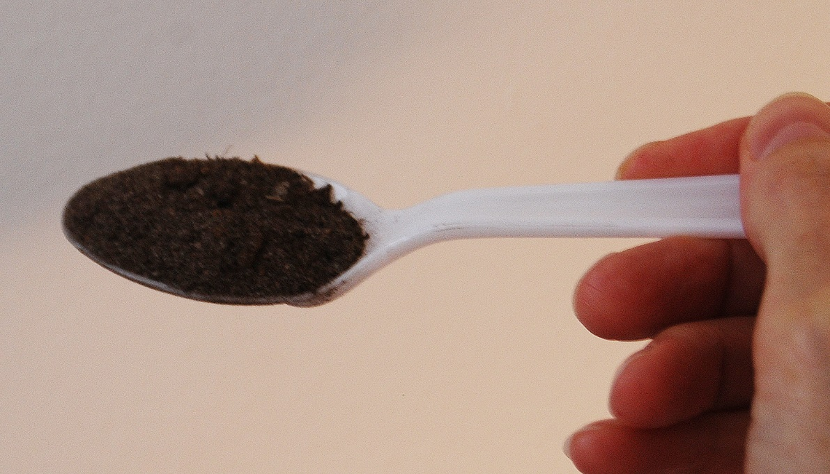
A teaspoon of healthy soil contains billions of microbes.
There are 5 major types:
bacteria
actinomycetes
fungi
algae
protozoa
Notes:
There are two broad categories of soil microbes. Naturally occurring, indigenous microbes help to define the soil community. They flourish or may become dormant as conditions become favorable or unfavorable. Allochthonous bacteria, or invader bacteria, are bacteria that are not part of the normal soil ecosystem and its activities. They can be introduced by diseased plants and precipitation, and intentional or unintentional application of materials like manure or chemical spills.

Slide 13
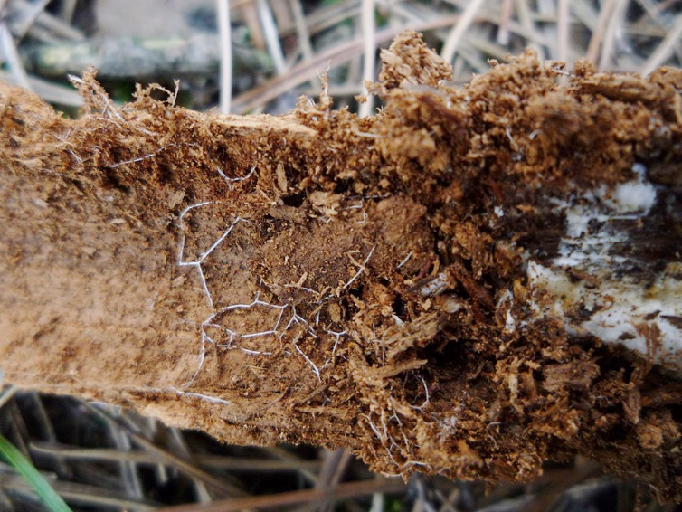
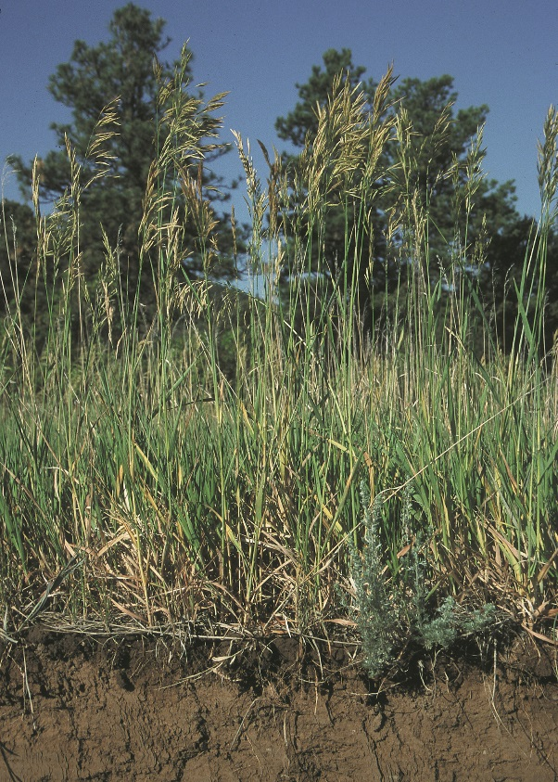
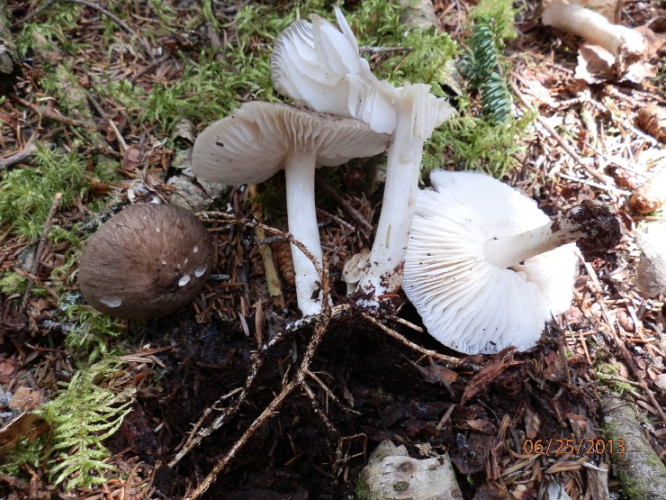
Rhizosphere – the interface between soil and plant roots
So much happens in such a tiny space!
Notes:
At the rhizosphere, the interface between soil and plant roots, the microbial diversity is determined by the genetics of the host plant, the physical and chemical characteristics of the soil, and the environmental conditions. A complicated association exists between the microbe population and the plant. In this narrow region, microbes convert minerals into forms that are usable by plants and protect plants from pathogens and other environmental challenges such as salinity and temperature extremes. Microbes in the rhizosphere may exist as a biofilm on plant roots.

Slide 14
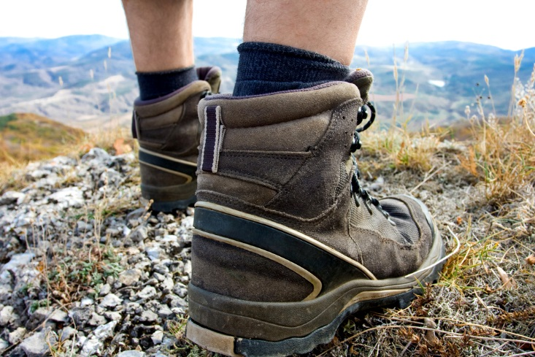
Biological Soil Crusts
Top 1 mm to 4 mm of soil
Stabilize soil
Affect water infiltration
Influence plant germination and growth
Susceptible to being crushed

Slide 15
Fertilizer
A fertilizer is an organic or inorganic material that is added to a soil to add or increase the amount of nutrients that are essential for plant growth.
N | Nitrogen
P | Phosphate
K | Potassium
What other Agricultural practices would influence the nutrient availability of the soil?
Notes:
Fertilizer can be applied to the soil in a natural form, such as manure, or in the form of a commercial fertilizer. A manufactured commercial fertilizer will list the names and percentages of the nutrients that it contains on the label. The most general fertilizers provide the macronutrients nitrogen, phosphorus (potash) and potassium – N, P, K – so the label will show the percentages for those nutrients. For example, a 24-2-8 fertilizer has 24% nitrogen (N), 2% available phosphate (P) and 8% soluble potash (K).

Slide 16
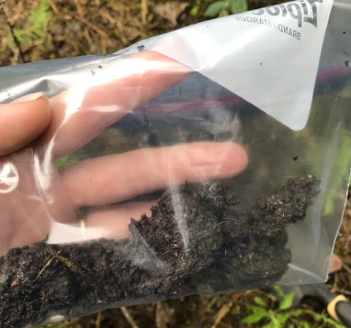
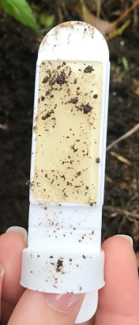
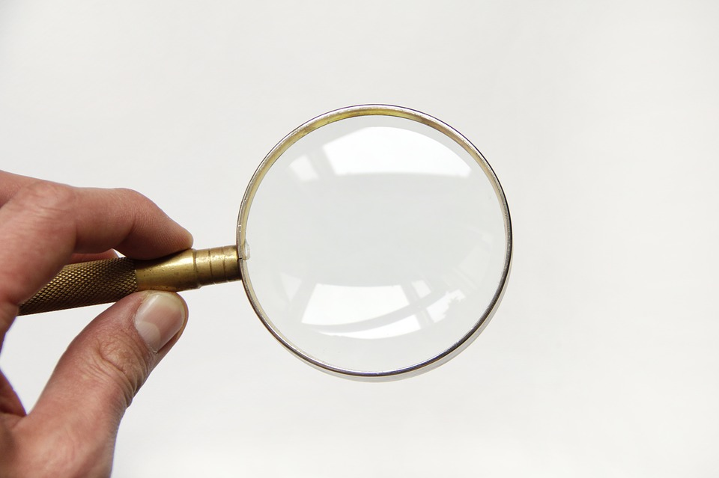
So how do we sample what we can’t see?
Collect
Culture
Classify

Slide 17
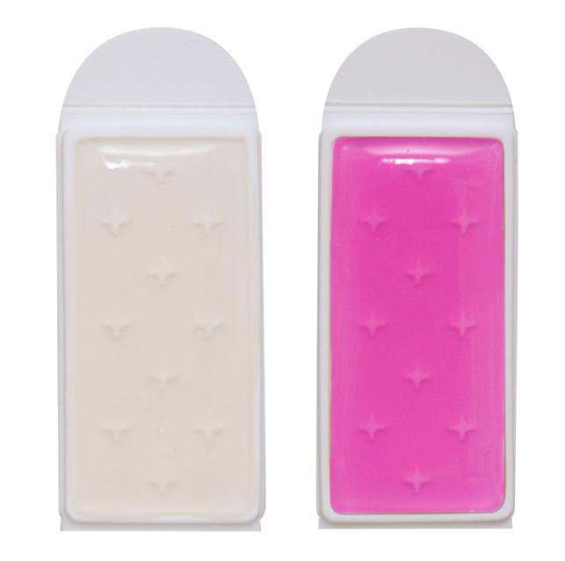
Using TSA/RB BioPaddles®
Paddle Support
Media Growth
Tryptic Soy Agar (Bacteria)
Rose Bengal
(Molds)
Paddle Handle
Plastic Vial

Slide 18
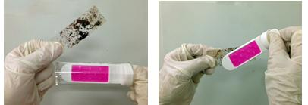
Using TSA/RB BioPaddles®
Sample a Biofilm
Also
Surface Contact Impression Technique of a Soil Sample
Dilutions Sampling of a Soil Sample
Root Wash Technique

Slide 19
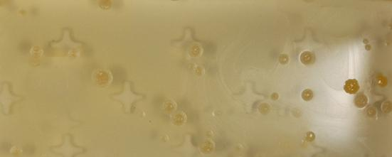
Soil Dilution Sampling
Example 2
A 10 g soil sample was thoroughly mixed with 990 mL bottled (assume sterile) water. A 40 mL aliquot of the 10⁻² dilution sample was contacted with the paddle agar surface. Paddle agar was incubated at 25 °C for 4 days.

Slide 20
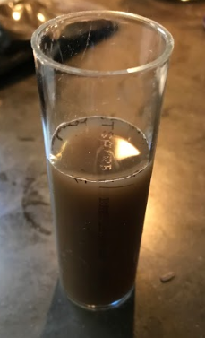
Dilation Sampling
5 grams of soil
50 ml of water.
Mix together and let the solids settle out of the solution.
Then pour into the vial
Immerse the paddle into the vial for 30 seconds, drain, shake off paddle, reinsert the paddle into the vial for incubation

Slide 21
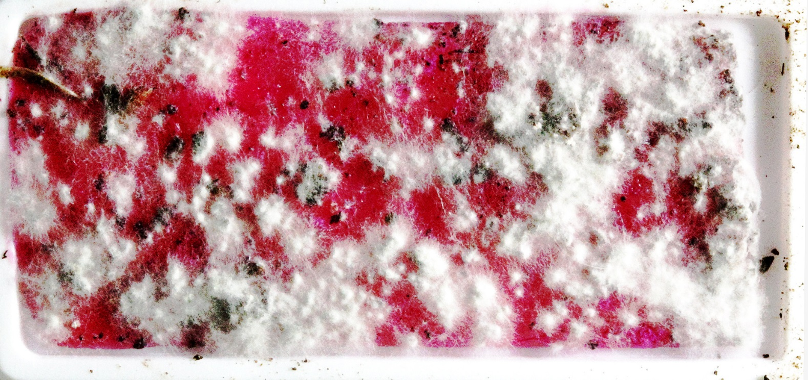
Soil Surface Contact Sample
Example 1
A RB paddle was pressed against a 1 cm deep potting soil layer. Paddle agar was incubated at 25 °C for 4 days and the paddle agar surface was photographed. Fungal colonies (early growth) were presumptively identified as Fusarium spp.
Courtesy: Luis Camus, MD

Slide 22
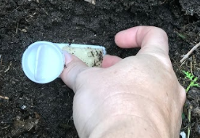
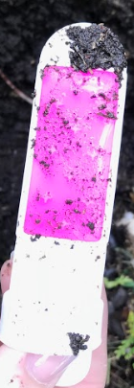
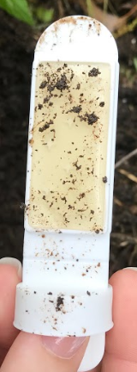
Contact Impressions
All vials marked with C!
Dig down 2-4 inches to expose the soil
Simply press the paddles firmly to the soil surface.
Shake off any loose particles
Re-insert into the vial for incubation.

Slide 23
Counting Colonies
Enumeration is quantifying the number of bacteria cells
Unit of measure is the colony forming units (CFU)
The results are given as:
CFU/mL (colony forming units per milliliter) for liquids CFU/g (colony forming units per gram) for solids
CFU/cm² (colony forming units per square cm) for surfaces
Microbiologists report microbial growth as the number of colony forming units (single living bacteria cells) per milliliter of liquid (CFU).
A total colony count (TCC) is made by counting all colonies

Slide 24
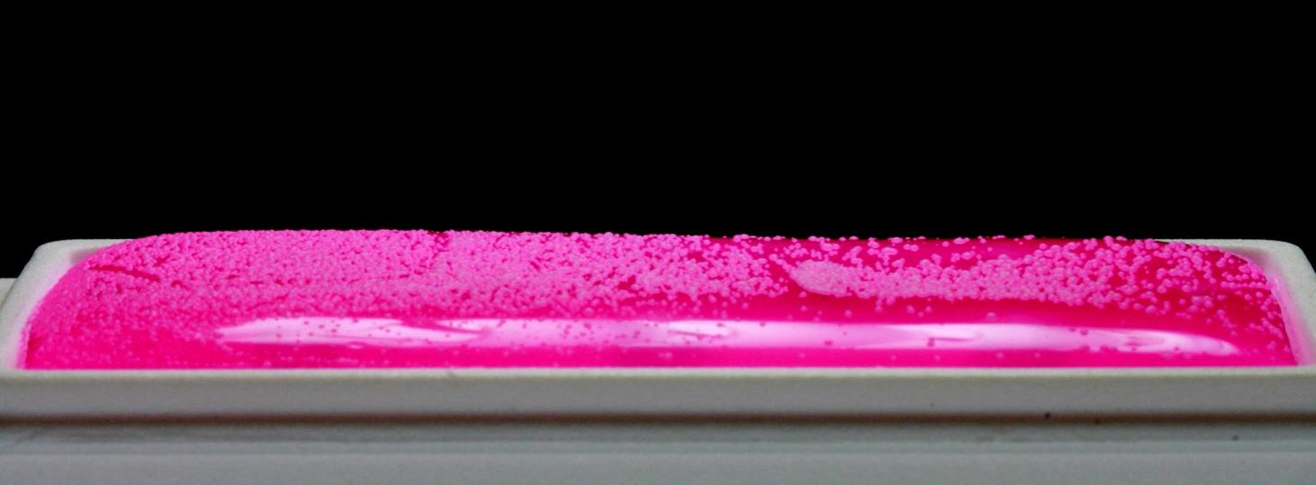
Counting Colonies
Example:
A surface biofilm of Saccharomyces cerevisiae was created and a paddle contact sample was taken. Quantify the colonies.

Slide 25
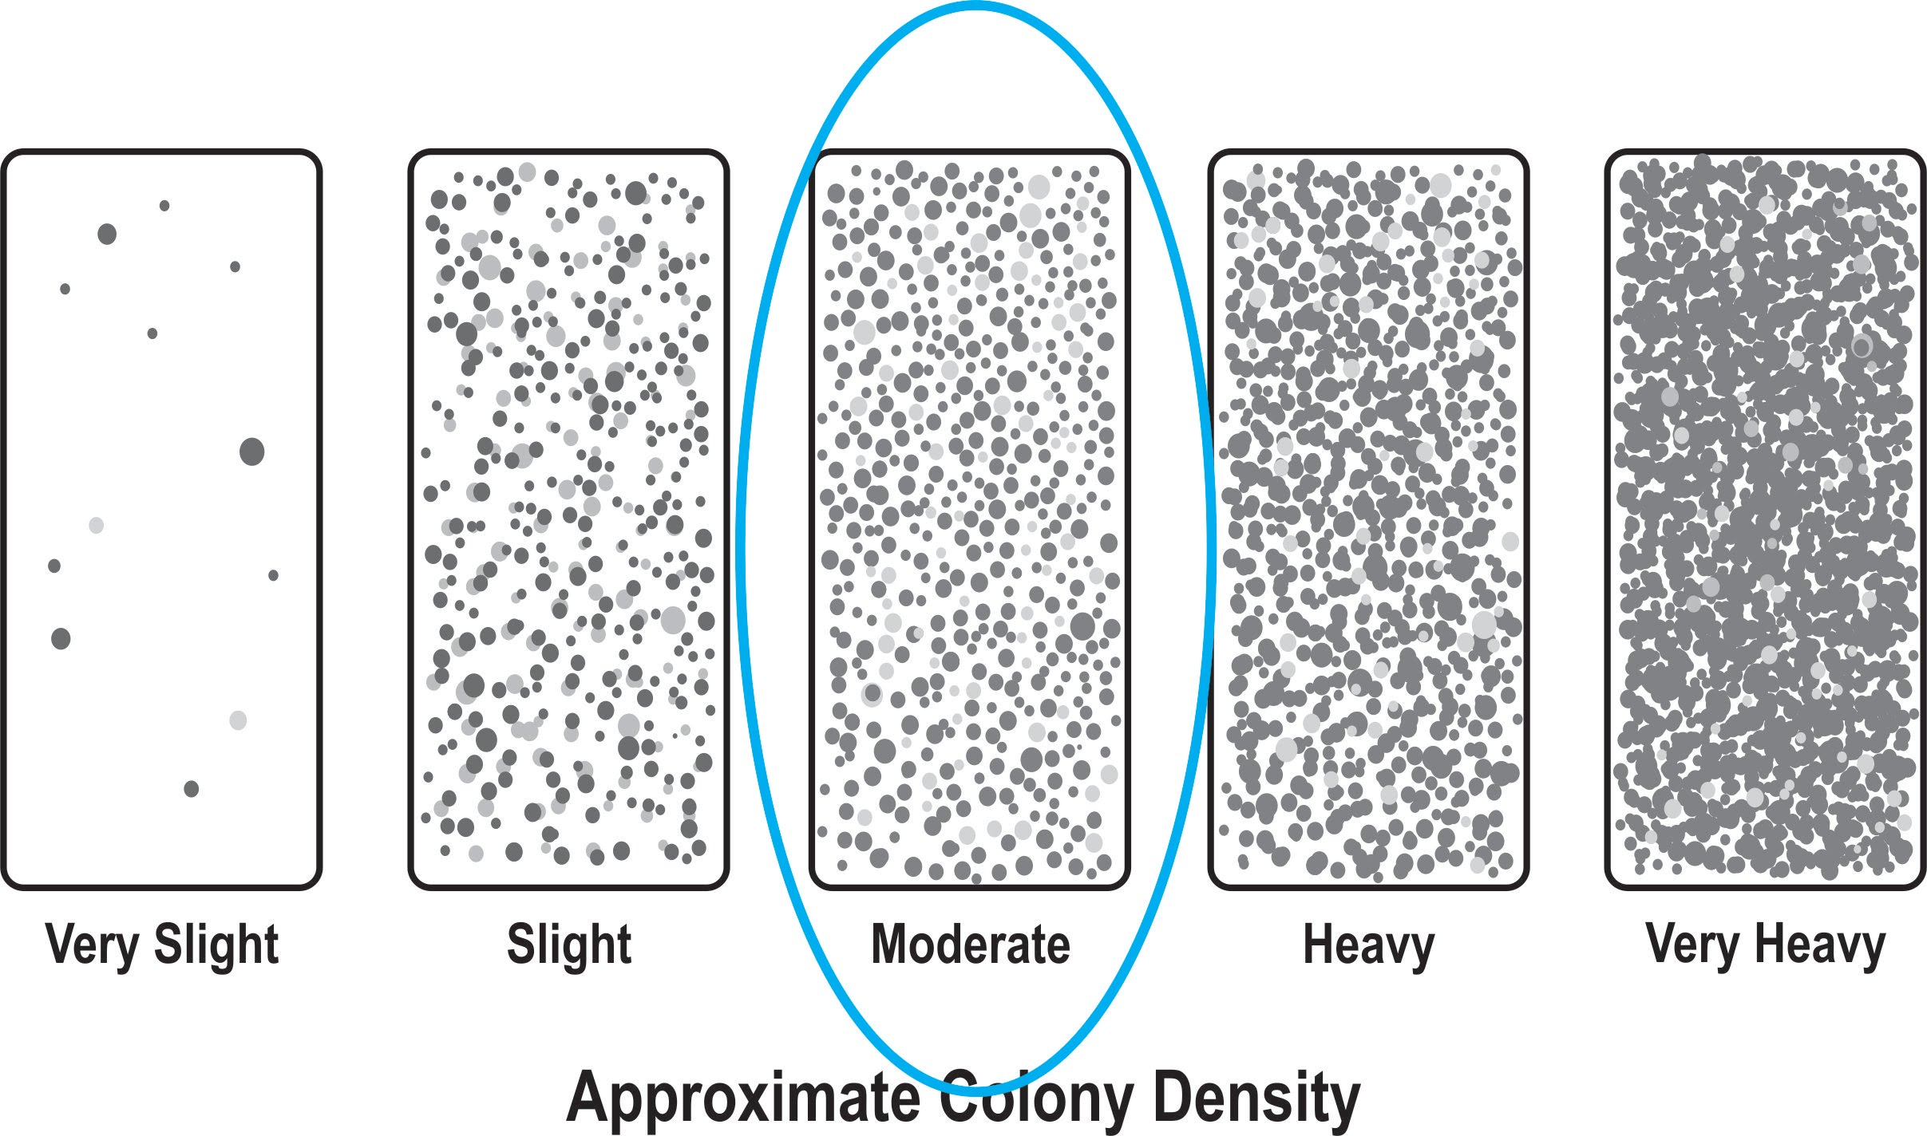
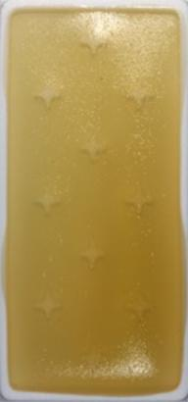
Counting Colonies
Using an Enumeration Panel

Slide 26
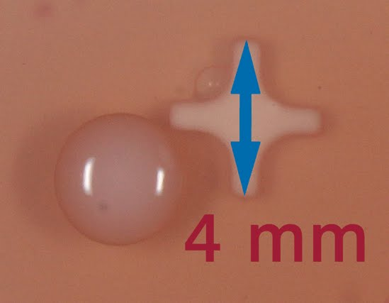
Estimating Colony Size
Each BioPaddle® has molded media attachment points that are 4 mm in length (point-to-point). This feature provides a useful guide to estimating nearby colony size.

Slide 27
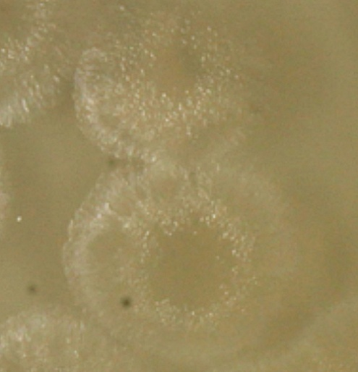
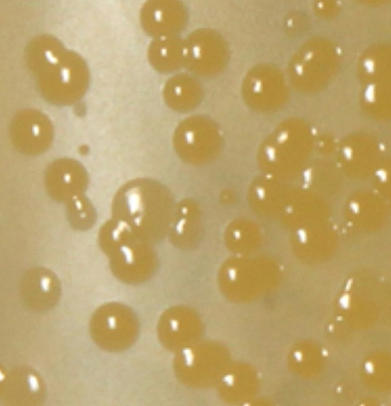
Cell Motility
Motile Cells
Colony borders have rough edges
Non-Motile Cells
Colony borders have smooth edges

Slide 28
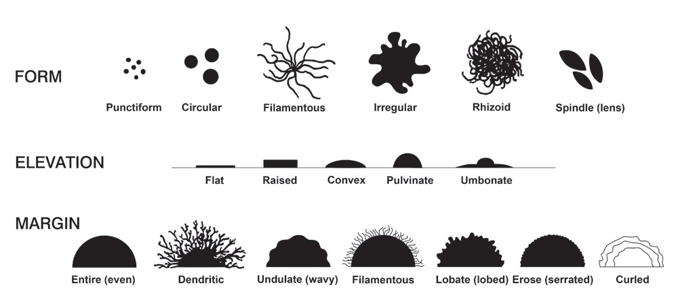
A Closer Look at Soil Microbes
The appearance of a bacterial colony is an important part of the process in identifying a microbe. Some factors that define the appearance are:
Size (in millimeters)
Color
Opacity (transparent, translucent, or opaque)
Texture (butyrous [buttery], viscous, or dry)
Surface texture (smooth, rough, mucoid)
Form, elevation, margin (see chart below)

Slide 29
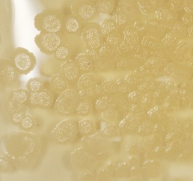
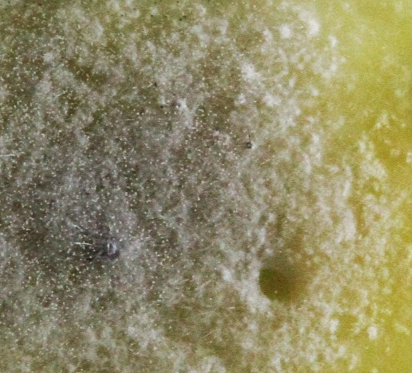
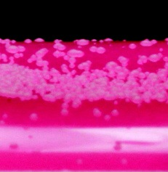
Bacteria Yeast Fungi
Bacteria
Fungi
Yeast

Slide 30
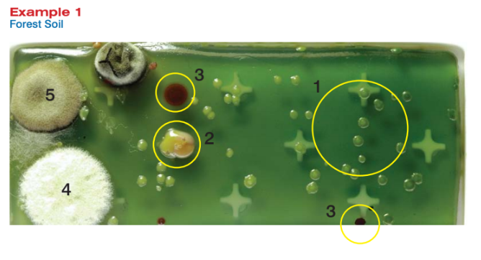
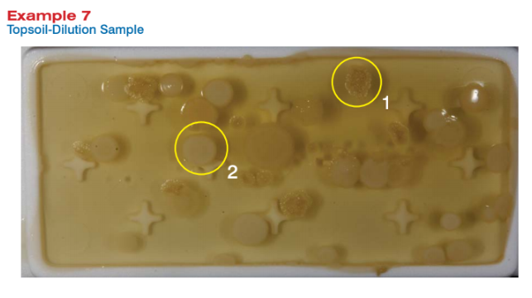
Practice slides!

Slide 31
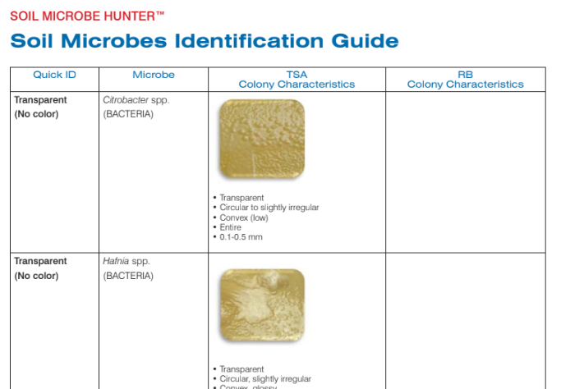
Located on the Disc in the kit!

Slide 32
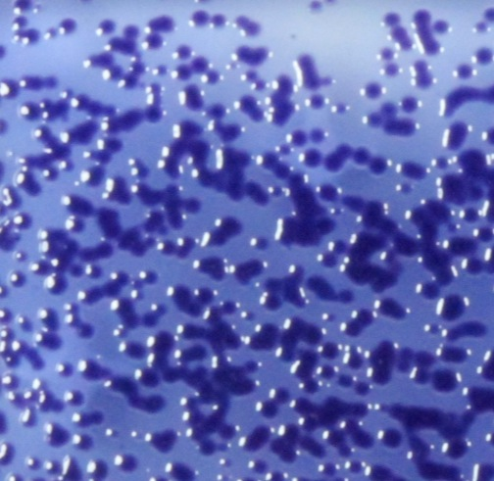
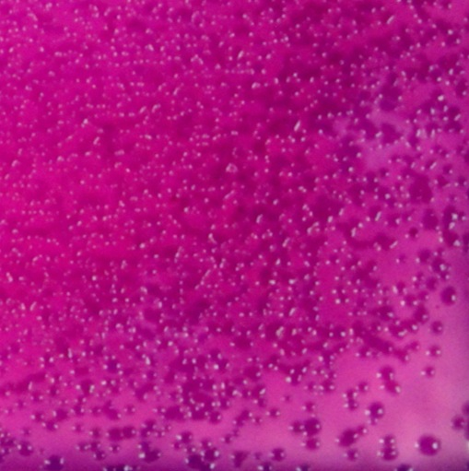
Presumptive Identification
Chrombacterium spp.
TSA
Violet
Circular
Convex
Entire to undulate
1-2 mm
RB
Pink
Circular
Convex
Entire to undulate
1-2 mm

Slide 33
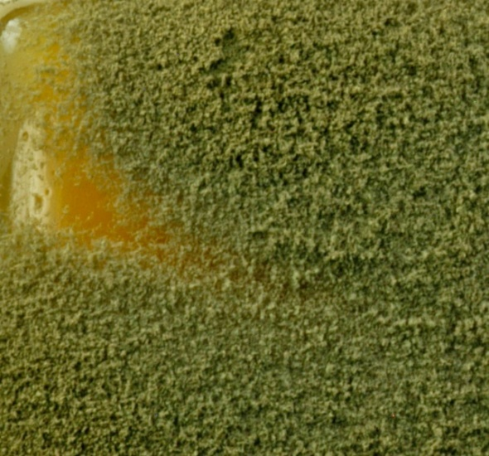
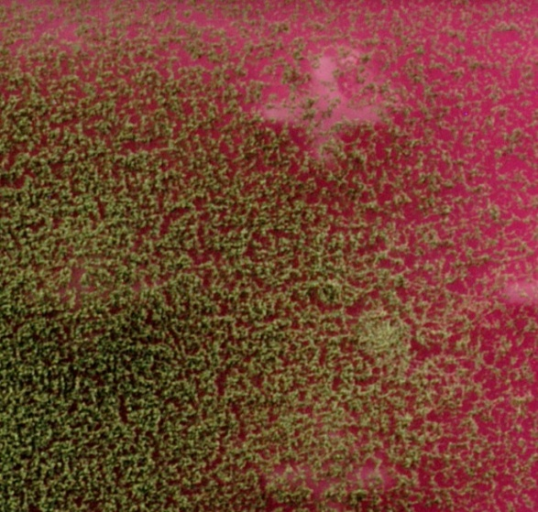
Presumptive Identification
Aspergillus fumagatus
TSA
Fast-growing
White to green to blue-green conidia
Felt-like
Forms a carpet
3-9+ cm
RB
Fast-growing
White to green to blue-green conidia
Felt-like
Forms a carpet
3-9+ cm

Slide 34
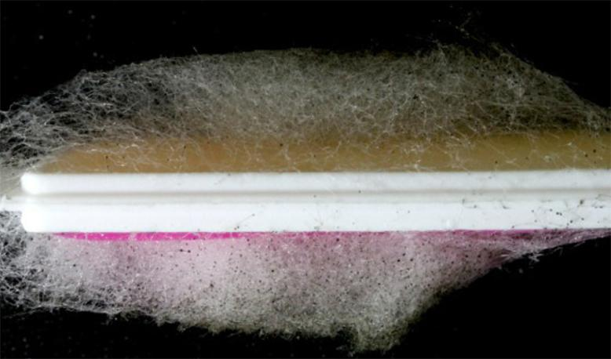
Soil Microbe Hunter
Code 5563
Photography credits:
Ken Rainis
Luis Camus, M.D.
LaMotte Company
Chestertown, MD 21620
800-344-3100
www.lamotte.com
©2016 LaMotte Company

