Slide 1
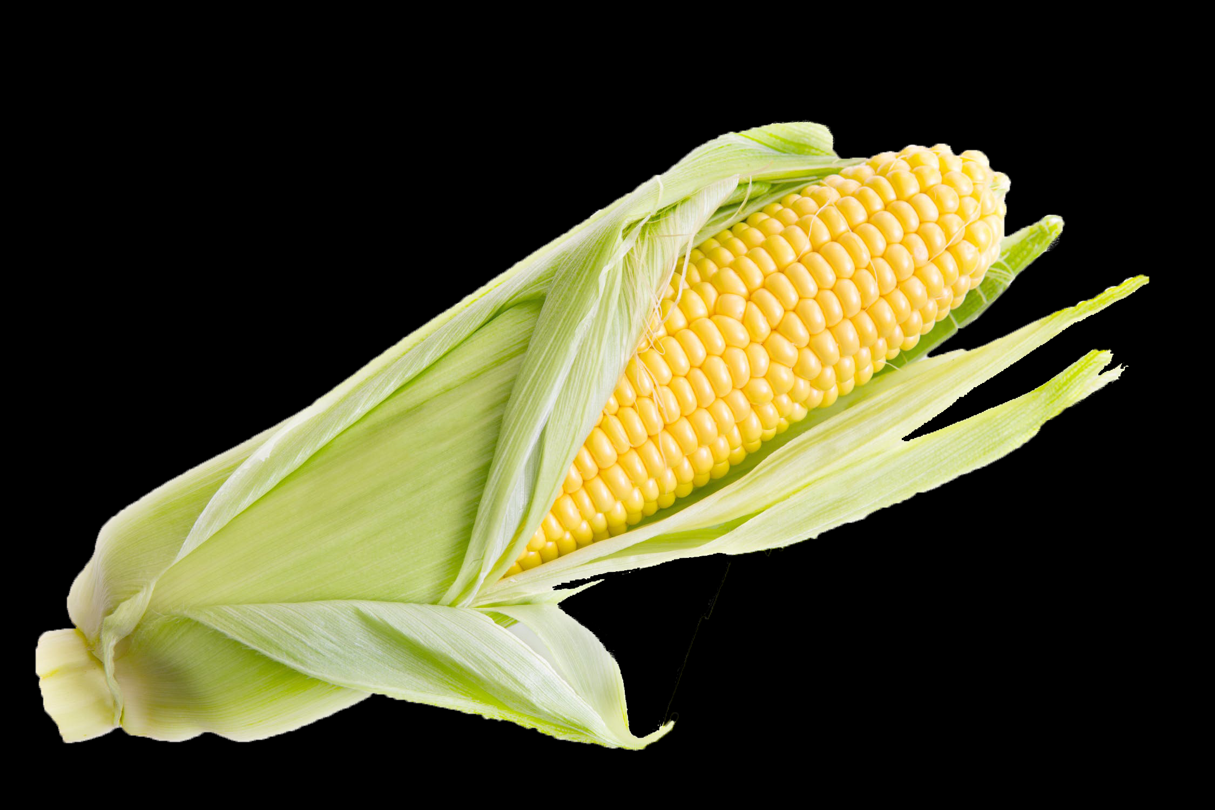
More Fuel: Biodiesel and Renewable Diesel

Slide 2
Diesel
Petroleum Diesel is a hydrocarbon that is refined from crude oil that is pumped from underground.
Diesel is the group of hydrocarbons ranging from C₁₀H₂₂, C₁₅H₂₈ having an average of C₁₂H₂₄.

Slide 3
Diesel
This fuel is a mixture, typically containing 75% saturated hydrocarbons and 25% aromatic hydrocarbons.

Slide 4
Concerns with Burning Petroleum Diesel
Old carbon that has been trapped underground for millions of years is added to the atmosphere.

Slide 5
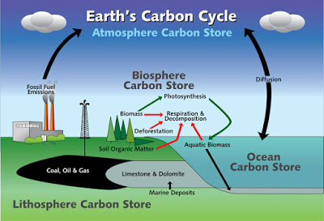
Advantages of Burning Renewable or Biodiesel

Slide 6
Advantages of Burning Renewable or Biodiesel

Slide 7
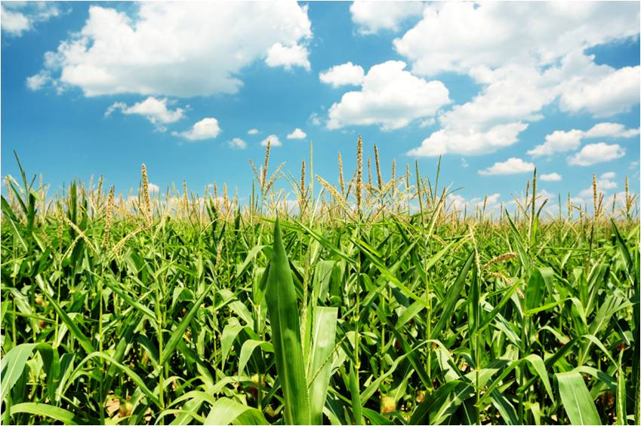

Slide 8
The Chemistry of Renewable and Biodiesel

Slide 9
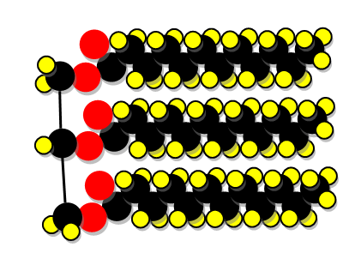
Triglycerides
Fats and oils are classified in a group of compounds called triglycerides.
These molecules are made up of a glycerol and three fatty acid molecules.
Fatty Acids
Glycerol

Slide 10
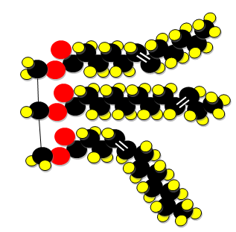
Saturated vs Unsaturated Triglycerides
Animal fats tend to be saturated triglycerides having all single bonds between carbons in the fatty acids.
Saturated Fatty Acids
Unsaturated Fatty Acids
Glycerol
Glycerol

Slide 11
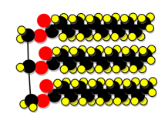
Saturated vs Unsaturated Triglycerides
This makes the chains nearly straight and allows them to solidify at higher temperatures.
Saturated Fatty Acids
Glycerol

Slide 12
Saturated vs Unsaturated Triglycerides
Plant oils are typically unsaturated, having at least one double bond.
Saturated Fatty Acids
Unsaturated Fatty Acids
Glycerol
Glycerol

Slide 13
Saturated vs Unsaturated Triglycerides
The fatty acid bends at this double bond and causes the oil to stay liquid at lower temperatures.
Unsaturated Fatty Acids
Glycerol

Slide 14
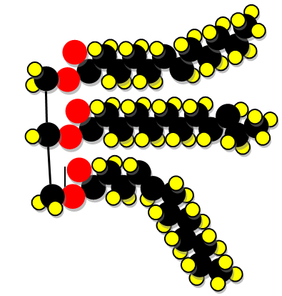
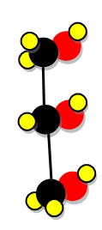
Triglyceride to Biodiesel
Biodiesel is produced when a catalyst, potassium hydroxide, is used to separate the fatty acids from the glycerol molecules. This produces fatty acid methyl esters, or biodiesel.

Slide 15
Triglyceride to Renewable Diesel
Biodiesel is produced when a catalyst, potassium hydroxide, is used to separate the fatty acids from the glycerol molecules. This produces fatty acid methyl esters, or biodiesel.
Catalyst

Slide 16
Biodiesel Lab Procedure
The production of biodiesel requires the use of caustic and flammable reagents.
Use caution and wear protective eyewear, chemical resistant gloves and lab coats or lab aprons.

Slide 17
Biodiesel Lab Procedure
Place 0.20g-0.30g KOH pellets in centrifuge tube.

Slide 18
Biodiesel Lab Procedure
Add 5.0 ml of methanol and replace lid.
When dissolved this produces potassium methoxide.
This is a very caustic and flammable mixture.
Use extreme caution when handling.

Slide 19
Biodiesel Lab Procedure
When KOH has completely dissolved, open lid and carefully add 25.0 ml of corn oil.
Replace lid and invert gently to mix the two liquids.

Slide 20
Biodiesel Lab Procedure
Loosen cap slightly to vent any pressure.

Slide 21
Biodiesel Lab Procedure
Loosen cap slightly to vent any pressure.
Placing in warm water bath at 50*C
To speed process, tighten cap and invert solution gently periodically

Slide 22
Biodiesel Lab Procedure
Overnight a layer of Biodiesel will form above a layer of glycerol.
The glycerol will contain most of the excess methanol.

Slide 23
Biodiesel Lab Procedure
Remove cap from tube.
Use a pipette to transfer as much biodiesel as possible into a clean centrifuge tube.

Slide 24
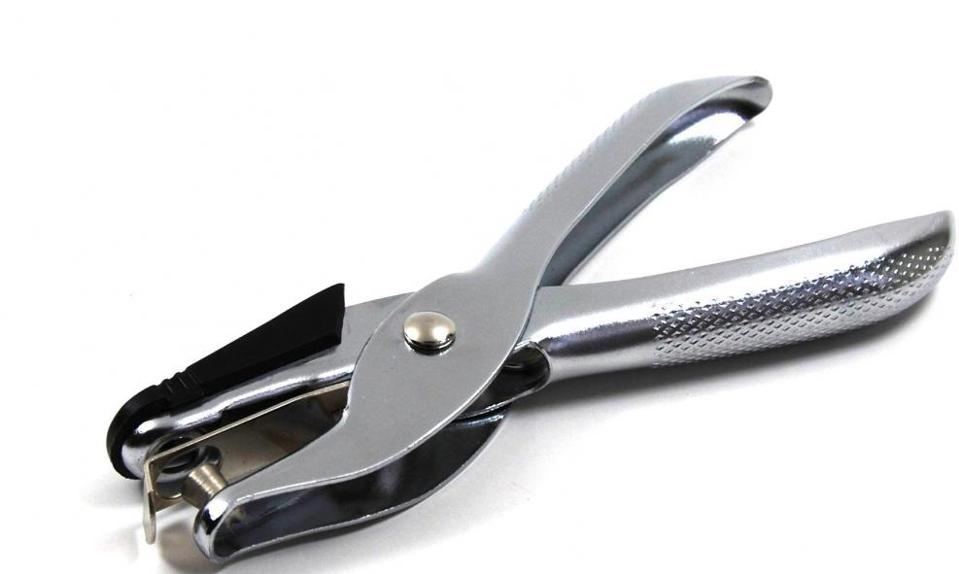
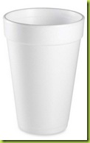
Comparing Fuels
Solubility
Use a hole punch to punch small Styrofoam disks from a Styrofoam cup.

Slide 25
Comparing Fuels
Add 5.0 ml of each fuel type to a labeled centrifuge tube.
Drip a styrofoam disk in each fuel type and replace caps.
Observe the disk after 10 minutes.
B D
R D
CO

Slide 26
Comparing Fuels
Place all three fuel samples in a room temperature water bath.
Record temperature.
Draw up 11.0 ml of fuel.
B D
R D
C O

Slide 27
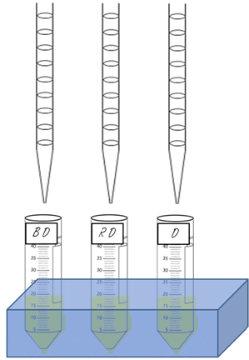
Comparing Fuels
Time how long it takes the fuel to drain from the pipette.
Start the stopwatch when the valve opens and stop when the level hits 1.0ml.

Slide 28
Comparing Fuels
Place all three fuel samples in a room temperature water bath.
Record temperature.
Draw up 11.0 ml of fuel.
B D
R D
C O

Slide 29
Comparing Fuels
Replace some of the water with water from an ice bath to lower the temperature.
Repeat the procedure.

