Slide 1
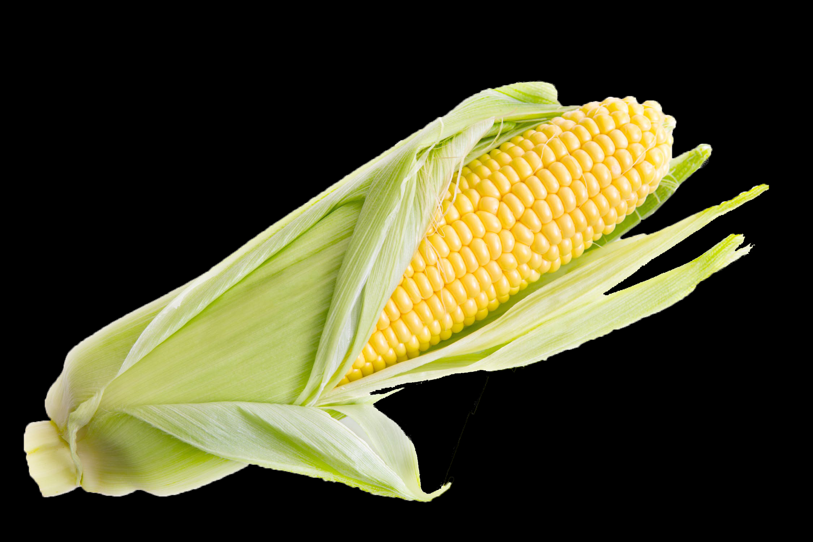
Water Conservation

Slide 2
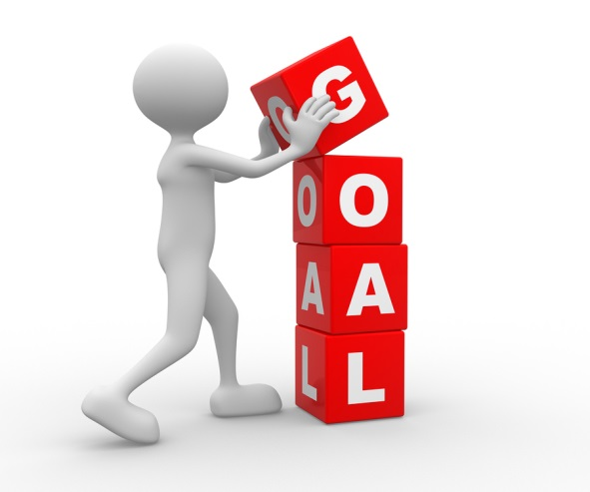
Goals for today
Complete Water Conservation lab
Actually do the lab and get comfortable with the procedure and materials.
Learn the different ways this lab can be differentiated
Be willing to ask questions
Share your knowledge with others and support each other
Discover how this lab can fit into your existing classroom curriculum.

Slide 3
Why I Love this Lab!
Very inexpensive
Easy setup
Easy cleanup
Can be done in one lab period
Can easily be differentiated up or down depending on your students

Slide 4
Water
Water usage and conservation is an important issue. Not all freshwater resources are evenly distributed.
In Kansas, water usage and water rights are very important topics. As a state, how do we balance the needs for water in agriculture, manufacturing, and our daily lives?
It is important that everybody does their part to conserve the invaluable natural resource.

Slide 5
Materials
Water Conservation PowerPoint (available at www.kscorn.com)
1,000-mL graduated cylinder
100-mL graduated cylinder
5 50-mL beakers
Pipet
Water
Food coloring
6 empty gallon milk jug-style containers
Timer
6 large bowls or large beakers (500-600 mL)
6 260-mL beakers or small plastic cups

Slide 6
Questions for Discussion ----just like the kids-----no phone allowed
What are some things we use water for?
How much of the Earth is covered in water?
How much of that water is available for human needs?

Slide 7
Demonstration “Water, Water everywhere…”
-1000 mL of water= all water on earth
-Remove 28 mL, leaving 972 mL for all saltwater in the ocean
-28 mL = freshwater on earth
-Remove 23 mL from the 28mL, this is the water in glaciers and ice caps
-Of the remaining 5 mL, remove 4 mL which represent our ground water
-Of the remaining 1 mL, 1/3 is in the atmosphere
-The last 2/3 mL is surface water
-Leaving 2 drops of the original 1000 mL for use in farming, industry and our personal
lives, half of which is polluted

Slide 9
Follow up questions
-Were you surprised at how little water is available for human use?
-Would you call water a scarce or abundant resource? Why?
-What is the main cause of the increased demand for freshwater?
-The number of people who need to use Earth’s freshwater keeps increasing. If the amount of freshwater cannot change, but there are more people who need it, what does that mean? What might happen?

Slide 10
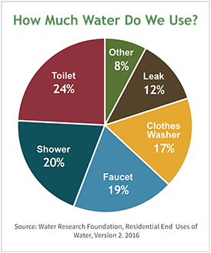
Flow Rate Activity
How much water do you use in a day’s time?
Make a list of all the things you do in your day that require water use
Make a guess as to how many gallons of water you personally are responsible for using each day or year.
Water Use Calculator

Slide 11
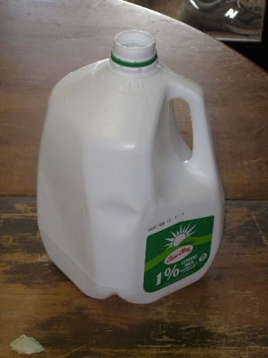
Flow Rate Activity Part 1: (pages S4-S5)
Hold the jug above the bowl or large beaker. Remove the tape and start the timer.
After 1 minute, place your finger over the hole on the bottom of the jug to stop the water. Hold the jug over the sink. Tilt the jug to the side so the tape can be replaced.
Use a graduated cylinder to measure the water that was collected. The amount of water collected is labeled mL/min
Repeat using each jug in the room.

Slide 12
Flow Rate Activity Part 2: (pages S4-S5)
Measure the flow rate of things in your building: Sinks, fountains, showers
You can measure the flow rate of the classroom sinks by timing how long it takes for a 500 mL beaker to fill. Divide 500 by your time. The answer will be in mL/sec. This can be converted to mL/min. by dividing the answer by 60. And converted to L/min. by further dividing it by 1,000.
___________mL/sec or ___________mL/min or ___________ L/min

Slide 13
Flow Rate Activity Part 3: (pages S4-S5)
Estimate the amount of water you use daily.
• One toilet flush uses 5 gal. of water. • A 10-minute shower uses 100 gal. of water. • To fill half a full bathtub takes 50 gal. of water. • Brushing teeth takes 2 gal. of water. • The dishwasher uses 10 gal. of water. • The clothes washer uses 50 gal. of water
On average, each of us uses about 70 gal. of water every day. Using the above information, calculate your daily water use. Use your own data collected to figure out how much your shower uses.
Fun Fact: In pioneer days, it is estimated that people used only 5 gal. of water per day.

Slide 14
Article: Water in The Heartland (pages S1-S3 or T9-T10)
-Divide the sections of the article among the group.
-Take a few minutes to read the article then you can discuss your section with your group.
-Use the Focused Note Taking guide to assist you
-Pick someone from your group to share what you learned with the class.

Slide 15
Questions
How does this fit into your classroom?
What are some ways you can modify this lesson?

Slide 16
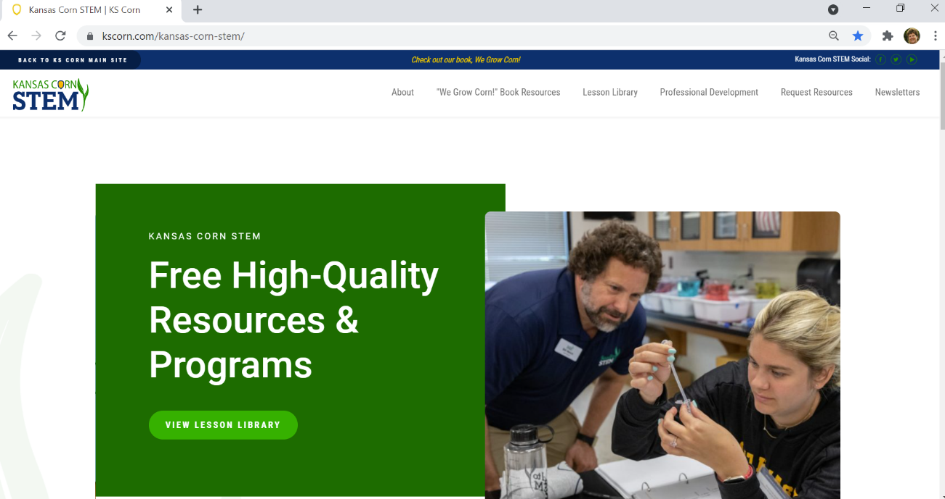
All of these lessons, including the PowerPoint presentations can be found at in the lesson library
www.kscorn.com

