Slide 1
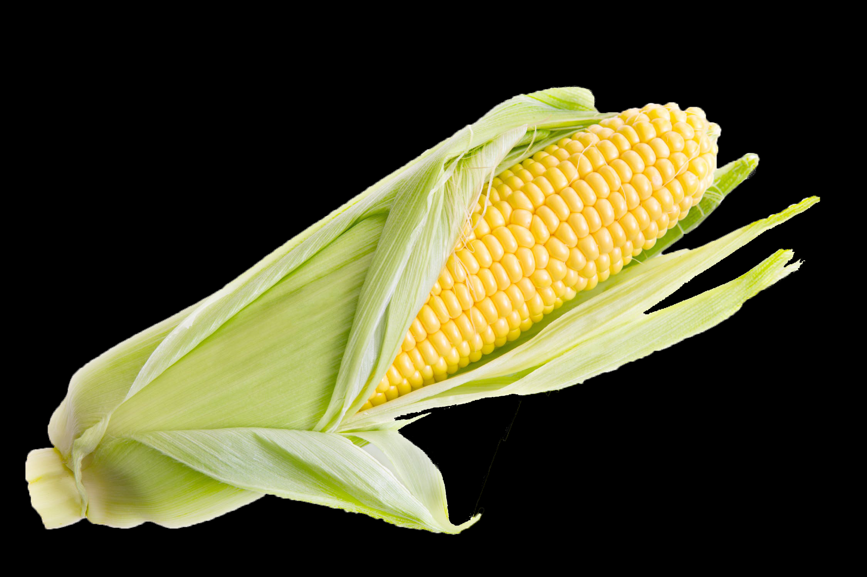
Water, Water, Everywhere

Slide 2
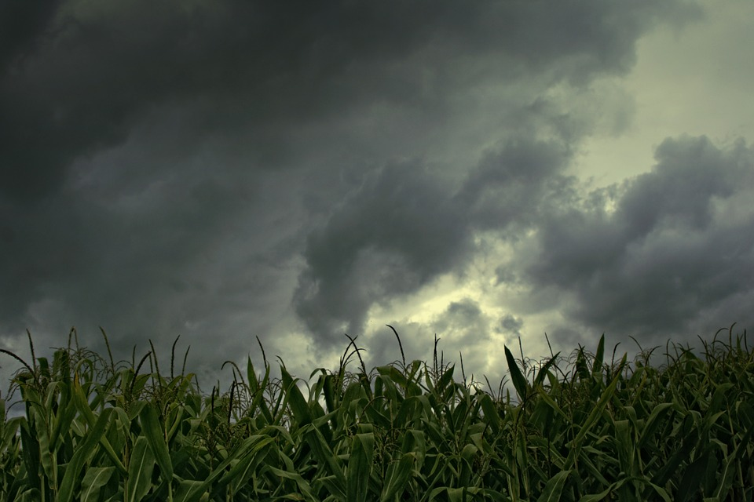
Water Cycle?
What do you know/remember about the water cycle?
On your Poster paper Draw a water cycle.

Slide 3
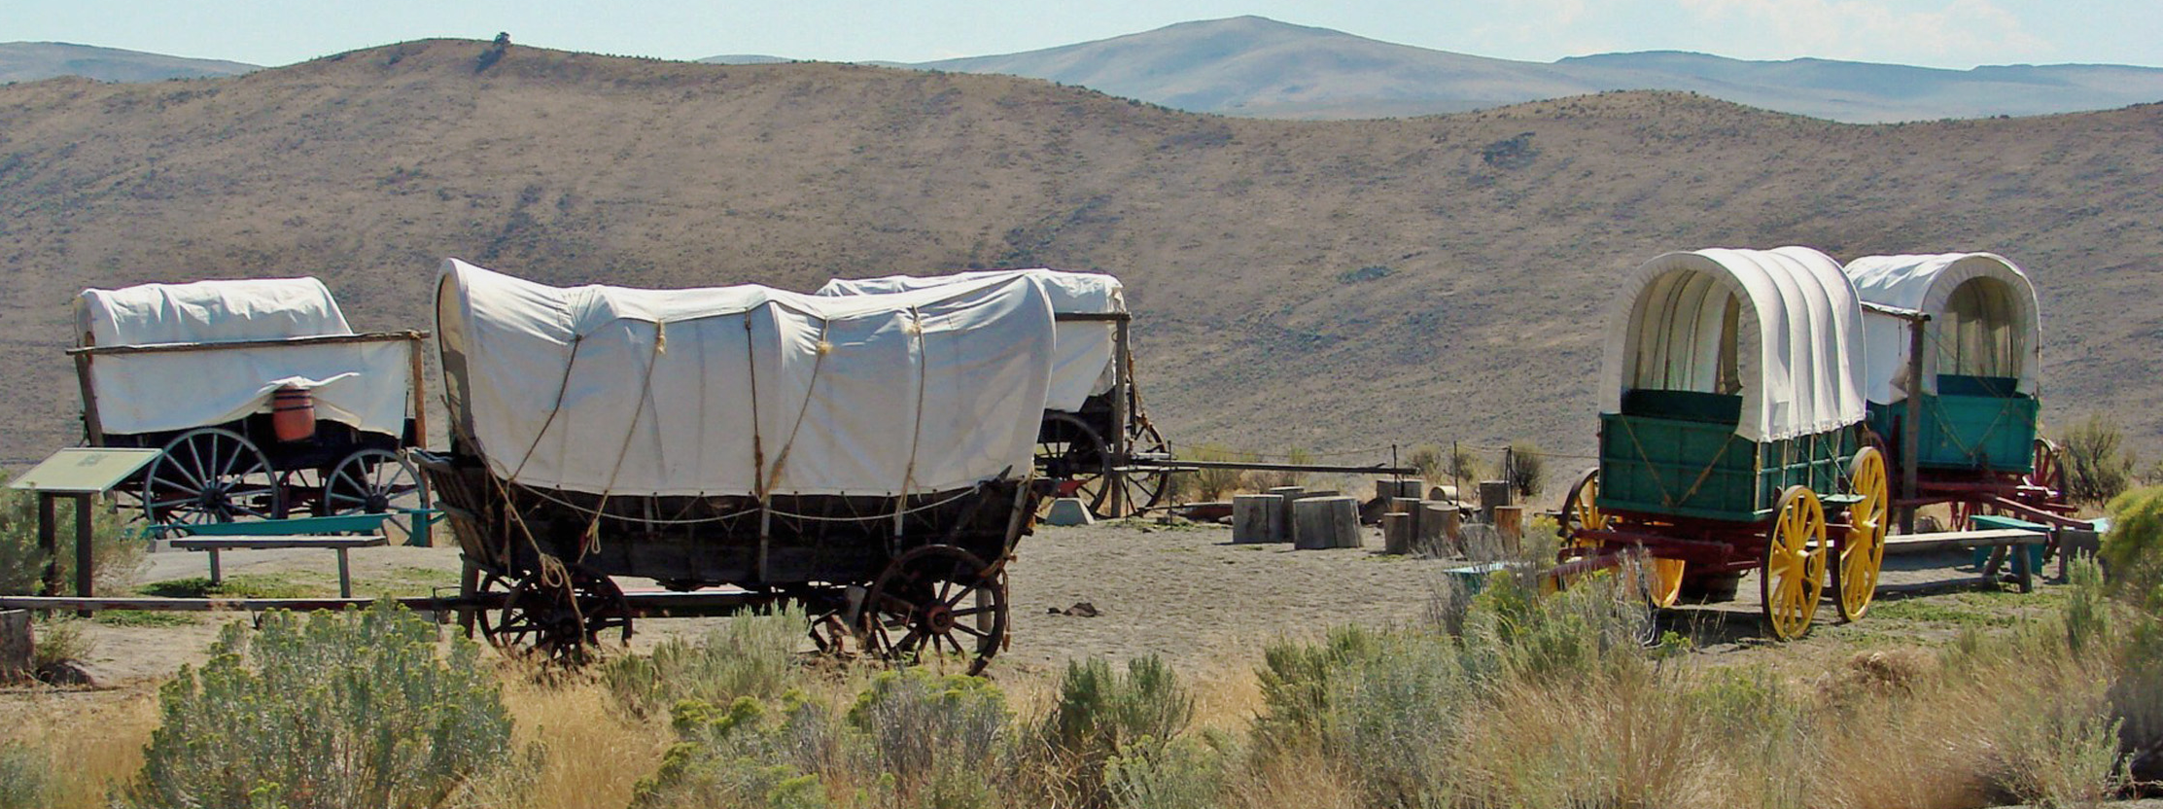
Board Meeting: Similarities
Circle the wagons for a board meeting
What are all the common features?
What are some features we don’t have but should?
What do you notice? What do you wonder?

Slide 4
States of Water
Label (IN RED) all the states of matter that water takes on your Diagram!
Don’t have them all… add in what you are missing now!

Slide 5
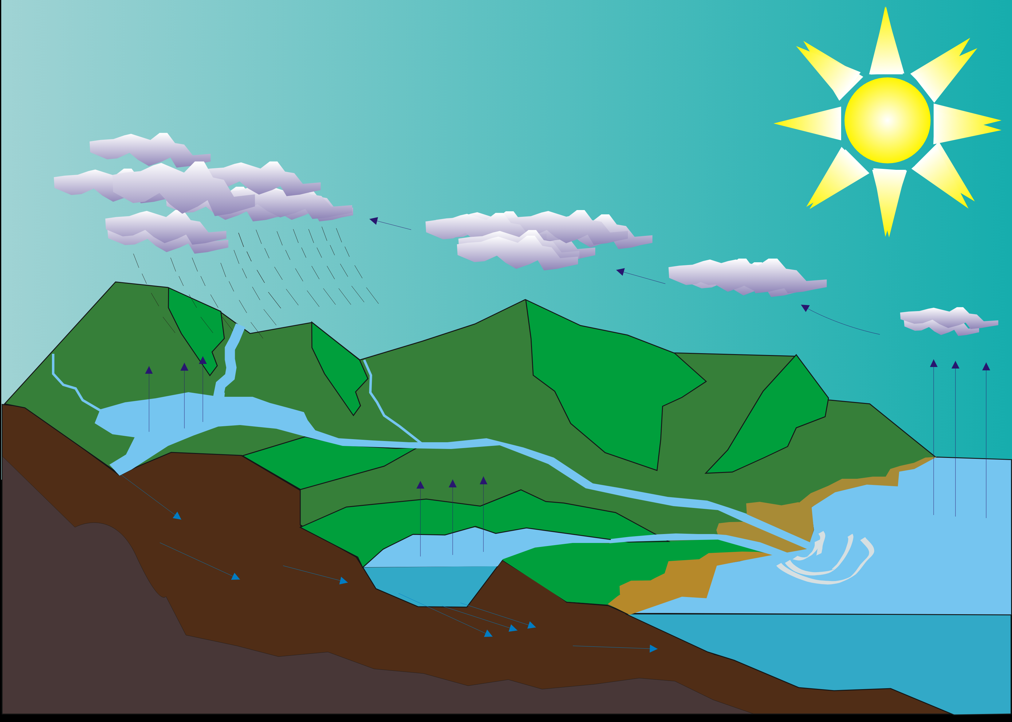
How does the water move?
Draw Arrows to show how water is moving from place to place on your diagram.
Label the names of processes that you have depicted on your diagram.

Slide 8
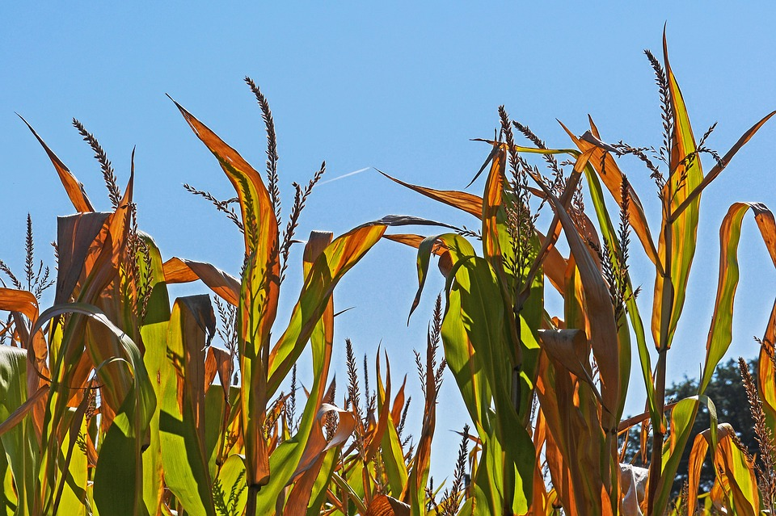
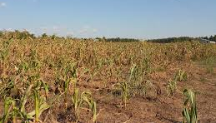
What's the difference?

Slide 9
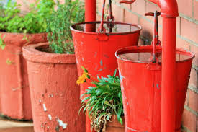
How much water do we need?
Approx. 20-22 inches to produce 200 bushels per acre
1 Inch of rain/ acre = 27,154 gallons
How much total water is needed in gallons?

Slide 10
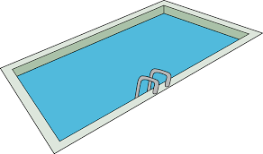
What would that look like?
27,154 gal x 22 inches = 597,388 gallons of water.
That’s per acre of land!
Approximately 3 ¾, 25 yard pools!

Slide 11
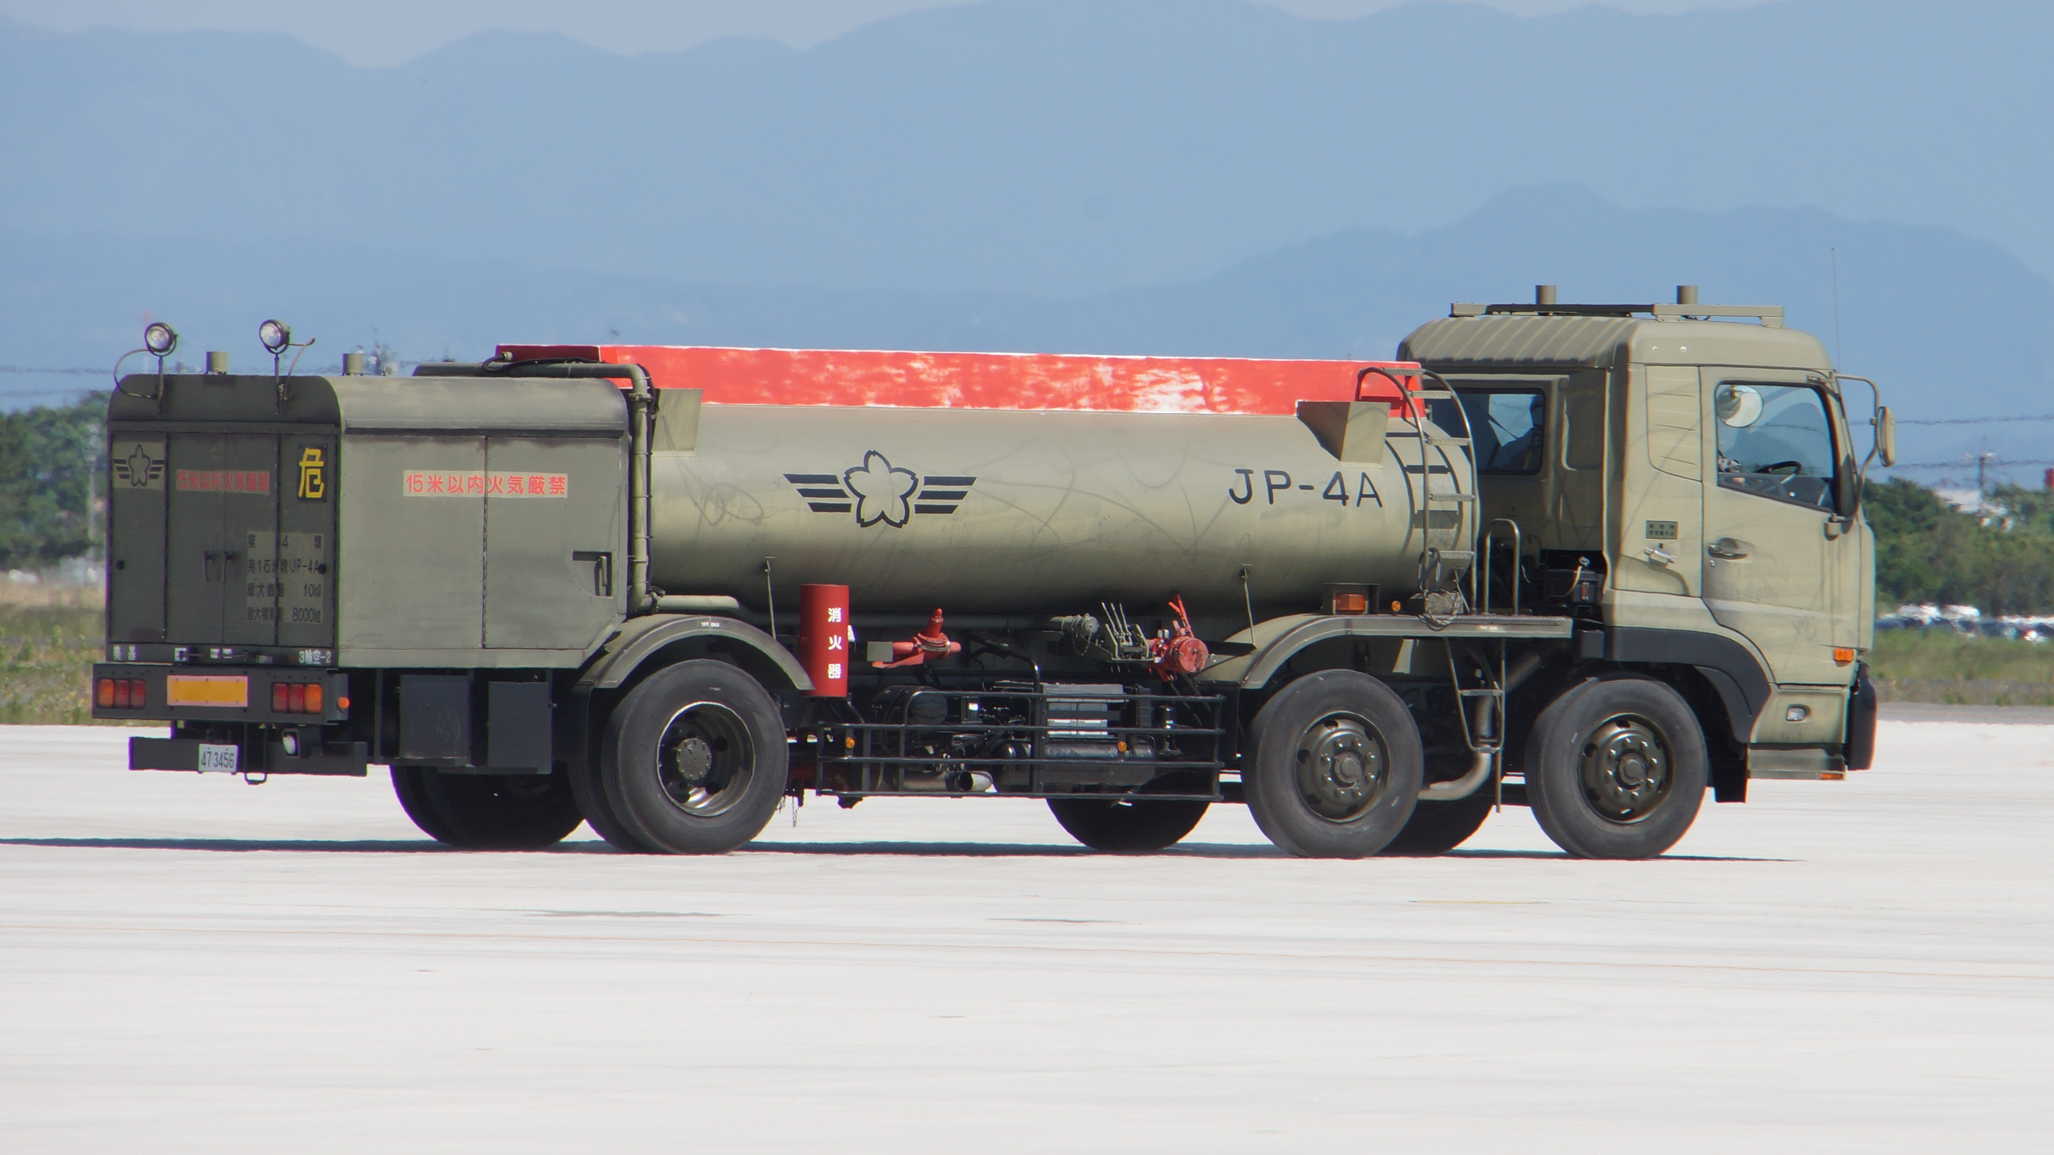
Suppose…
At harvest your equipment says you have an average of 200 bushels per acer of corn….
How much water was use to produce on bushel?
597,688 gallons / 200 bushels = 2,986.94 gallons of water!

Slide 12
How much does mother nature give us?
http://climate.k-state.edu/precip/county/
Choose what ever county you would like?
You can toggle between monthly and yearly.
Use the drop down menu’s to select the month and year.

Slide 14
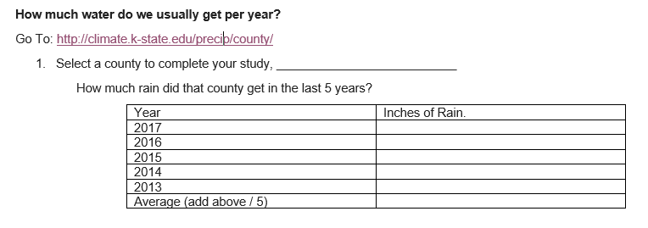
Student data sheet provided!

Slide 15
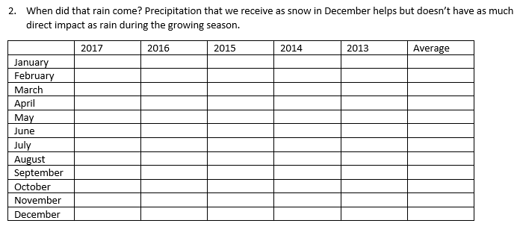

Slide 16
Other factors at play?
Humidity?
Wind?
Run-off?
Soil compaction?
Temperature?
Type of Soil?
http://mesonet.k-state.edu/weather/historical/

Slide 17
Kansas State University Mesonet Data

Slide 18
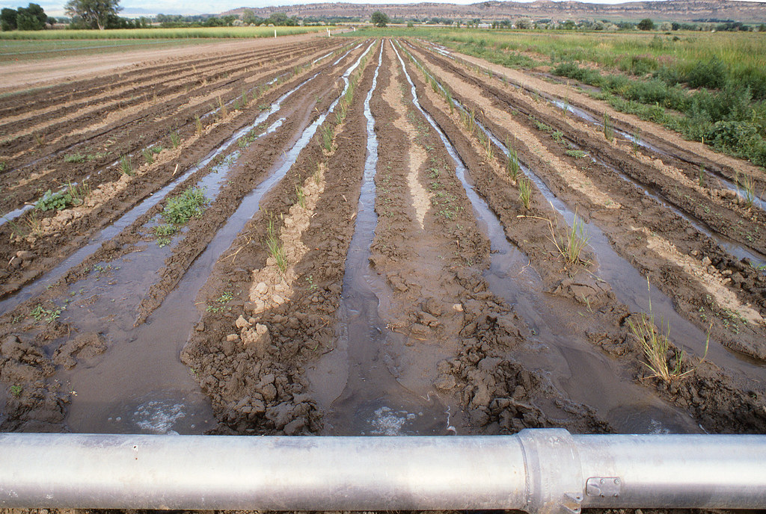
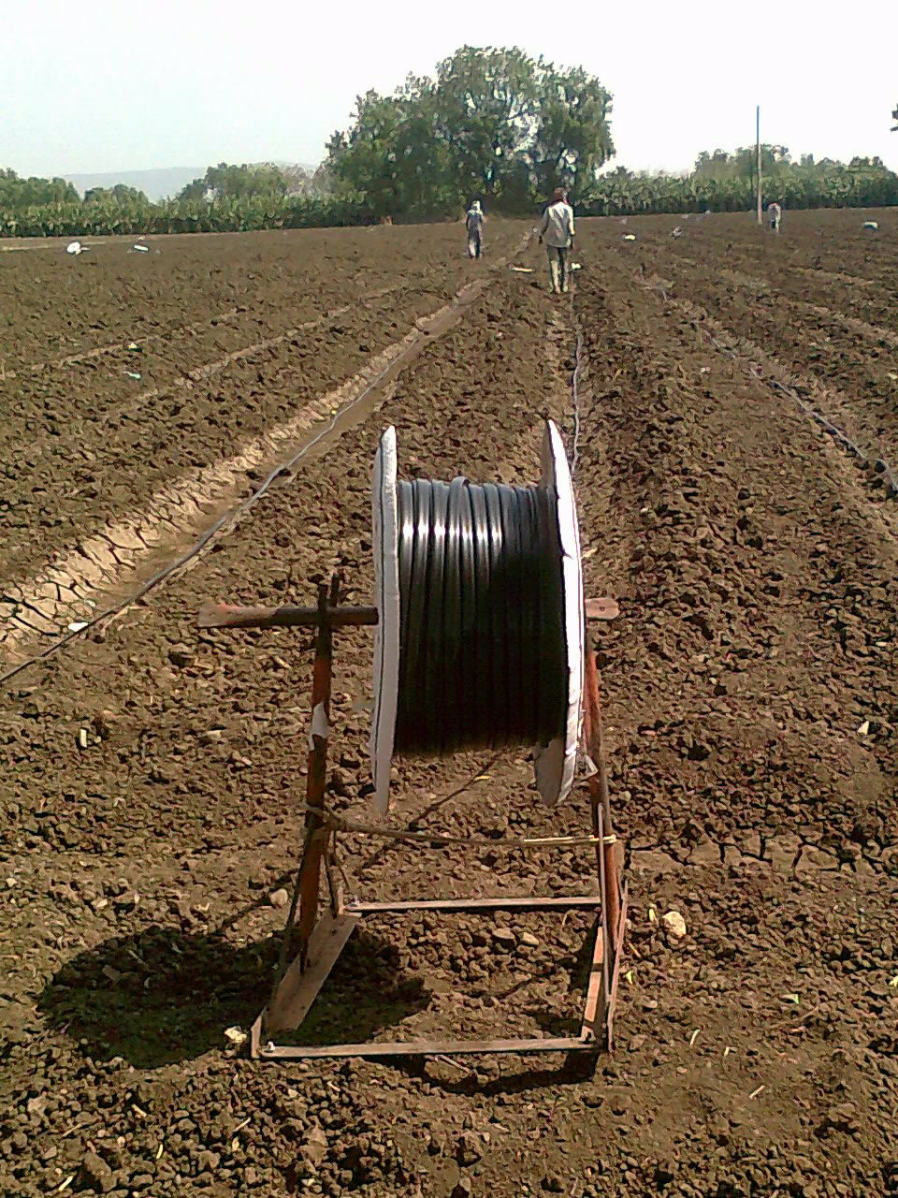
How do I get more water to the field?

Slide 20
Design your own system!

