Slide 1
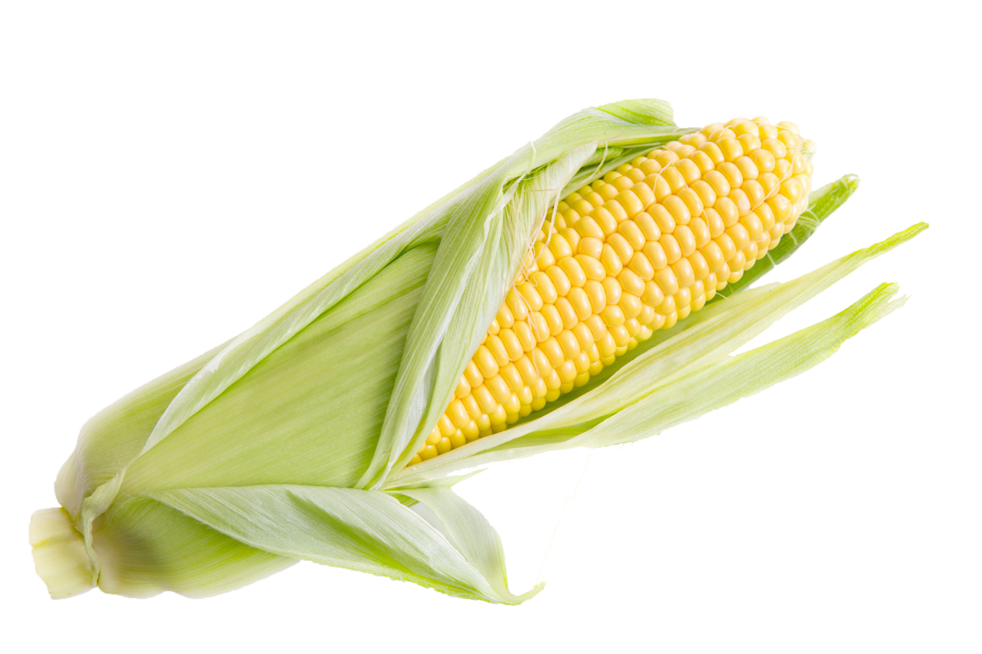
Pipette Technique
Grade Level: Middle School

Slide 2
What is it?
What is the purpose of this equipment?
Where might we find this equipment?
What are some of the major features we can use as clues?
How would you operate this equipment?
Notes:
You can do a table discussion, white board discussion or just a shout out type of review for these questions. Students will fill out their “Mystery Tool Worksheet” either before or after the discussion.

Slide 3
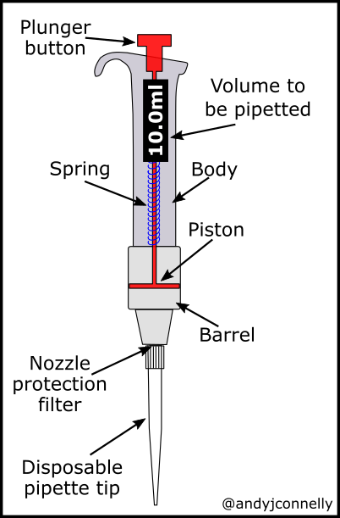
Actually it’s a pipette!
It’s a tool used in labs around the world
It measures very small amounts of liquid samples.
The numbers on the dial tell you how many microliters you are measuring.
Micropipettes come in many volume ranges and some are fixed volumes.

Slide 4
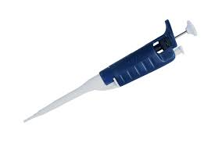
How do I use it?
Loading a tip
Soft vs Hard Stop
Drawing up a sample
Expelling a sample

Slide 5
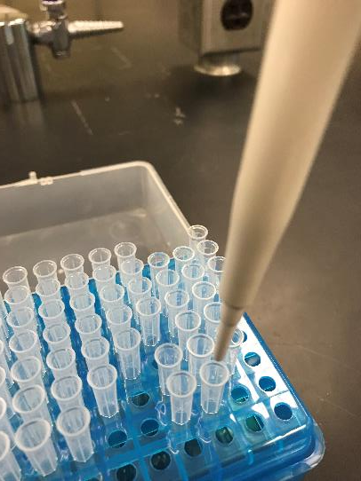
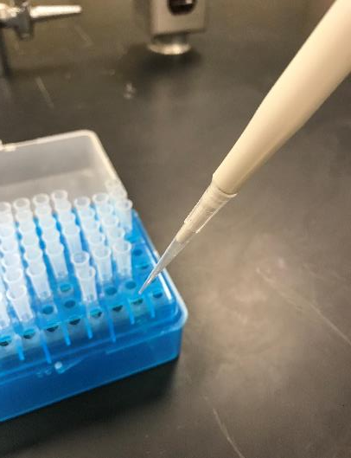
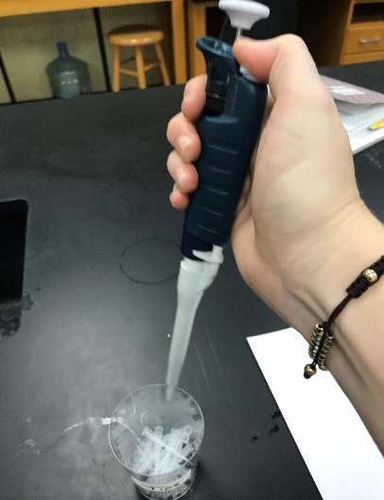
Operation: Step 1 Load a tip
Line up your pipette
Push down on the pipette firmly
Pick up the pipette,
Tip will be attached!
Get a new tip for every
sample! Push the eject
button to remove the
used tip

Slide 6
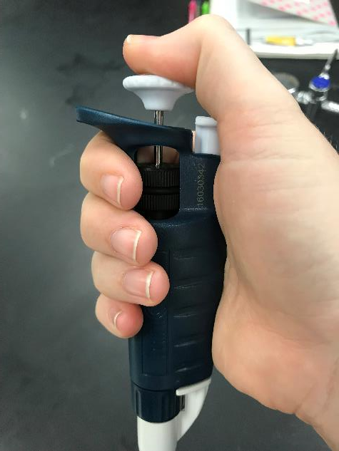
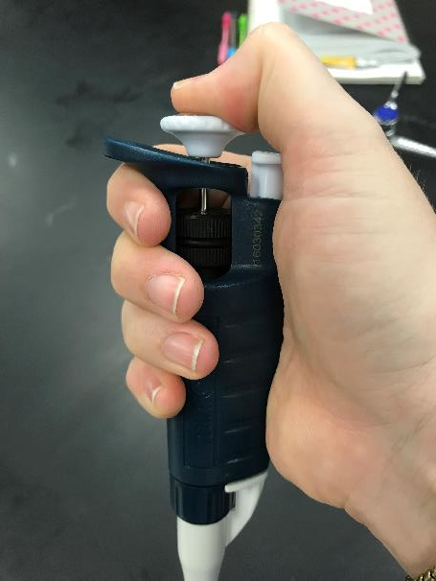
Operation: Step 2 Soft vs Hard Stop
If you continue to push down
Until you can push down no more,
You are at the HARD STOP.
Push down on the plunger
The first point of resistance is
The SOFT STOP

Slide 7
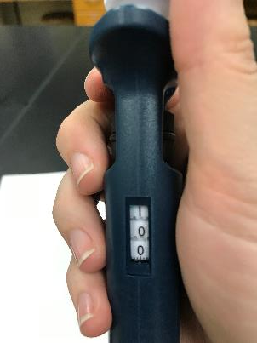
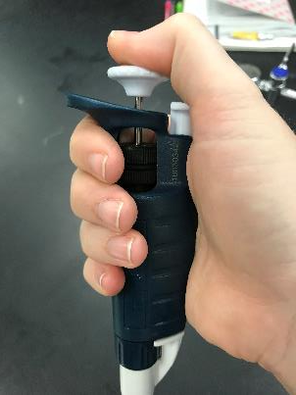
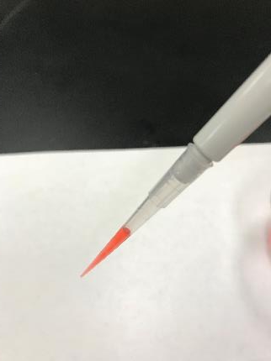
Operation: Step 3 Drawing up a sample
Check your volume
Push plunger to
soft stop
Dip tip into sample,
Do NOT touch the sides
of the container
Release plunger,
The Sample will be drawn
into the tip,
raise the pipette and tip

Slide 8
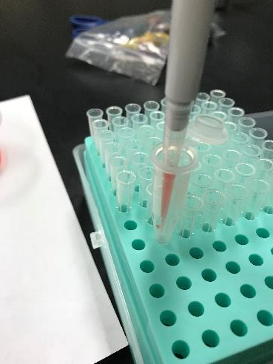
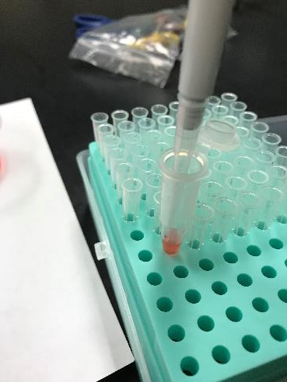
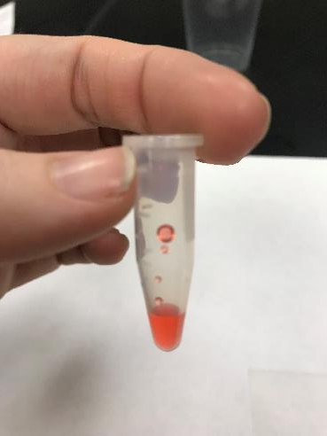
Operation: Step 4 Expelling Sample
Put tip into the
intended container
Make sure you aren’t
touching the bottom or
the sides of the container
Push the plunger
down to the hard Stop
If you touch the sides
you end up with sample
on the sides, instead of all
at the bottom!
Notes:
You can have your students practice these steps by drawing up samples and expelling them back into their containers to save product.

Slide 9
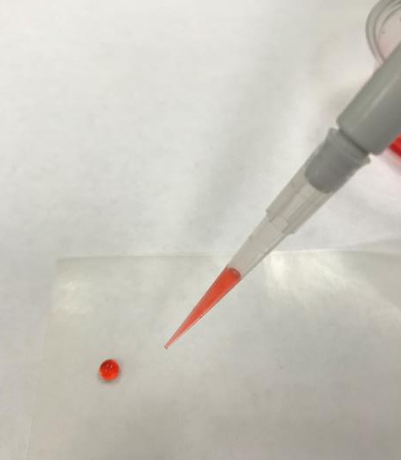
Activity Part 1
Practice Drawing up samples
10ul, 20ul, 30ul
Practice Expelling Samples
Put each sample close to each other
Check your accuracy by combining different volume samples, touch the tip of the pipette into the sample and drag it up to another sample close to it. Adjust your pipette to the volume of these two samples together.
Try and draw up the new joined sample without leaving any behind, or creating air bubbles!

Slide 10
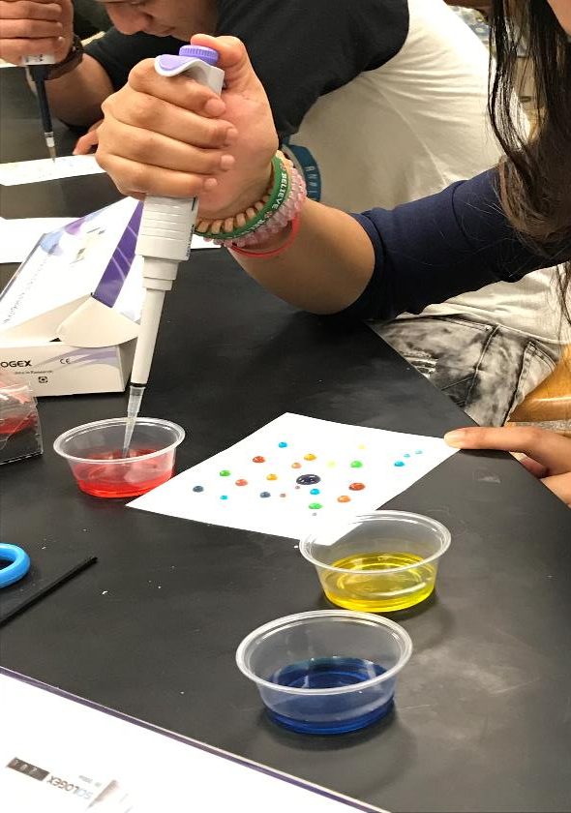
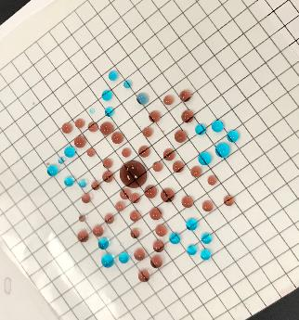
Activity Part 2
Practice, Combine samples, Create something unique and new!
Celebrate your new skill!!
Notes:
Students will need a grid paper with wax paper covering or a laminated sheet.

