Slide 1
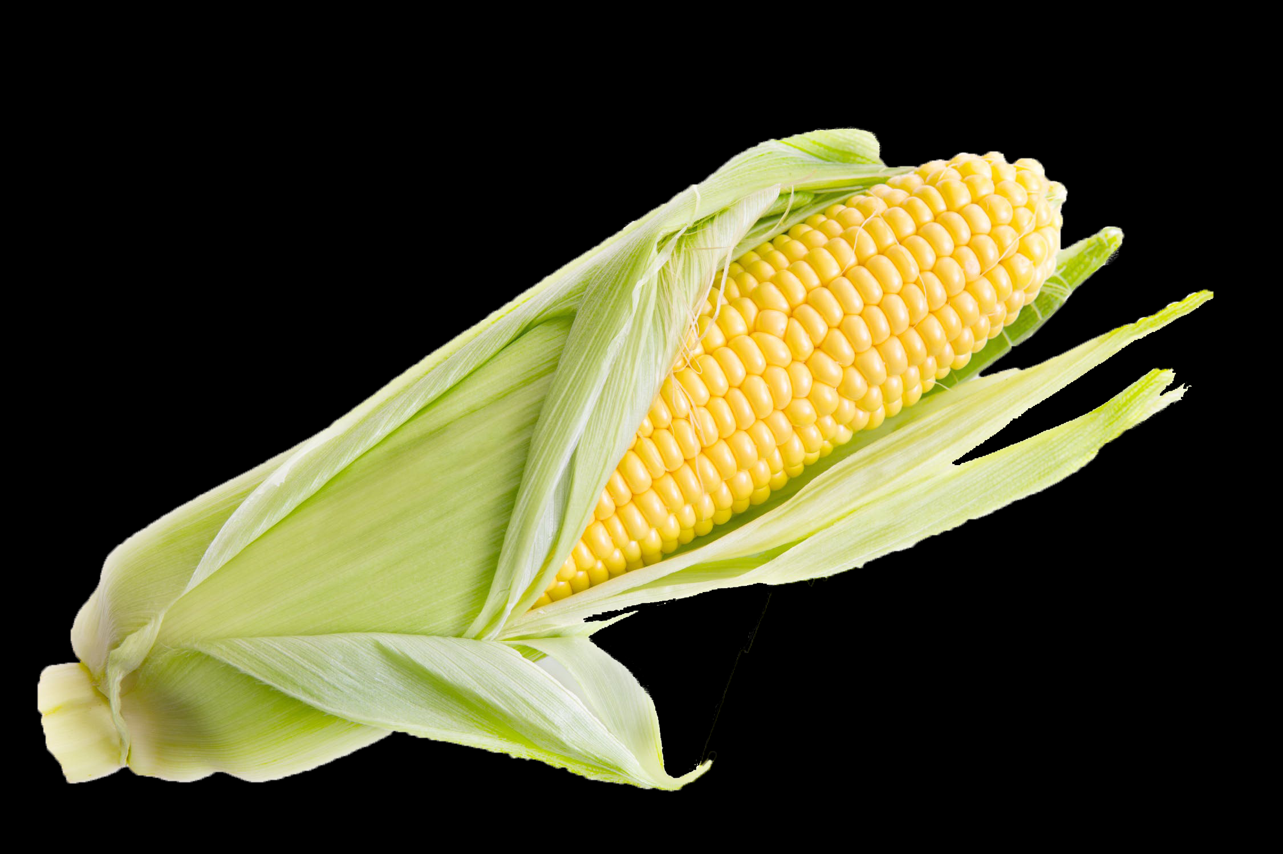
Corn Calculations
Corn Calculations
Notes:
Sharon
Before we beginning get an idea of the audience. K-5-6-12-Collegiant

Slide 2
Discover How to Calculate
Mean, Median, Mode and Range on an Ear of Corn?
Introduction:
Everywhere we look we see numbers. Speed limit signs, gas prices, temperature for the day, the population of a city. A set of numbers or numbers comparing more than one thing can take on a different meaning. For example the average salary of the players on a sports team or the average class score on a math test. Many career fields use mean, median, mode and range to find important information that helps with understanding data and or trends. Farming is one career field that uses information to help and predict corn yields in a field. Why do you think it is important for farmers to predict harvest yields?

Slide 3
Facts
Most of the corn we grow in the U.S. is dent corn (also called field corn). While a small portion of dent corn is used for corn cereal, corn starch, corn oil and corn syrup, dent corn is a grain used mostly for livestock feed and ethanol production. You could cook and eat both as corn on the cob, but the dent corn won’t be as sweet and juicy.

Slide 4
Activity
This activity is designed to reinforce the concept of how to calculate mean, median, mode and range on an ear of corn of field corn. If you have access to multiple ears you may use them, but for this activity we will provide the data from three ears of corn.
The amount of kernels on an ear of corn varies depends on many growth factors during the growing process. Water, sunlight, soil nutrients, temperature, humidity and other factors all are important as corn is developing. Before beginning the activity have students answer the questions on Before Activity.

Slide 5
Math Review
Mean: Is the average of a data set. You add up all the numbers and divide by the number in the data set. Ex:( 3, 5, 2, 7)….3+5+2+7 = 17…..17 divided by 4 = Answer is 4.25
Median: Is the middle number in the data set. The numbers have to be listed from least to greatest. The middle number is the median. 2, 3, 5, 7…..Since we have an even number in the data set take the middle number 3 and 5 add them then divided by 2….3+5 = 8…..8 divided by 2 = Answer is 4. In the following data set there are an odd number in the set so you take the middle number. ( 2, 3, 5, 6, 9) The median is then the middle number, Answer is 5.
Mode: The mode is the number that appears the most. In the above examples the mode is 0. In the following data set the mode is 4. (2, 4, 4, 5, 9)… Answer is 4
Range: The range is the difference (subtraction) between the largest and smallest number. In the data set (2, 4, 4, 5, 9)… the range is 9-2 = 7….Answer is 7

Slide 6
Materials
corn data sheet
pencil
calculator
corn worksheet

Slide 7
Directions
Mean or Average: Add up the number of kernels for Corn Cob #1 and then take the total number of kernels in cob #1 and divide by the number of rows. Round to the nearest hundredth. Record your answer. Do this for Corn Cob #2 and Corn Cob #3, Record your answers.
Median: List all the numbers in Corn Cob #1 in order from least to greatest. Find the middle number in the list. If the cob has an even number of rows take the two middle numbers add them together and divide by 2. Do this same for Corn Cob #2 and Corn Cob #3.
Mode: Look at the numbers you listed for the median and find the number that appears the most that is the mode.
Range: Take the smallest number in Corn Cob #1 and subtract it from the largest this will get you the range. Do the same for Corn Cob #2 and Corn Cob #3.

Slide 8
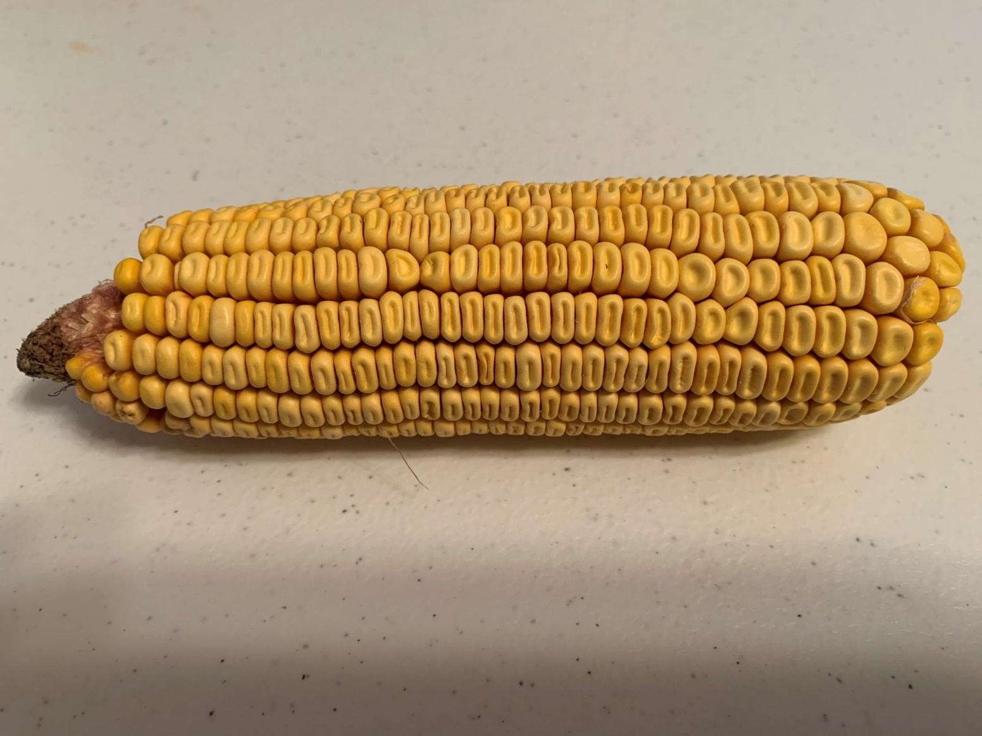
Procedure
Data is provided on slide #10
Count the number of kernels the corn cob has in each row. This one has 31 kernels in this row. Numbers may vary on each row.

Slide 9
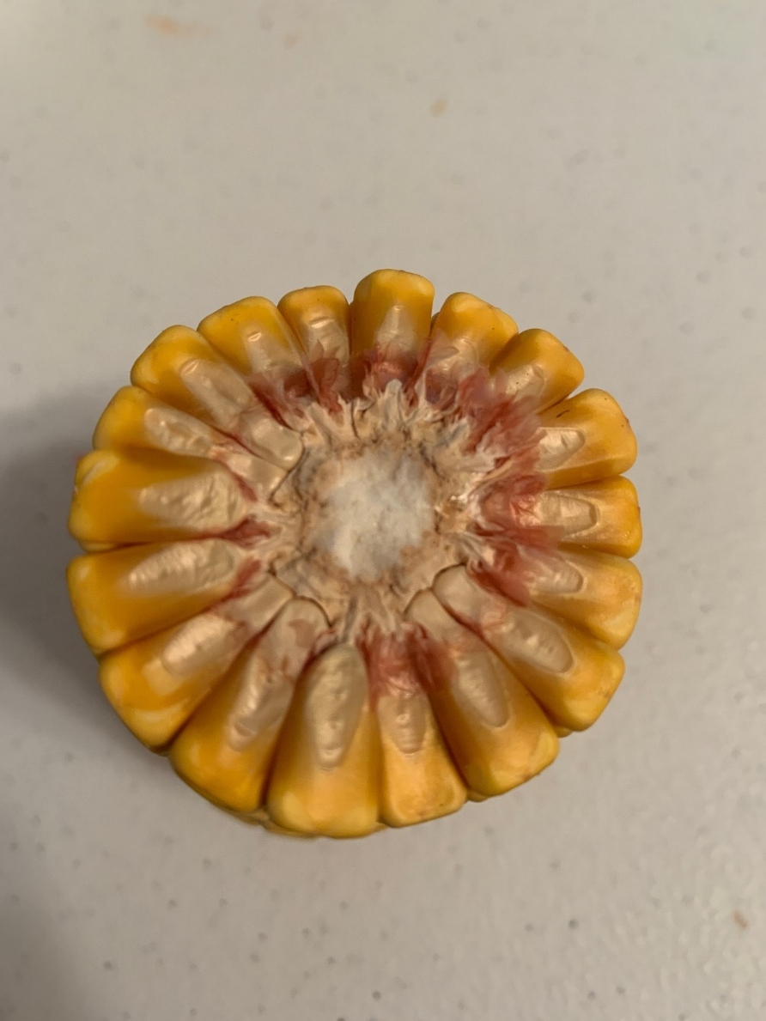
Starting with any row, count around the cob to determine how many rows it has.
This corn cob has 18 rows.
Keep track as to where you start by making a mark.

Slide 10
Corn Cob #! |  | Corn Cob #2 |  | Corn Cob #3
Row Number | # of Kernels | Row Number | # of Kernels | Row Number | # of Kernels
1 | 29 | 1 | 23 | 1 | 23
2 | 28 | 2 | 25 | 2 | 23
3 | 30 | 3 | 23 | 3 | 24
4 | 29 | 4 | 24 | 4 | 25
5 | 28 | 5 | 22 | 5 | 22
6 | 29 | 6 | 26 | 6 | 23
7 | 31 | 7 | 27 | 7 | 23
8 | 35 | 8 | 25 | 8 | 26
9 | 30 | 9 | 23 | 9 | 26
10 | 31 | 10 | 25 | 10 | 25
11 | 30 | 11 | 27 | 11 | 24
12 | 31 | 12 | 25 | 12 | 26
13 | 30 | 13 | 23 | 13 | 26
14 | 28 | 14 | 25 | 14 | 23
15 | 29 | 15 | 26 | 15 | 24
16 | 29 | 16 | 27 | 16 | 23
 |  | 17 | 25 | 17 | 22
 |  | 18 | 22

Slide 13
Post Activity Questions

