Slide 1
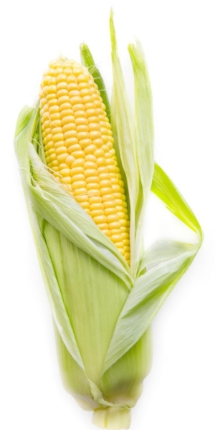
Genetically Modified?
What do you know about GMO?

Slide 2
Budget
2019 Expenses $778,404
2020 Proposed $753,497
Notes:
Most people don’t really even know what GMO stands for yet, they have very strongly help opinions.
Why is that? They have been shaped by the ideas and images they have seen in the media overall.

Slide 3
On your student sheet write your own definition for what GMO means.
Find a partner or group! Compare your definitions…
Underline anything you have in common.
What’s left? Can you eliminate anything or does it have to stay??
Put a single line through anything that can go
Create a team definition.
must include all the important underlined elements from before.
You must all agree on your definitions.
Notes:
Goes with GMO Discussion Student Sheet questions.
Walk students through the questions one at a time. Make sure each step is complete before you move on to the next.

Slide 4
Why an Operational Definition?
Notes:
Operational Definitions help us be able to compare apples to apples not apples to oranges. Just as different people gather different information, like these blind men and the elephant, each is making different assumptions based on their limited amount of information. In order to really know what you are dealing with, you have to look at the full picture.
Making sure that everyone has a clear picture of the topic is vitally important to having constructive conversations.
Because GMO is such a polarizing term most scientists don’t even use the phrase since the vast amount of the public already has preconceived, and often incorrect definitions of the term.

Slide 5
Our Definition:
Look at the meaning of each word independently…
Genetic: referring to genes or DNA
Modification: changing from an original
Organism: any living thing including animals, plants, bacteria, fungi….
Now add all of these definitions together:
Intentionally changing a living thing’s original genes or DNA.
Notes:
One approach might be to look at each word in this important phrase.
This will be our operational definition.

Slide 6
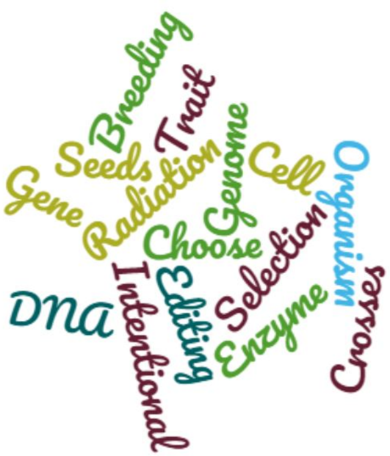
Okay so lets use it…
Look at all these methods of modifying plants. Lets use our definitions to classify whether these would create a GMO based on our operational definition.
Notes:
Sometimes its hard to make sense of different methods of breeding because their definitions seem so similar. When you start to see the same words over and over again, it helps to try and organize them based on some simple differences. Let’s begin.

Slide 7
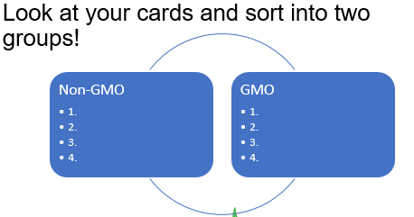
Notes:
Have students use the information they have gathered to sort the six techniques into the category of GMO or Non-GMO….
There is really no right or wrong answer at this point, students should use the criteria in the definition to help group them.
Use leading questions such as “So how is DNA changed?” or “Does it matter what changes the DNA?” to help guide students.

Slide 8
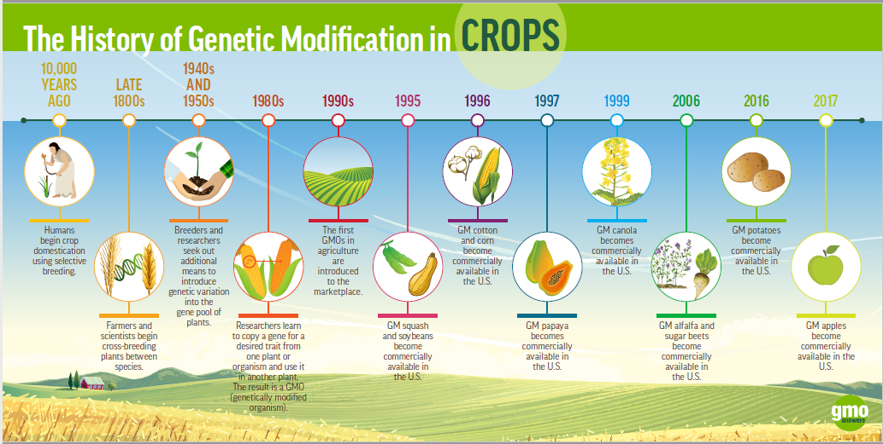
Notes:
Pay close attention to the timeline… Where would you put each of these methods?
When did we start the domestication of crops?
When did we start choosing the genes in our crops?

Slide 9
Technically….
Since we have been choosing plants to domesticate we have been creating GMOs!
10,000 year ago
We choose the plants with desirable traits, (good DNA/Genes)
Produces lots of fruit, survives drought, doesn’t get eaten by bugs…
We plant those seed with those traits (others we don’t)
Making breeds of plants!
So any plant we choose to domesticate or grow for our own good, is having their genes changed by us, it’s a GMO!

Slide 10
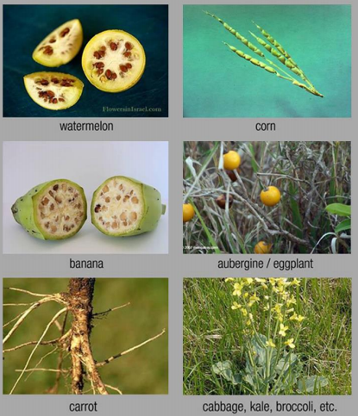
Before Domestication
So many of our most common foodstuffs look nothing like their ancestors.
Since humans have started domesticating plants for wide spread production we have chosen the traits we want to see in plants.

Slide 11
Notes:
Let your students move around any of the card they feel should be moved into a new group.
Ask them some more leading questions : “When we select plants to grow as crops how do we choose? What controls those traits?”

Slide 12
Notes:
Clearly some of these techniques have been used long before we knew anything about DNA specifically.
We didn’t find out about DNA structure until 1952 and it still took several years before we fully understood the importance of DNA to heredity.
Not all of these techniques require the same level of technology to achieve.

Slide 13
What’s the difference…???

Slide 14
Notes:
The key is specifically the number of genes that are changed at once.
Traditional techniques have the potential to change thousands or hundreds of thousands of genes at once. With this type of breading you cannot choose to target one specific gene without possibly effecting many others. This of it as one good but thousands of possible bads too…. This process can take a long time, with many many crosses before the desirable combination of traits occurs, if ever at all!
Genetic Engineering uses technology to specifically isolate one gene or one small set of genes to confer the a single desirable trait. Since only one gene is altered or inserted you don’t have to worry about any additional changes to the rest of the genome.

Slide 15
So where would we draw the line here?
Source: GMOanswers.com

Slide 16
Only Transgenesis
Adding a specific , well-characterized gene to a new organisms to transfer a specific trait!
One or a few traits!
Lots of methods to get the new trait into the cell!
Gene Gun Particle Accelerator
DNA microinjection
Retrovirus Insertion
Restriction Enzyme Insertion
Stem Cell Transgenesis

Slide 17
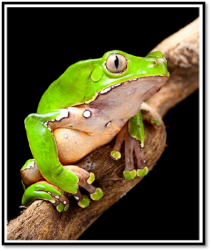
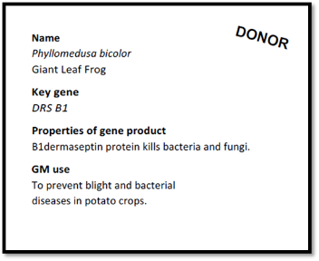
Transgenic Speed Dating!!!
Part of the struggle is finding your match!
What gene do I need to add into this crop? Where do I get it from?
Lets Play!
Each player has a card (Recipient or Donor)
Read your card, find your purpose, what do you do?
Find your gene mate!
Hint, there might be more than one!!!
Notes:
Hand out a card to each individual. Make sure that you have provided pairs to all the cards.
Arrange students in your preferred mode, just make sure it involved movement!
Option 1: Could be donor sitting and recipients standings and recipients move from table to table, rotating every 30-60 seconds.
Option 2:Could do an inside outside circle donors in one circle, recipients in the other, rotating every 30-60 seconds. ….
Option 3: Could do a “stand up, pair up”….. Have students mill around the room until their find their match

Slide 18
Match Reflections….
What organisms are involved?
Who is the donor, what are they giving?
Who is the recipient?
Are these the same type of organism?
What problem is this addressing?
Aka Pest resistance, medical treatments….
How can this help the world? / Making things easier or better?
Notes:
Have students fill out their reflections on a large piece of sticky paper or a white board.
Set up all the reflections for the students to see the pairs OR have students share out their reflections for the entire group.
Once all groups have shared or you have gone through a gallery walk, ask students if you have all the data yet?
The biggest question out there today is “ARE GMO’s SAFE?”

Slide 19
Notes:
Here is an example of how you might decide to make your poster to share with the class!

Slide 20
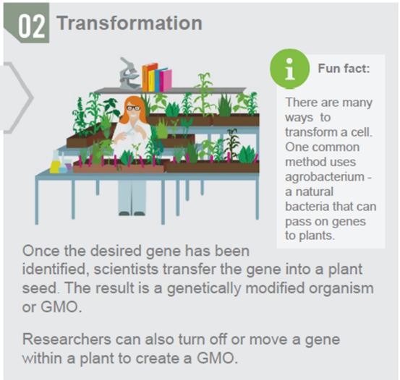
What happens next? Here’s a look a the cycle!
Notes:
Scientists are not going through the world and randomly creating transgenic organisms with whatever they can find. The process is long, takes millions of dollars, and can be decades of work by countless individuals completing rigorous testing at every possible turn.

Slide 21
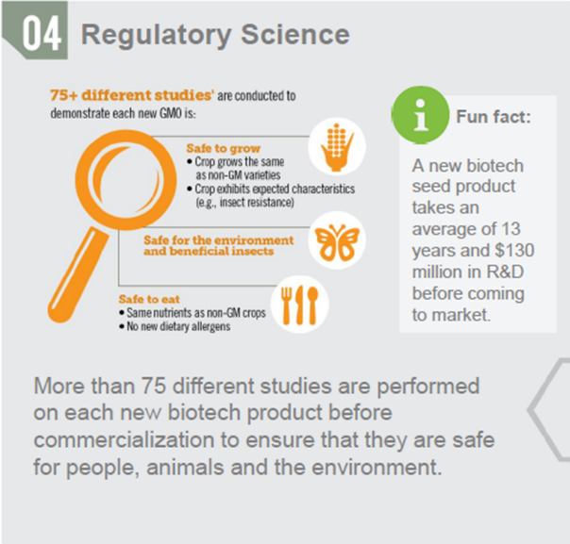

Slide 22
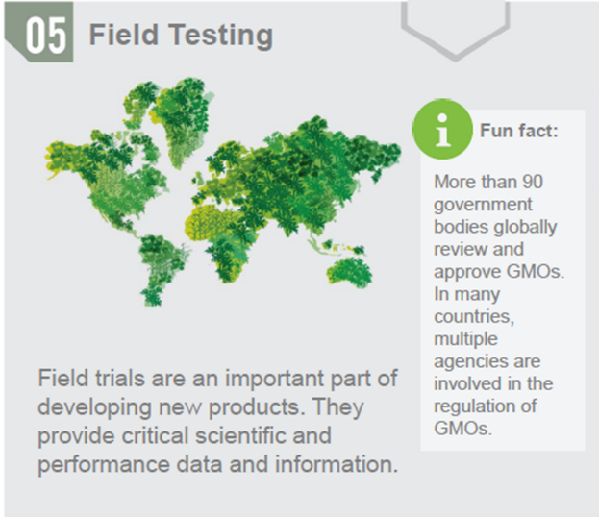
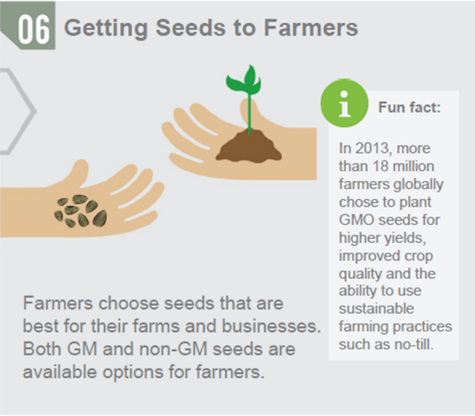

Slide 23
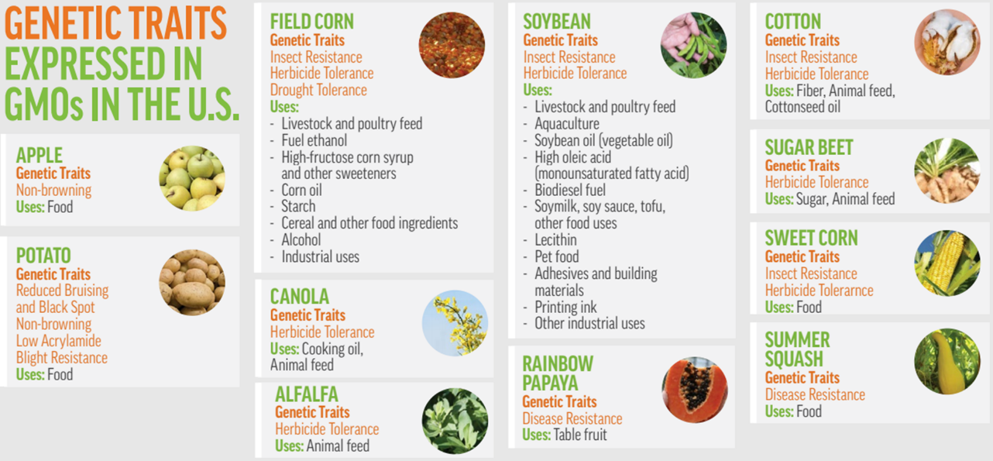
Notes:
This represents all of the transgenic crops that are present in the US!
Is this smaller than you expected? Do you see some missing?
All of the medical uses have been omitted because they are screened under a much more rigorous standards by the FDA!
All of the fiber transgenics are also excluded, like spider web goats milk, are used in industry and not food or crop production.

Slide 24
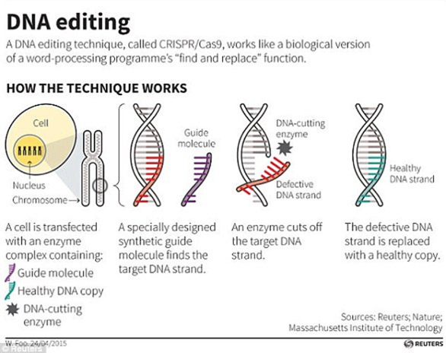
Genetic Engineering in the future?
Altering the DNA within an organism by changing the organisms original genome.
Deleting genes that are harmful
Duplicating genes that induce certain protein productions, additional starch production in corn
Editing genes to change specific sequences and change proteins
So… GMO or Not?

Slide 25
Budget
This lab is made possible with the support and content contributions of the Kansas Corn Commission.

