Slide 1
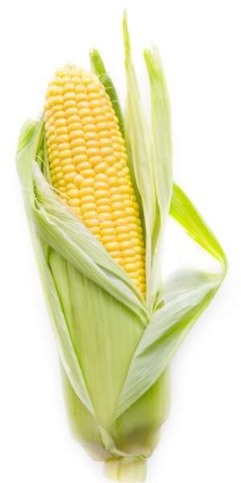
Mendelian Inheritance and Chi Square Analysis

Slide 2
Observe the ear of corn your group has been given, and record your observations.

Slide 3
What did you notice?

Slide 4
Do you think blue is dominant or recessive?
Are there any green kernels?
What does this indicate?

Slide 5
If this is ear is the F₂ generation, what do you think is the genotype of the F₁ plants that produced it?
Bb x Bb

Slide 6
Pick several rows of kernels and count 100 kernels keeping track of how many are blue and how many are yellow.
 | Blue | Yellow
Observed | 67 | 33
Expected 3:1 | 75 | 25

Slide 7
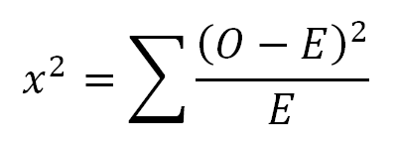
Chi Square Analysis
A chi square is used to determine the percent chance that the observed difference between the predicted and observed value is due to chance alone. The agreed upon limit for this value is 0.05 or 5%.
sum
observed
expected
Chi square value
expected

Slide 8
Chi Square Analysis
 | Blue | Yellow
Observed | 67 | 33
Expected 3:1 | 75 | 25
(8)²
(8)²
64
64
+
+
75
25
75
25
64
64
+
3.41
75
25

Slide 9
Chi Square Analysis
3.41
 | Blue | Yellow
Observed | 67 | 33
Expected 3:1 | 75 | 25
Degree of freedom = # possible outcomes -1
Degree of freedom= 2 - 1
Degree of freedom= 1
Degrees of Freedom | Probability of exceeding critical value
 | 0.10 | 0.05 | 0.025
1 | 2.706 | 3.841 | 5.024
2 | 4.605 | 5.991 | 7.378
3 | 6.251 | 7.815 | 9.348
4 | 7.779 | 9.488 | 11.143

Slide 10
Repeat the procedure for the Smooth or Shriveled trait.

Slide 11
Dihybrid cross, looking at the inheritance of both traits at the same time.
Possible Phenotypes
Blue & Smooth : Blue & Shriveled : Yellow Smooth : Yellow Shriveled
How many degrees of freedom? # possible outcomes - 1
4 - 1 = 3 degrees of freedom

Slide 12
If the traits are inherited independently, the rule of multiplication applies and the probabilities of each event occurring can be multiplied together to find the probability of both occurring.
Blue x Smooth
Blue x Shriveled
Yellow x Smooth
Yellow x Shriveled

Slide 13
Chi Square Analysis
 | Blue Smooth | Blue Shriveled | Yellow Smooth | Yellow Shriveled
Observed
Expected Ratio : : :

Slide 14
What value should the X² be compared to in this cross?
Degrees of Freedom | Probability of exceeding critical value
 | 0.10 | 0.05 | 0.025
1 | 2.706 | 3.841 | 5.024
2 | 4.605 | 5.991 | 7.378
3 | 6.251 | 7.815 | 9.348
4 | 7.779 | 9.488 | 11.143

Slide 15
Budget
This lab is made possible with the support and content contributions of the Kansas Corn Commission.

