Slide 1
Corn-ucopia
(Explore Corn)
Kansas Corn STEM - kscorn.com
Presenter: Christopher Remmich
Garden City High School
cremmich@gckschools.com

Slide 2
Goals - Corn-ucopia
Overall - Learn about the copious amounts of different activities to introduce your students to the science of corn and agriculture
Learn the characteristics of 8 different types of corn
Identify the main structures of a corn plant
Explore an ear of corn using qualitative and quantitative analysis
Identify the different corn growth stages with the Leaf Collar Dissection Method

Slide 3
But, First........
Some Jokes
3 - 5 minutes

Slide 4
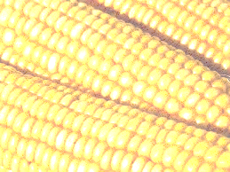
Joke
What do you call a single kernel of corn?

Slide 5
Answer
a uni-corn

Slide 6
Joke
What advice did a mother give her child for taking a shortcut through the cornfield to go to school?

Slide 7
Answer
Watch out for stalkers!

Slide 8
Joke
What did the baby corn say to the mommy corn when Daddy corn did’t come home?

Slide 9
Answer
Where’s Popcorn?

Slide 10
Joke
What does kansas corn and kansas basketball have in common?

Slide 11
Answer
They are both better than what nebraska has to offer

Slide 12
Joke
What do you call it when A carrot, some corn and a cucumber fall into the ocean?

Slide 13
Answer
C food

Slide 14
Joke
What happens when you take off your shoes next to the campfire while eating corn chips?

Slide 15
Answer
you get Tostitoes

Slide 16
Joke
I always love telling jokes about corn having eyeballs...

Slide 17
Answer
But they keep getting cornea and cornea

Slide 18
Joke
Why did they plant wheat next to Mike Tyson’s house instead of corn?

Slide 19
Answer
They were afraid he would eat all of the ears

Slide 20
JOKE!
How much does a pirate pay for an ear of corn?

Slide 21
Answer
Answer: A buccaneer

Slide 22
Joke
I am writing a TV show about two ears of corn that are cops......

Slide 23
Answer
It’s called STARCHsky and Husk

Slide 24
Well Done!
You all deserve.........
Some corn dogs!

Slide 25
Introduction to Corn Article
Highlight 5 things you feel are the most important takeaways.
Then.......fold your paper in half - hamburger style - and on the back of your paper..........draw (without using any words and without your neighbors seeing) the one thing you found to be the most interesting.
When finished, fold it closed and wait until further instructions.
5 - 7 minutes

Slide 26
Introduction to Corn - Article with Kahoot!
A. Start a class discussion:
Where is corn grown? Why is it grown there?
How is corn grown?
Are there specific stages that corn goes through when it grows?
When can you harvest corn?
How many ears of corn are there on one stalk?
How many kernels of corn are found on each ear?
How many corn plants can be grown on an acre of land?
What types of corn are there?
What products are made from corn?
B. Have students read Introduction to Corn article:
Encourage students to highlight, in a specific color, important concepts they would like to further explore. Also, have students highlight, in a different color, important facts or take-a-ways from the world of corn.
Then have students get together in groups. Hand each group a big sheet of butcher paper and a box of colored markers or pencils.
Ask each student within the group to draw a picture that represents a piece of information they took away from the article – no words!
After given enough time to complete this activity (~15 minutes), ask each group to present their drawings to the class and talk about one of the pictures and the information it represents. Once a piece of information has been used, groups afterwards cannot repeat that information.

Slide 27
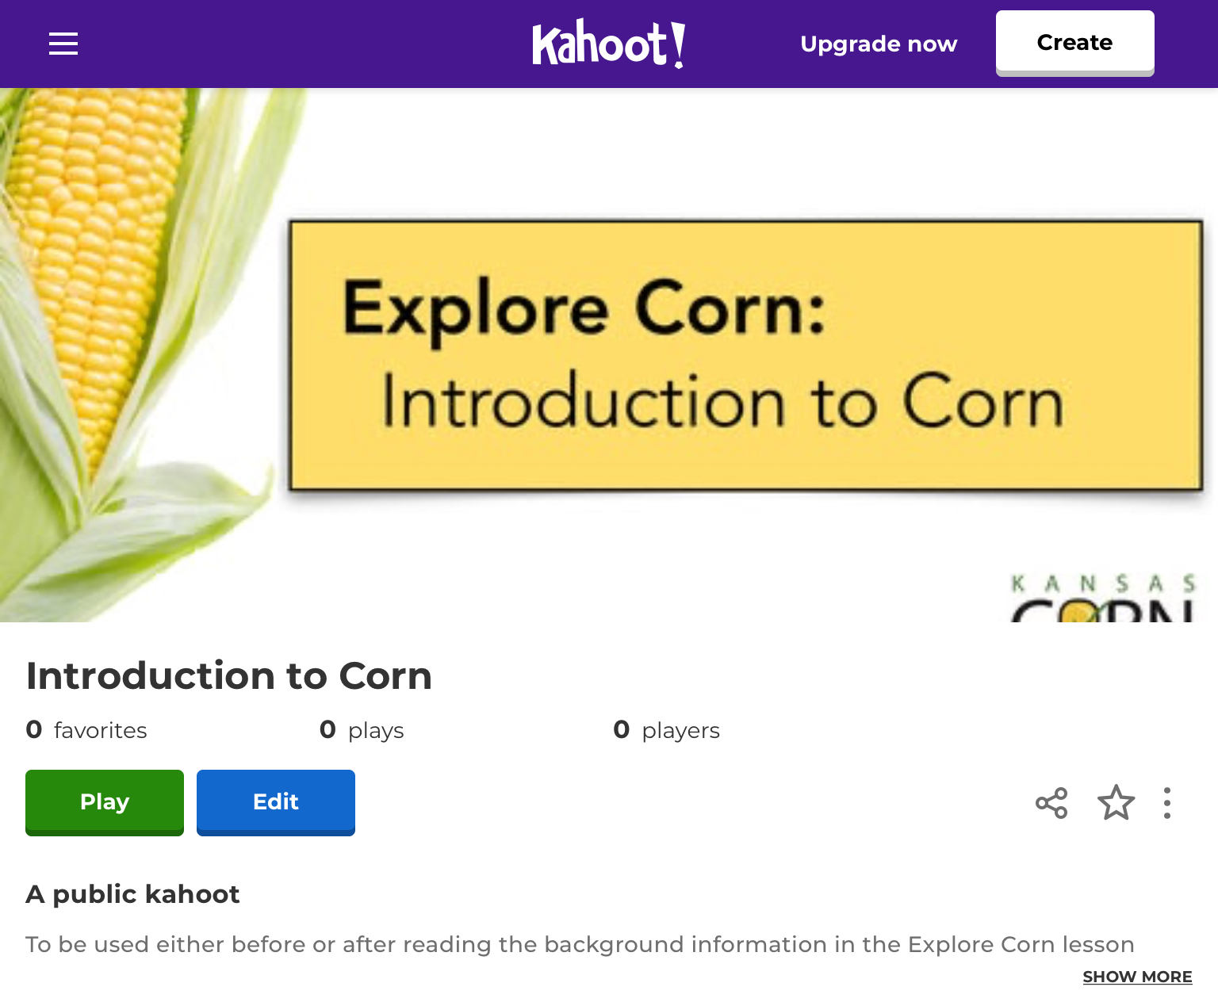
Introduction to Corn - Article with Kahoot!
C. Kahoot!: Introduction to Corn
https://tinyurl.com/CornIntroKahoot
D. Reflection Questions
What are three uses for corn?
Human consumption, livestock feed, ethanol, nylon fibers, plastics, etc.
How long has corn been around? Where did it originate?
9,000 years from Central Mexico or sweet corn developed in 1700s.
How many kernels are on an ear of corn? How many plants can grow on one acre?
600-800 kernels on one ear and 22,000 to 35,000 plants per acre.
What percentage of corn is used for human consumption?
9%
What should the ground temperature reach before planting corn?
After consecutive or future days of 50 °F

Slide 28
Section 1 - History of Corn
A Brief History of Corn Article and Quizizz
A. A Brief History of Corn Article:
Make copies of the A Brief History of Corn article.
Students can read the article individually or,
If in groups, each student can read one of the pages and become an “expert” on that topic.
Be sure that they are actively reading by highlighting key points.
After each student is done reading their page, they will then explain what they have read to the group.
B. A Brief History of Corn Quizizz:
Each student can follow the link to the Quizizz that contains 10 review questions. This can be assigned individually and at the student’s pace, or this can be done as a whole class.
A Brief History of Corn Quizizz: https://tinyurl.com/CornBriefHistory
As a class: Click on the Play Live button. Choose either: Team, Classic or Test and click the Continue button. Have students enter the Game Code. When all players have entered, click the Start button to begin the game.
For self-paced individuals: Click on the Assign HW button. Enter how long you want the Quizizz to be open as well as any customizations found under the Advanced Settings. Click the Continue button. You can copy the link and give that to your students or give them the join code.

Slide 29
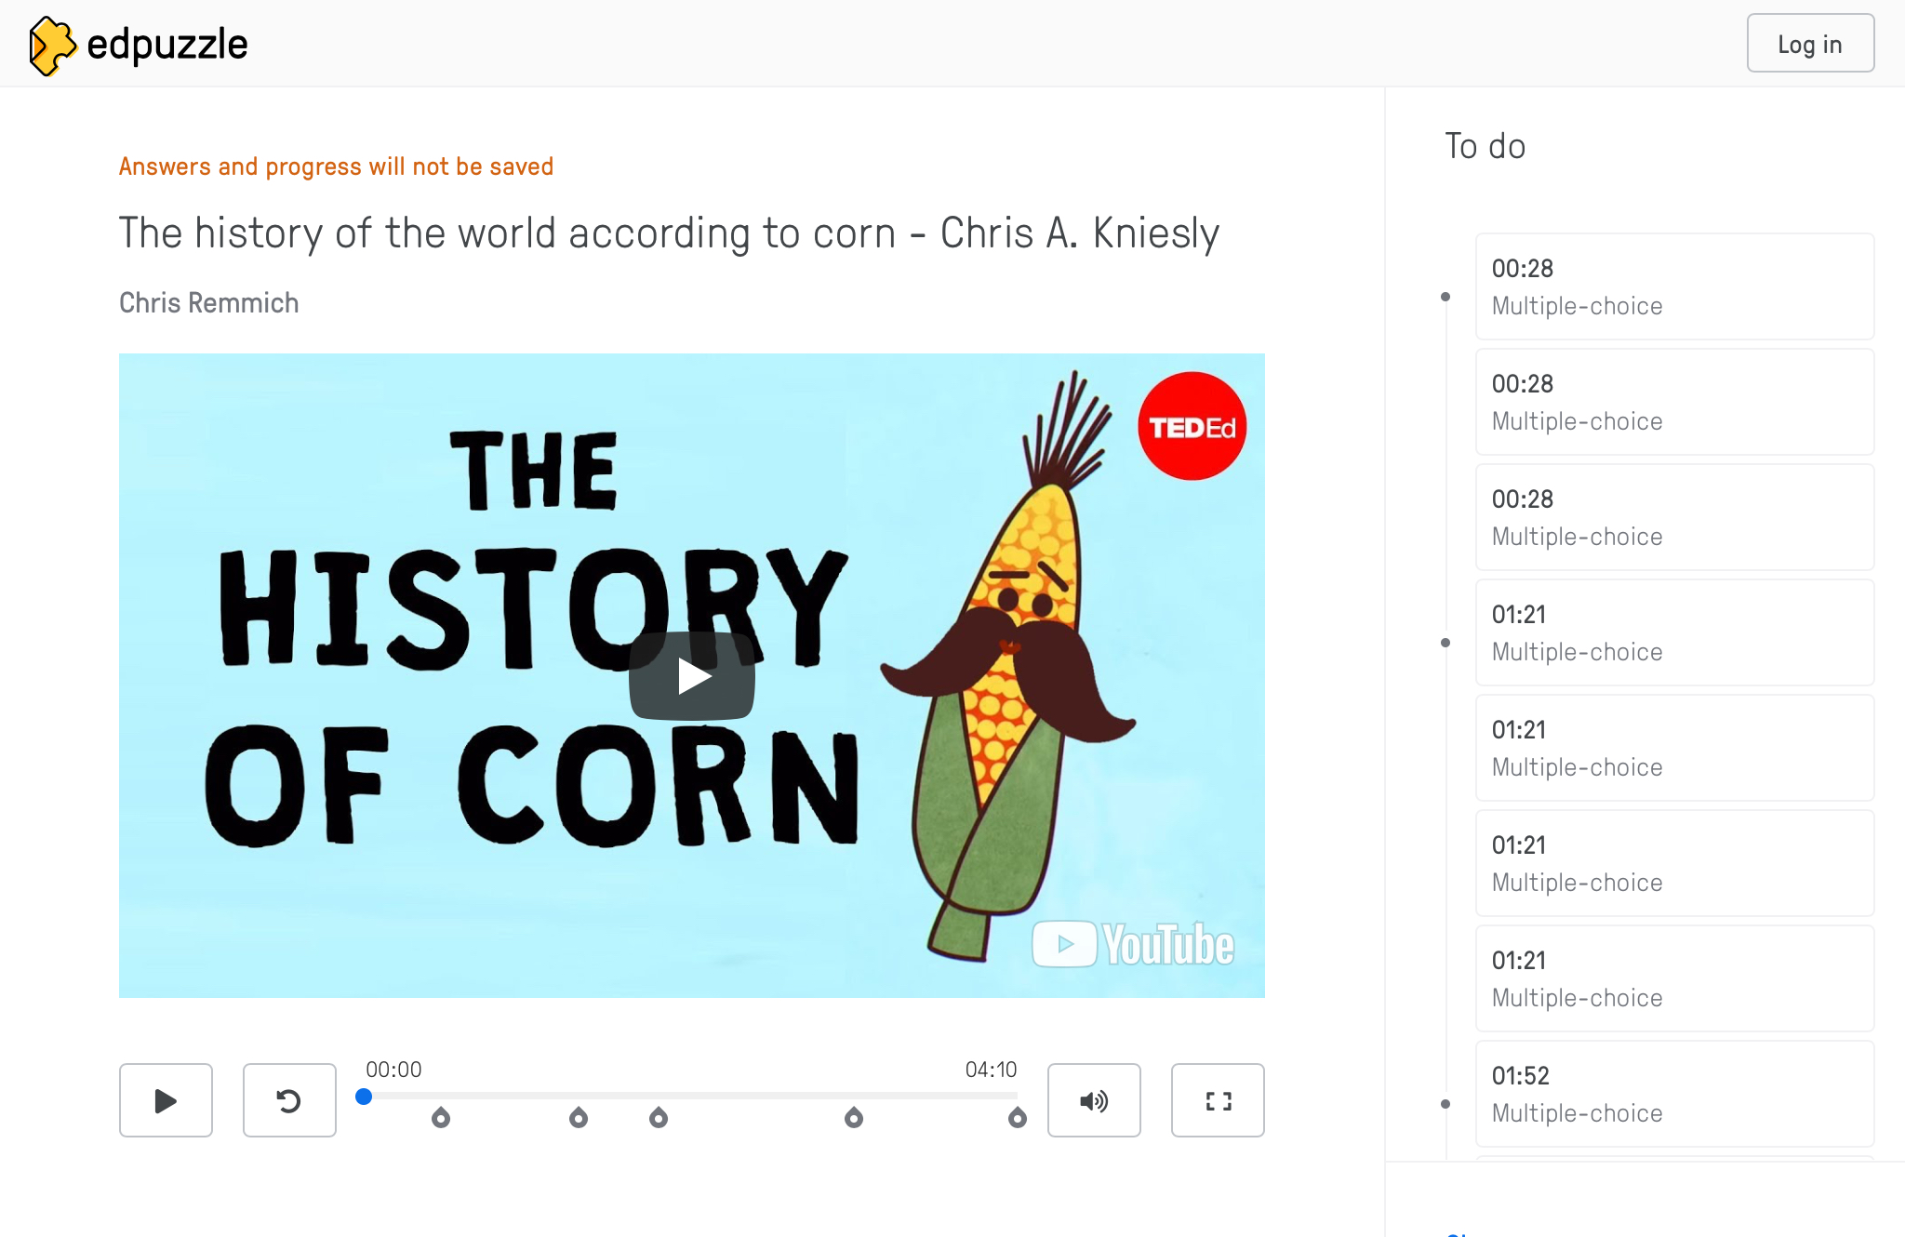
Section 1 - History of Corn
TED-Ed: The History of the World According to Corn Edpuzzle Video with Questions
A. TED-Ed: The History of the World According to Corn Video
Have students access the TED-Ed: The History of the World According to Corn video through Edpuzzle by the following link:
https://tinyurl.com/TedEdCornHistory
There are 14 multiple choice questions that pop up throughout the video.
This can be done together as a class or assigned to the individual student.
To track student progress, the teacher will want to create an Edpuzzle account, it’s free.
www.edpuzzle.com
Create a class and give the Class Code to each of your students.
Find this video, either through the search function or the link above.
Click the Assign button to the right and select the class you want to assign it to.
You can customize the features and the due date.
B. TED-Ed Edpuzzle:
https://tinyurl.com/TedEdCornHistory

Slide 30
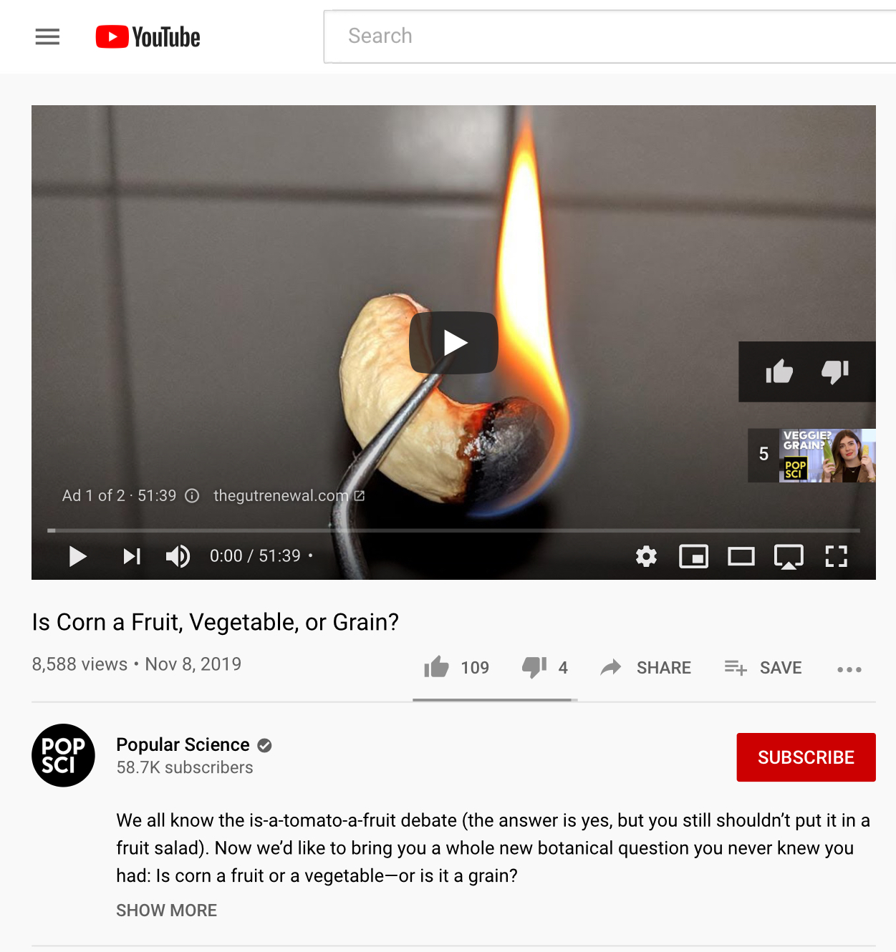
Section 1 - History of Corn
Is Corn a Fruit, Vegetable, or Grain Discussion and Video Clip
A. Is Corn a Fruit, Vegetable, or Grain? Discussion Question:
Ask students if corn is a vegetable, fruit or a grain.
Then have the students break out into three different groups based on what they believe. Put each group in a different part of the room – like the room’s corners.
Give each group 3-5 minutes to discuss why they chose their answer amongst themselves.
Then have each group make their case to the class.
Give a few minutes for students from each group to counter argue their case and to try to bring other students to their side of the room.
Be sure to give students a chance to move to a different group if they change their view.
Afterwards, count how many students were in each group: Fruit, Vegetable or Grain.
B. Is Corn a Fruit, Vegetable, or Grain? video:
Have the students return to their seats to watch the video, Is Corn a Fruit, Vegetable, or Grain?:
https://tinyurl.com/CornFruitVegetableOrGrain
As a review, ask if the video helped to change anyone’s mind.

Slide 31
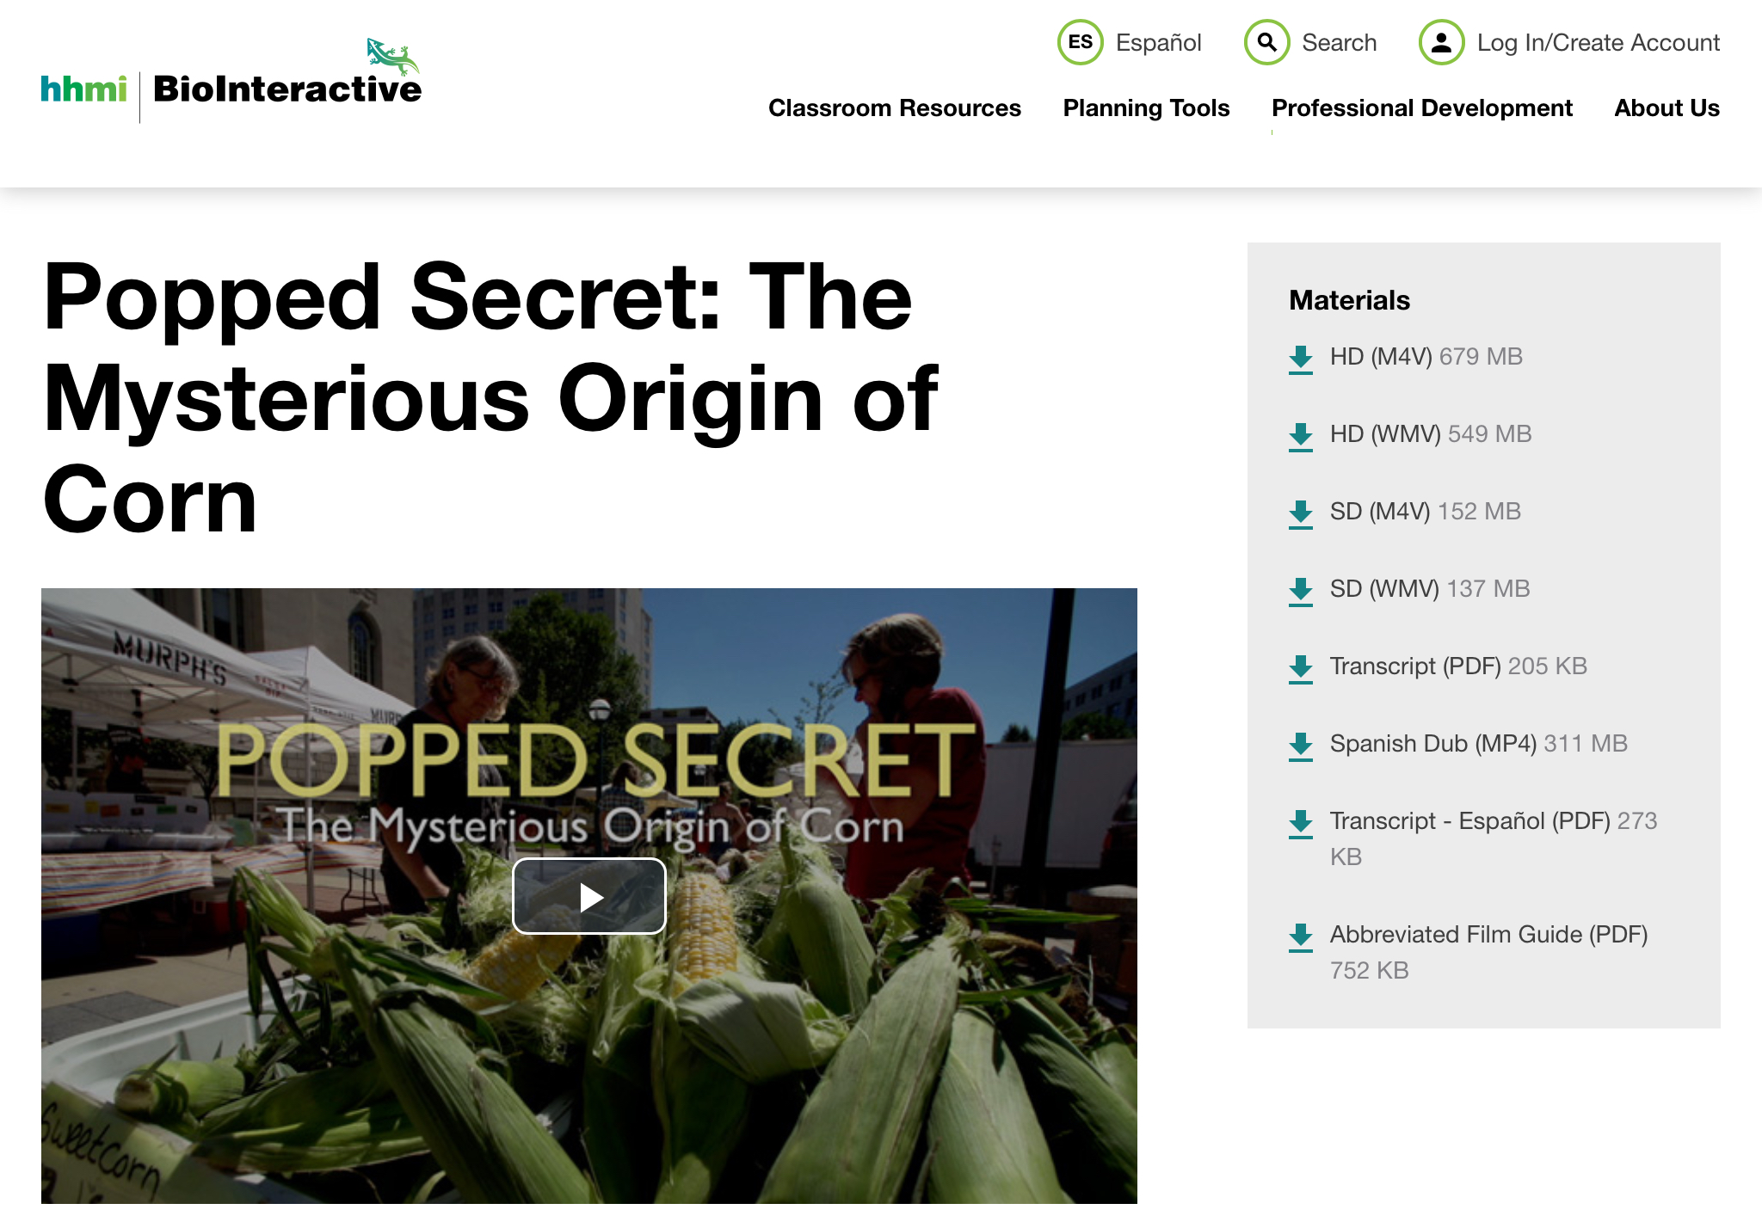
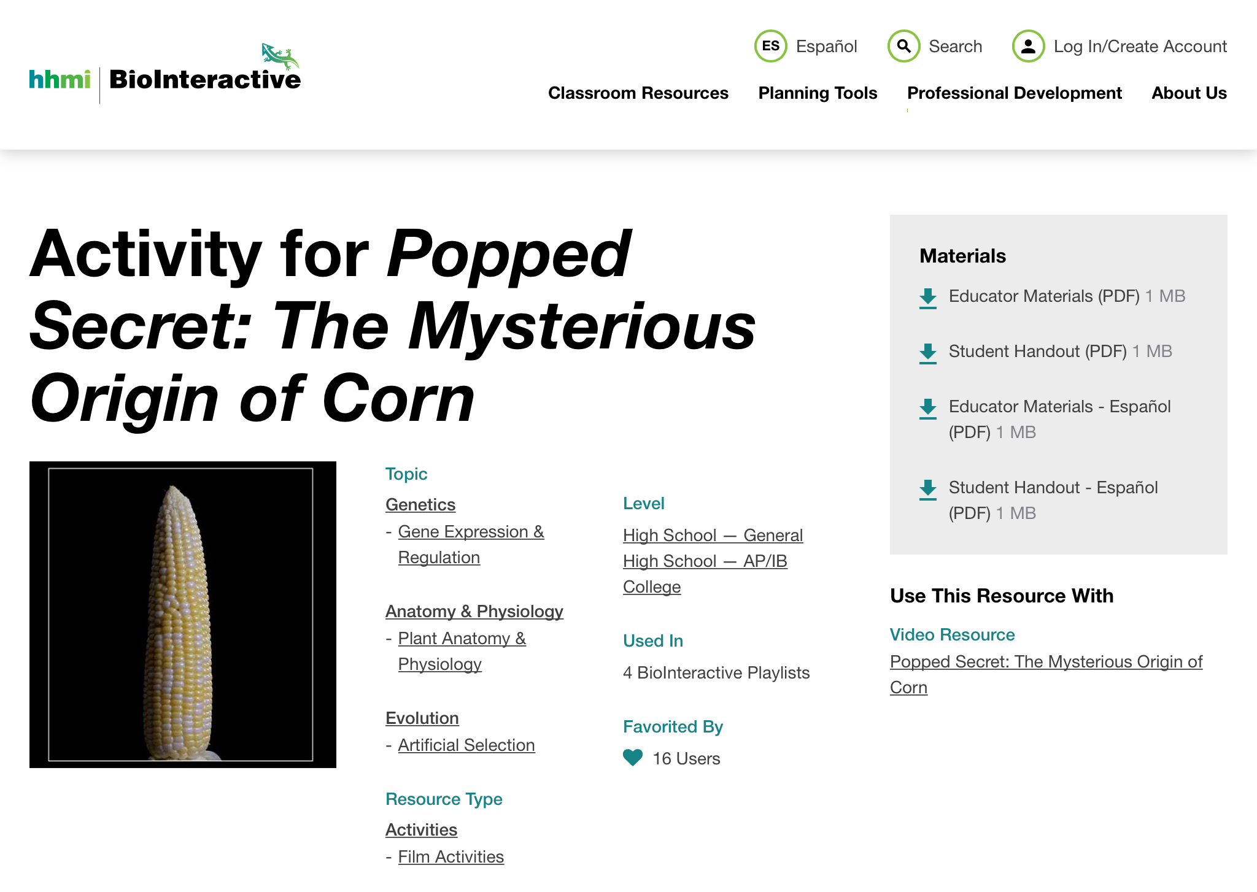
Section 1 - History of Corn
HHMI Biointeractive: Popped Secret - The Mysterious Origins of Corn Video and Activity Sheet
A. HHMI Biointeractive: Popped Secret - The Mysterious Origins of Corn Video:
This film and its activity worksheet explore how scientists used genetic and archaeological evidence to determine when, where and how corn was domesticated from the Mexican grass teosinte. Access the Popped Secret video (18 minutes) from the following link:
https://tinyurl.com/PoppedSecretVideo
B. HHMI Biointeractive: Popped Secret - The Mysterious Origins of Corn Activity Worksheet:
The Student Handout reinforces the concepts found in the video and can be downloaded using this link:
https://tinyurl.com/PoppedSecretActivity
Have students watch the video in its entirety before working on the student handout.
Educator materials are also available from the link above.

Slide 32
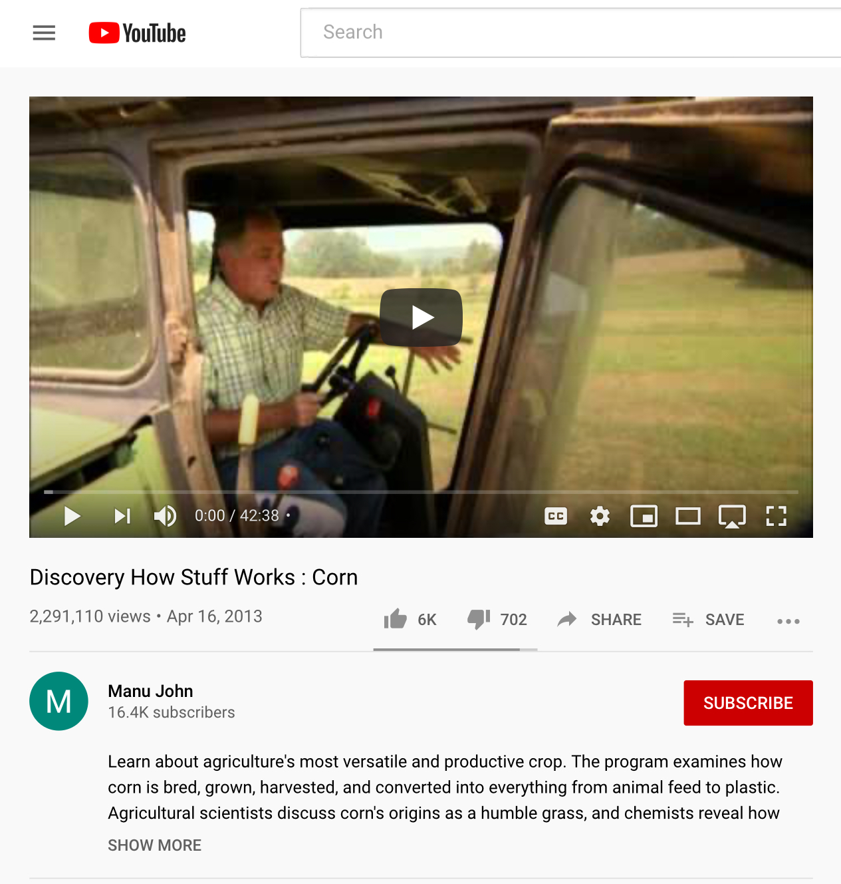
Section 1 - History of Corn
How Stuff Works: Corn Video
A. How Stuff Works: Corn Video:
A great video that introduces a person to the world of corn:
From how it is planted, harvested, used for feed and industry and as an ingredient in many household products.
This can be a video for students to watch as a class or as a reference for the educator to get a nice overview on the versatile role corn plays in our everyday life.
Here is the YouTube link to the video:
https://tinyurl.com/CornHowStuffWorks
B. Section 1 Reflection Questions:
When and where corn was first domesticated?
~9,000 years ago in Central America
What is another name for corn?
Maize
What was the earliest ancestor of modern-day corn?
The wild grass - Teosinte
What type of corn is the most widely used?
Yellow Dent #2
What common products can we find corn in?
Cereals, sodas, bioplastics, many foods, animal feed, ethanol, cosmetics, diapers, medicines, salad dressings, perfume, envelopes, gum, toothpaste, etc.

Slide 33
Section 2: Types of Corn
Corn Types Biosheet and Quizlet

Slide 34
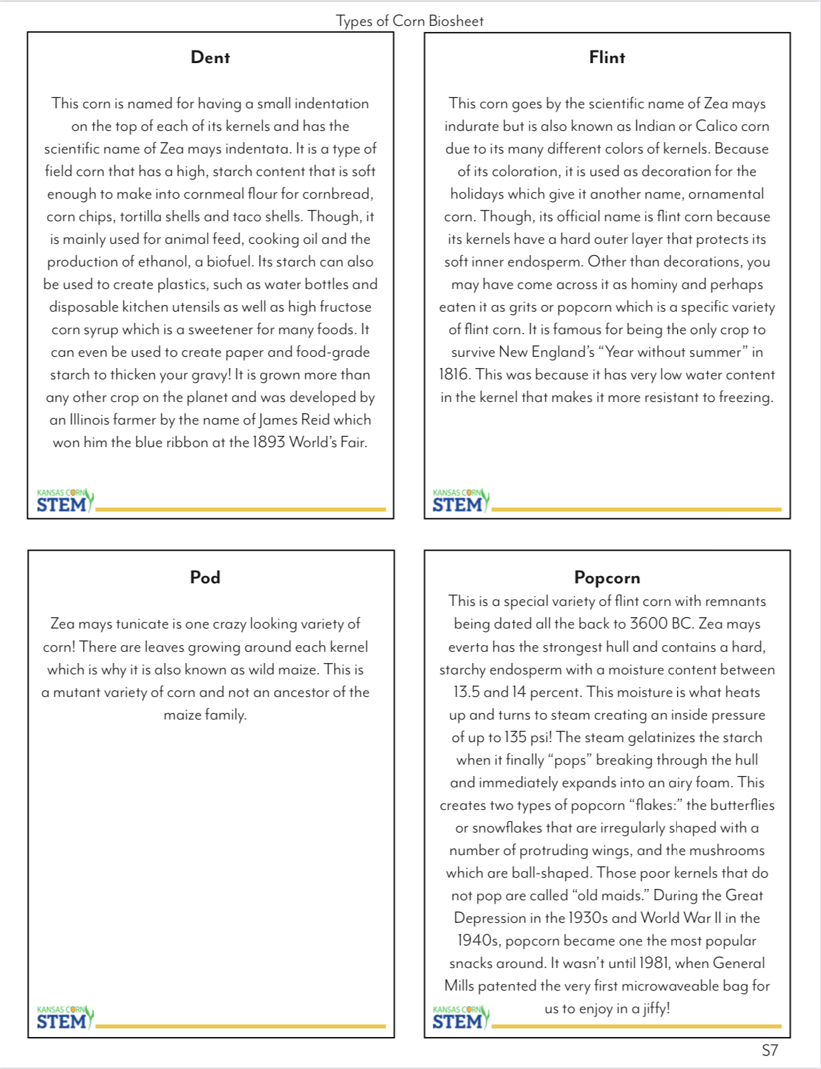
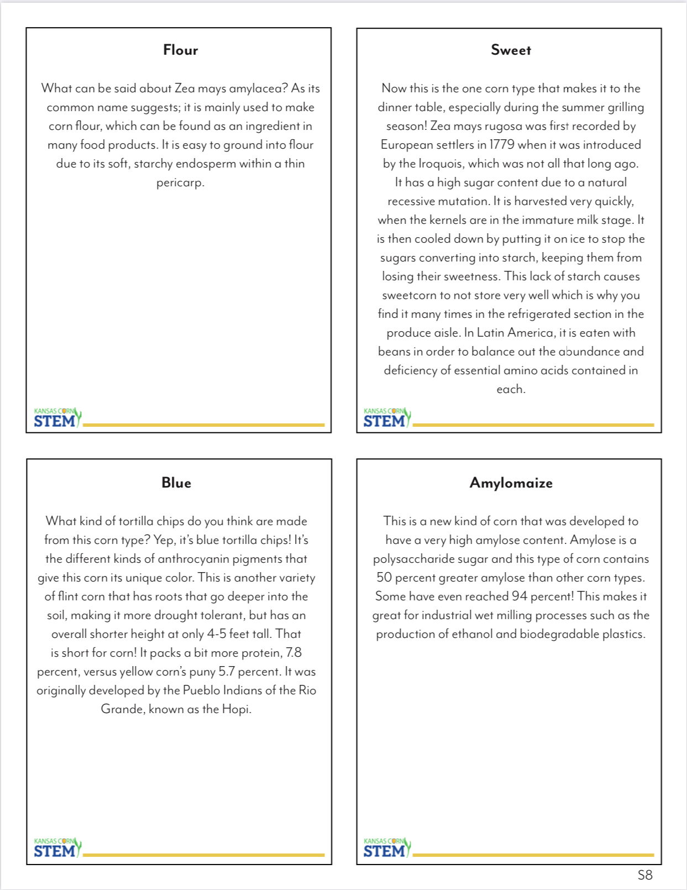
Section 2: Types of
Corn Biosheets

Slide 35
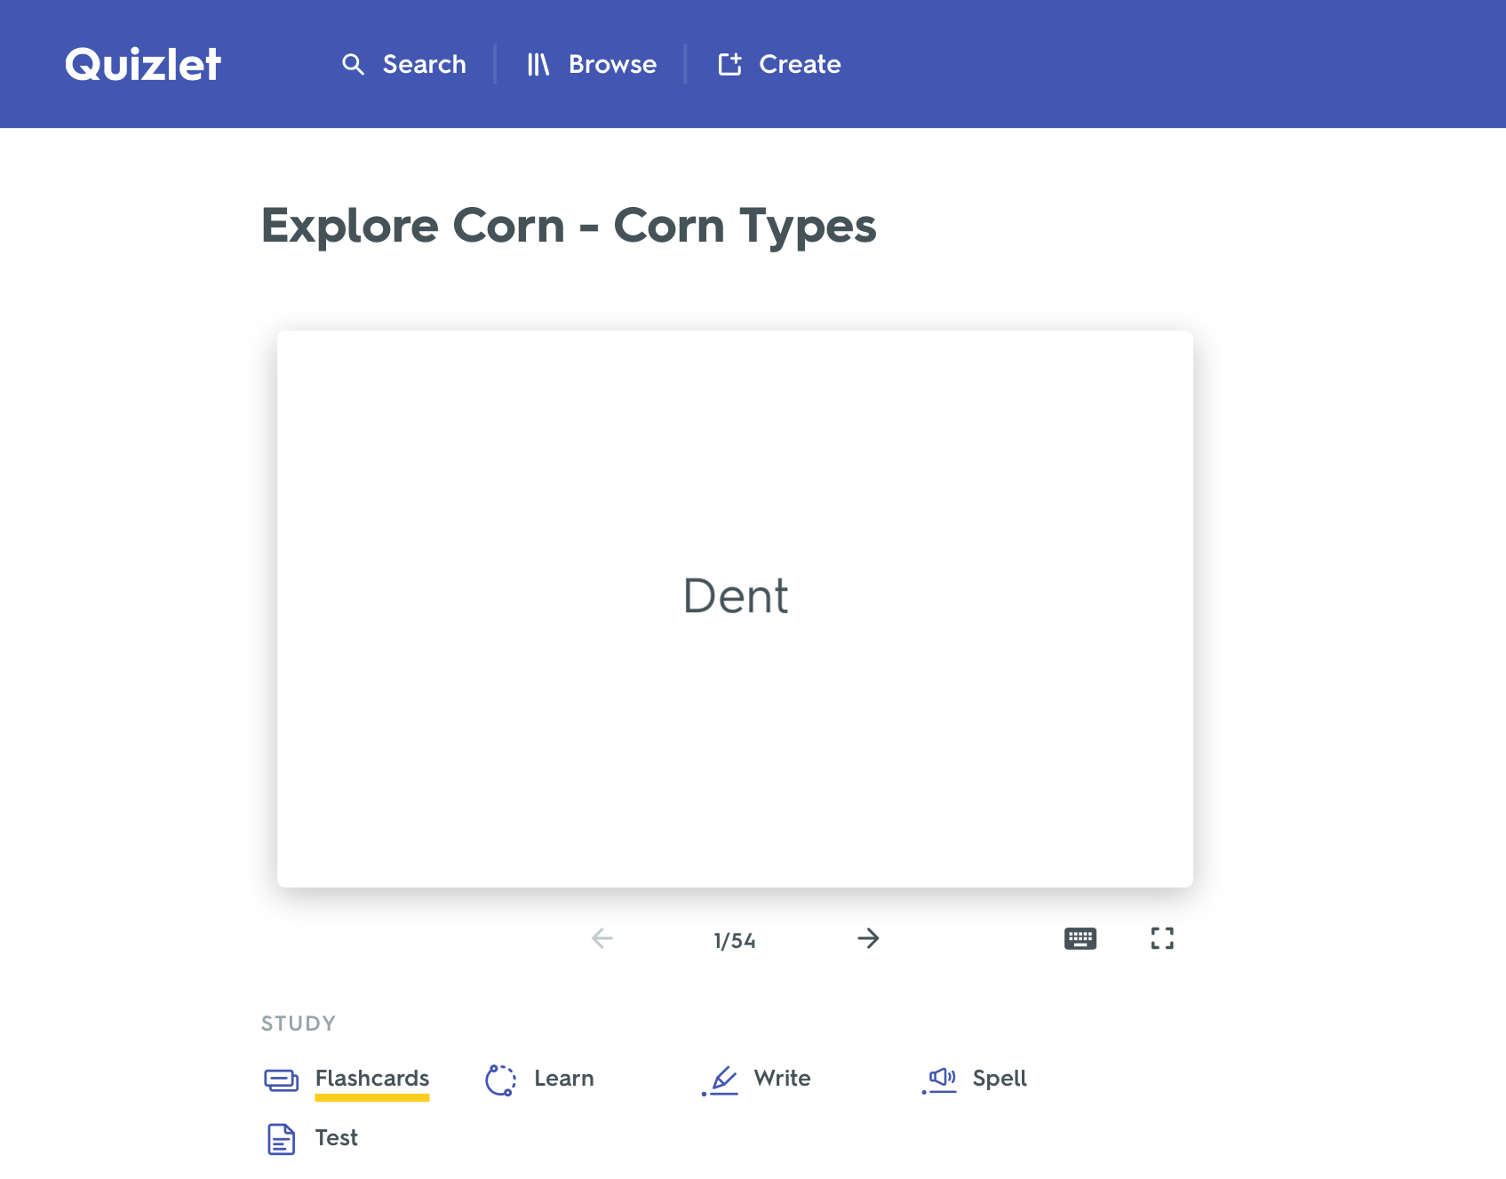
Section 2: Types of Corn
Corn Types Biosheet and Quizlet
A. Eight Types of Corn Biosheet:
Print out the Eight Types of Corn Biosheet for each group.
Have students highlight and compare the major differences between each type of corn.
A digital card set has been created in Quizlet. It contains the eight types of corn that are being studied in this unit along with their descriptions and characteristics. Students can access this card set and use it to study. The teacher can use it as a review after reading the Eight Types of Corn Biosheet.
B. Eight styles of Corn Quizlet:
Open Quizlet (www.quizlet.com) and find the Explore Corn – Corn Types or click the link:
https://tinyurl.com/CornTypesQuizlet

Slide 36
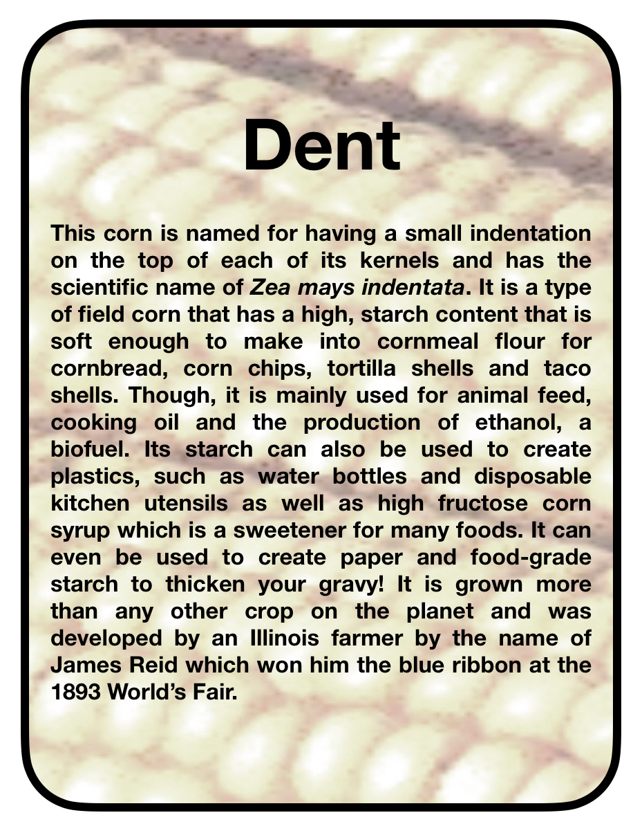
Section 2: Types of Corn
Corn Types Cardsort
A. Corn Types Cardsort Activity:
This is a fun reinforcement activity after reading the Eight Types of Corn Biosheet. There are eight Corn Type cards with Description cards that give the characteristics of each type of corn. These cards can be printed in as many sets as your classroom needs and can also be found at kansascornstem.com. Students will match the Description cards with the correct Corn Type card.
The group that correctly matches the most Description cards to their Corn Type cards, the fastest - Wins!
B. Corn Types Cardsort Alternatives:
Alternatively, groups can be timed how long it takes to complete the game. When finished, every wrong answer gets 10 seconds added to their time. The group with the shortest time wins!
Alternatively, the teacher can pass out the Corn Type cards and the Description cards along with the Eight Types of Corn Biosheet. Students can spread out the different Corn cards and as they read the Biosheet, they can place the Description cards with the proper Corn card. The teacher can check to see how well they were able to grab information from the text.
Alternatively, have all the Description cards placed around the room. Give each group one type of Corn card. They have to find all the Description cards for that type of corn and then they share afterwards.

Slide 37
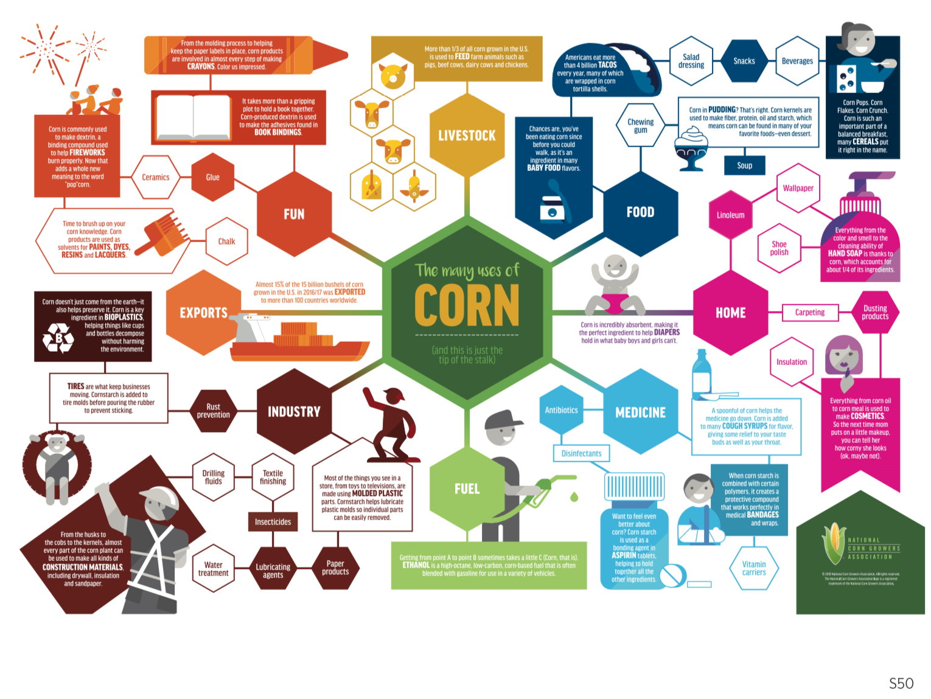
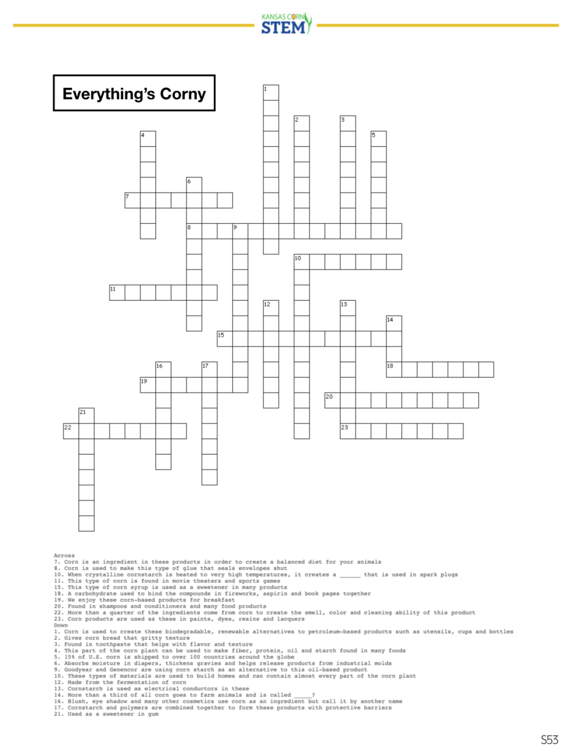
Section 6: Corn in Everyday Products
Everything’s Corny Crossword Puzzles

Slide 38
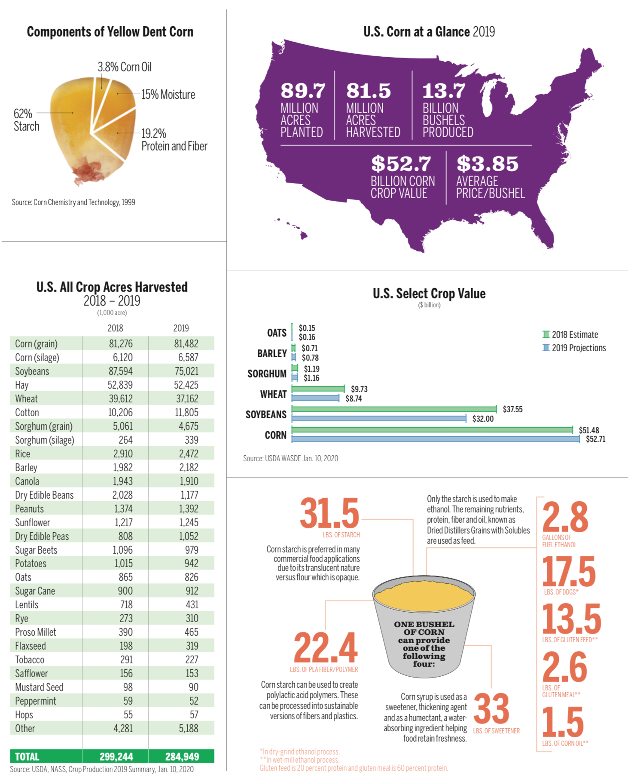
Section 7: Corn Data
Corn Graphs and Maths

Slide 39
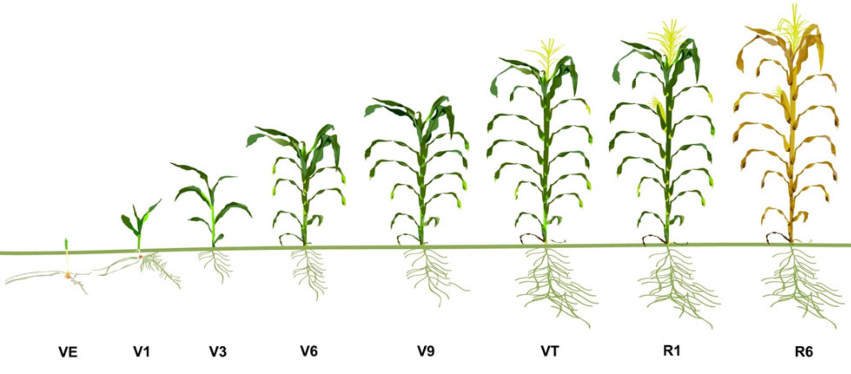
Section 3: Corn Growth and Development
Corn Stages

Slide 40
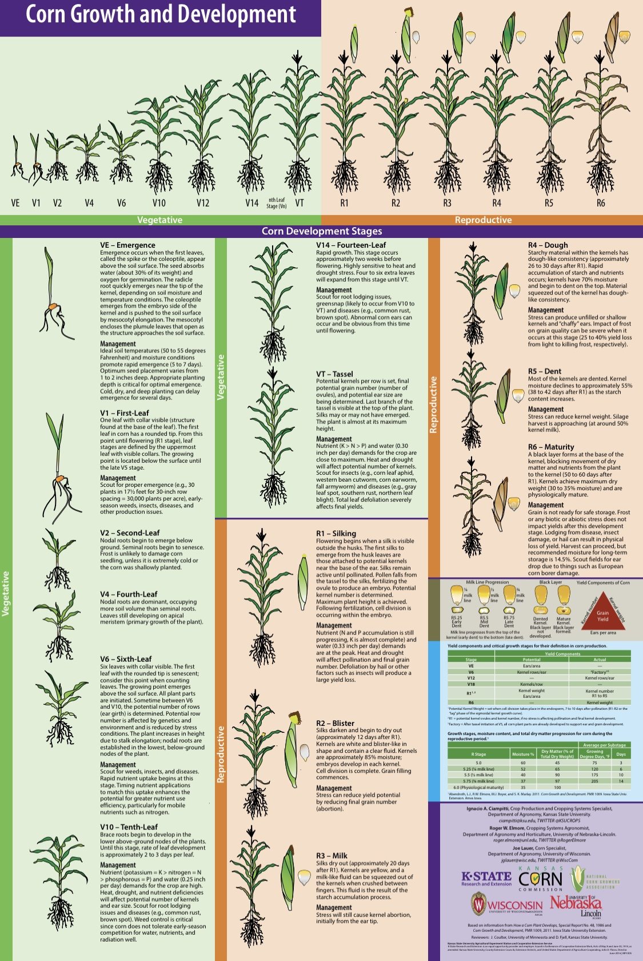
Section 3: Corn Growth and Development
Corn Stages

Slide 41
Section 3: Corn Growth and Development
Pioneer Corn Stages Webquest
A. Corn Staging Student Worksheet:
Pass out a copy of the Corn Staging Student Worksheet.
Students will need internet access to visit the DuPont Pioneer websites. The websites will be used as a resource to complete the Corn Staging Student Worksheet.
Students will read about and explore the different stages of corn growth while completing the worksheet.
Think of this as a pre-lab so students understand different stages of life of corn.
B. Corn Staging Resources:
Dupont Pioneer Overview of Stages of Corn Growth
Tinyurl.com/cornstages
Dupont Pioneer Vegetative Stages of Corn Growth
https://tinyurl.com/PioneerCornVegetativeStages
Dupont Pioneer Reproductive Stages of Corn Growth
https://tinyurl.com/PioneerCornReproductiveStages

Slide 42
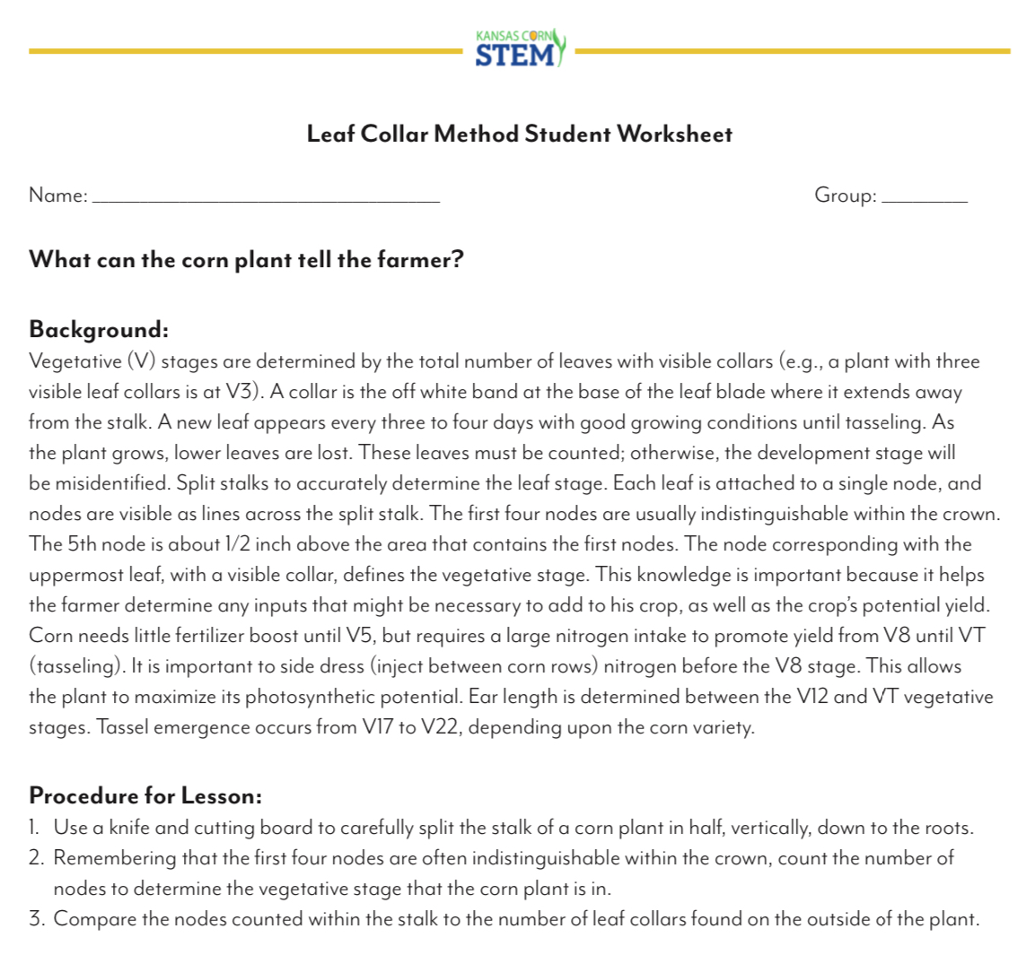
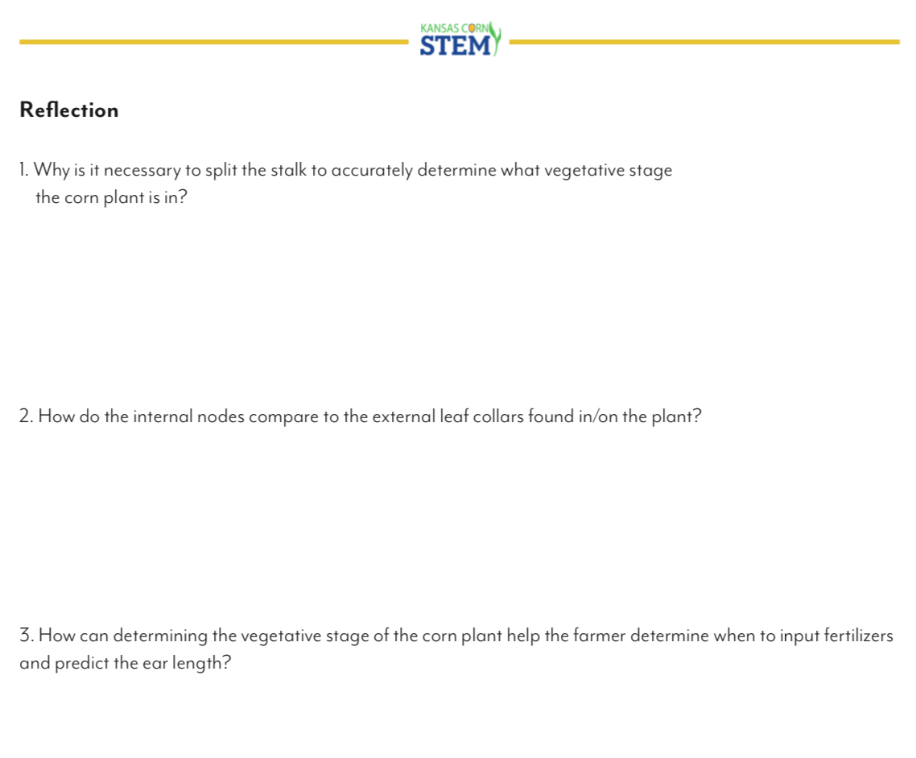
Section 8: Corn Plant Dissection
Leaf Collar Dissection Method

Slide 43
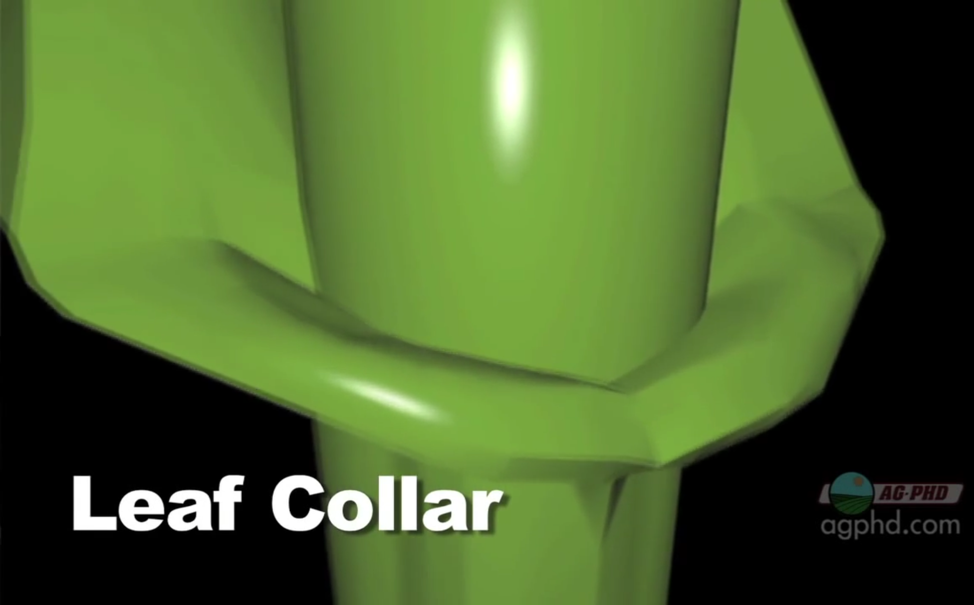
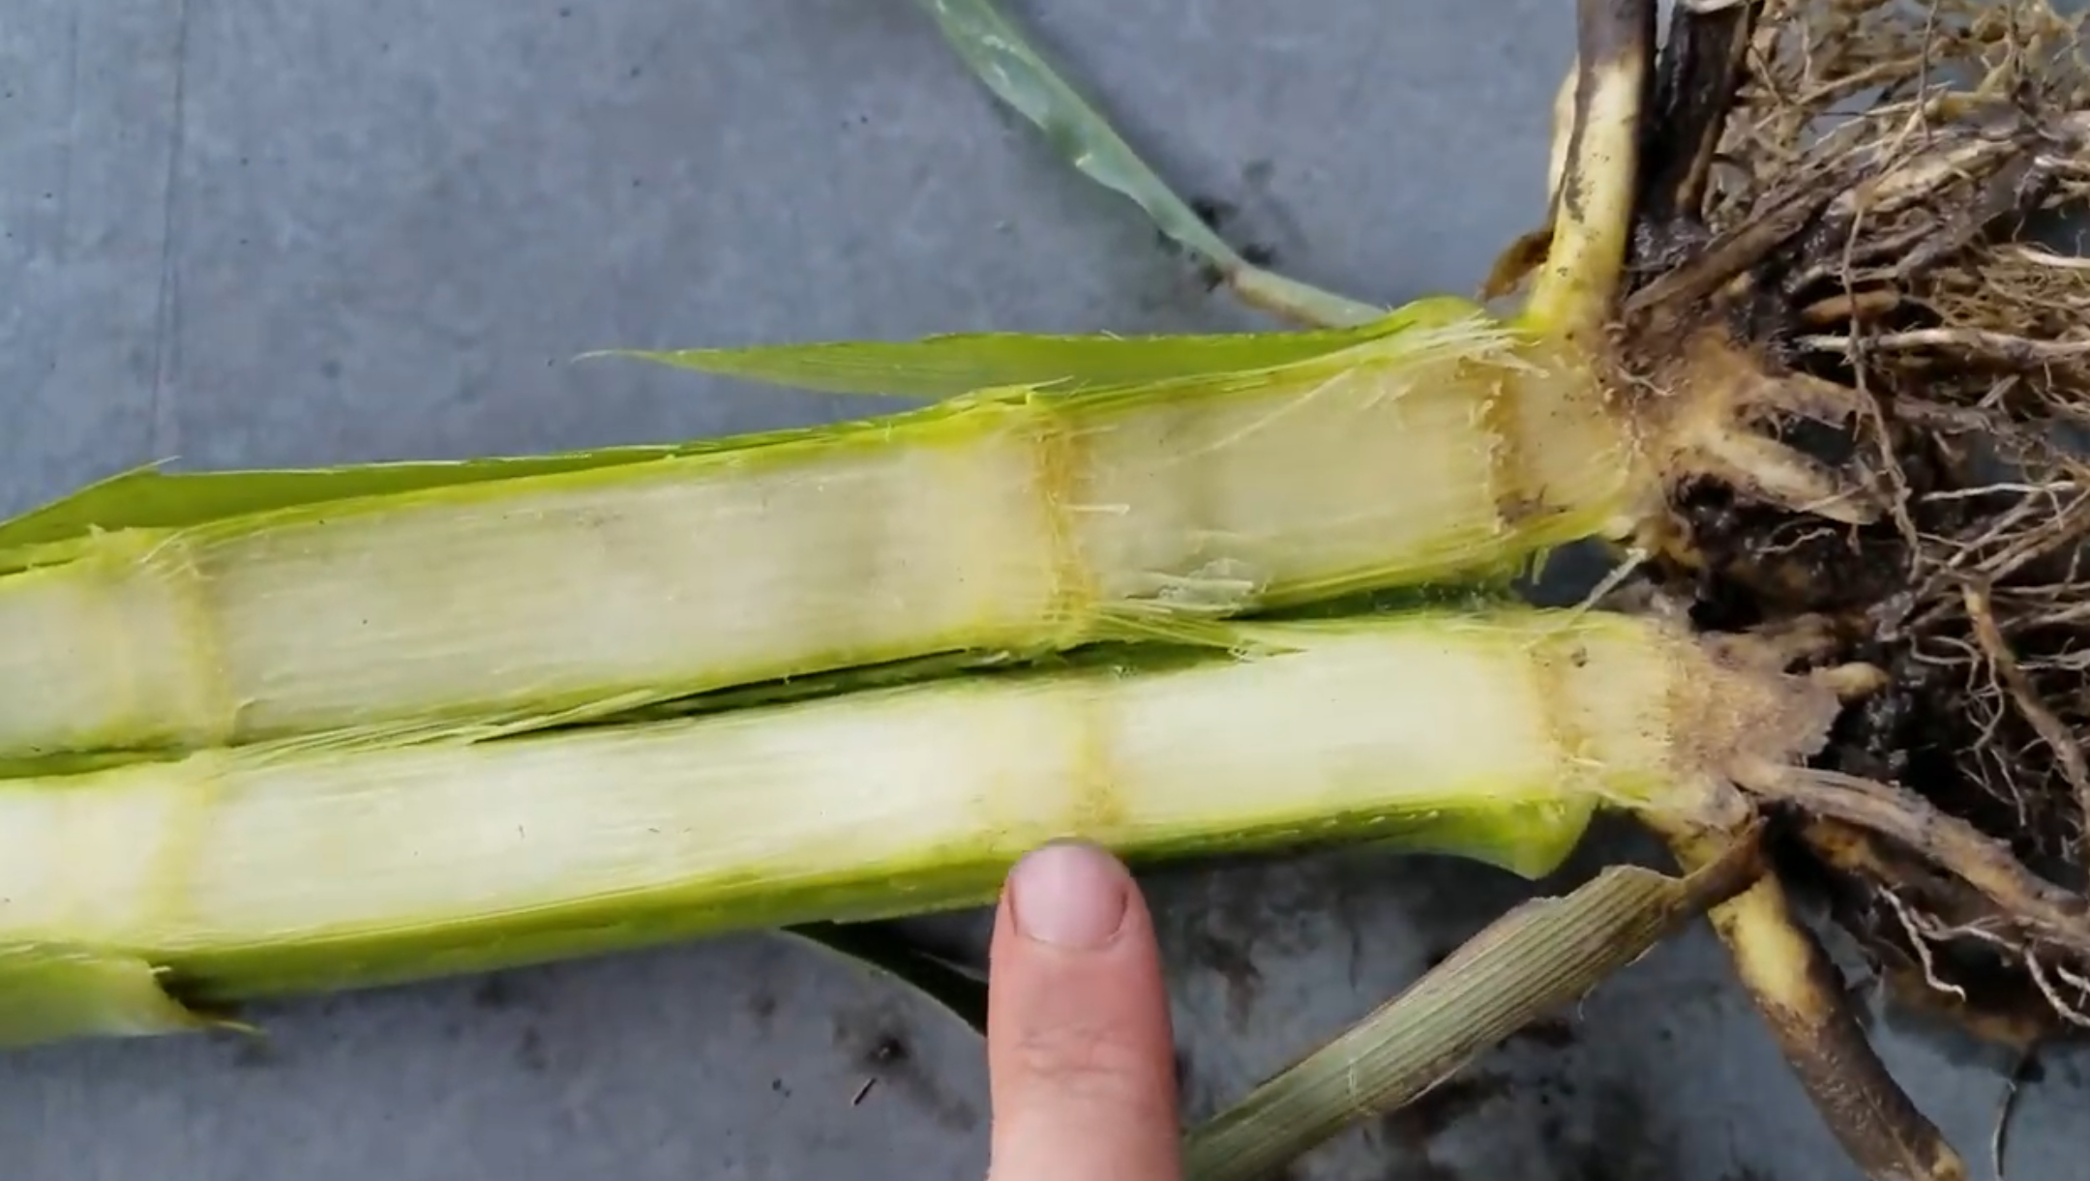
Section 8: Corn Plant Dissection
Leaf Collar Dissection Method

Slide 44
Section 8: Corn Plant Dissection
Leaf Collar Dissection Method
As a class, watch the following YouTube videos that discuss the Growth Stages of Corn:
https://tinyurl.com/FarmBasicsCornGrowthStages
https://tinyurl.com/GrowthStagingCorn

Slide 45
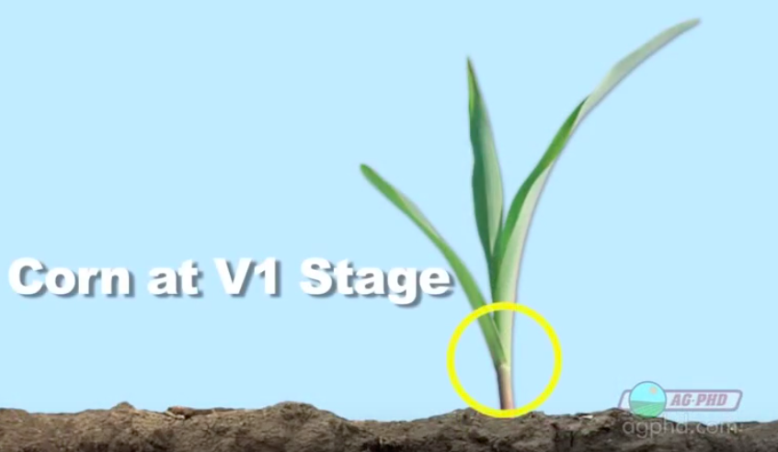
Section 3: Corn Growth and Development
Corn Stages
Click for Video on Corn Stage Growth
4 - 5 minutes

Slide 46
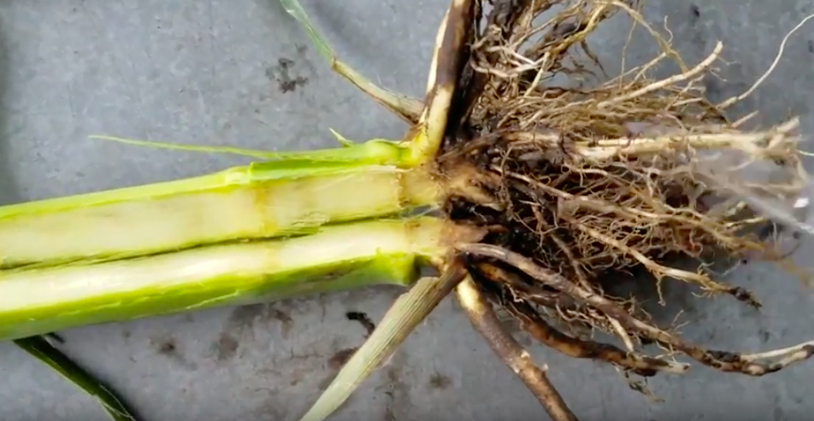
Section 8: Corn Plant Dissection
Leaf Collar Dissection Method
Click for Video on Corn Stage Growth
3 - 4 minutes

Slide 47
Section 8: Corn Plant Dissection
Leaf Collar Dissection Method
A. Leaf Collar Dissection Student Worksheet:
Students will break back out into groups of 3-5 for the Leaf Collar Method activity.
Students will be working with cutting utensils for this portion. Have students closely follow the instructions on their Leaf Collar Method Student Worksheet.
Use a knife and cutting board to carefully split the stalk of a corn plant in half, vertically, down to the roots.
The first four nodes are often indistinguishable within the crown, count the number of nodes to determine the vegetative stage that the corn plant is in.
Compare the nodes counted within the stalk to the number of leaf collars found on the outside of the plant.
B. Reflection Questions:
Why is it necessary to split the stalk to accurately determine what vegetative stage the corn plant is in?
How do the internal nodes compare to the external leaf collars found in/on the plant?
How can determining the vegetative stage of the corn plant help the farmer determine when to input fertilizers and predict the ear length?
Regroup the class at the end of this activity to talk through answers to questions.
*Corn Plant Structures and Function Matching Worksheet
12 - 15 minutes

Slide 48
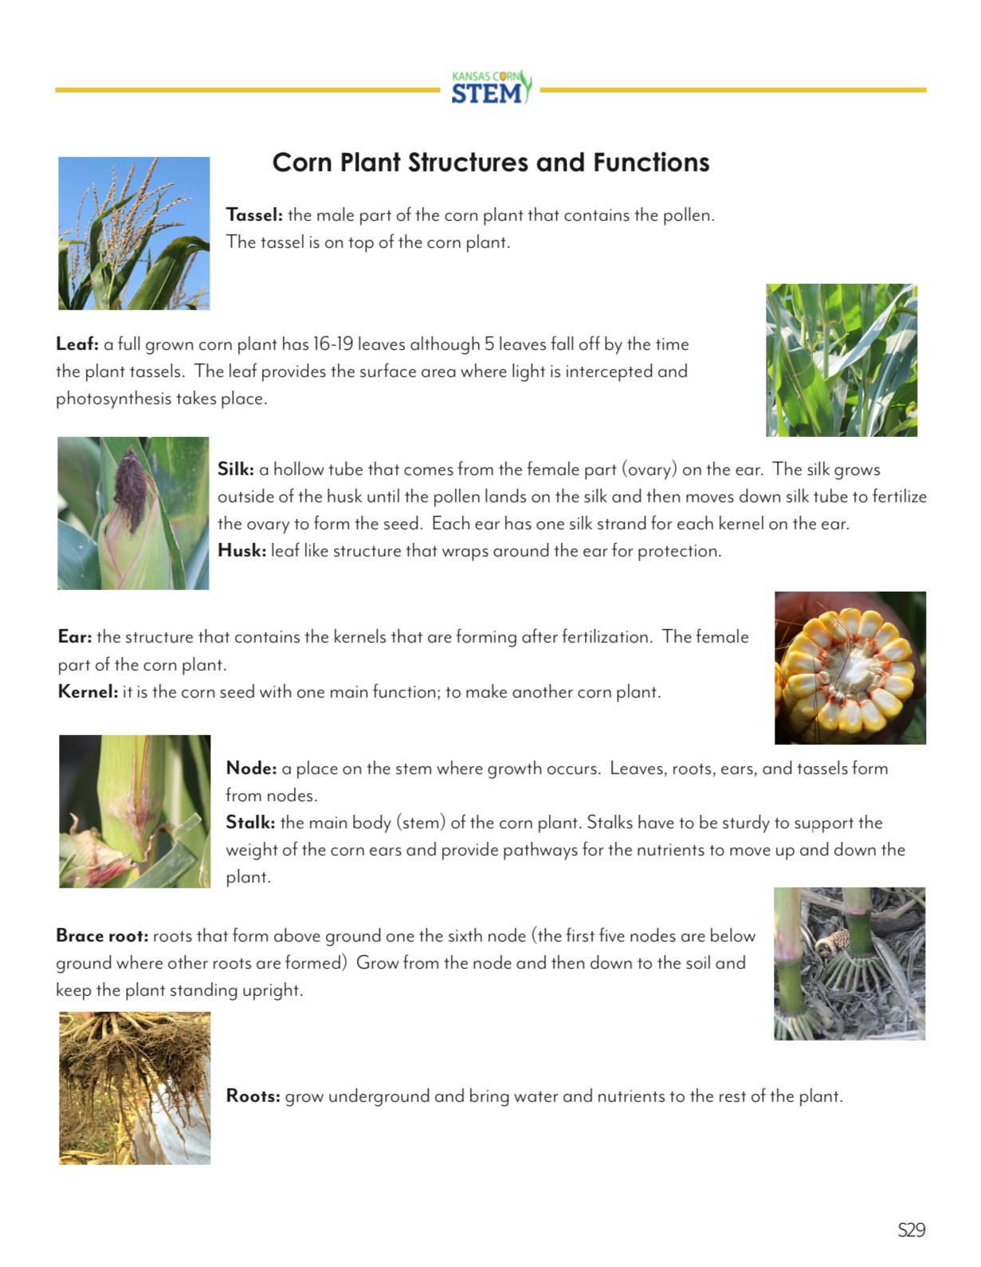
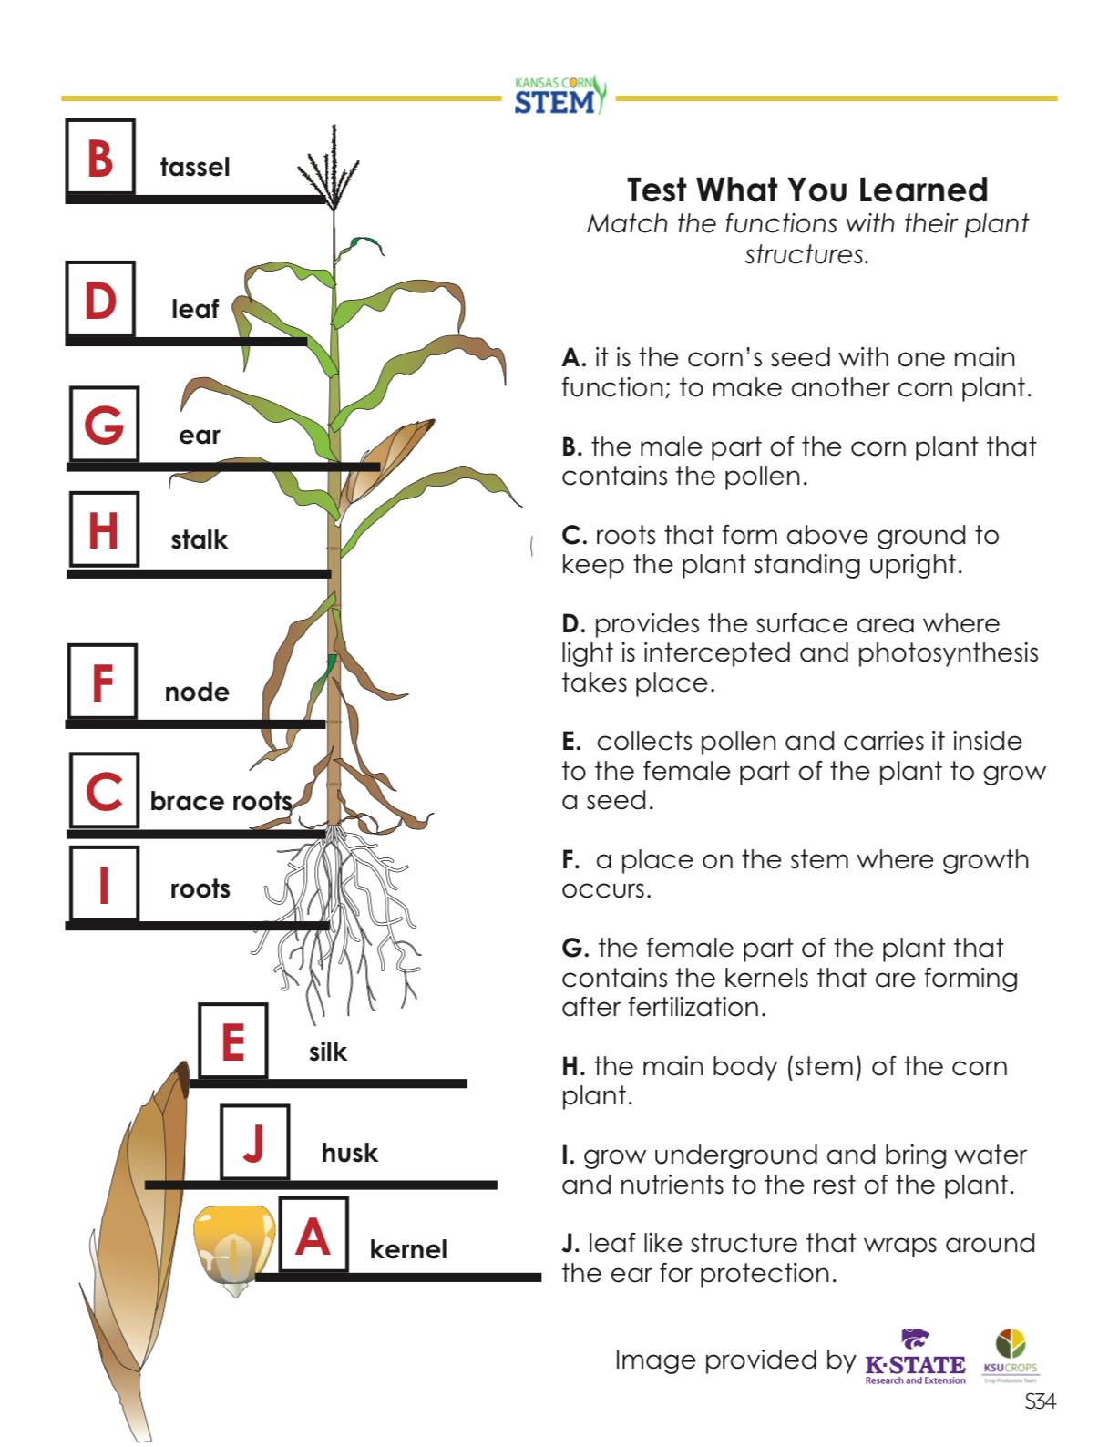
Section 4: Corn Plant Anatomy
Corn Plant Structures and Functions Info and Worksheets

Slide 49
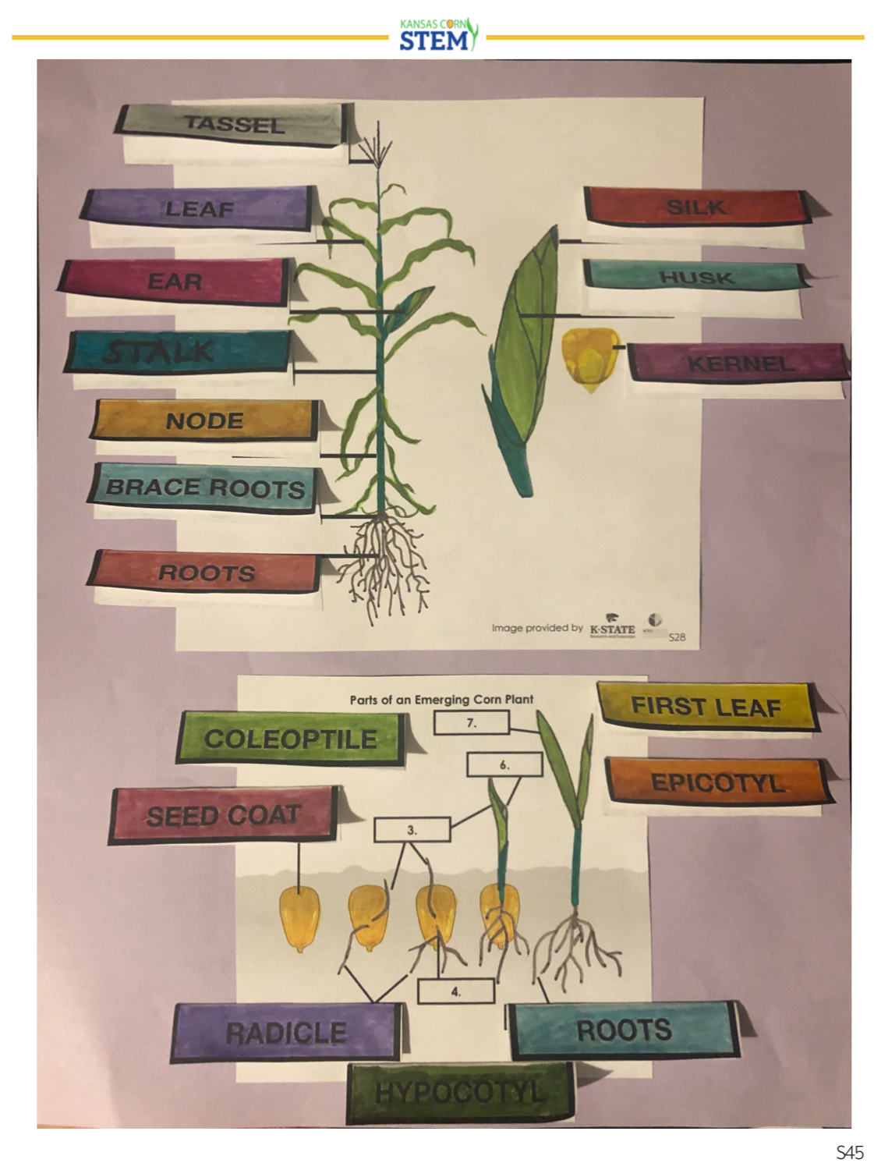
Section 4: Corn Plant Anatomy
Corn Plant Structures and Functions Interactive Notebook

Slide 50
Section 3 and 4: Corn Growth and Development and Anatomy
3D Corn Plant Paper Model

Slide 51
Section 4: Corn Plant Anatomy
Corn Felting Activity

Slide 52
Section 5: Mathematics with Corn
Corn Kernel Math with Ear of Corn Dissection
A. Corn Kernel Math / Ear of Corn Dissection Labsheet:
Print out the Corn Kernel Math Labsheet for each student..
Part 1: Give each lab station 3-6 ears of corn, a handful of loose corn kernels (at least 50) and a scale.
Students will count the number of rows found on their ear of corn and the number of kernels found in each row in order to determine the total number of corn kernels found on an ear of corn.
Part 2: Students will determine the average mass of a corn kernel and use that mass to determine a large number of corn kernels found in a container without counting individual kernels.
Part 3: Students will use the average mass of a kernel of corn to determine how many kernels are in a bushel of corn.
Part 4: Students will estimate the number of corn plants per acre by determining how many plants or seeds are in a 17.5 feet long row.
The last part of the lab contains review questions based on the lab. Students will also be able to determine how much carbon in their bodies comes from corn and will also find out how many corn kernels make up their body!
12 - 15 minutes

Slide 53
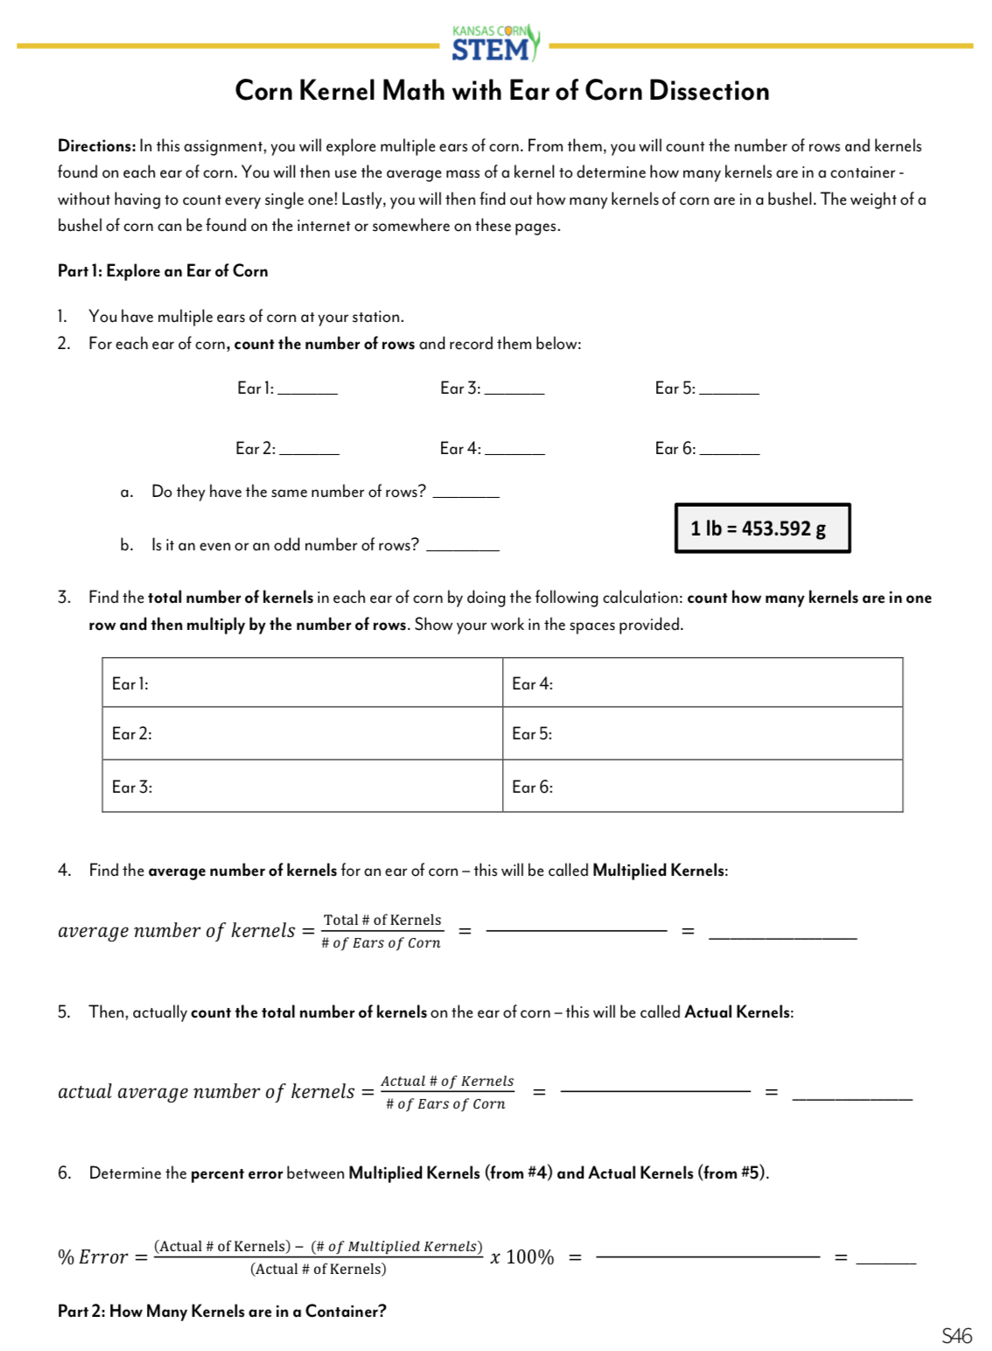
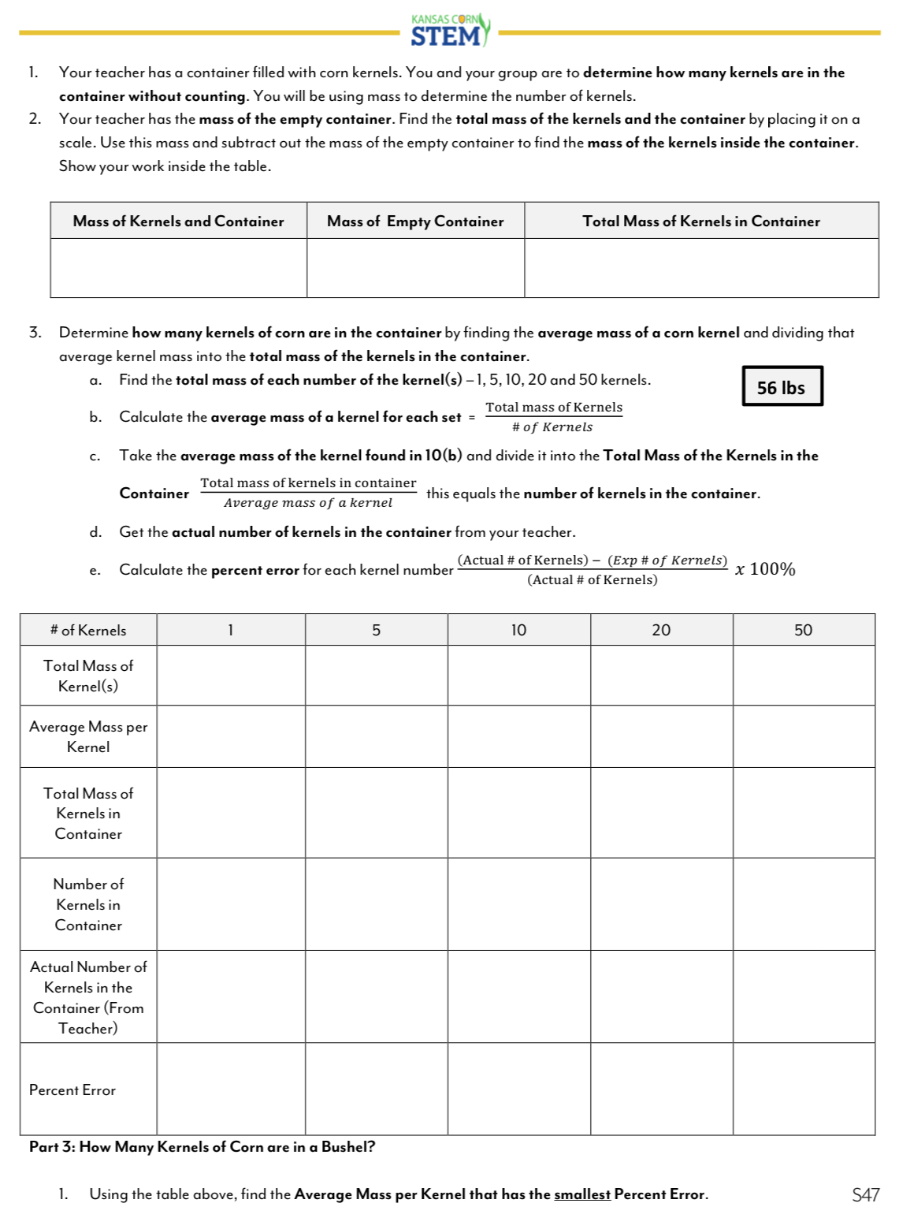
Section 5: Mathematics with Corn
Corn Kernel Math with Ear of Corn Dissection

Slide 54
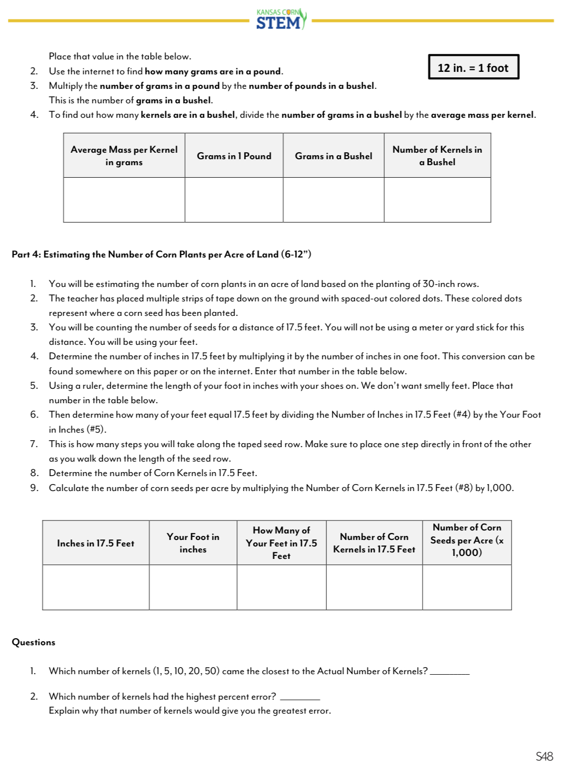
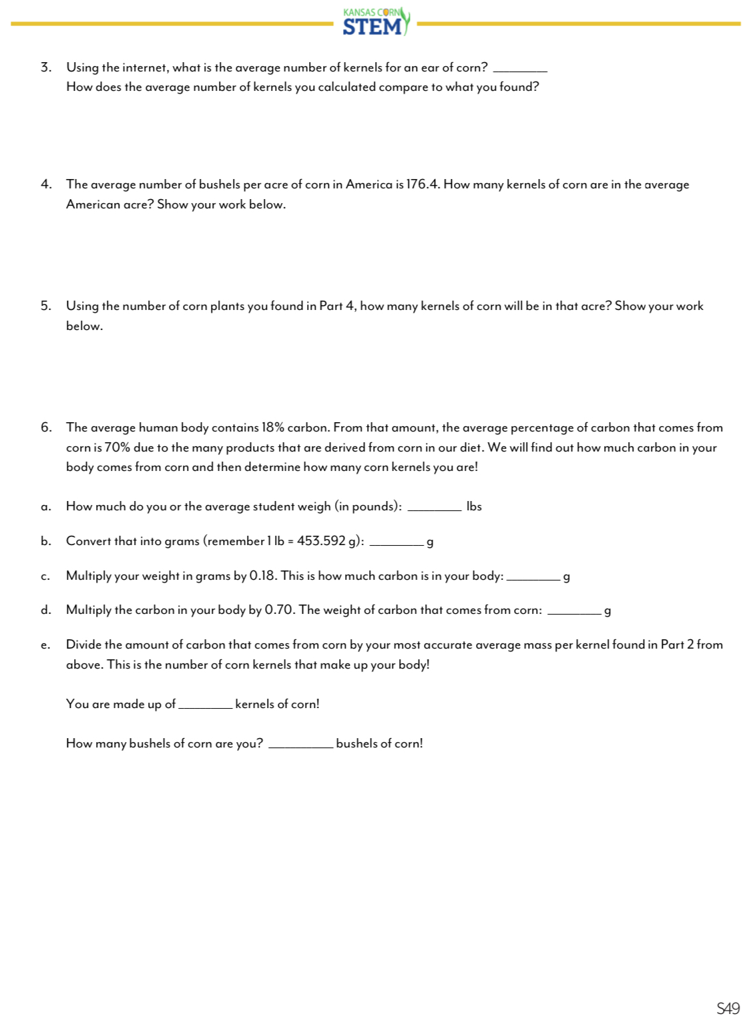
Section 5: Mathematics with Corn
Corn Kernel Math with Ear of Corn Dissection

Slide 55
Section 5: Mathematics with Corn
Corn Kernel Math with Ear of Corn Dissection
WiFi:
Password:
Corn Container: 578.71g
Empty Container: 56.58g

Slide 56
Doing Great?
Let’s take a Quiz(let)!
www.quizlet.live
Enter Code:

