Slide 1
CornSTARch
Kansas Corn STEM - kscorn.com
Presenter: Christopher Remmich
Garden City High School
cremmich@gckschools.com

Slide 2
Mystifying Mysterious Mixture - Introduction
You have a mysterious white powder and want to test its properties.
For one of the tests, you decide to add water to see if it dissolves the mystery substance.
When you add approximately 1/4th to 1/3rd the amount of water compared to powder, you get a homogenous mixture that has the consistency of school glue, but.........
You notice that it has some strange properties........
So, you begin to experiment and play with it by.......
Stirring it slowly and then really fast
Tossing it in the air
Playing “hot potato” with your friend
Placing it on the ground and hit it with a hammer
Throwing it against a wall
Inserting your hands in it, squeezing it and scratching it along its surface
Floating a wooden block on top of the substance and hammer nails into it
And ultimately comparing this substance to water and its properties

Slide 3
Mystifying Mysterious Mixture - Procedure
Each person gets a plastic cup and a popsicle stick
Fill your cup 1/2 - 1/3 full of the mystery powder
Then add about 1/4th to 1/3rd the amount of water compared to the powder
Stir to combine until you get the consistency of school glue
Play with it
Throw cup, popsicle stick, substance and paper towels in the trash
Rinse hands in the water bucket, then thoroughly wash them in the bathroom
This substance easily washes away with water

Slide 4
Mystifying Mysterious Mixture - Properties
What properties did this mystery substance display?
Thick-ish, glue-like consistency
Liquid when moving slowly
Solid when a force was applied
Shattered when too much force was applied too quickly
Would then return to a liquid when force was removed
Would get dry and crumbly after awhile

Slide 5
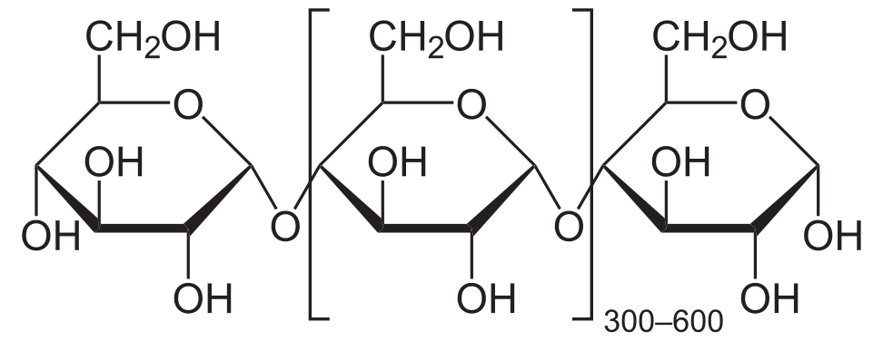
Oobleck
Named after gooey green substance from Dr. Seuss’ “Bartholomew and the Oobleck”
A homogenous mixture of cornstarch and water
From the corn plant and is used as a thickening agent in sauces, soups and gravies
It is a starch that contains a lot of sugars linked together that like to absorb water:
Straight Chain - Amylose
Branched Chain - Amylopectin
A Non-Newtonian Fluid

Slide 6
Mixtures
A homogenous mixture
A substance that has only one phase and looks the same throughout
Kool-Aid, Vegetable Oil, Milk Chocolate, Air
A heterogeneous mixture
A substance that has multiple phases and is not the same throughout
It has layers, parts or is “chunky”
Salad, Pizza, Chocolate Chips Cookies, Snack Mix, Soda with Ice

Slide 7
Non-Newtonian Fluid
A Non-Newtonian Fluid
The fluid does not follow Newton’s Law of Viscosity
When a force is applied, the fluid becomes more liquid or solid instead of remaining constant
Viscosity
A substance’s thickness and how easily it can flow
Higher Viscosity = Thicker Fluid
Lower Viscosity = Thinner Fluid

Slide 8
Flow Rate
Flow Rate
The rate at which molecules within a fluid are able to move past one another
The faster the the fluid moves, the faster its flow rate
Cohesive Forces (Cohesion)
The attraction of similar molecules to each other
Stronger Cohesive Forces = Slower Flow Rate = Higher Viscosity = Thicker Fluid
Weaker Cohesive Forces = Faster Flow Rate = Lower Viscosity = Thinner Fluid

Slide 9
Ketchup and Cornstarch
A Thixotropic or Pseudoplastic Fluid
The viscous fluid becomes thinner (less viscous) over a period of time or due to an outside force or agitation
Hitting or shaking a ketchup bottle
A Dilatant Fluid
The fluid becomes thicker (more viscous) or harder when a force is applied
Hitting Oobleck or stirring it really fast

Slide 10
Disco Dancing Oobleck - Procedure
How can Sound Waves display the properties of a Non-Newtonian Fluid?
Find a speaker with a decent-sized subwoofer cone
Cover the cone with plastic wrap
Color the water before adding to the cornstarch
Connect the speaker system to a frequency generator
Set the frequency to a low setting between 20 and 40 Hz
Set the subwoofer to its highest setting
Adjust the volume and the frequency of your system to get the party started!
Record how Oobleck behaves using the Slo-Mo feature on your phone
What frequency made the Oobleck dance the most?

Slide 11
Design the Perfect Oobleck - Procedure
What ratio of Cornstarch to Water will Maximize it’s Non-Newtonian properties?
What would the “perfect” Non-Newtonian properties look like?
How could you test for that?
Mass the starting amounts of Cornstarch and Water - Record in Table
Adjust the amounts until it passes your “perfect” criteria
Don’t forget to record these additions (in grams and mL)
Determine the “perfect” ratio by dividing the total mass of Cornstarch used by the total volume of Water used.

Slide 12
Oobleck - Real World Applications
Individually brainstorm uses of Non-Newtonian fluids
Together, as a group, determine the top two most interesting
Design/Sketch your useful Oobleck inspired product
Develop a marketing campaign to pitch your product
Try to make a prototype if possible!

Slide 13
Oobleck - Egg Drop Test
Design an Oobleck Safety System to protect a falling egg
Brainstorm possible ideas on how to protect your egg using Oobleck
Use other materials provided by your instructor
Choose the best idea from your group
Design your Oobleck Safety System
Record each height you drop your egg from
Note any observations on what worked and what didn’t
Get as high as you can!

Slide 14
Viscosity Races - Procedure
Determine the Flow Rate (Viscosity) of Oobleck and compare it to other household items
Measure out the same amount of each liquid and pour them into small cups
Create a Racing Board with a starting and finishing line - measure that distance and cover it in plastic wrap
Pour each liquid at the starting line and time how long it takes to reach the finish line.
Determine the substance’s Flow Rate by dividing your distance travelled by the time it took in seconds.
Rank, in order, the fastest flow rates to the slowest flow rates

Slide 15
Graduated Cylinder Viscosity Test - Procedure
Determine the Flow Rate (Viscosity) of Oobleck and compare it to other household items
Measure out the same amount of each liquid in each granted cylinder
Hold a marble at the top of each graduated cylinder
Drop it and start your timer right as it hits the top of the liquid
Measure how long it takes to reach the bottom of the cylinder
Determine the substance’s Flow Rate by dividing the volume travelled by the time it took in seconds.
Rank, in order, the fastest flow rates to the slowest flow rates

Slide 16
Viscosity Cup Test - Procedure
Determine the Flow Rate (Viscosity) of Corn Syrup at different temperatures - ice bath, room temperature, and warm water - using a Viscosity Cup
Make a viscosity cup by taking a plastic cup and making a hole in the bottom center of the cup using a nail or drill bit. Cover the hole with Duct tape
Place the cup on a Ring stand with another cup underneath to collect each substance
Fill each Viscosity Cup with the same amount of each Corn Syrup
Completely remove the Duct tape and record how long it takes the syrup to empty through the opening at the bottom of the cup.

Slide 17
Oobleck Form and Function - Procedure
To observe and simulate the structure and properties of Oobleck and compare the difference between Newtonian and Non-Newtonian fluids.
Part 1:
Make Cornstarch, but this time add sprinkles - lots of sprinkles - to the powder.
Mix it and stir in about 1/4th the amount of water as powder
The sprinkles are there to simulate the cornstarch molecules
Gently and slowly stir the mixture - pay close attention to the sprinkles and how they behave
Then quickly pull upwards to force the Oobleck to solidify around the stirrer.
Have a phone to record video of these interactions
Use these videos to go back, zoom in and/or slow down
Note your observations

Slide 18
Oobleck Form and Function - Procedure
To observe and simulate the structure and properties of Oobleck and compare the difference between Newtonian and Non-Newtonian fluids.
Part 2: This part is MESSY
Fill three wide-mouthed plastic cups 3/4 full with the following:
Water, Oobleck and Ketchup
Lay these cups on the ground on top of a generous amount of newspaper or plastic trash bags
Or you can contain them inside a clear storage bin
Record video: Gently set a golf ball in each one. Record the observed behavior
Then, remove the golf ball and wipe it off
This time, drop each golf ball a little higher up - make sure they are all from the same height
Record video of this and document in Lab Report.

Slide 19
Oobleck Explanation Comic Activity
To visually summarize how Oobleck works as a Non-Newtonian fluid at the molecular scale
Using the boxes, create a comic strip that explains how Oobleck behaves as a Non-Newtonian fluid at the microscopic and macroscopic scale
Be sure to include any relevant keyterms

