Slide 1
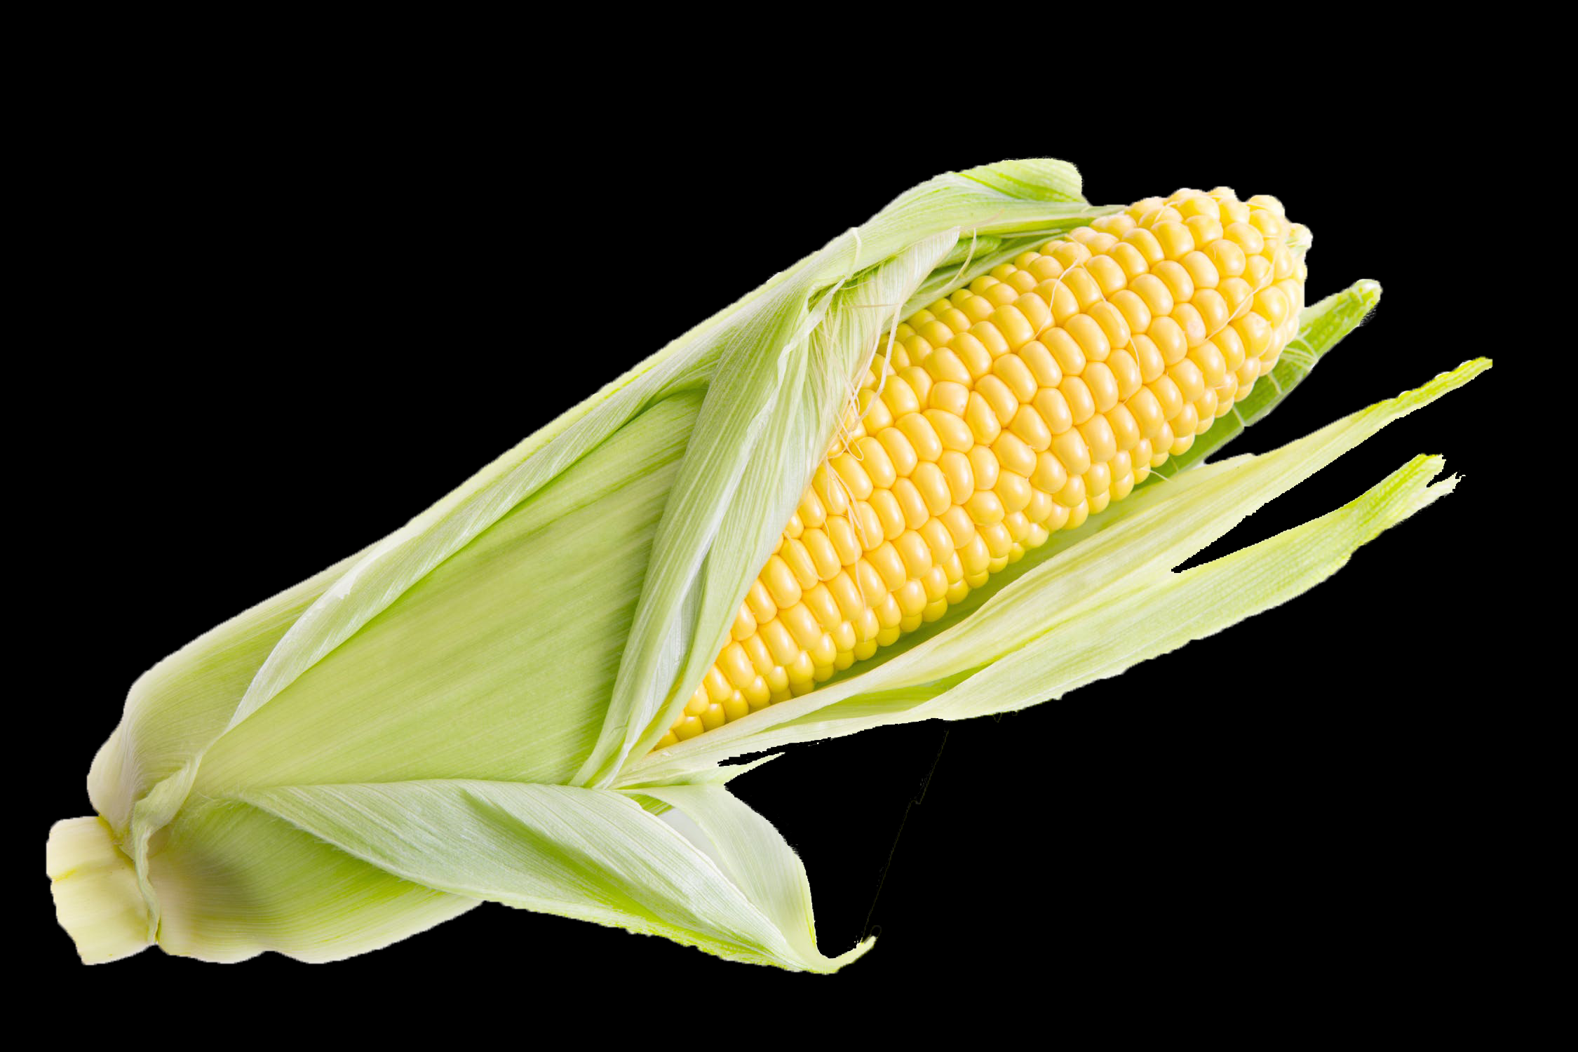
Top Fuel: Ethanol Production Analysis

Slide 2
Learning Objectives
Determine the percent ethanol in the distillate sample.
Determine the total volume of ethanol collected.
Determine the energy density of student’s distillate samples.

Slide 3
What Percent Ethanol?
The amount of ethanol produced in the fermentation and collected during distillation can be determined by the density of the distillate.

Slide 4
Determining Density
In order to determine the total volume of ethanol collected, the total volume of the distillate and the percent by volume ethanol in the distillate need to be determined.

Slide 5
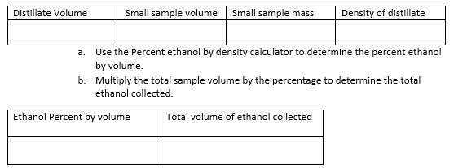
Determining Density
Use a graduated cylinder to determine the total volume of the distillate. Record this amount in the data table.
28.25 ml

Slide 6
Determining Density
Place a small beaker or graduated cylinder on the balance and tare or zero it out.
28.25 ml

Slide 7
Determining Density
Use a pipette to add a sample less than 10 ml to the beaker or graduated cylinder. Record the volume from the pipette or cylinder.
28.25 ml
9.45 ml

Slide 8
Determining Density
Read the balance and record mass of sample.
28.25 ml
9.45 ml
7.82 g

Slide 9
Determining Density
Calculate the density of the sample by dividing mass by volume.
28.25 ml
9.45 ml
7.82 g
0.828 g/ml

Slide 10
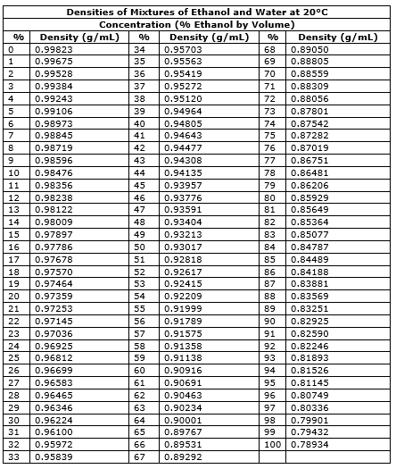
Determining Density
Use the density vs percent by volume table to determine the percentage of ethanol in the distillate.
28.25 ml
9.45 ml
7.82 g
0.828 g/ml

Slide 11
Determining Density
Use the density vs percent by volume table to determine the percentage of ethanol in the distillate.
28.25 ml
9.45 ml
7.82 g
0.828 g/ml
90 %

Slide 12
Determining Density
Multiply the total sample volume by the percent by volume to calculate total pure ethanol volume.
28.25 ml
9.45 ml
7.82 g
0.828 g/ml
90.1 %
24.5 ml

Slide 13
Calorimetry: Testing fuel energy density
1. Mass an empty. clean soda can.
2. Using a graduated cylinder. measure and add
100.0 mL of water to the soda can.
3. Measure and record the mass of the water

Slide 14
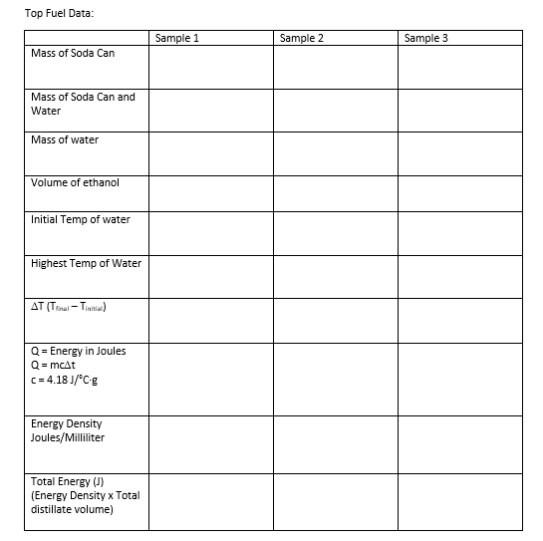
14.65 g

Slide 15
Calorimetry: Testing fuel energy density
4. Pour the sample of ethanol used to calculate density into a clean evaporating dish. Record the volume.
5. Place the evaporating dish on the base of a support stand.
6. Bend the tab on the soda can and slide a glass stirring rod through the hole. Suspend the can on a support stand using a metal ring (see Figure 2). Adjust the height of the can so that it is about 2.5 cm above the evaporating dish.

Slide 16
14.65 g
111.32 g
96.67 g

Slide 17
Calorimetry: Testing fuel energy density
7. Insert a thermometer into the can. Measure and record the initial temperature of the water.
8. Light the ethanol sample and center it under the soda can. Allow the water to be heated until the ethanol stops burning. Record the maximum (final) temperature of the water in the can.

Slide 18
14.65 g
111.32 g
96.67 g
9.45 ml
21.2 C
68.4 C
47.2 C

Slide 19
14.65 g
111.32 g
96.67 g
9.45 ml
21.2 C
68.4 C
47.2 C

Slide 20
Calculate joules of energy
Q = Energy in Joules
Q = mcΔt
c = 4.18 J/°C·g
Q = (96.67g) cΔt
Q = (96.67g) c (47.2C)
Q = (96.67g) 4.18 J/°C·g (47.2C)
Q = 19,100 J
14.65 g
111.32 g
96.67 g
9.45 ml
21.2 C
68.4 C
47.2 C

Slide 21
Calculate energy density
Q = 19,100 J of energy in 9.45 ml
Q = $\frac{\text{19,100} \text{J}}{\text{9.45 }\text{ml} }$
2020 J/ml
14.65 g
111.32 g
96.67 g
9.45 ml
21.2 C
68.4 C
47.2 C

Slide 22
Calculate total energy
J/ml x ml
2020 J/ml (28.25 ml)
57,100J
47.2 C

Slide 23
Calculate cost effectiveness of protocol
57,100J/cost of protocol
47.2 C

