Slide 1
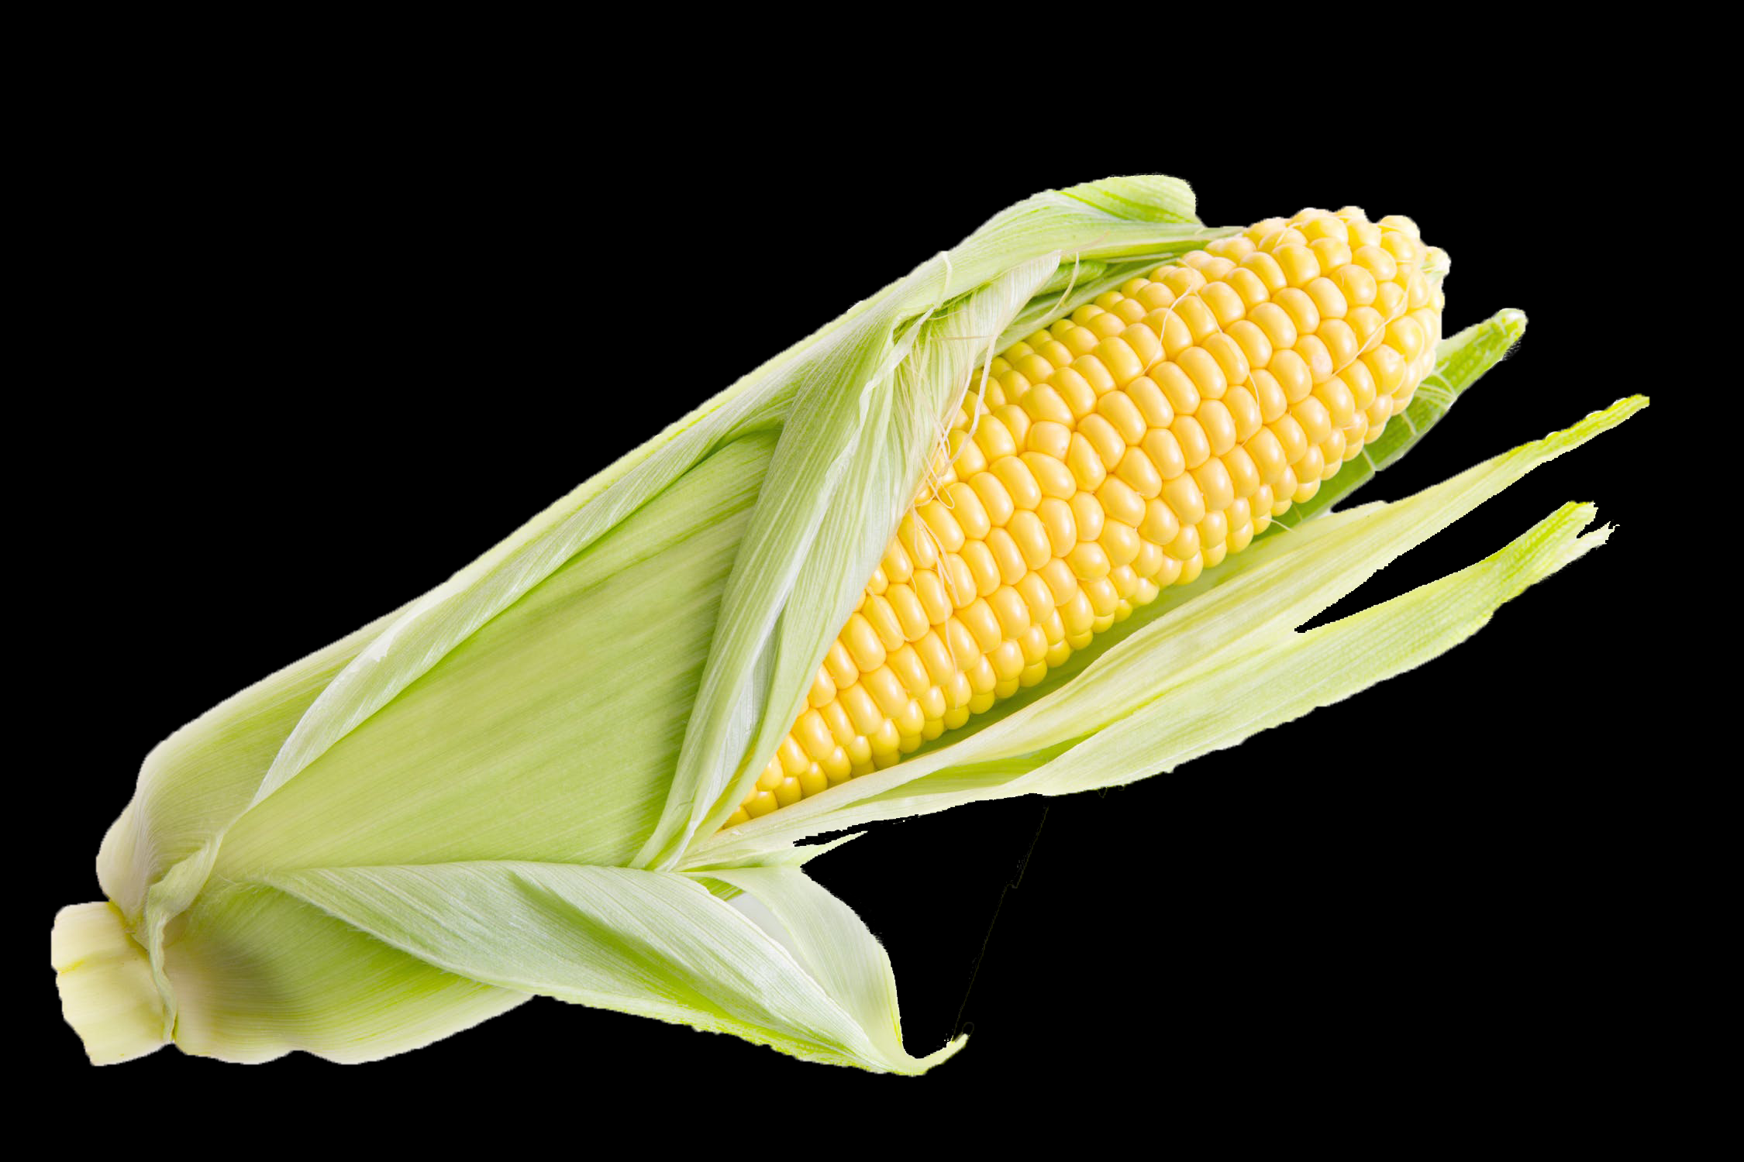
How Sweet it Is!
Analyzing sugar composition of different sweeteners.

Slide 2
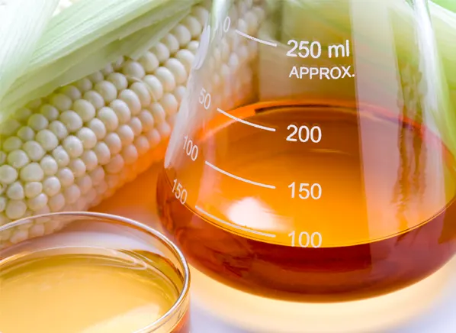
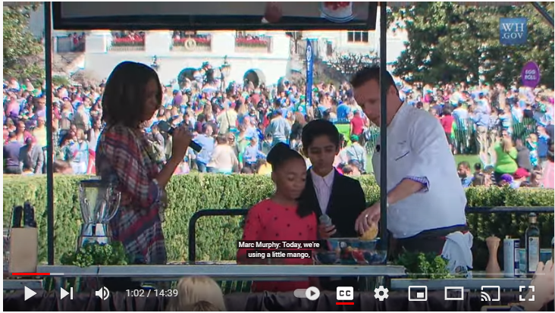
High Fructose Corn Syrup (HFCS)
High fructose corn syrup has drawn a lot of negative attention in recent years.
The “High” fructose concentration is claimed to make it unhealthy.

Slide 3
Chemistry of sugars
Simple sugars are called monosaccharides or “single sugars”.
The two most common monosaccharides are glucose and fructose.
They are isomers, having the same formula, but different structure.
F
G
C₆H₁₂O₆
C₆H₁₂O₆

Slide 4
Disaccharides “two sugars”
Table sugar, made from cane is sucrose. This is a sugar made up of a bonded glucose and fructose.
G
F

Slide 5
Disaccharides “two sugars”
Maltose is a disaccharide sugar made up of two bonded glucose molecules.
G
G

Slide 6
Digestion
Invertase is an enzyme that breaks the bond in sucrose.
G
F
G
F

Slide 7
How much Fructose is really in High Fructose Corn Syrup?
In this lab we will measure the amount of glucose present in a known amount of HFCS
This will be compared with a pure glucose sample with the same amount of sugars.
The missing glucose in HFCS will be assumed to be Fructose.

Slide 8
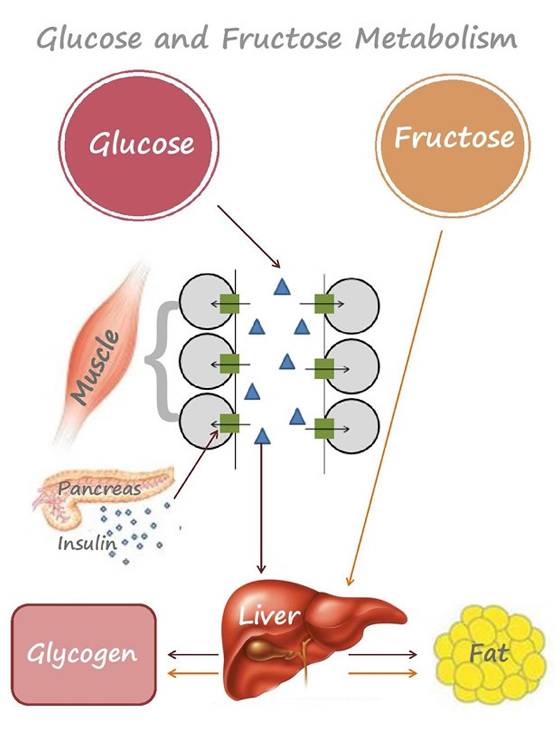
Differences in metabolism are blamed
Glucose can be absorbed directly from the blood stream into cells.
Fructose must be processed by the liver.
This is difference in metabolism is one of the reasons often cited in advising avoidance of fructose.
Fructose is rated as approximately four times sweeter than glucose.

Slide 9
Preparing Sugar Solutions
In order to be able to accurately compare sugar concentrations of different sweeteners, we need solutions of equal concentration of total sugar.
The soft drink is label says it contains 11.00g of HFCS/100ml.
There is an optional procedure for determining the amount of sugar in the soft drink by evaporation.

Slide 10
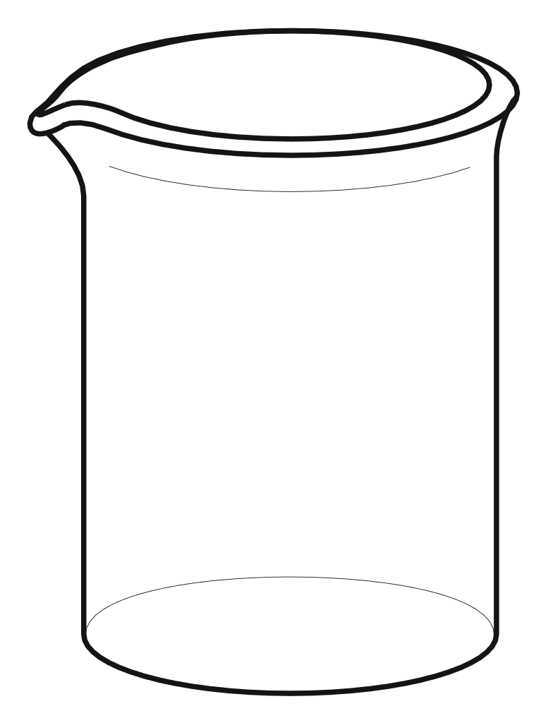
Preparing sweetened solutions
Add 11.00g of dry sweetener to the beaker.
Dextrose

Slide 11
Preparing sweetened solutions
Add approximately 70 ml distilled water to the beaker.
Stir until completely dissolved or let stand overnight.
Dextrose

Slide 12
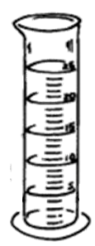
Preparing sweetened solutions
Pour the solution into a 100 ml graduated cylinder.
Dextrose

Slide 13
Preparing sweetened solutions
Add distilled water to make 100.0 ml of solution.
Dextrose

Slide 14
Preparing sweetened solutions
Pour the solution back into the beaker.
Dextrose

Slide 15
Preparing sweetened solutions
This solution is the same concentration of total sugar as the
Soft drink sweetened with HFCS.
Dextrose

Slide 16
Preparing sweetened solutions
Repeat this will all other sweeteners.
Note the liquid sweeteners contain water so the mass
will be higher to obtain an equal amount of sugar.
Dextrose

Slide 17
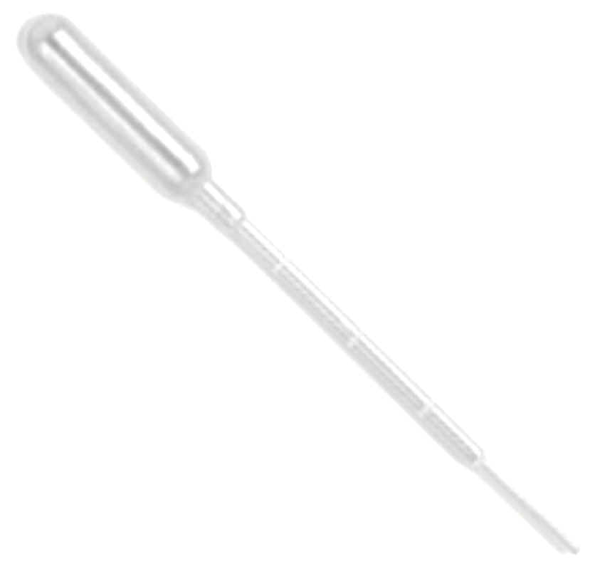
Diluting solutions Add 10.0 ml of sweetener to 100 ml Graduated cylinder.
Dextrose

Slide 18
Diluting solutions Add distilled water to the cylinder until it reads 100.0 ml. This results in a 1/10 dilution
H₂O

Slide 19
Diluting solutions Pour the solution in the 1/10 sweetener beaker.
1/10 Dextrose

Slide 20
Diluting solutions Add 10.0 ml of sweetener to 100 ml Graduated cylinder.
1/10 Dextrose

Slide 21
Diluting solutions Add distilled water to the cylinder until it reads 100.0 ml. This results in a 1/100 dilution
H₂O

Slide 22
Add 10 ml of each sweetener to two centrifuge tubes.
Dextrose (Glucose)
7 up (HFCS)
Light Corn Syrup
Sucrose (Table Sugar)
Honey
Fructose
Dextrose (Glucose)
7 up (HFCS)
Light Corn Syrup
Sucrose (Table Sugar)
Honey
Fructose

Slide 23
Add 250ul of invertase and glucoamylase to each of the six tubes labeled enzymes.
Dextrose (Glucose)
7 up (HFCS)
Light Corn Syrup
Sucrose (Table Sugar)
Honey
Fructose
Dextrose (Glucose)
7 up (HFCS)
Light Corn Syrup
Sucrose (Table Sugar)
Honey
Fructose

Slide 24
Replace caps and allow to sit overnight.
Dextrose (Glucose)
7 up (HFCS)
Light Corn Syrup
Sucrose (Table Sugar)
Honey
Fructose
Dextrose (Glucose)
7 up (HFCS)
Light Corn Syrup
Sucrose (Table Sugar)
Honey
Fructose

Slide 25
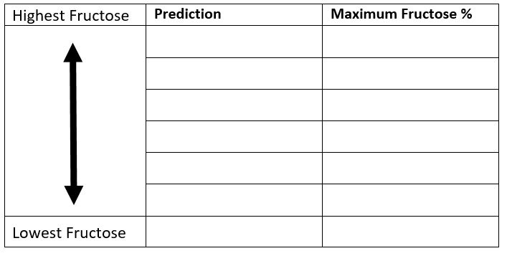
Dextrose (Glucose)
7 up (HFCS)
Light Corn Syrup
Sucrose (Table Sugar)
Honey
Fructose
Budget

Slide 26
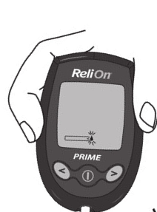
Glucose testing
1
F
G
Fructose
G
G
F
G

Slide 27
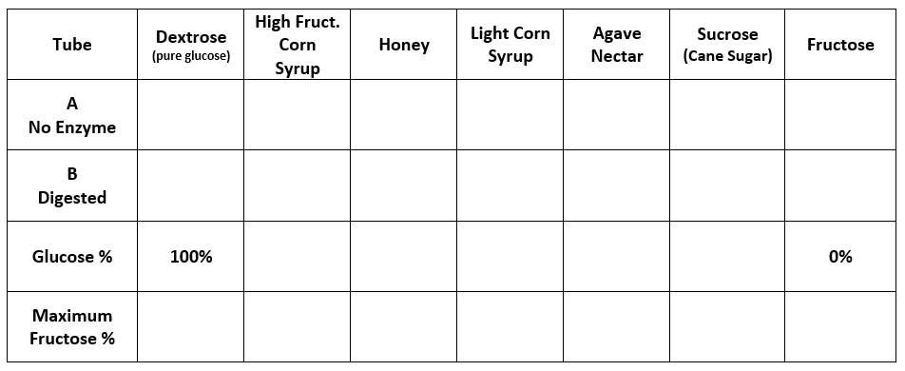
Collect Data

Slide 28
Glucose testing
4
F
G
Fructose
G
G
F
G

Slide 29
Collect Data

Slide 30
Dextrose (Glucose)
7 up (HFCS)
Light Corn Syrup
Sucrose (Table Sugar)
Honey
Fructose
Budget

Slide 31
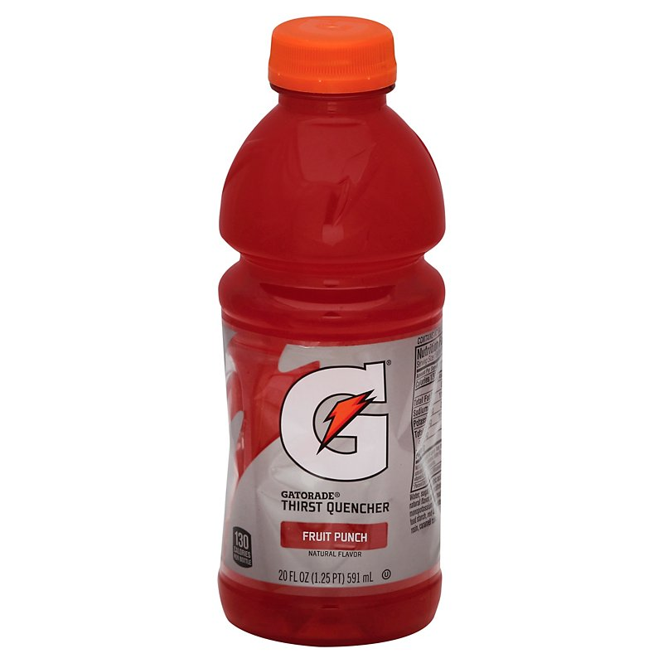
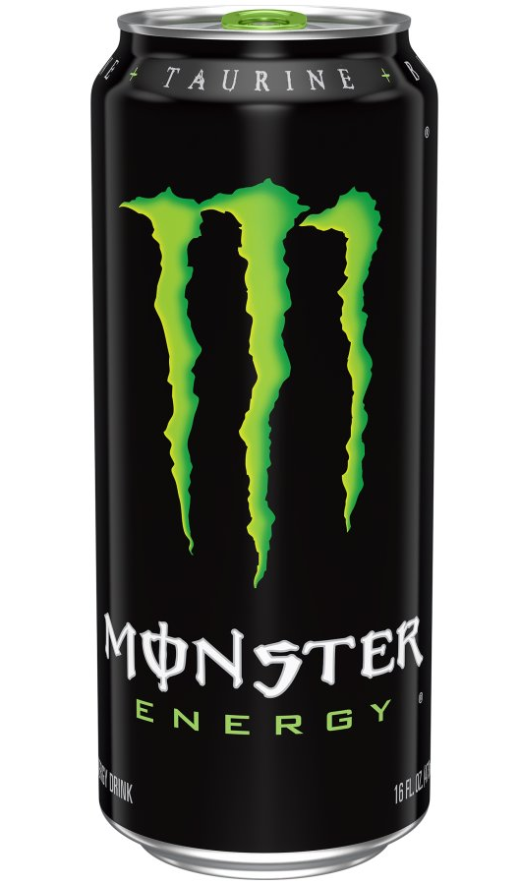
Large Caramel
Frappe
88 g
Large
Dr. Pepper
78 g
Monster
16 oz
54 g
Apple Juice
12 oz
39 g
Gatorade
24 oz
21 g

Slide 32
https://www.consumerreports.org/cro/news/2015/02/no-high-fructose-corn-syrup-label/index.htm

Slide 33
Budget
This lab is made possible with the support and content contributions of the Kansas Corn Commission.

