Slide 1
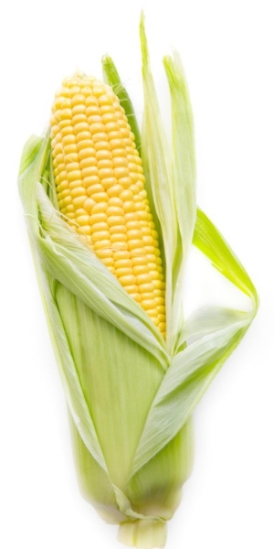
Chopped
Gene Editing using CRISPR-Cas9

Slide 2
What is Genome Editing?
Genome editing is modifying the DNA of a living cell.
This has can be used to
determine what genes do by turning them off
correcting mutations that cause disease
introducing desirable traits to crops.

Slide 3
What is CRISPR/Cas?
DNA
CRISPR/Cas is a naturally occurring molecular system found in bacteria.
It serves as a type of adaptive immune system that cuts viral DNA or RNA.
D
N
A

Slide 4
CRISPR/Cas is made up of two parts.
Spacer
Guide RNA sequences that determine where DNA is cut.
The spacer consists of 20 bases that will match DNA to be cut
The scaffold compliments itself and folds
Guide RNA
Scaffold

Slide 5
CRISPR/Cas is made up of two parts.
Cas 9 Nuclease
Cas is a nuclease enzyme that cuts DNA or RNA.
Cas9 is the most common used in editing.
The Cas enzyme can match up with different guide RNA molecules.
Guide RNA

Slide 6
Cas 9 Nuclease
AUACGUACGAUCGAUCGACU
A T A C G T A C G A T C G A T C G A C T
TATGCATGCTAGCTAGCTGA
End of Slide

Slide 7
Cas 9 Nuclease
AUACGUACGAUCGAUCGACU
A T A C G T A C G A T C G A T C G A C T
TATGCATGCTAGCTAGCTGA

Slide 9
How is this different?
The guide RNA is much more specific than restriction enzymes.
The entire 20 base sequence must match the DNA.
This means it is unlikely to produce unintended cuts.
The guide RNA can be programmed to cut any sequence.

Slide 10
Setting up the Lab
Label 4 PCR tubes, A, B, C and D
A
B
C
D

Slide 11
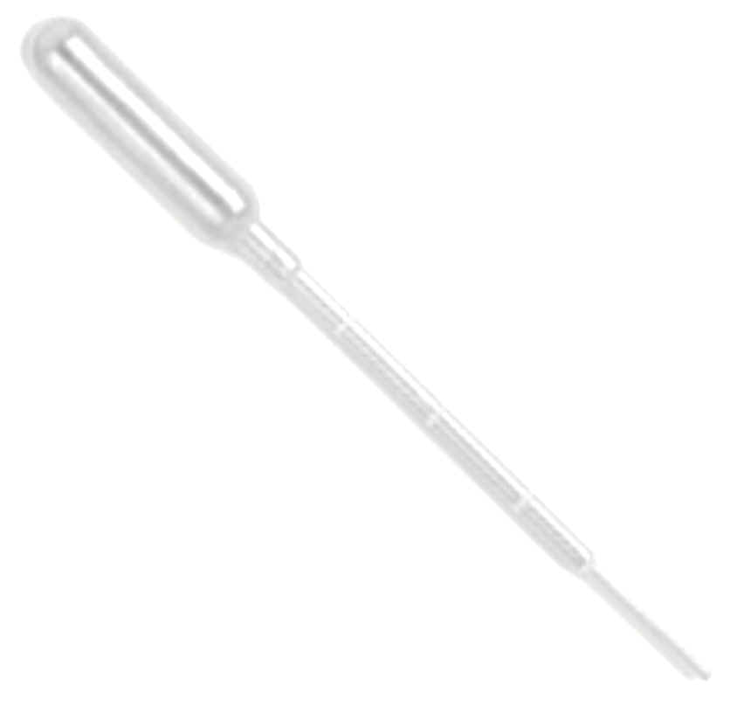
Sample | A | B | C | D
Nuclease Free Water | 10μl | 5μl | - | -
Reaction Buffer | 5μl | 5μl | 5μl | 5μl
Cas 9 | - | 5μl | 5μl | 5μl
Guide RNA 1 | - | - | 5μl | -
Guide RNA 2 | - | - | - | 5μl
A
B
C
D
H₂O

Slide 12
Sample | A | B | C | D
Nuclease Free Water | 10μl | 5μl | - | -
Reaction Buffer | 5μl | 5μl | 5μl | 5μl
Cas 9 | - | 5μl | 5μl | 5μl
Guide RNA 1 | - | - | 5μl | -
Guide RNA 2 | - | - | - | 5μl
A
B
C
D
Buffer

Slide 13
Sample | A | B | C | D
Nuclease Free Water | 10μl | 5μl | - | -
Reaction Buffer | 5μl | 5μl | 5μl | 5μl
Cas 9 | - | 5μl | 5μl | 5μl
Guide RNA 1 | - | - | 5μl | -
Guide RNA 2 | - | - | - | 5μl
A
B
C
D
Cas-9

Slide 14
Sample | A | B | C | D
Nuclease Free Water | 10μl | 5μl | - | -
Reaction Buffer | 5μl | 5μl | 5μl | 5μl
Cas 9 | - | 5μl | 5μl | 5μl
Guide RNA 1 | - | - | 5μl | -
Guide RNA 2 | - | - | - | 5μl
A
B
C
D
RNA-1

Slide 15
Sample | A | B | C | D
Nuclease Free Water | 10μl | 5μl | - | -
Reaction Buffer | 5μl | 5μl | 5μl | 5μl
Cas 9 | - | 5μl | 5μl | 5μl
Guide RNA 1 | - | - | 5μl | -
Guide RNA 2 | - | - | - | 5μl
A
B
C
D
RNA-2

Slide 16
Mix contents of each tube by pipetting up and down 10 times.
Let set at room temperature for 10 minutes to allow complexes to combine
A
B
C
D

Slide 17
Add 5 μl of DNA to each sample tube.
Mix contents of each tube by pipetting up and down 10 times.
Incubate at 37⁰C for 15 minutes to allow complexes to find and cut matching DNA sequences
A
B
C
D
DNA

Slide 18
Add 4 μl of Proteinase K to each sample tube.
Mix contents of each tube by pipetting up and down 10 times.
Incubate at 37⁰C for 10 minutes or freeze to continue later.
A
B
C
D
or
Proteinase K
37

Slide 19
Gel Electrophoresis
Pour a 1% agarose gel using a 6 well comb.
Place gel in gel box and cover with buffer solution.

Slide 20
Gel Electrophoresis
In well 1 add 10 μl of DNA ladder
In well 2 add 15 μl of sample A
In well 3 add 15 μl of sample B
In well 4 add 15 μl of sample C
In well 5 add 15 μl of sample D
Replace cover and allow the gel to run for 20-30 minutes.

Slide 21
The target DNA
Open the linked google document from MiniPCR and make a copy.
This document contains the sequence of the entire DNA molecule that will be edited.
To determine the length of this molecule highlight the entire sequence on the 3’ to 5’ page.
Use the word count option in the tools menu to count the base pairs.

Slide 22
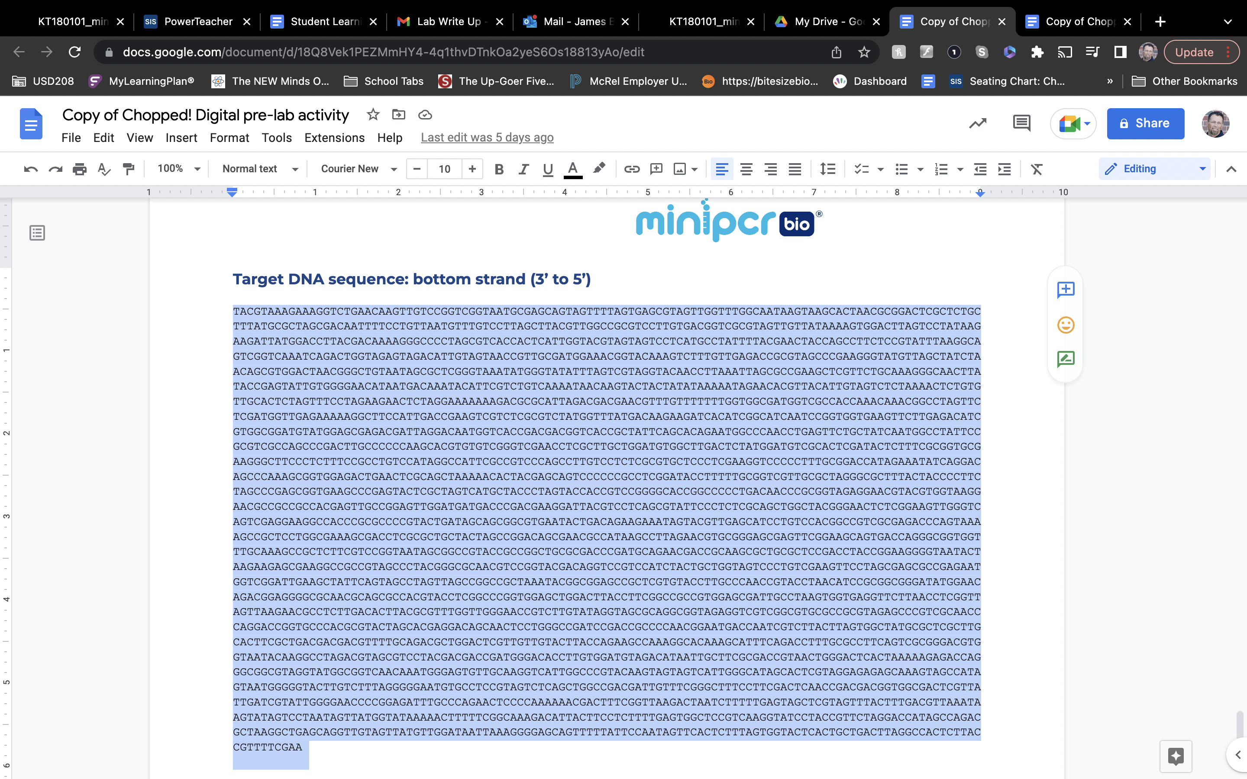

Slide 25
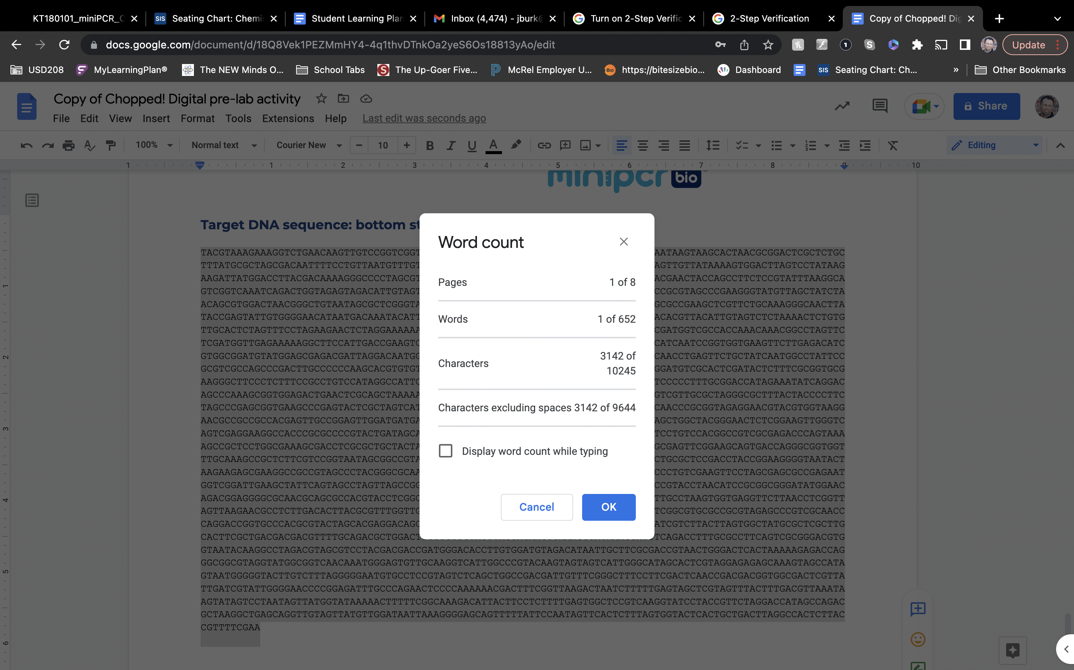

Slide 26
The uncut DNA strand is 3142 base pairs (bp) in length
3142 bp

Slide 27
Predicting the outcome. gRNA 1:
CGAUCAGUACGAUGGGAUCAGUUUUAGAGCUAGAAAUAGCAAGUUAAAAUAAGGCUAGUCCGUUAUCAACUUGAAAAAGUGGCACCGAGUCGGUGCUUUU
Spacer region: CGAUCAGUACGAUGGGAUCA
Complementary
DNA sequence: GCTAGTCATGCTACCCTAGT
Highlight and copy the Complementary DNA Sequence
Scroll to the Target DNA sequence bottom strand (3’ to 5’)

Slide 28
Use Ctrl + F keys to open the find tab.

Slide 29
Paste the DNA sequence in the tab and google will find the sequence.

Slide 30
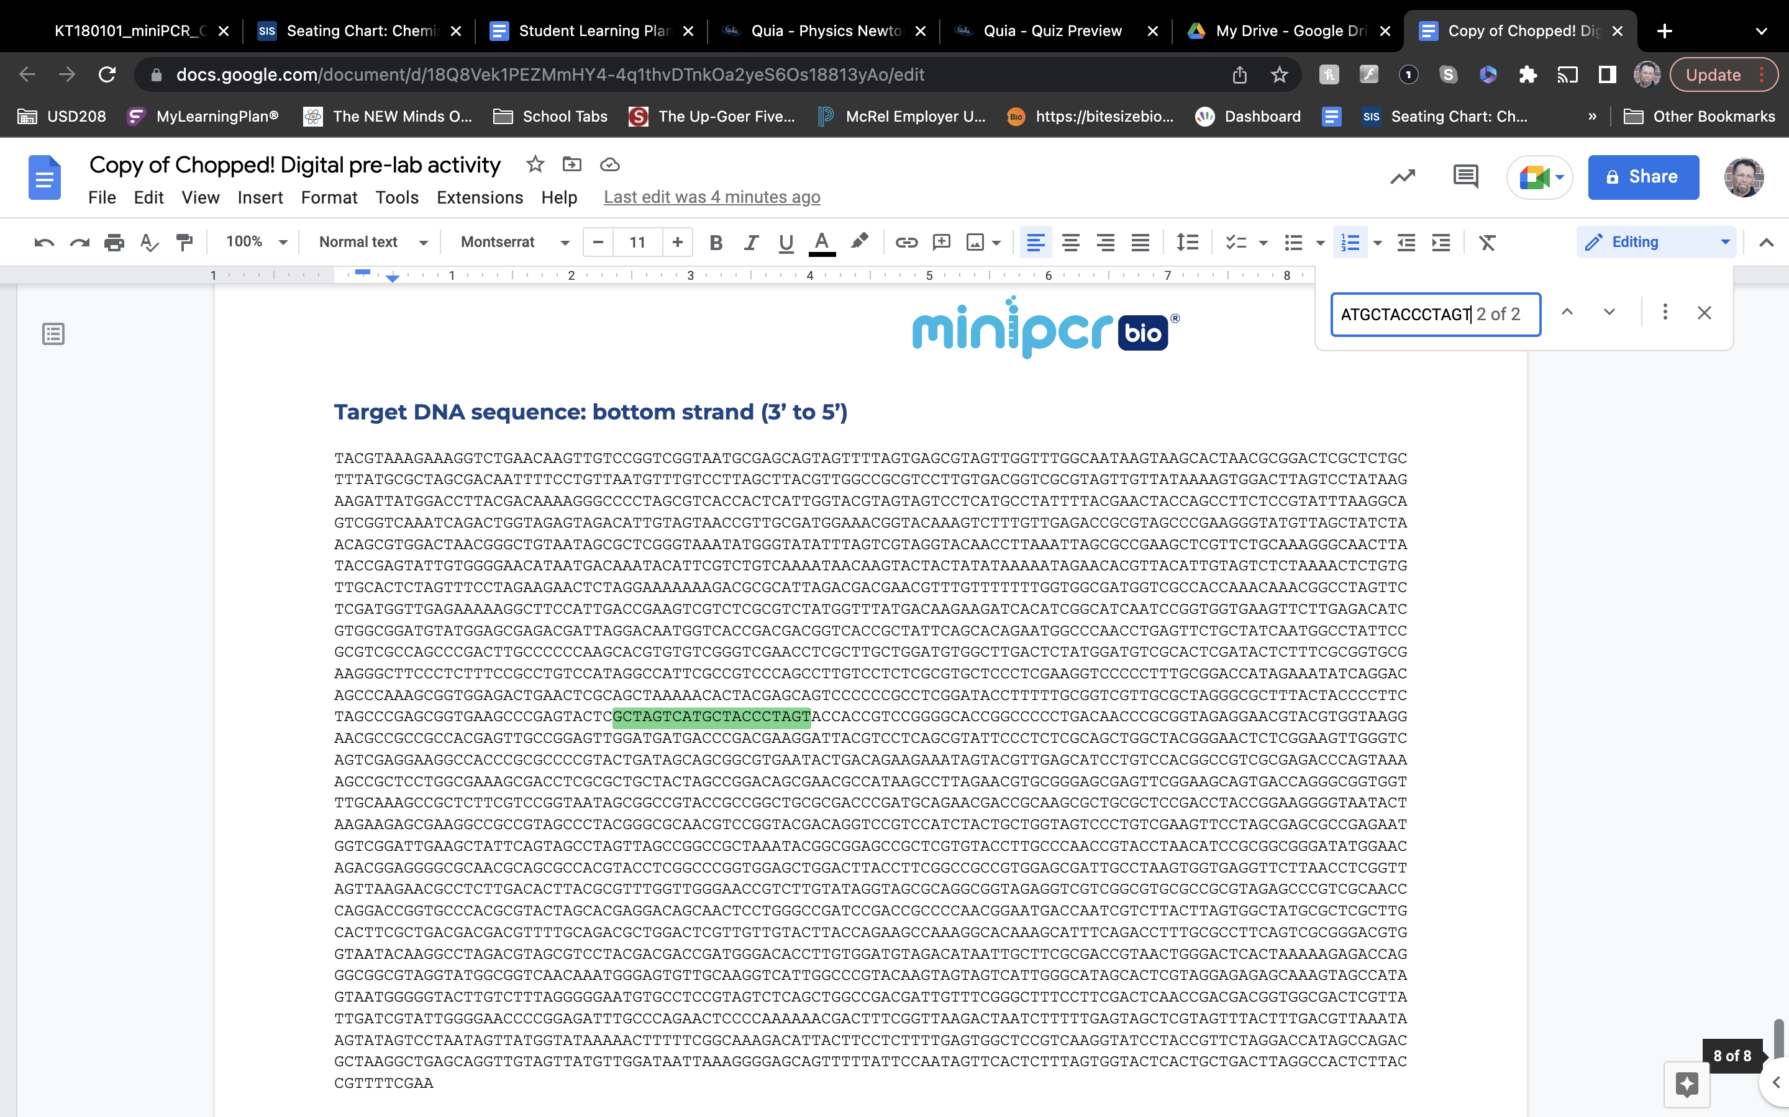
Place the cursor between the 3rd and 4th base from the end of the sequence and hit return to “cut the strand.

Slide 31
Highlight the top segment.

Slide 32
Use the word count in the tools menu.

Slide 34
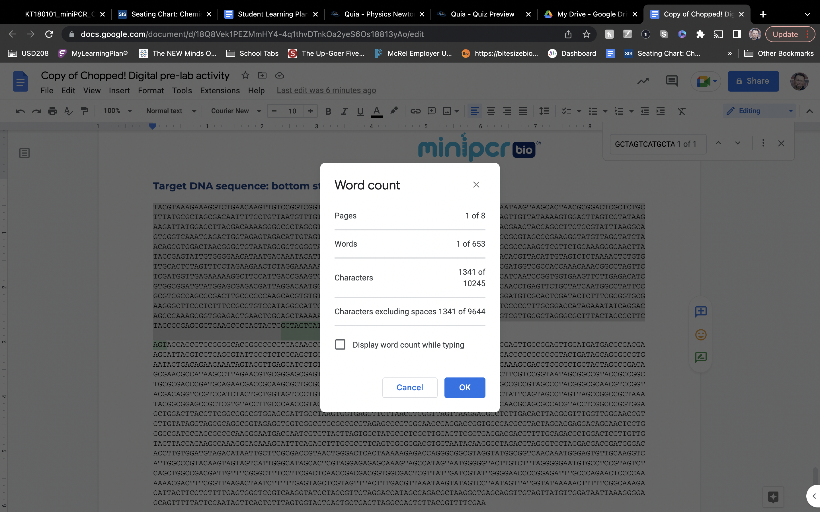

Slide 35
gRNA1 fragments
The gRNA1 will cut this gene once resulting in two fragments.
3142 bp
1341 bp
?
3142 – 1341 = 1801 bp

Slide 36
Use the back space key to put the DNA strand back together.

Slide 37
Place the cursor between the 3rd and 4th base from the end of the sequence and hit return to “cut the strand.

Slide 38
Predicting the outcome. gRNA 2:
AAGUCAUCGGAUCAAUCGGCGUUUUAGAGCUAGAAAUAGCAAGUUAAAAUAAGGCUAGUCCGUUAUCAACUUGAAAAAGUGGCACCGAGUCGGUGCUUU
Spacer region:AAGUCAUCGGAUCAAUCGGC
Complementary
DNA sequence: TTCAGTAGCCTAGTTAGCCG
Highlight and copy the Complementary DNA Sequence
Scroll to the Target DNA sequence bottom strand (3’ to 5’)

Slide 39
Use Ctrl + F keys to open the find tab.

Slide 40
Paste the DNA sequence in the tab and google will find the sequence.

Slide 41
Place the cursor between the 3rd and 4th base from the end of the sequence and hit return to “cut the strand.

Slide 42
Highlight the bottom segment.

Slide 43
Use the word count in the tools menu.

Slide 45
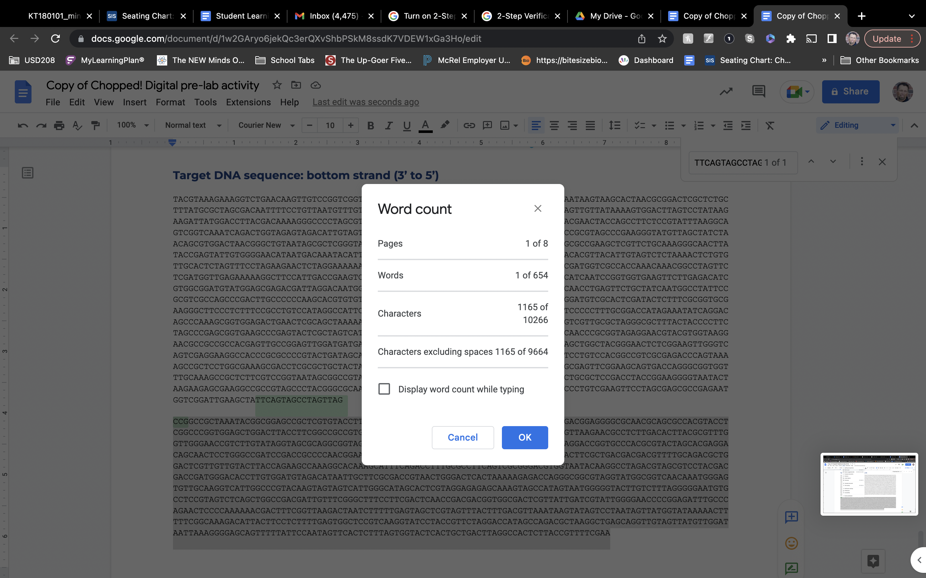

Slide 46
gRNA1 fragments
The gRNA1 will cut this gene once resulting in two fragments.
3142 bp
1165 bp
3142 – 1165 = 1977 bp
?

Slide 47
Gel Electrophoresis Prediction
Predict the bands in the gel
Lane 2 and 3 Uncut strand 3142 bp
Lane 4 RNA1 1801 bp + 1341bp
Lane 5 RNA2 1977 bp +1165 bp
4500→
3000→
2000→
1200→
800→
500→
200→

Slide 48
Run Gel Electrophoresis
Observe bands in gel
Uncut strand 3142 bp
RNA1 1801 bp + 1341bp
RNA2 1977 bp +1165 bp
4500→
3000→
2000→
1200→
800→
500→
200→

Slide 49
Budget
This lab is made possible with the support and content contributions of the Kansas Corn Commission.

