Slide 1
Corn Conundrum

Slide 2
Goals - Corn-ucopia
Overall - Learn about the copious amounts of different activities to introduce your students to the science of corn and agriculture
Learn the characteristics of 8 different types of corn
Identify the main structures of a corn plant
Explore an ear of corn using qualitative and quantitative analysis
Identify the different corn growth stages with the Leaf Collar Dissection Method

Slide 3
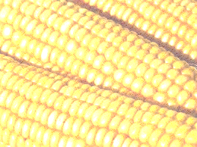
Joke
What do you call a single kernel of corn?

Slide 4
Answer
a uni-corn

Slide 5
Joke
What advice did a mother give her child for taking a shortcut through the cornfield to go to school?

Slide 6
Answer
Watch out for stalkers!

Slide 7
Joke
What does kansas corn and kansas basketball have in common?

Slide 8
Answer
They are both better than what Nebraska has to offer

Slide 9
Introduction to Corn – S1
A. Start a class discussion:
Where is corn grown? Why is it grown there?
How is corn grown?
Are there specific stages that corn goes through when it grows?
When can you harvest corn?
How many ears of corn are there on one stalk?
How many kernels of corn are found on each ear?
How many corn plants can be grown on an acre of land?
What types of corn are there?
What products are made from corn?
• Encourage students to highlight, in a specific color, important concepts they would like to further explore. Also, have students highlight, in a different color, important facts or take-a-ways from the world of corn. They should have at least 5-10 pieces of information/facts highlighted.
•Have students agree on one image that represents a fact from their sheets, ONLY 1 for the whole group. Hand each group a big sheet of butcher paper and a box of colored markers or pencils.
• When they are finished selecting and drawing their one group fact, they need to go to the butcher paper of another group. They will draw an image that represents a fact. They are not able to draw an image that is already on that paper representing a fact. For instance, if one group has a football field, representing the acres planted with corn, already on their paper, something else would have to be drawn. No Words!
•After giving enough time to complete this activity (about 15 minutes), ask each group to return to their butcher paper and write next to the images what fact from the reading that it relates to. Feel free to call on a few groups to share their graffiti notes with everyone.

Slide 10
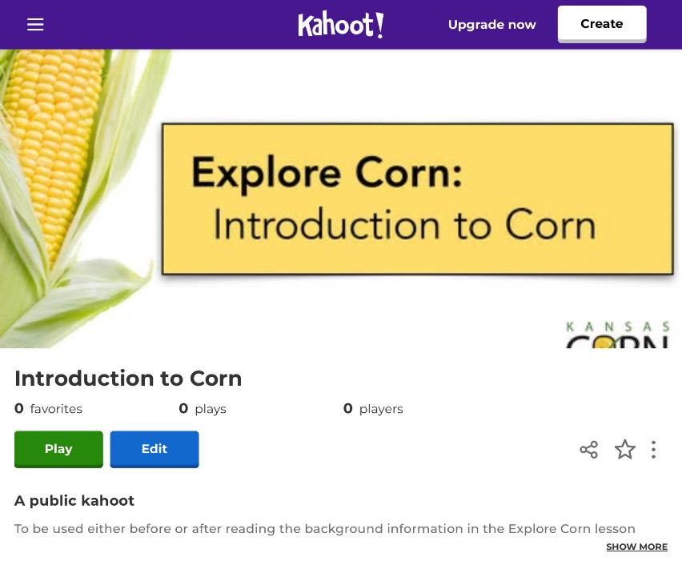
Introduction to Corn – OPTIONAL Article with Kahoot!
C. Kahoot!: Introduction to Corn
https://tinyurl.com/CornIntroKahoot
D. Reflection Questions
What are three uses for corn?
Human consumption, livestock feed, ethanol, nylon fibers, plastics, etc.
How long has corn been around? Where did it originate?
9,000 years from Central Mexico or sweet corn developed in 1700s.
How many kernels are on an ear of corn? How many plants can grow on one acre?
600-800 kernels on one ear and 22,000 to 35,000 plants per acre.
What percentage of corn is used for human consumption?
9%
What should the ground temperature reach before planting corn?
After consecutive or future days of 50 °F

Slide 11
Corn Stages Doodle Notes- S2
Discussion:
What do you already know about corn staging?
Why might corn staging be important to a farmer?
What kind of differences do you think you might notice in a corn plant that is at an earlier stage versus a later stage?
Corn Stages Doodle Notes
As we are looking at the two different videos, please feel free to work on your doodle notes. You will be using these later during our dissection.
https://www.youtube.com/watch?v=yW63L-GstOU&list=PLPJSvGGt4JU2nWGOCCrKhfoJS4O5zos79&index=1
https://www.youtube.com/watch?v=7SPXXuyci-A&list=PLPJSvGGt4JU2nWGOCCrKhfoJS4O5zos79&index=4

Slide 12
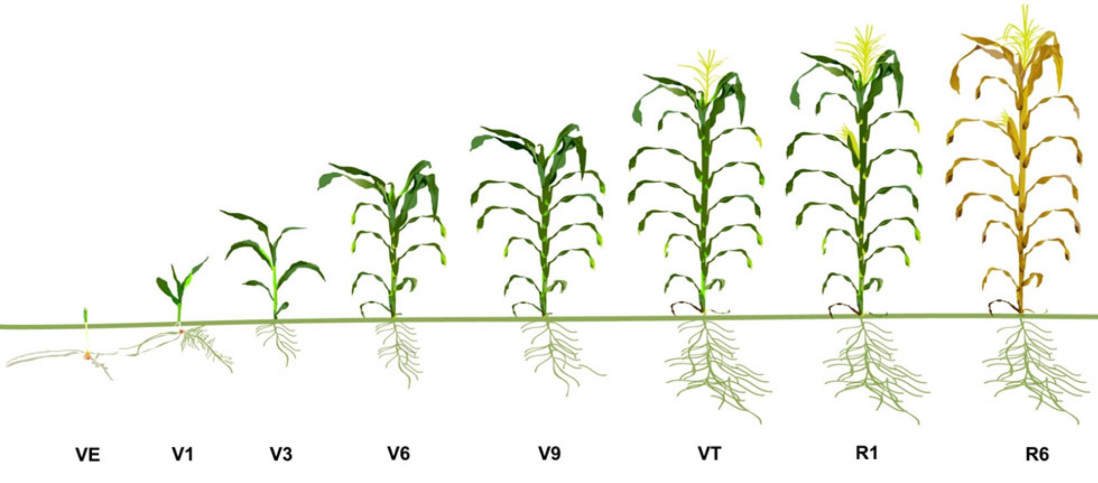
Corn Growth and Development
Corn Stages

Slide 13
Mathematics with Corn
Corn Kernel Math with Ear of Corn Dissection- S3-S7
A. Corn Kernel Math / Ear of Corn Dissection Labsheet:
Print out the Corn Kernel Math Labsheet for each student..
Part 1: Give each lab station 3-6 ears of corn, a handful of loose corn kernels (at least 50) and a scale.
Students will count the number of rows found on their ear of corn and the number of kernels found in each row in order to determine the total number of corn kernels found on an ear of corn.
Part 2: Students will determine the average mass of a corn kernel and use that mass to determine a large number of corn kernels found in a container without counting individual kernels.
Part 3: Students will use the average mass of a kernel of corn to determine how many kernels are in a bushel of corn.
Part 4: Students will estimate the number of corn plants per acre by determining how many plants or seeds are in a 17.5 feet long row.
The last part of the lab contains review questions based on the lab. Students will also be able to determine how much carbon in their bodies comes from corn and will also find out how many corn kernels make up their body!
12 - 15 minutes

Slide 14
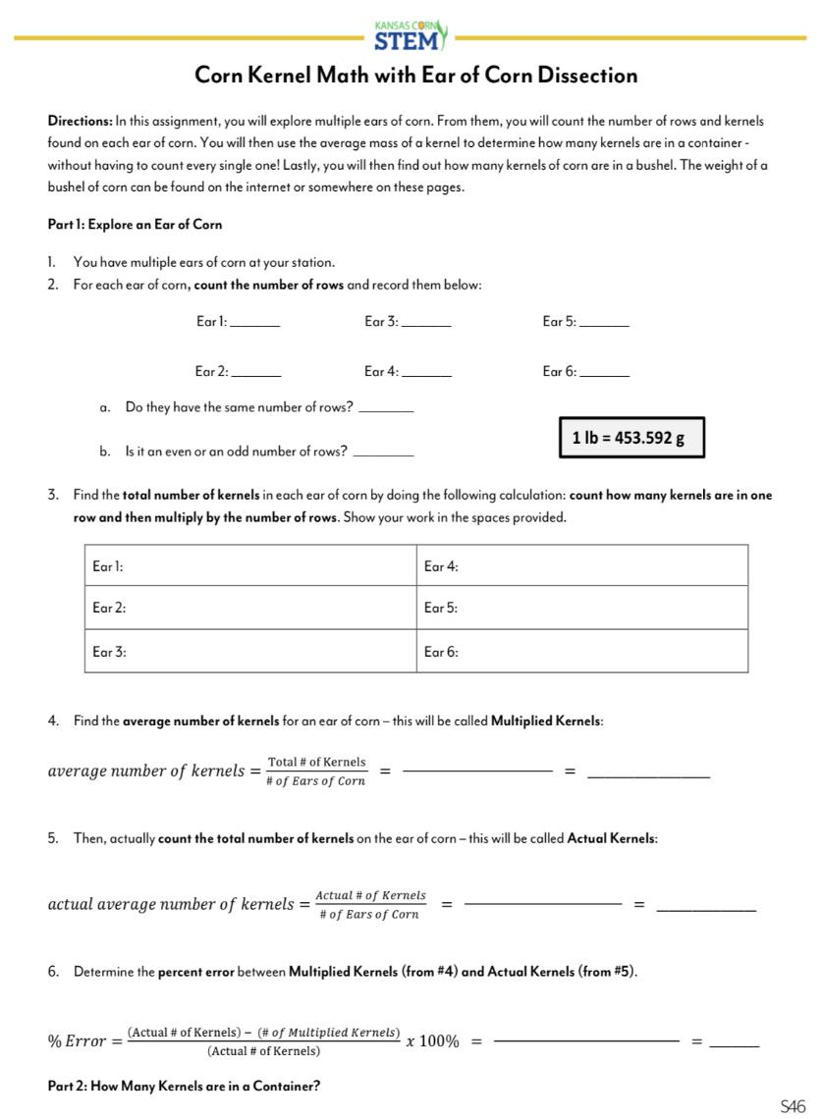
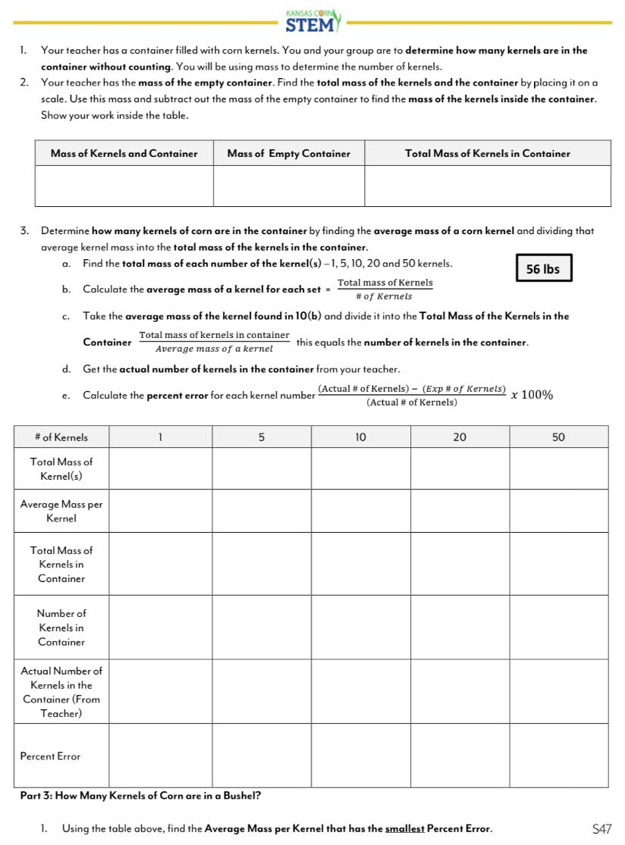
Mathematics with Corn
Corn Kernel Math with Ear of Corn Dissection

Slide 15
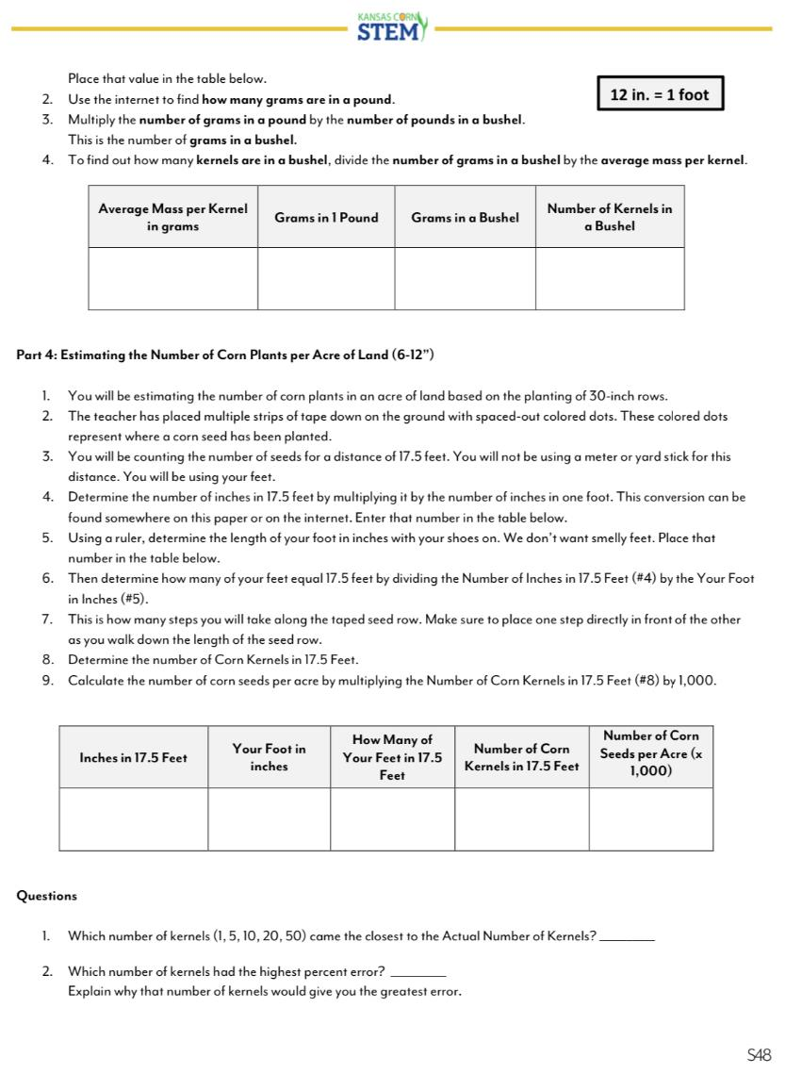
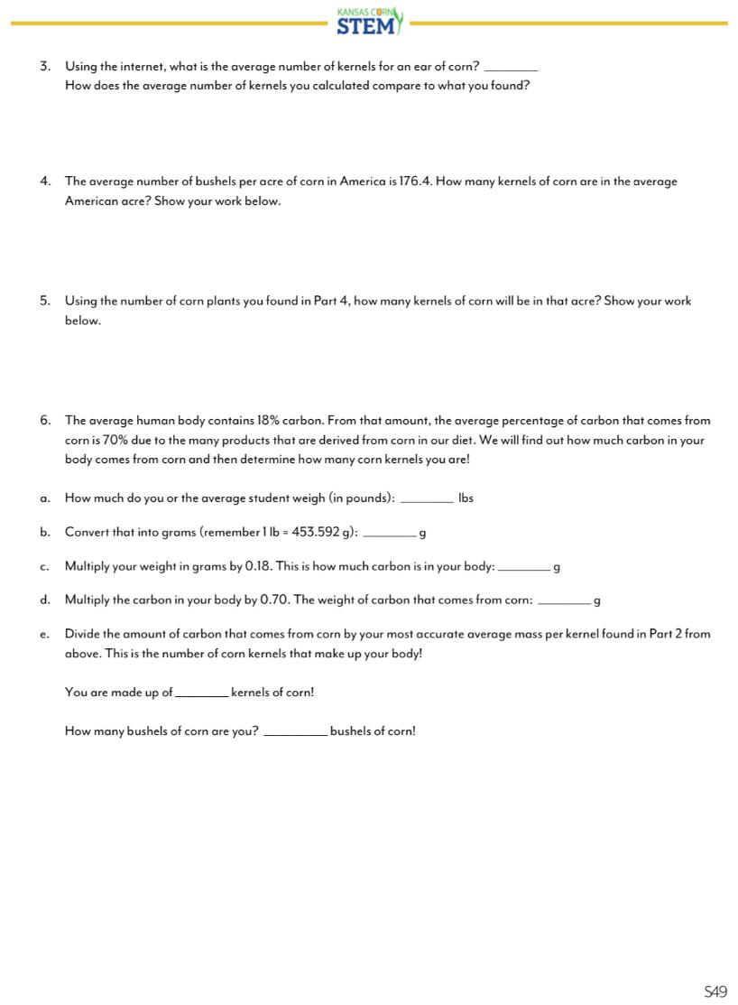
Mathematics with Corn
Corn Kernel Math with Ear of Corn Dissection

Slide 16
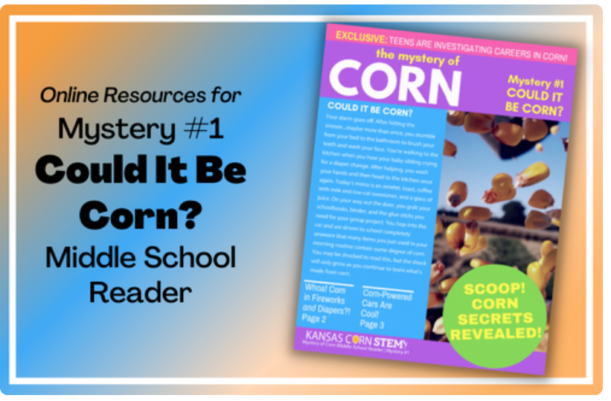
Mystery of Corn Reader # 1
Hint: A prize awaits, but for that you must read. Carefully, slow, so clues you won’t miss. Like kernel parts and corn products; most definitely on the list. What’s a barbeque without a plate? A fossil fuel can be made from corn, that would be great? Plastic from cornstarch…I’ll need a fork for that feast. Sorry to be so cryptic. I hope you’ll do well. When you finally solve it, don’t you dare tell.

Slide 17
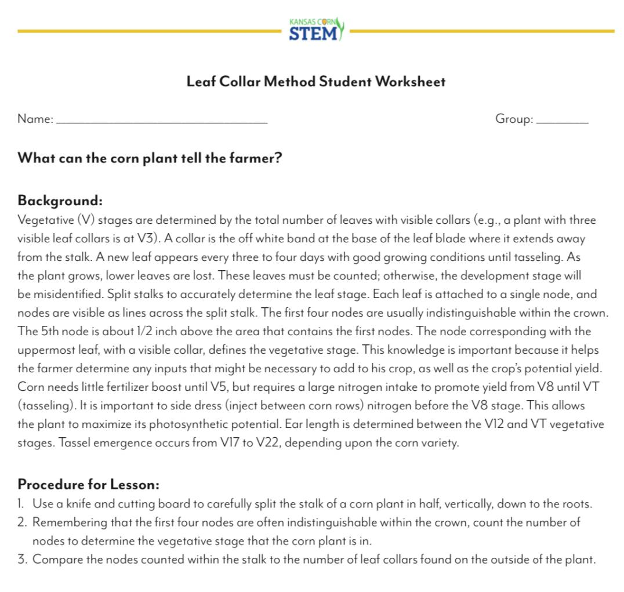
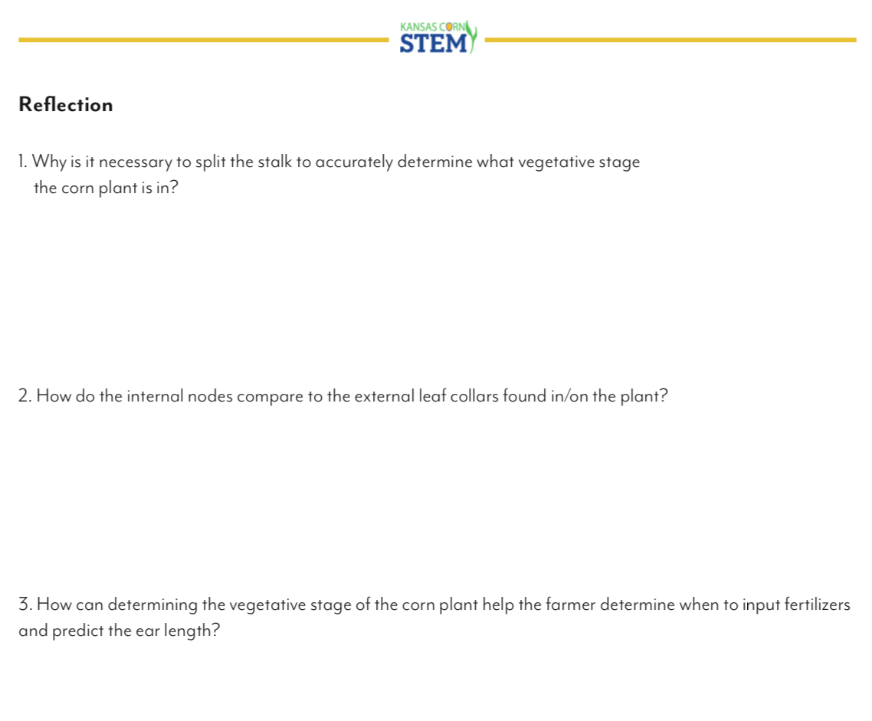
Corn Plant Dissection
Leaf Collar Dissection Method S8-S9

Slide 18
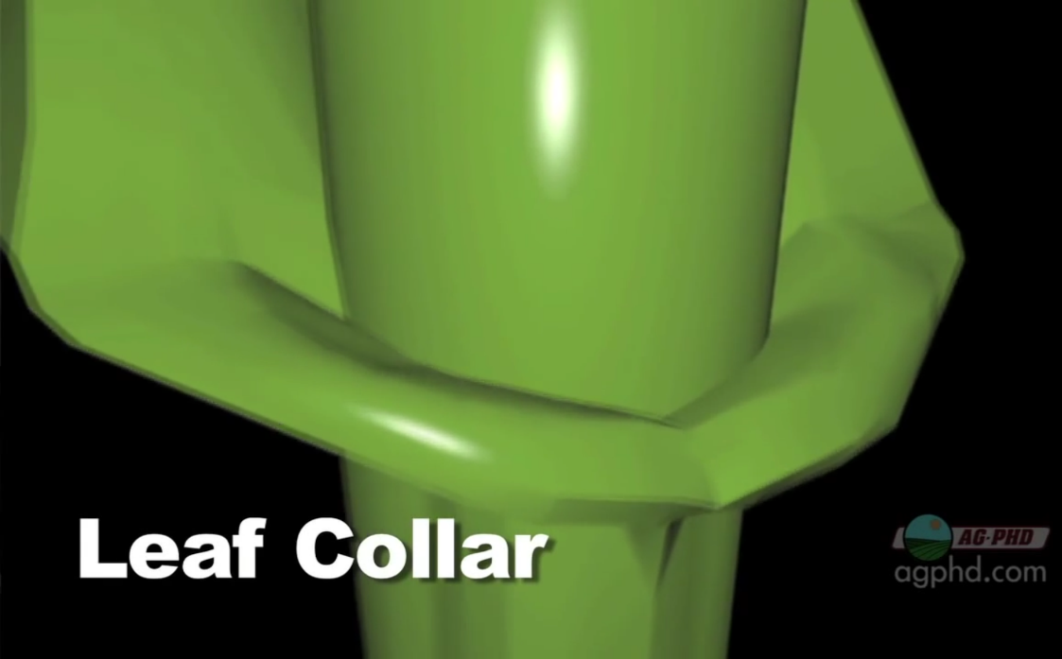
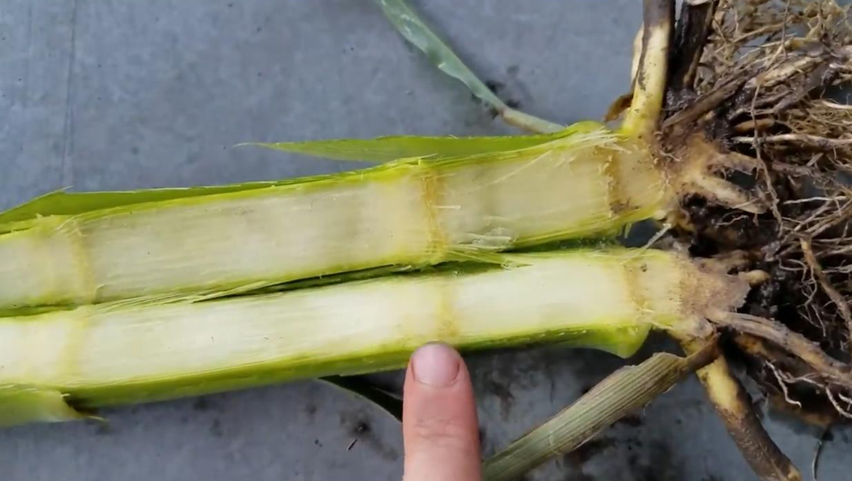
Corn Plant Dissection
Leaf Collar Dissection Method

Slide 19
Corn Plant Dissection
Leaf Collar Dissection Method
As a class, watch the following YouTube videos that discuss the Growth Stages of Corn:
https://tinyurl.com/FarmBasicsCornGrowthStages
https://tinyurl.com/GrowthStagingCorn

Slide 20
Corn Plant Dissection
Leaf Collar Dissection Method
A. Leaf Collar Dissection Student Worksheet:
Students will break back out into groups of 3-5 for the Leaf Collar Method activity.
Students will be working with cutting utensils for this portion. Have students closely follow the instructions on their Leaf Collar Method Student Worksheet.
Use a knife and cutting board to carefully split the stalk of a corn plant in half, vertically, down to the roots.
The first four nodes are often indistinguishable within the crown, count the number of nodes to determine the vegetative stage that the corn plant is in.
Compare the nodes counted within the stalk to the number of leaf collars found on the outside of the plant.
B. Reflection Questions:
Why is it necessary to split the stalk to accurately determine what vegetative stage the corn plant is in?
How do the internal nodes compare to the external leaf collars found in/on the plant?
How can determining the vegetative stage of the corn plant help the farmer determine when to input fertilizers and predict the ear length?
Regroup the class at the end of this activity to talk through answers to questions.
*Corn Plant Structures and Function Matching Worksheet
12 - 15 minutes

Slide 22
Section 5: Mathematics with Corn
Corn Kernel Math with Ear of Corn Dissection
WiFi:
Password:
Corn Container: 578.71g
Empty Container: 56.58g

