Slide 1
Corn Breakout Box
Brought to you by Kansas Corn STEM
Funded by Kansas Corn Commission (Kansas Corn Farmers)

Slide 2
Before we get started.

Slide 3
Your Shogun is requiring you to develop a STEAM program in your province (classroom) using agriculture. The Shogun is giving each rival Daimyo 30 minutes to find resources to use in your Province. Lucky for you, the Portuguese are wanting to establish a port in a Japanese province to trade valuable resources. The first group to breakout wins the Shoguns respect and admiration, as well as a prize from the Portuguese.
As an Inquiry Ninja, you need to be extra sneaky in how you deliver content in your province. In this lesson, you will learn to utilize the inquiry ninja ability of delivering NGSS into your province while creating an ABC lesson. The current Shogun is in love with ABC or Phenomenon based lessons. Activity Before Concept engages students within their learning, builds upon their curiosity, wonder and questioning. After anchoring your instruction to authentic phenomena, you will have the concepts necessary to build vocabulary.
It is now time for you to find a way to trade with the Portuguese.

Slide 4
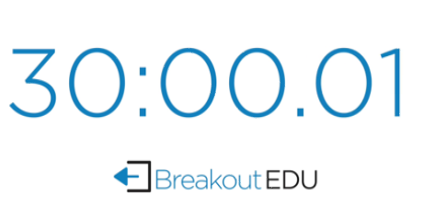
Budget
2019 Expenses $778,404
2020 Proposed $753,497

Slide 5
Your Boxes!
https://www.breakoutedu.com/resources

Slide 6
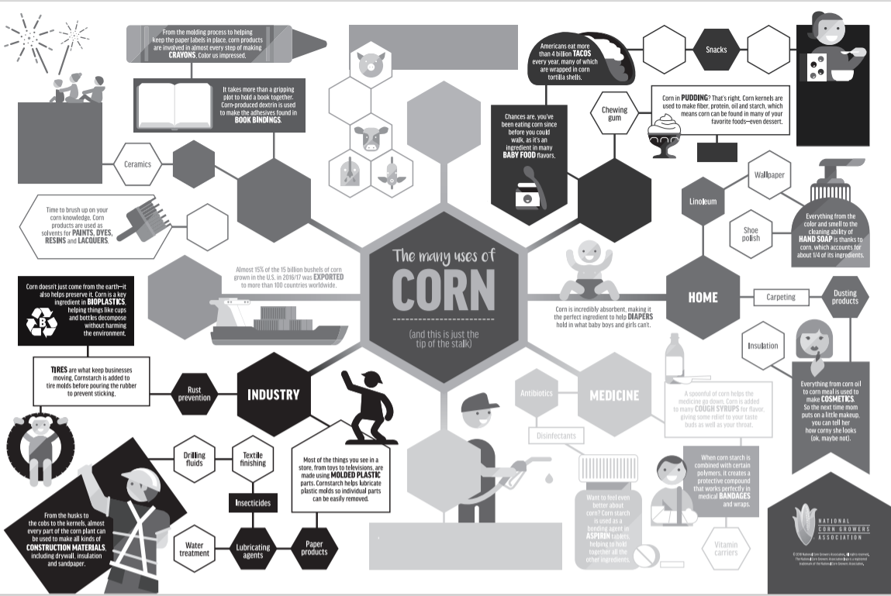
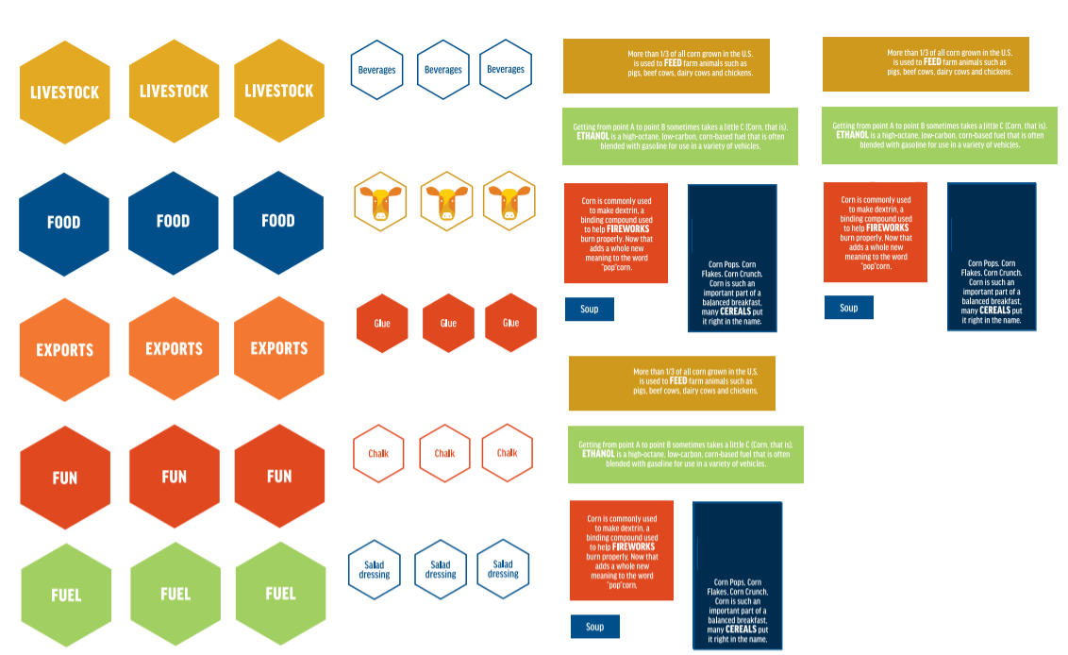
Kansas Corn Breakout Box lessons: Ready to go!

Slide 7
Tips:
New to Breakout Boxes-Practice round and/or explain locks
Parking Lot for Locks
Use tape to create boundaries
Hint Cards (ask a good question)
Even the playing field
The next class
Have students wait outside/sign on door
Have a student help reset.
Take your time setting locks
Have a good plan for sharing the boxes
Kansas Corn Breakout lock tips https://www.youtube.com/watch?v=1BkhZyK0-2o

Slide 9
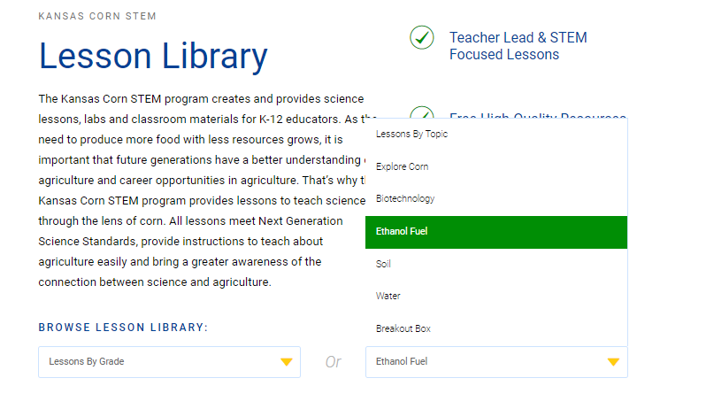
Budget
2019 Expenses $778,404
2020 Proposed $753,497
Notes:
We are starting off 2020 with a new look on our Kansas Corn STEM website.
With all of our offerings we have created an easy way for teachers to find what they are looking for.
With over 40 lessons currently available for teachers K-12 this website is now a tool for teachers to learn about our industry and access resources.

Slide 10
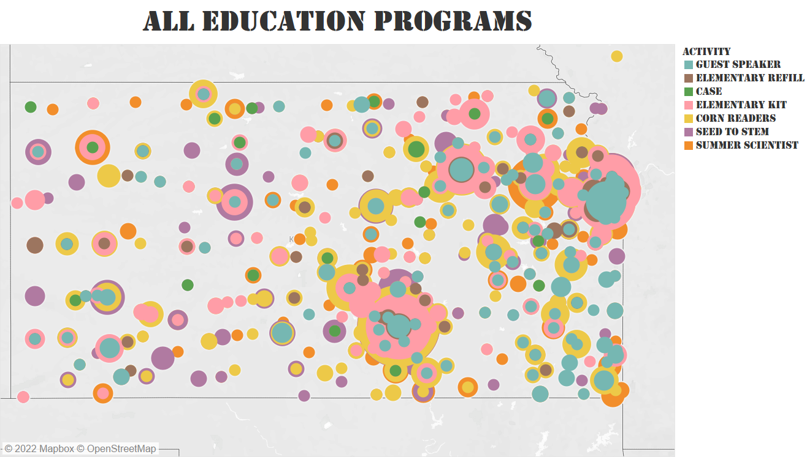
+210%

Slide 11
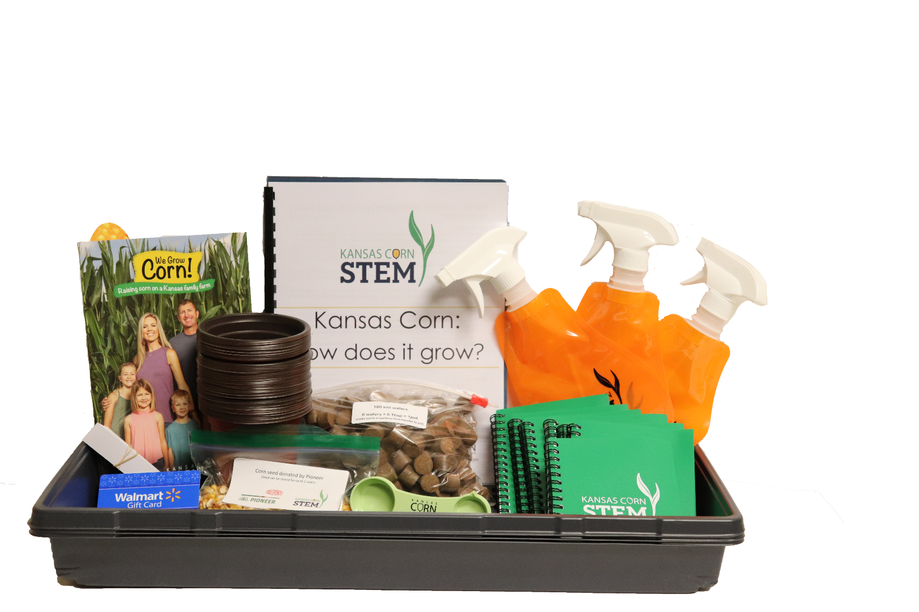
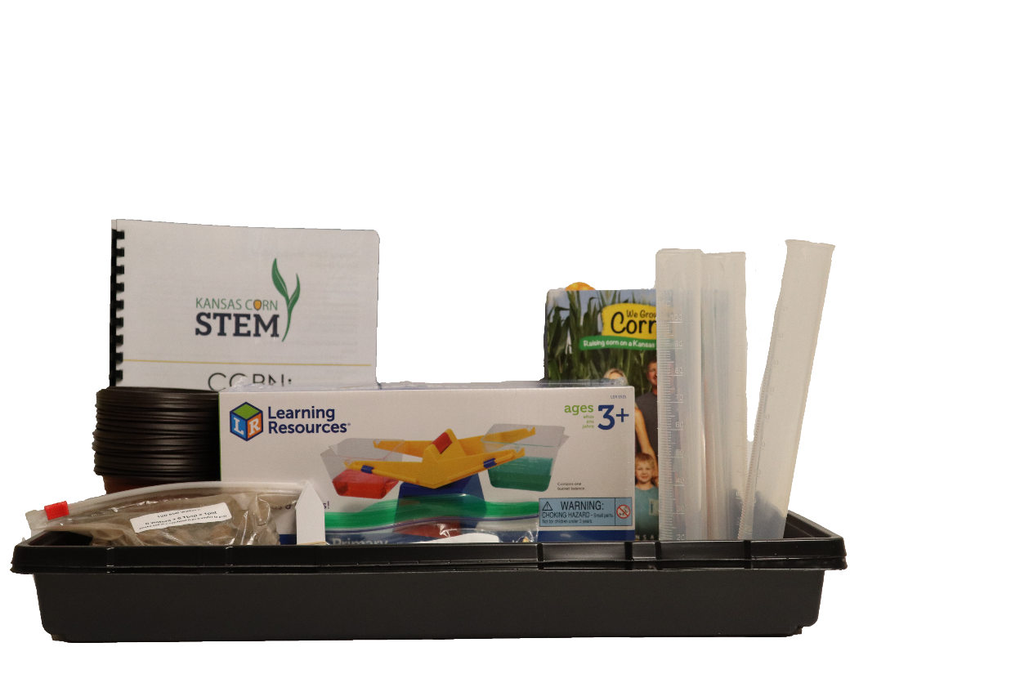
Elementary
+4
Notes:
We offer lessons and materials to K-5 grade teachers. No training is needed. Managed out of our Garnett office….
Point out Kylie-new member of our team.
Elementary teachers do not have to teach science throughout the year, so we have put math and language arts in our lessons so we have covered and so it covers varies subjects that the teachers have to teach.

Slide 12
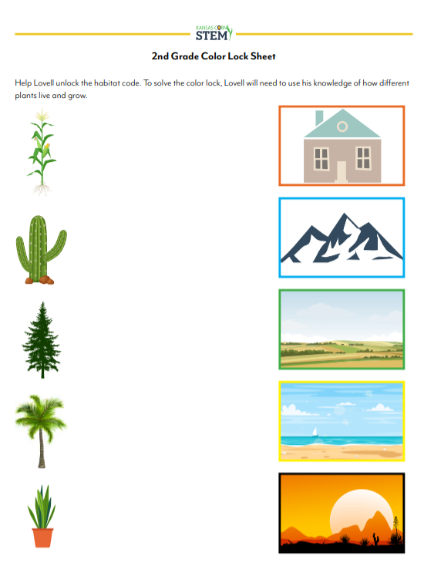
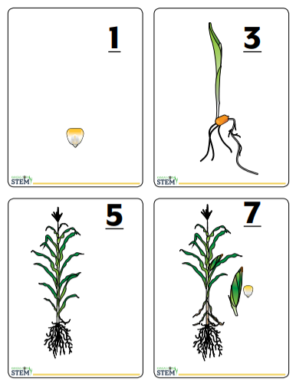
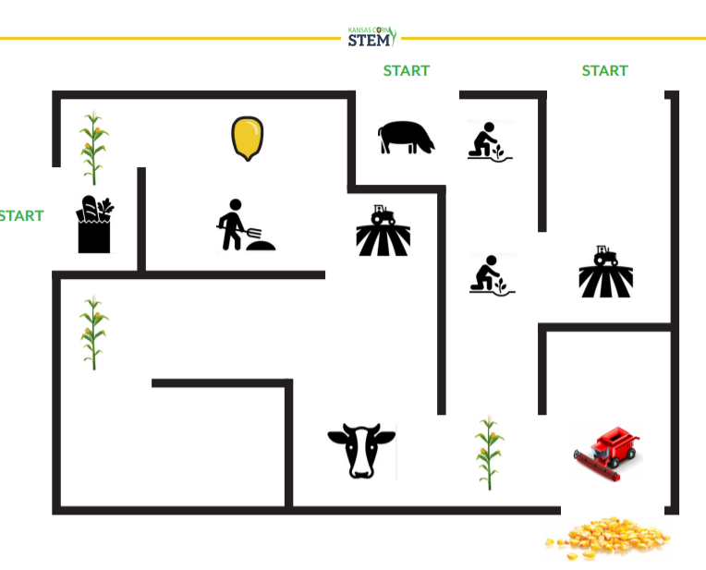
Budget

Slide 13
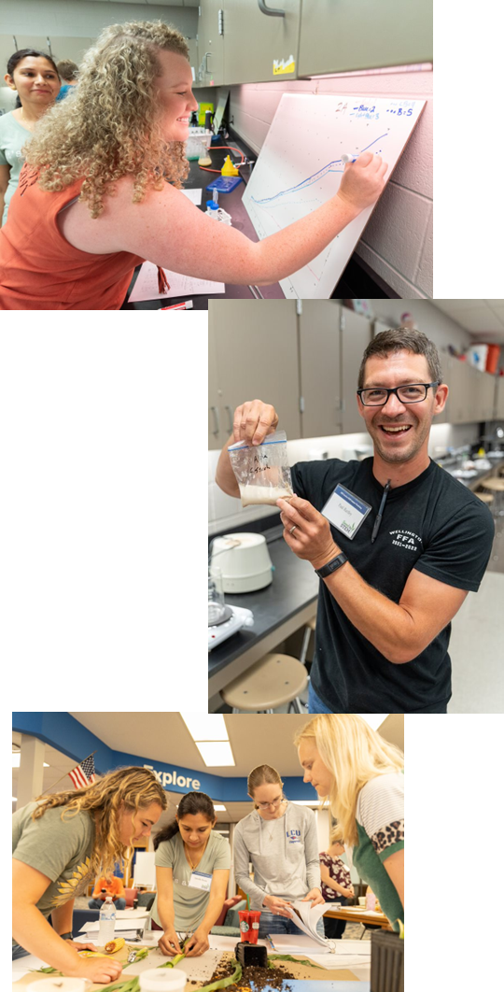
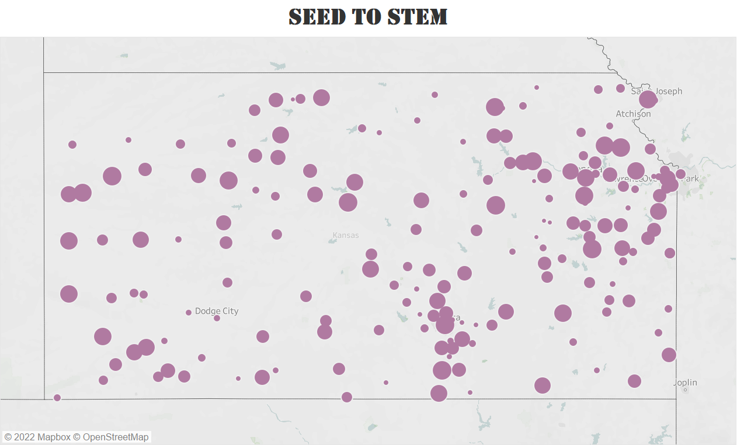
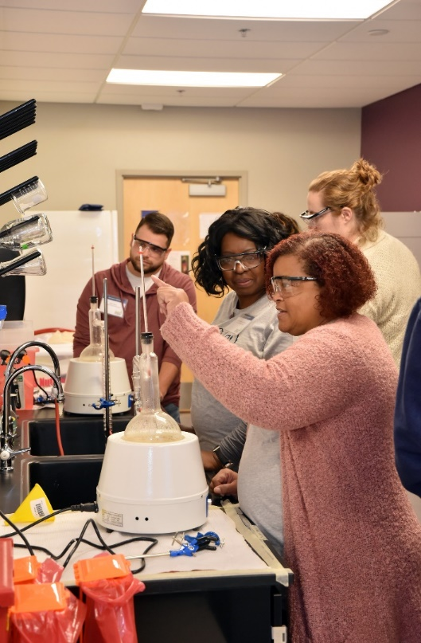
442 teachers completed program
YTD: 442 Teachers
+45%

Slide 15
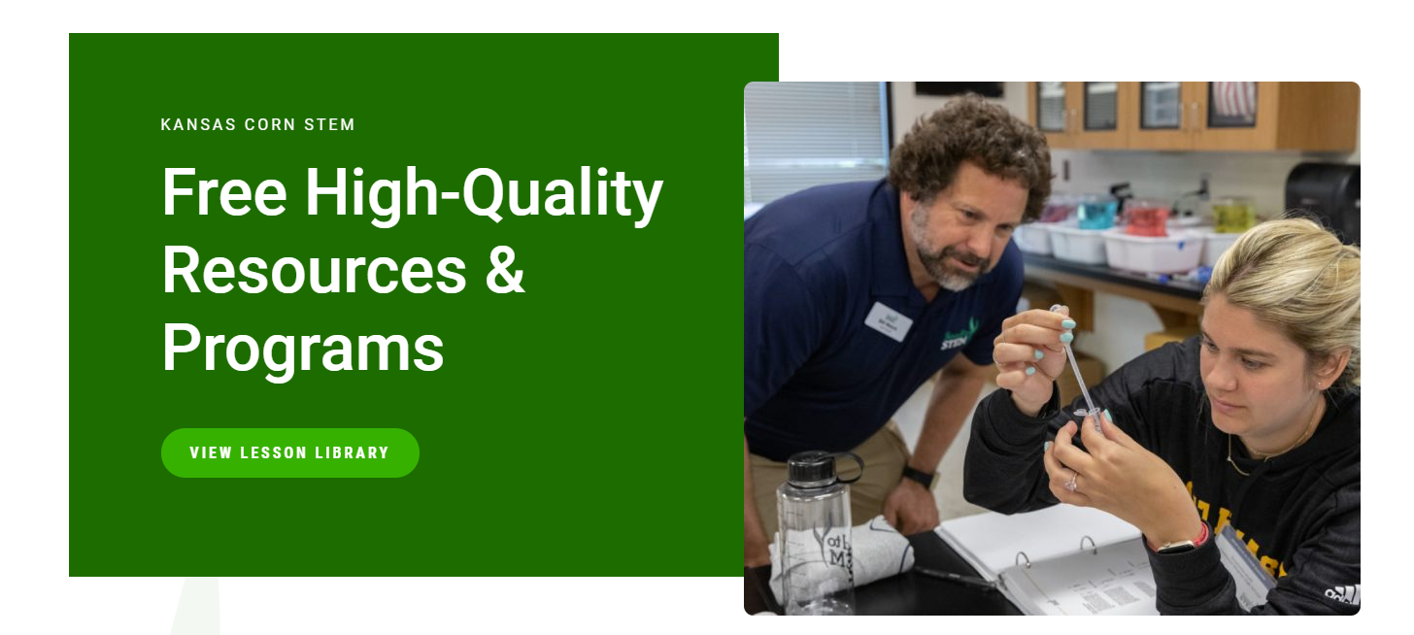
Kansascornstem.com

